Slide 1
logo /
route-mark
screenshot:
home screen
TransportFlow
Real-time public transport, for riders and the people who run it.
Azer Debbabi — July 2026
Notes:
TransportFlow is a mobile app where riders see live schedules, delays and alerts, and transit staff publish those updates — one app, both roles. I'll show the app, then what's technically interesting underneath.

Slide 2
The timetable says 07:10.
The bus knows otherwise.
Printed/static schedules can’t say “10 minutes late today”
Riders find out by waiting at the stop
Operators have no direct channel to the riders affected
Notes:
The information exists — the operator knows the bus is late — but there's no channel from the operator to exactly the riders who care. That channel is the product.

Slide 3
One app, two roles.
Riders: browse & search lines, live ETAs per stop, nearby stops on a map, favorites, push notifications
Staff: report delays/cancellations, post service alerts — from the same app
A staff report reaches affected riders in seconds, as a push
screenshot:
line detail
screenshot:
trip + ETAs
screenshot:
notification
Notes:
Same codebase, role-gated. The key promise: when staff report a delay, every rider who starred that line or a stop on it gets a push within seconds, and their open screens update live without refreshing.

Slide 4
Built on Tunisia’s open transport data
5
78
474
2,000+
transit networks
lines
stops
trips a week
TRANSTU — Tunis métro & TGM
Métro du Sahel (SNCFT) · STS — Sousse
SORETRAK — Kairouan · SNTRI — intercity
Source: the Ministry of Transport’s open-data portal (catalogue-data.transport.tn)
Notes:
This isn't demo data. The catalog is five real Tunisian networks imported from catalogue-data.transport.tn — the métro and TGM in Tunis, the Métro du Sahel and STS buses around Sousse, Kairouan's buses, and SNTRI intercity coaches. Seventy-eight lines, 474 stops, about two thousand scheduled trips live in the app every week. Two of those feeds needed real rescue work to be usable — I'll come back to that in the technical part.

Slide 5
Rider experience
Typo-tolerant search (“cartage” → Carthage Byrsa)
Route maps + stops near me (3 km, live location)
Star a line or stop → that’s your subscription
Mute per favorite · quiet hours at night
Notification inbox with live unread badge
screenshot:
search results
screenshot:
nearby map
screenshot:
favorites + mute
Notes:
Favorites are the subscription model — no separate settings maze. Mute keeps a favorite visible but silent; quiet hours suppress pushes at night but the in-app inbox still records everything. Search is typo-tolerant using Postgres trigram matching — no external search service.

Slide 6
The app at a glance
Five screens, no manual needed.
screenshot:
search +
network list
screenshot:
route map +
today’s trips
screenshot:
live ETA
per stop
screenshot:
stops
around you
screenshot:
notifications +
unread badge
Home
Line
Trip
Nearby
Inbox
Notes:
A quick visual tour before the demo. Home is search plus the network list; a line shows its route on the map and today’s trips; a trip shows a live ETA per stop; Nearby finds stops around you; and the inbox keeps every notification with an unread badge. Navigation is three taps deep at most.

Slide 7
Staff experience
Report status: on time / delayed +minutes / cancelled
Post line alerts: “Strike this Friday” (info / warning / disruption)
Every report is attributed and permanent — an audit log, not an edit
Admins promote staff in-app
screenshot:
staff report card
screenshot:
alert banner
Notes:
Staff tools appear inline in the rider UI, amber-bordered, only for staff accounts. Design decision: staff never *edit* a trip — they append a report to a log, and the trip's current state is derived from it. Full audit trail: who reported what, when. Corrections are new entries, not rewrites.

Slide 8
A morning with TransportFlow
1
07:31
2
07:38
3
07:38
4
07:39
She checks her starred TGM line. On time.
→
Staff report: delayed +10.
→
Push lands on her lock screen.
→
One tap: new ETA for her stop. Coffee first.
One star. Zero refreshes.
Notes:
The whole product in sixty seconds, from the rider's side. She didn't refresh anything, didn't search anything — she starred a line once, and the one delay that affects her morning found *her*. That's the loop I'll now show you live.

Slide 9
Live demo
staff report → rider push → deep link
Notes:
DEMO SCRIPT — Two phones (or phone + emulator). 1) Rider phone: open a favorited line’s trip. 2) Staff phone: report “delayed 10 min”. 3) Point at the rider phone: status badge and every stop ETA update live — no refresh. 4) Push arrives; tap it — deep-links straight into the trip. FALLBACK if network misbehaves: pre-recorded screen video on the next hidden slide, or show the notifications inbox from an earlier report.

Slide 10
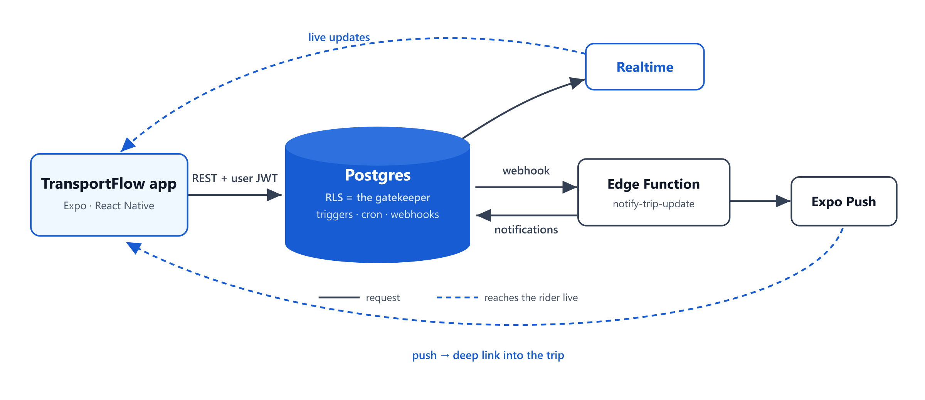
Architecture: there is no backend server
No Express/API layer — nothing to host, nothing to bypass
Supabase: Postgres + Auth + Realtime + 2 Edge Functions
Security enforced by Row-Level Security, in the database — not middleware
Notes:
The unconventional choice: we deleted the middle tier. The app talks straight to the database and holds only a public key plus the user's JWT; Postgres itself decides what each request may read or write, via Row-Level Security. That means the security rules live in exactly one place, there's no server to keep in sync or pay for, and the same rules protect *every* path — app, API, or someone with curl.

Slide 11
Security: the database is the gatekeeper
Every table: RLS + explicit grants (deny by default)
trips has no client write path — only the append-only report log
Riders physically can’t self-promote: the role column is write-locked by Postgres
Secrets in Vault, never in code · pushes sent by a service-role Edge Function
Notes:
Three layers: grants are the ceiling, RLS narrows per-row, and column-level locks handle the rest — a rider PATCHing their own `role` gets a permission error from Postgres itself, no app code involved. The one privileged path that writes roles is a single audited SQL function that requires the caller to be an admin.

Slide 12
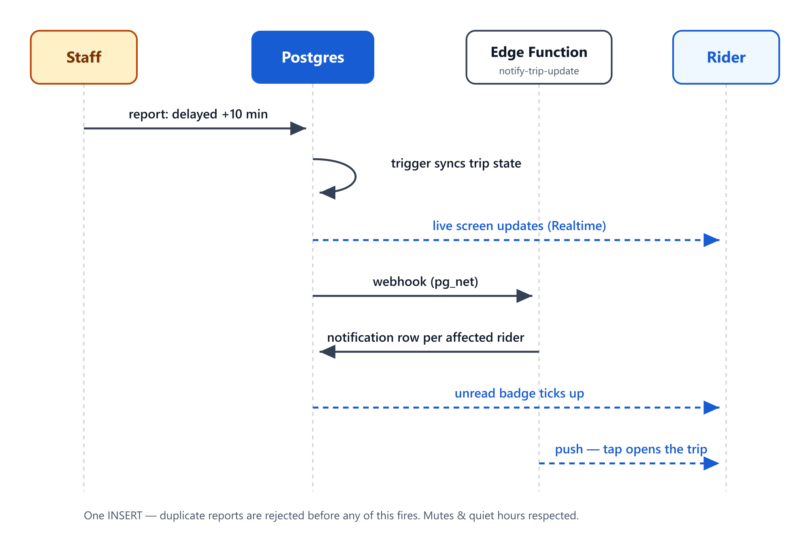
One write, four effects
One INSERT powers everything:
Trip state syncs (trigger)
Rider’s open screen updates (Realtime)
Durable notification per affected rider (Edge Function)
Push to their phones — respecting mutes & quiet hours
Notes:
When staff hit submit, a database trigger syncs the trip, Supabase Realtime streams the change to open screens, and a webhook — fired by the database itself — calls our Edge Function, which finds every rider with an unmuted favorite on that line or its stops, writes each a durable notification, and sends the pushes. Duplicate reports within five minutes are rejected *before* any of this fires, because every accepted write costs real notifications.

Slide 13
Real data, real schedules
One importer, any GTFS feed → our model (5 feeds, namespaced)
STS feed: broken 2016 pseudo-GTFS in a RAR → repaired + stops geocoded
Métro du Sahel: no digital feed existed → GTFS hand-authored from the été 2026 timetable
No external scheduler: pg_cron turns 318 patterns into ~2,000 dated trips a week
Notes:
Getting real data in was its own engineering story. The importer maps any standard GTFS feed onto our model, with namespaces so five agencies’ IDs don’t collide. Two feeds fought back: STS published a broken 2016 pseudo-GTFS inside a RAR archive — repaired and geocoded — and the Métro du Sahel had no digital feed at all, so I authored one from the printed summer timetable. And there’s no external scheduler: recurring patterns like “line 3, 07:10, Mon–Sat” become concrete dated trips via cron jobs *inside* Postgres, timezone-correct.

Slide 14
Engineering practice
13 reviewed PRs to a protected master · conventional history
Typed end-to-end: generated DB types → typed queries → typed routes
Production build 1.5.0 · JS ships over-the-air on relaunch (EAS Update)
Free-tier ops: scheduled keep-alive, zero hosting cost
Notes:
Every feature landed as a PR. TypeScript types are generated from the live database schema, so a schema change that breaks a screen fails compilation, not the demo. The app is past “runs on my machine”: version 1.5.0 is a production build, and day-to-day fixes ship over the air — a fix reaches installed phones on relaunch, no store round-trip. Total hosting bill: zero.

Slide 15
Honest limits & next steps
Today: staff-reported status (operator in the loop) — not vehicle GPS
One direction per line; holiday calendars not applied yet
Next: GTFS-RT vehicle positions · both directions · dark mode · offline cache · automated test suite
Notes:
Being upfront: “real-time” here means operator-reported, which is a deliberate product choice — it works for networks without GPS-equipped fleets, which is most of Tunisia’s. The architecture is ready for GTFS-RT vehicle feeds as the natural next step, since the ingestion and fan-out pipeline already exists.

Slide 16
Stack & deliverables
Expo (React Native) · Supabase (Postgres · Auth · Realtime · Edge Functions) · Google Maps · EAS
✓ Working app — production build, verified on device
✓ Source on GitHub, PR history
✓ README + as-built technical documentation
✓ These slides
logos row: Expo · Supabase · Google Maps · GitHub (add in Canva)

Slide 17

TransportFlow
The bus is late. Now everybody knows.
github.com/azer-dev1/TransportFlow
one last
screenshot

