Slide 1

Ruby On Rails

Slide 2
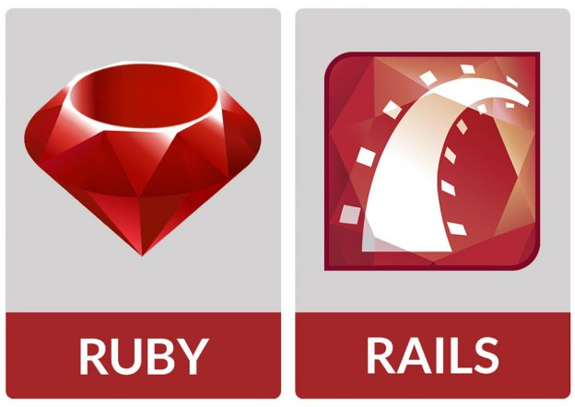

Slide 3


Slide 4
Variable naming
my_name ipv myName
local_var = ‘local’
@instance_var = ‘instance’
@@class_var = ‘class’
$global_var = ‘global’
CONSTANT = 100

Slide 5
Variable
string = ‘string’
int = 1
array = [1, 2, 3, 4, 5]
hash = {
“name” => “niels”,
“age” => 20
}

Slide 6
Condities
if
unless
while
until
for
loop

Slide 7
Other loops
array = [1, 2, 3, 4, 5]
array.each do |x|
puts “#{x}”
end
hash = {
“name” => “niels”,
“age” => 20
}
hash.each do |x, y|
puts “#{x}: #{y}”
end
number = 10
number.times do
puts “hello world”
end

Slide 8
Functies/Methodes
def functionname(variable)
return variable
end
functionname(param1)

Slide 10
Getting started
Ruby (met devkit) installeren
Sqlite 3 installeren
gem install rails

Slide 11
Nieuw rails project
Aanmaken project
rails new project_name
In project
bundle install
Webserver starten
rails server
127.0.0.1:3000 of localhost:3000

Slide 12
Controller
rails generate controller Home index
naam action
app\controllers\home_controller.rb
rails generate controller Welcome index

Slide 13
View
Vorige command
rails generate controller Home index
app\views\welcome\index.html.erb
Link in view
<%= link_to ‘Welcome', controller: ‘welcome' %>

Slide 14
Routing
config\routes.rb
Route naar welcome_controller.rb
get ‘welcome/index’ localhost:3000/welcome/index
get ‘welcome’ => ‘welcome#index’ localhost:3000/welcome
get ‘home/index’
root ‘home#index’

