Slide 1
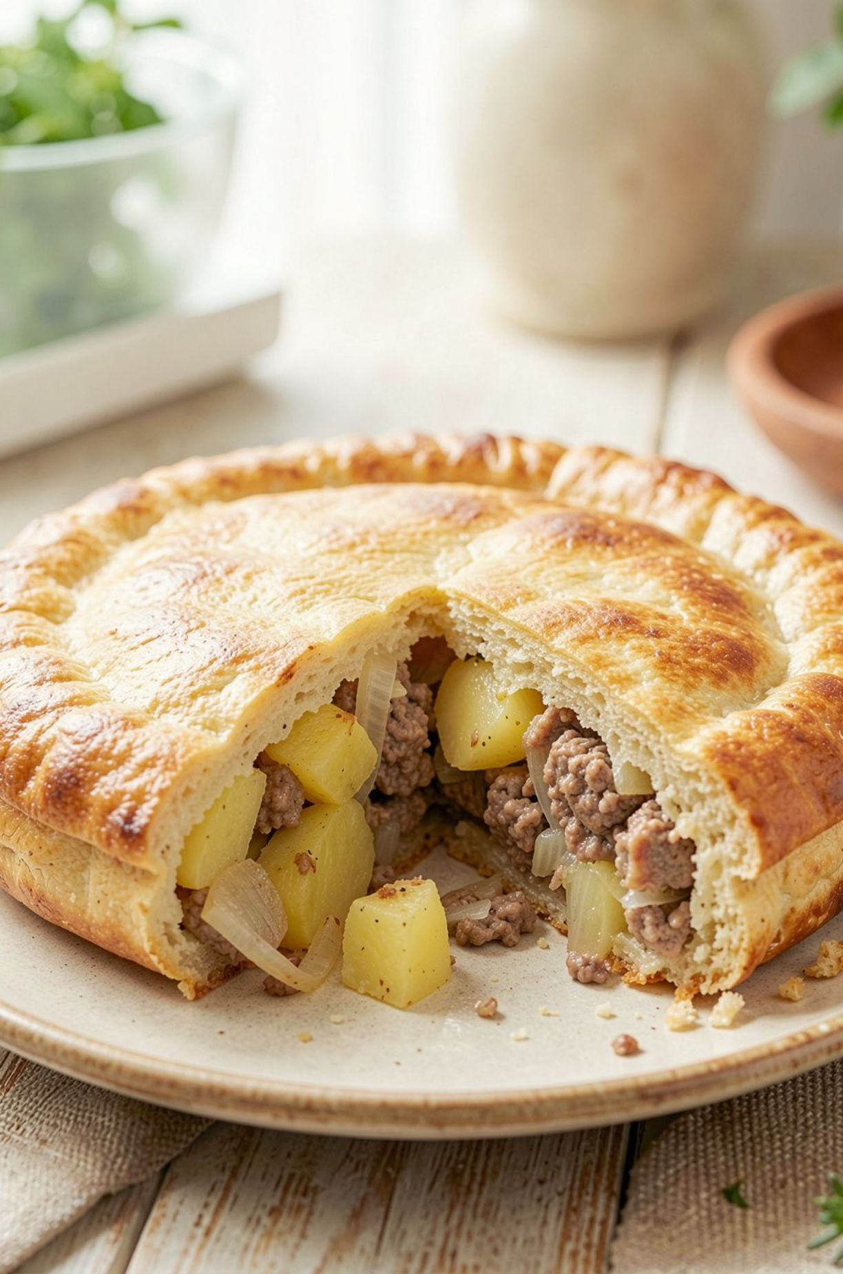
Tsikan: A Lezgin Pie
Tsikan (цкан) is a traditional Lezgin meat pie. It is filling, warm, and made for sharing.

Slide 2



Why I Like Tsikan
Warm and filling
Rich taste
Good to share
Tsikan has meat, potatoes, and onion. It makes me feel full.
Salt, pepper, and herbs give the pie a good taste.
One big pie is good for family, friends, and guests.

Slide 3
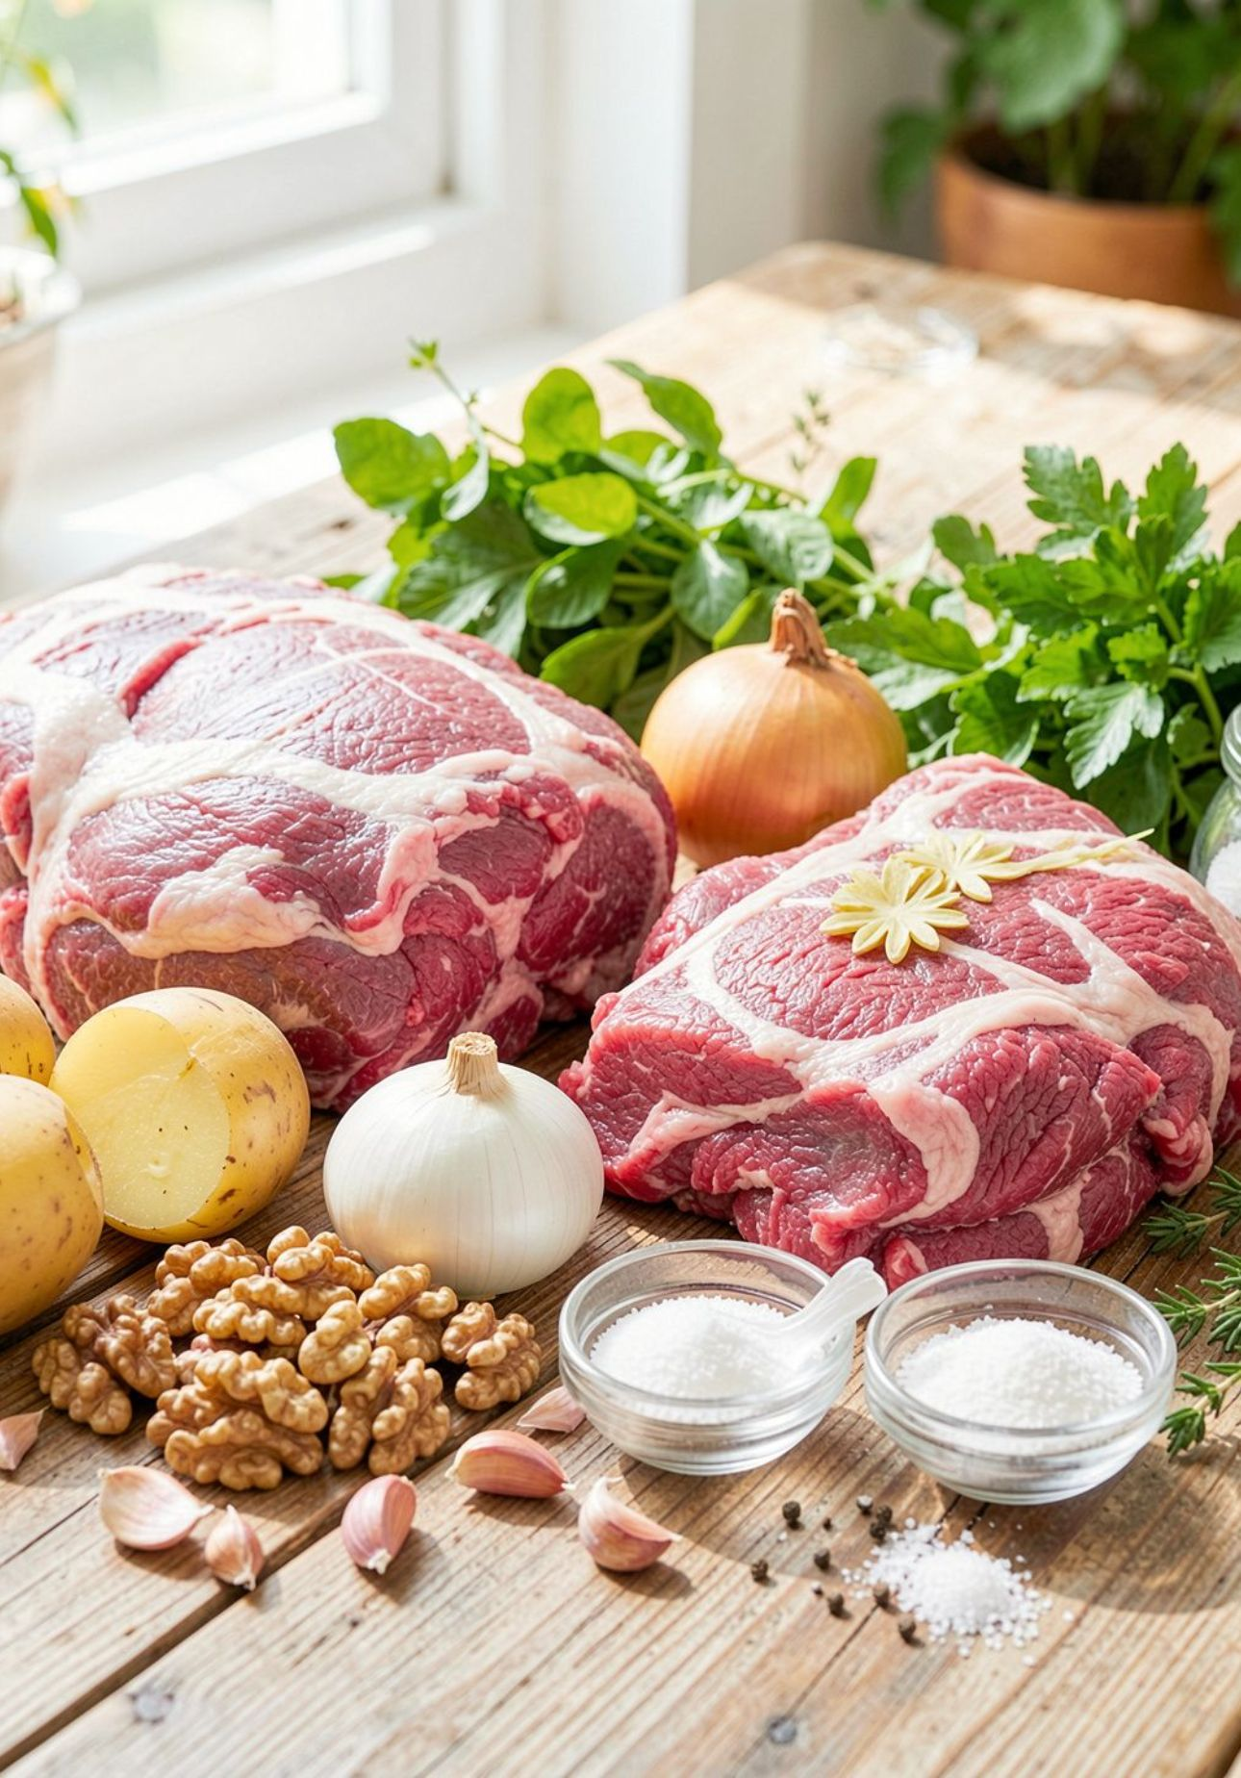
What Is Inside Tsikan?
1
Meat
Use lamb or beef.
2
Potato and onion
They make the filling soft and rich.
3
Herbs and spices
Use salt, pepper, and thyme.
4
Walnut and greens
Some recipes add walnut or fresh greens.

Slide 4



When and How We Eat Tsikan
Special days
Simple steps
Share it warm
Tsikan is good for holidays and a festive table.
Roll the dough. Add the filling. Pinch the edges.
Bake it in the oven and serve it warm to guests.

Slide 5
Tsikan Is Great!
Tsikan is a simple and tasty Lezgin meat pie. It brings people together.
Цкан — tsikan. Try it with family or guests.

