Slide 1
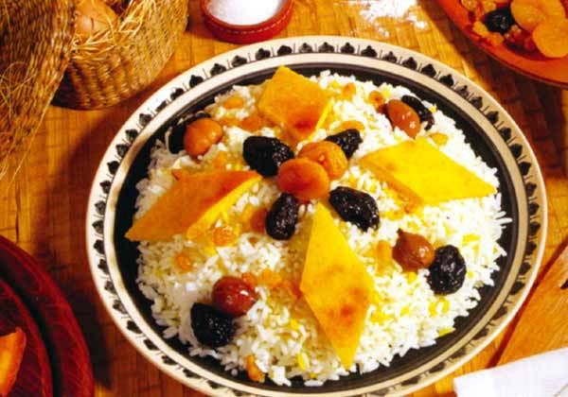
My Favorite Dish:
Azerbaijani Plov

Slide 2
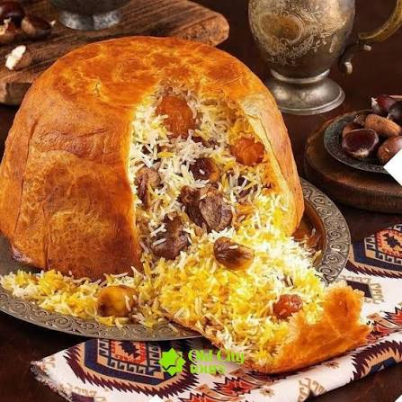
THE DISH
What Is Azerbaijani Plov?
Azerbaijan’s national dish: fluffy rice with saffron and butter.
Served with a separate topping of meat, dried fruit, and chestnuts.
Shah plov is baked inside a crust of thin lavash.
Always cooked slowly, for the people we care about.

Slide 3




Why Plov?
Nobody leaves the table hungry.
It is the taste of my culture and of meals at home with my family.
On Novruz, holidays, and every gathering, plov is on the table.

Slide 4
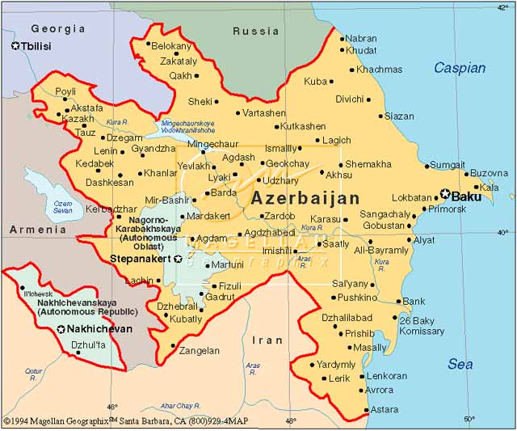
TRADITION AND VARIETY
One Dish, Many Versions
Every region and every family has its own recipe.
Shah plov: rice baked in a golden lavash crust.
Plov with dried fruit and sweetness.
Recipes are passed down from grandmothers to mothers and children.

Slide 5
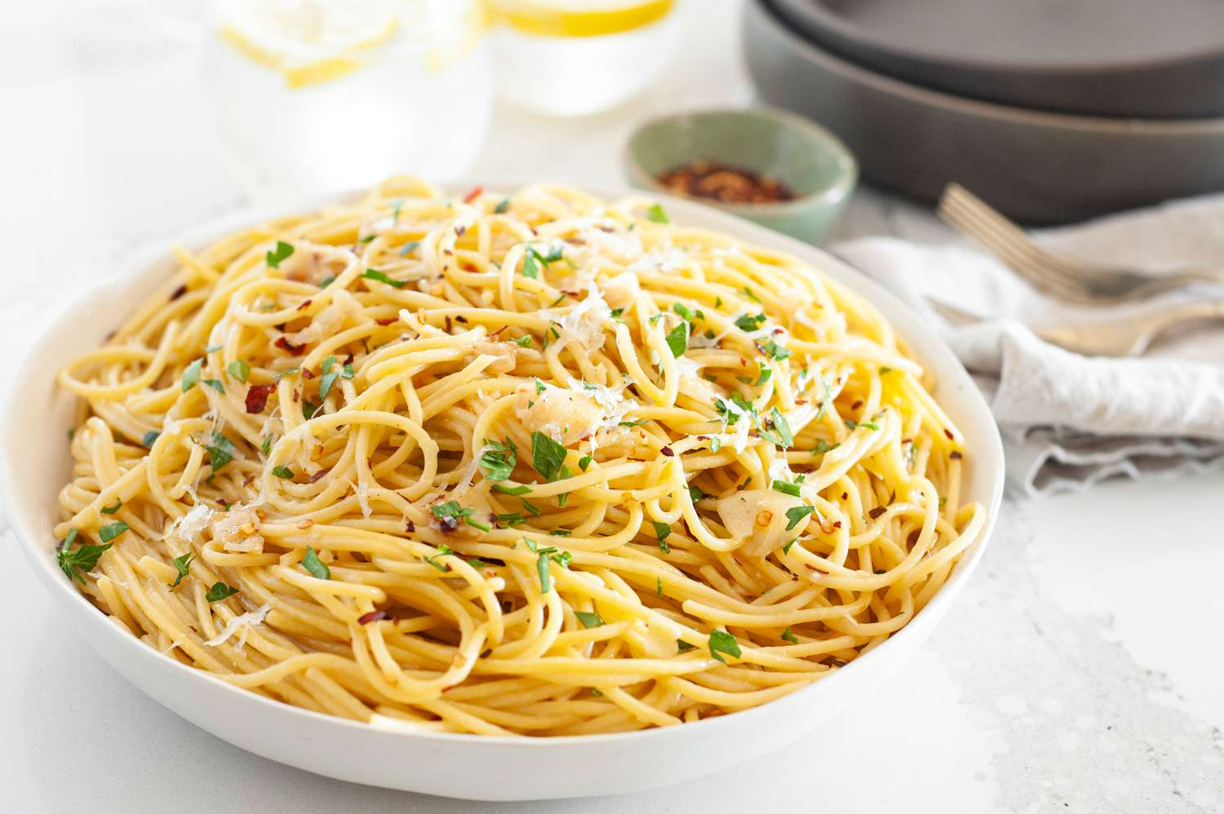
The Dish I Cook Best:
Pasta with olive oil
My favorite dish is plov, but the one I cook best is Pasta.
Simple ingredients
Quick and simple
Pasta, olive oil, garlic, salt, and black pepper.
Optional: Red pepper, parsley or some cheese.
Pasta, garlic cooked slowly in olive oil, and a splash of pasta water.

Slide 6
Two Different Dishes, Two Different Stories
Azerbaijani plov
Pasta
Home and everyday
The dish of my family, my holidays, and my home.
The dish I cook best, with simple Italian ingredients and bold flavor.
Plov is my family at the table. Pasta is my everyday cooking.
Good food connects culture, memories, beautiful taste.

