Slide 1
Nonce-Disrespecting Adversaries: Practical Forgery Attacks on GCM in TLS
Hanno Böck, Aaron Zauner, Sean Devlin,
Juraj Somorovsky, Philipp Jovanovic
Notes:
Juraj

Slide 2
TLS Encryption
Asymmetric key exchange
RSA, DHE, ECDHE
Symmetric encryption

Slide 3
TLS Encryption
Asymmetric key exchange
RSA, DHE, ECDHE
Symmetric encryption
CBC/HMAC
RC4 (stream cipher)
(new: ChaCha20/Poly1305)
AES-GCM

Slide 4



CBC / HMAC
2014 Poodle
Arbitrary padding in SSLv3
Implicit IVs in TLS 1.0
MAC-then-Pad-then-Encrypt
2011 BEAST
2002 Padding
Oracles
C
Valid / Invalid
Alert
Lucky 13

Slide 5
CBC / HMAC
2014 Poodle
Arbitrary padding in SSLv3
Implicit IVs in TLS 1.0
MAC-then-Pad-then-Encrypt
2011 BEAST
2002 Padding
Oracles
Lucky microseconds
Lucky 13

Slide 6
CBC and Lucky 13: Patching is complex …
Amazon’s s2n
OpenSSL
Don’t fix: Botan, Go, TLS Lite
Lucky microseconds
CVE-2016-2107

Slide 7
TLS Encryption
Asymmetric key exchange
RSA, DHE, ECDHE
Symmetric encryption
CBC/HMAC
RC4 (stream cipher)
(new: ChaCha20/Poly1305)
AES-GCM

Slide 8
RC4
Generates a key stream
Some bytes more likely to occur
https://www.rc4nomore.com/
RFC 7465: Prohibiting RC4 Cipher Suites
2001: Fluhrer, Mantin, Shamir
2013: Isobe et al.
2013: AlFardan et al.
2015: Vanhoef, Piessens
2015: Garman et al.
Notes:
2001: first few bytes are non-random
2015: Garman, Paterson, van der Merwe
2015: cookie in 50 hours

Slide 9
TLS Encryption
Asymmetric key exchange
RSA, DHE, ECDHE
Symmetric encryption
CBC/HMAC
RC4 (stream cipher)
(new: ChaCha20/Poly1305)
AES-GCM

Slide 10
TLS Encryption
Asymmetric key exchange
RSA, DHE, ECDHE
Symmetric encryption
CBC/HMAC
RC4 (stream cipher)
(new: ChaCha20/Poly1305)
AES-GCM

Slide 12
AES
Symmetric cipher
Considered secure
Block ciphers
Constant block length
Arbitrary plaintext length:
Mode of operation
plaintext
16 bytes
AES - Enc
Key
16 bytes
ciphertext

Slide 13
AES Counter Mode
Nonce || Counter
J₁
J₂
AES-Enc
AES-Enc
P₁
P₂
C₁
C₂

Slide 14
Bit Flipping in AES Counter Mode
J₁
J₂
AES-Enc
AES-Enc
C₁
C₂
P₁
P₂
Attacker can modify messages

Slide 15
AES-GCM
GCM – Galois Counter Mode
AEAD (Authenticated Encryption with Additional Data)
Only in TLS 1.2
Combination of Counter Mode and GHASH authentication
Computed over Galois field

Slide 16
AES-GCM
J₀
J₁
J₂
AES-Enc
AES-Enc
AES-Enc
P₁
P₂
C₁
C₂
Gmul_{H}
Gmul_{H}
Gmul_{H}
Hash key H
Encryption of 128
zero bits: H=Enc(0)
Output: C || T
A
len(A)||len(C)
Gmul_{H}
T

Slide 17
GCM: Opinions of Cryptographers
"Do not use GCM. Consider using one of the other authenticated encryption modes, such as CWC, OCB, or CCM." (Niels Ferguson)
"We conclude that common implementations of GCM are potentially vulnerable to authentication key recovery via cache timing attacks." (Emilia Käsper, Peter Schwabe, 2009)
"AES-GCM so easily leads to timing side-channels that I'd like to put it into Room 101." (Adam Langley, 2013)
"The fragility of AES-GCM authentication algorithm" (Shay Gueron, Vlad Krasnov, 2013)
"GCM is extremely fragile" (Kenny Paterson, 2015)
Notes:
Cryptographers do not like GCM

Slide 19
The Forbidden Attack
Nonce:
Number used once
TLS: 8 Byte / 64 Bit nonce
Joux (2006): Nonce reuse allows an attacker to recover the authentication key
Attacker can modify messages
Notes:
Described by Joux during NIST GCM standardization (2006)

Slide 20
Consider one block
J₀
J₁
AES-Enc
AES-Enc
P₁
C₁
Gmul_{H}
len(A)||len(C)
Gmul_{H}
T

Slide 21
Consider one block
J₀
J₁
H = AES (0)
T = C₁ * H² + L * H + AES (J₀)
Unknown values:
H
AES (J₀)
AES-Enc
AES-Enc
P₁
T =
+ AES (J₀)
(
C₁* H
+ L) * H
C₁
Gmul_{H}
len(A)||len(C)
Gmul_{H}
T

Slide 22
Duplicate nonce
J₀
J₁
H = AES (0)
T₁ = C_{1,1} * H² + L₁ * H + AES (J₀)
T₂ = C_{2,1} * H² + L₂ * H + AES (J₀)
T₁ - T₂ = (C_{1,1} – C_{2,1}) * H²
+ (L₁ – L₂) * H
AES-Enc
AES-Enc
P₁
C₁
Gmul_{H}
len(A)||len(C)
Gmul_{H}
Finding H possible
T

Slide 24
TLS 1.2 / RFC 5288
"Each value of the nonce_explicit must be distinct for each distinct invocation of the GCM encrypt function for any fixed key. Failure to meet this uniqueness requirement can significantly degrade security. The nonce_explicit may be the 64-bit sequence number.“
Two problems:
Random nonces: Collision probability
Repeating nonces
How about real
implementations?

Slide 25
Internet-wide Scan
Problems:
Certificate info, website content, HTTP "Server:" header.
Often load balancers
False positives
Check Point devices using LFSR (secure)

Slide 26
Internet-wide Scan
184 hosts with repeating nonces
Radware (Cavium chip)
Several pages from VISA Europe
72445 hosts with random looking nonces
A10, IBM Lotus Domino (both published updates)
Sangfor (no response)
More devices that we were unable to identify

Slide 27
Example: Radware
0100000003001741
0100000003001741
f118cd0fa6ff5a15
f118cd0fa6ff5a16
f118cd0fa6ff5a74
OpenSSL 1.0.1j
e_aes.c (EVP_CIPHER_CTX_ctrl/aes_gcm_ctrl):
if (c->encrypt &&
RAND_bytes(gctx->iv + arg, gctx->ivlen - arg) <= 0)
return 0;
t1_enc.c:
if (EVP_CIPHER_mode(c) == EVP_CIPH_GCM_MODE)
{
EVP_CipherInit_ex(dd,c,NULL,key,NULL,(which & SSL3_CC_WRITE));
EVP_CIPHER_CTX_ctrl(dd, EVP_CTRL_GCM_SET_IV_FIXED, k, iv);
}
No random generation
return value check

Slide 28
Open Source Libraries
Botan, BouncyCastle, MatrixSSL, SunJCE, OpenSSL
No real problems
Counter overflows in Botan and MatrixSSL

Slide 30




Attacking Vulnerable Websites
GET visa.dk/index.html
HTTP 1.1 200 OK
…
<html>
<script> … </script>
</html>
HTTP 1.1 200 OK
…
<html>
<h1>Hello Visa</h1>
</html>

Slide 31
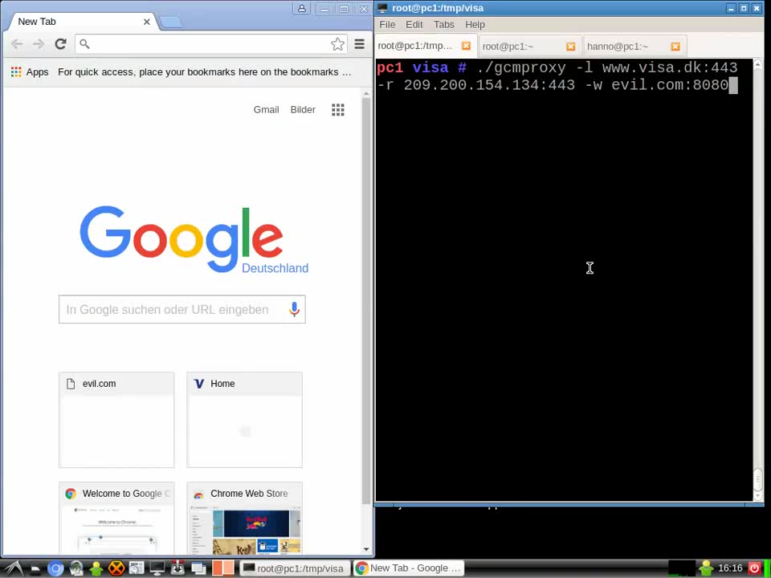
Demo

Slide 32
Demo

Slide 33
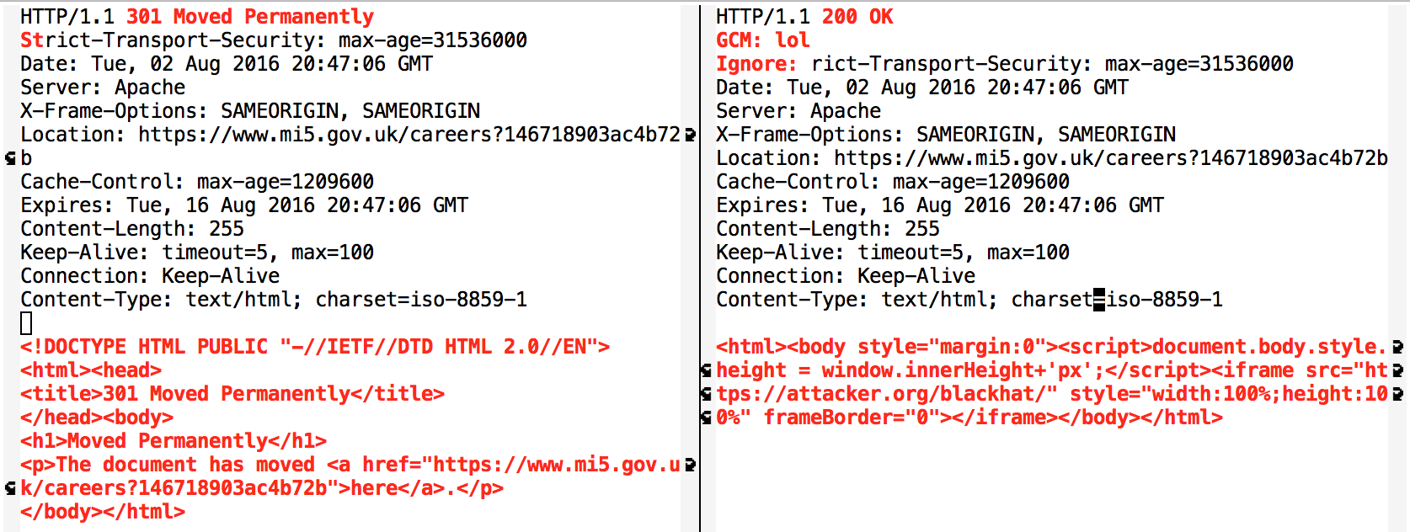
Attacking mi5.gov.uk

Slide 34
Conclusions
TLS 1.2: no guidance how to use nonces correctly
Some people get it wrong
Implicit nonces needed:
Chacha20/Poly1305 and TLS 1.3 based on record number
Better test tools for TLS implementation flaws

