Slide 1



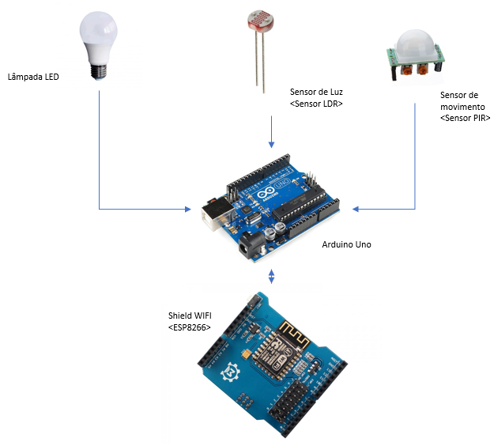
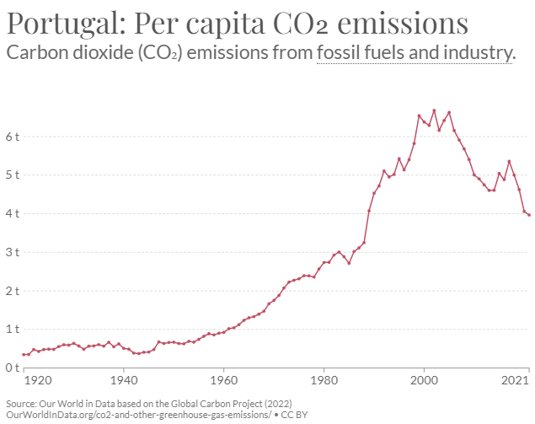
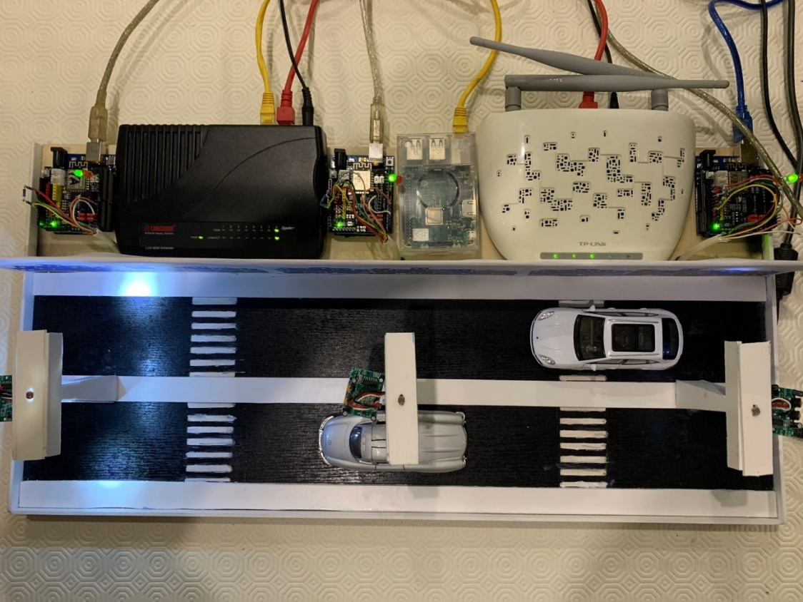
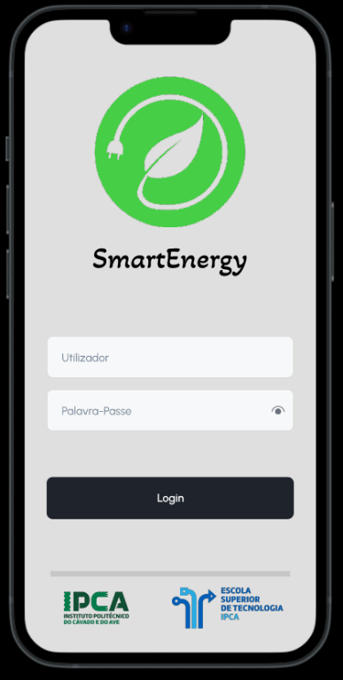
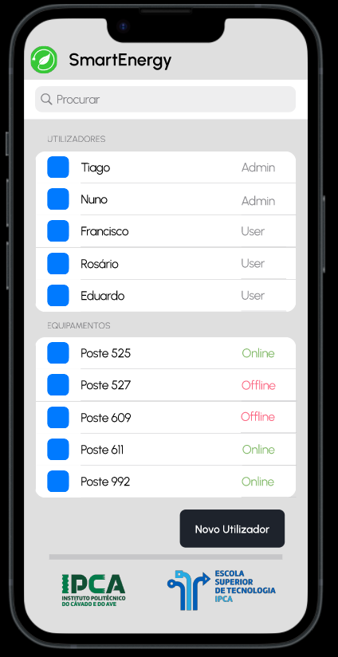
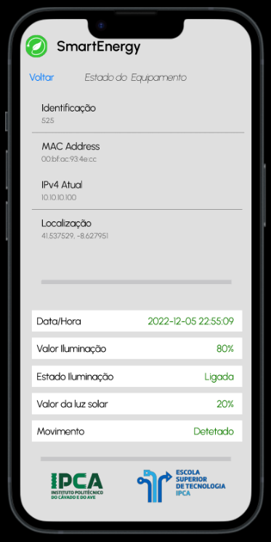

SmartEnergy: A Solution to a Smarter Campus With Less Energy Consumption
Nuno Mendes | Tiago Azevedo | Francisco Pereira
Students in Information Systems Engineering
Prof. Eduardo Peixoto and Prof. Patrícia Leite
BACKGROUND
OBJECTIVES
Energy consumption is a significant concern for colleges and universities, as these institutions often have large, complex campus systems that require a significant amount of energy to operate. In addition to the financial cost of this energy usage, it also has an environmental impact, as the burning of fossil fuels to generate electricity is a major source of carbon emissions. As such, many schools are looking for ways to reduce their energy consumption and become more sustainable. One potential solution to this problem is to create a "smarter" campus, using advanced technologies and strategies to optimize energy use and minimize waste.
The main goal of this project is to assess the energy efficiency issue, in order to combine performance and efficiency in the same system.
Make the campus street lights inteligent, creating a system of sensors and cloud based access;
Creation of an App to manage all system and provide useful information about the lights status;
Reduction costs and failures of the whole system, providing automatic maintenance alerts.
METHODOLOGY
This system will be developed based on knowledge obtained in multiple engineering classes, such as Embed Systems & Real Time, Information Systems Integration and Mobile Devices Programming. Our team developed several diagrams that aim to guide us in every step of this project. Each team member is giving their contribution based on the original task plan created to ensure a flawless process and meet the strong suit of every member. Alongside several brainstorming meetings, our team get together twice a week to provide valuable feedback about the project status.
Figure 1 – CO₂ emissions in Portugal since 1920.
Figure 2 – Hardware Diagram of a light post.
RESULTS AND CONCLUSIONS
BIBLIOGRAPHY
The expected results point to the reduction of energy consumptions, therefore a reduction in the environmental footprint caused by excessive energy consumption. A proof of concept prototype is already fully functional and ready to be presented. Based on our research, our team recognises the emerging problem of CO₂ emissions in Portugal and hopes that projects like this one may provide awareness and inspiration to create more innovative ideas in the future.
[1] Our World in Data. (2022). CO₂ emissions in Portugal from 1920 to 2022. Washington, DC: Hannah Ritchie, Max Roser and Pablo Rosado, OurWorldInData.org/co2-and-other-greenhouse-gas-emissions/
[2] Michael Margoles, Brian Jepson & Nicholas Robert Weldin, (2020). Arduino Cookbook: Recipes to Begin, Expand, and Enhance Your Projects [Adobe Digital Editions version]. Retrieved from IPCA’s Moodle (ISI Class).
[3] RaspberryPi.com, (2022). Raspberry Pi Documentation [edited by community on GitHub]. https://www.raspberrypi.com/documentation/
SmartEnergy
CONTACTS
a2727@alunos.ipca.pt (Nuno Mendes)
a21153@alunos.ipca.pt (Tiago Azevedo)
a21156@alunos.ipca.pt (Francisco Pereira)
epeixoto@ipca.pt (Prof. Eduardo Peixoto)
patricialeite@ipca.pt (Prof. Patrícia Leite)

