Slide 1
Conflict-free replicated data type

Slide 2
COLLABORATIVE EDITING
It is an application which enables the different users in different places to access the same file over the internet.
It has two types namely non real-time collaboration and real-time collaboration.

Slide 3
To achieve consistency
Convergence
All replicas must have the same content after the operations.
Causality preservation
Operations must be performed in cause-effect order.
Intention preservation
A local change must be preserved in all replicas.

Slide 4
OPERATIONAL TRANSFORMATION
The basic idea of OT is to transform (or adjust) the parameters of an editing operation according to the effects of previously executed concurrent operations
LIMITATIONS OF OT
Operational transformation is not always commutative.
The OT algorithm is really hard and time consuming to implement correctly. Wave took 2 years to write.

Slide 5
WHAT IS CRDT
CRDT is a data structure which is used to maintain consistency across many computers in a network.
All those replicas can be updated independently and concurrently.
It is initially designed for document editing.
There are two types of CRDT
State based CRDT
Operation based CRDT

Slide 6
CRDT
Counter
G-Counter
PN-Counter
Set
G-Set
2P-Set
LWW Set
OR Set
Sequence

Slide 7
CRDT IN COLLABORATIVE EDITING
While trying to simplify Operational Transformation, Conflict-free data type came into picture.
In CRDT, the underlying structure of text editor is changed.
Instead of seeing a character as a value and absolute position, each character is made globally unique.

Slide 8
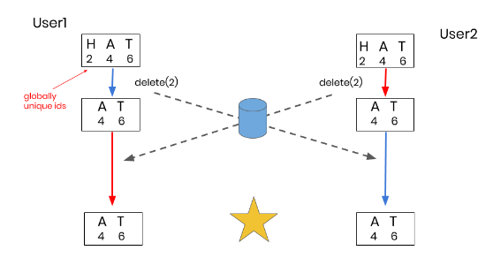
Globally unique id
Each character is assigned a site id and site counter when a new character is inserted make it globally unique.

Slide 9
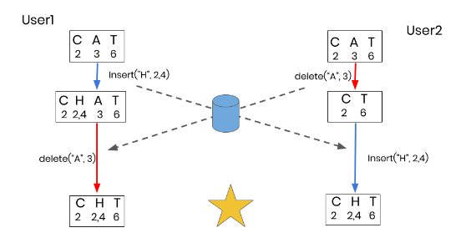
Globally Ordered Characters
To ensure commutativity we use fractional indices.

Slide 10
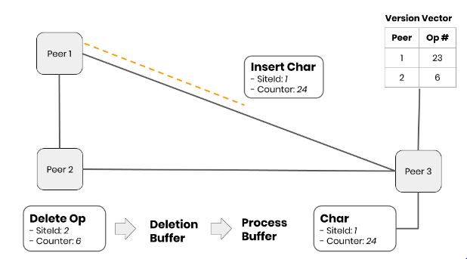
PEER-TO-PEER
To reduce the latency, we can switch to peer to peer architecture.
VERSION VECTOR

Slide 11
CONCLUSION
CRDT ensures commutativity and idempotence.
It is much simpler than OT when applied in real-time collaborative editing.
CRDT is also used in distributed databases where synchronization plays main role.

Slide 12
Thank you

