Slide 1
Conflict-free replicated data type

Slide 2
What is crdt
CRDT is a data structure which is used to maintain consistency across many computers in a network.
All those replicas can be updated independently and concurrently.
It is initially designed for document editing but is used in online chat, online gambling also.

Slide 3
Types of crdt
There are two types of CRDT
State based CRDT
Operation based CRDT
Delta State CRDT
Pure-Operation based CRDT

Slide 4
State based crdt
Any change in document is updated in the local copy and then sends the full state to other replicas.
They are merged by function which are commutative and associative.
The merge function provides a join for any pair of replica states, so the set of all states forms a semilattice.
The update function must monotonically increase the internal state, according to the same partial order rules as the semilattice.
Also known as convergent replicated data type.

Slide 5
Operation based crdt
If any operation is performed in the document, the full state is not sent but the update operation alone is sent to all replicas.
But they are not idempotent.
Also known as commutative replicated data type.

Slide 6
Delta state crdt
This is the variant of state based CRDT
Instead of transferring whole state, delta state CRDT transfers only the part of the state in which the changes are made recently.
This reduces the overhead of transferring the whole state which may be large.

Slide 7
Pure operation based crdt
Pure operation based CRDT is the operation based CRDT’s variant.
It reduces the metadata size.

Slide 8
CRDT
Counter
Register
Set

Slide 9
counter
An integer with the support for increment and decrement.
G-Counter (Grow-only counter)
Its monotonically increasing counter.
Data will be stored in a vector whose dimension is equal to the number of nodes.
And each replica increases the value in position with its ID in position array.
The merge function will take the maximum in the positions, and the final value will be the sum of all elements of the vector.

Slide 10
Continued..
PN-Counters
To create a counter with both increment and decrement operation, we use two G-Counters.
One G-Counter for increment and another for decrement.

Slide 11
register
Register is a memory cell with two operations- read and write.
Write is not commutative. So to solve this there is two approaches.
Last Write Win Register
Multi-Value Register

Slide 12
SETS
G-Sets
It is a grow only set which only allows addition of elements to the sets.
2P-Sets
It allows us to add and remove elements from the set.
It uses two G-Sets – one to add elements and one remove set.
Once the element is removed from the set, it cannot be added again.

Slide 13
Continued..
Last-Write-Wins Set
It is also similar to 2P set.
It uses two G-Sets – add set and remove set with a timestamp for each element.
But it allow us to reinsert the removed elements also.
Observed - Removed Set
It differs from LWW Set by using unique id instead of timestamp.
Unique tag is added to both the add set and remove set.

Slide 14
applications
CRDT is used in Redis - a distributed, highly available and scalable database.
No-sql distributed database Riak supports CRDT datatype.
Facebook implements CRDTs in their Apollo low-latency "consistency at scale" database.
Microsoft's Cosmos DB uses CRDT's to enable a multi-master write mode.
Sequence CRDT is used in Collaborative Real-time Editor.

Slide 15
Collaborative editing
It is an application which enables the different users in different places to access the same file over the internet.
It has two types namely non real-time collaboration and real-time collaboration.
In non real-time collaboration editing, the same file is not edited by different users simultaneously.
But real-time collaboration allows users to edit the same file simultaneously by different users across the world.

Slide 16
consistency in distributed system
Strong consistency
The data will be passed to all replicas as soon as a user writes in any of the replicas.
But during update any subsequent request to any of the replicas will be delayed.
After the update they start to take care of the requests arrived.
Eventual consistency
It does not update all replicas at once. But has a fixed time to become consistent.
Any request to the data at any time may not be the same.
It can be used in fault tolerant application.

Slide 17
Continued..
Strong eventual consistency
Here, the order in which we apply update doesn’t matter. The operation takes place simultaneously and the send the update to each other. Then they acquire consistency eventually.
They can be applied in only some data types and they are called CRDT.

Slide 18
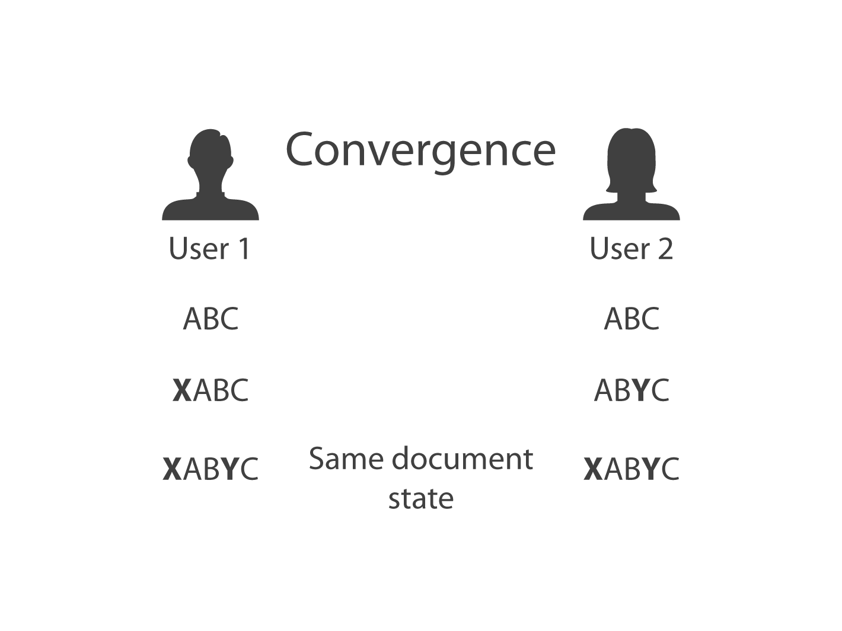
To achieve consistency
Convergence
All replicas must have the same content after the operations.

Slide 19
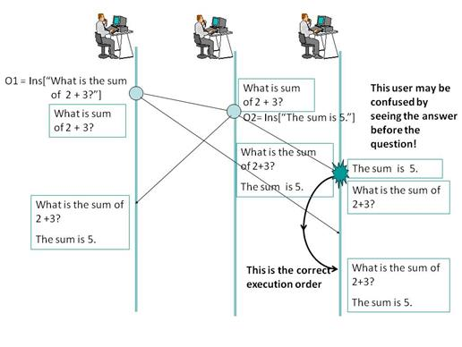
Causality preservation
Operations must be performed in cause- effect order.

Slide 20
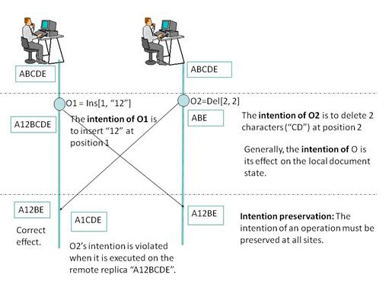
Intention preservation
A local change must be preserved in all replicas.

Slide 21
terms
Commutative
The change in operation order should not change the result.
Associativity
The grouping of operations doesn’t matter.
Idempotence
Applying an operation more than once should not affect the result.
Partial order
Reflexivity + Transitivity + Antisymmetry.
Semilattice
Partially ordered set with exact upper (lower) face

Slide 22
Operational transformation
Operational Transformation was originally invented for consistency maintenance and concurrency control in collaborative editing of plain text documents.
OT is an algorithm that compares concurrent operations and detects if they will cause the documents to not converge. If the answer is yes, the operations are modified (or transformed) before being applied.
OT transforms the parameters of an operation according to the effects of previously executed concurrent operations so that the transformed operation can achieve the correct effect and maintain document consistency.

Slide 23
Continued..
OT treats each character as having a value and an absolute position. And to achieve the commutativity and idempotency required by a collaborative text editor, OT relies primarily on an algorithm.

Slide 24
Limitations in ot
Operational transformation is not always commutative.
The OT algorithm is really hard and time consuming to implement correctly. Wave took 2 years to write and if we want to rewrite it today, it would take almost as long to write a second time.

Slide 25
Crdt in collaborative editing
While trying to simplify Operational Transformation, Conflict-free data type came into picture.
In CRDT, the underlying structure of text editor is changed.
Instead of seeing a character as a value and absolute position, each character is made globally unique.

Slide 26
Globally unique id
Each character is assigned a site id and site counter when a new character is inserted make it globally unique.
Site id is a unique value assigned to a character.
Site counter is incremented when a character is inserted or deleted.

Slide 27
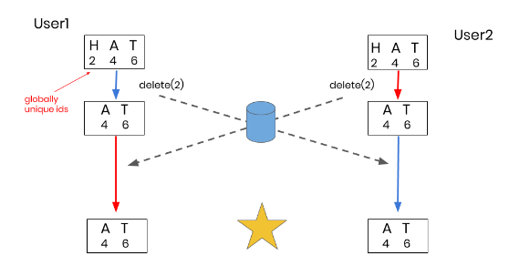
Continued..

Slide 28
Globally Ordered Characters
To ensure commutativity we use fractional indices.
When two users inserting same character at the same position at same time, to make that character unique we attach the site id to the position identifier.

Slide 29
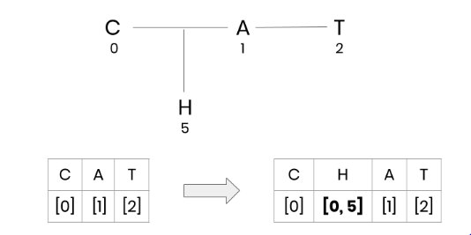
Continued..
Using fractional indices, instead of inserting “H” at position 1, we insert “H” at a position between 0 and 1. We represent it in code as a list of integers as [0, 5].

Slide 30
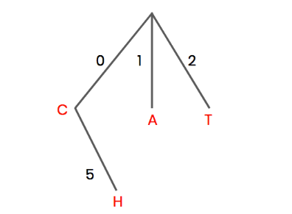
Continued..
Another way to imagine fractional indices is as a tree. As characters are inserted into the document, they can be inserted in between two existing position identifiers at one level of the tree.
if there is no space between two existing character positions, as demonstrated below, we proceed to the next level of the

Slide 31
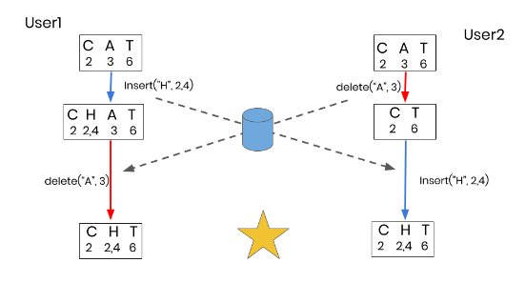
Continued..

Slide 32
conclusion
CRDT ensures commutativity and idempotence.
It is much simpler than OT when applied in real-time collaborative editing.
CRDT is also used in distributed databases where synchronization plays main role.

