Slide 1
Слайд 1 с информацией о кадрах
Machine Interaction
Author: Adil Zhaksylyk

Slide 2
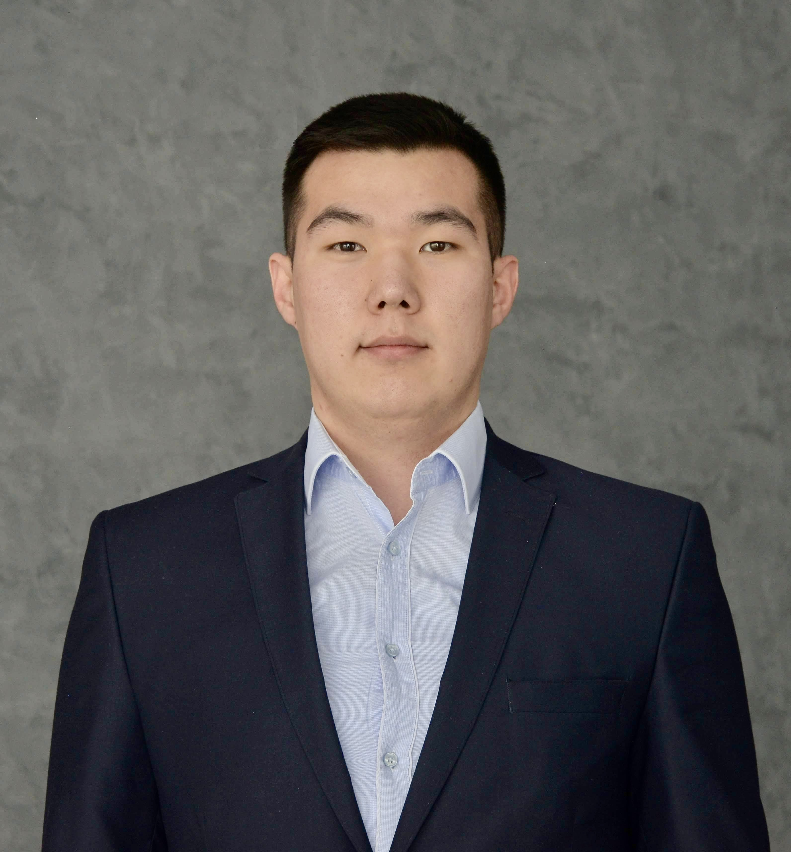
Слайд 2 с информацией о кадрах
ADIL ZHAKSYLK
Research assistant at ICPS (Hochschule Heilbronn)
PhD candidate
Project: Intelligent Manufacturing Assistant Bot (IMAB)
Budget – 250 000 €
4 years of experience in Oil and Gas in Kazakhstan
Master in Engineering – Automation and Control
Bachelor of Science – Robotics and Automation

Slide 3
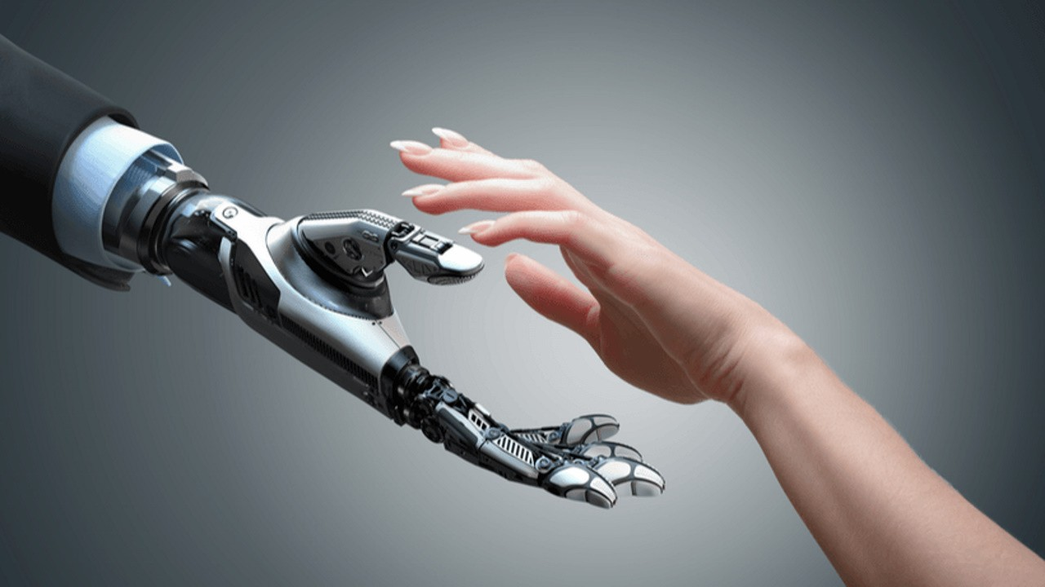
What is Human-Machine Interaction?

Slide 4
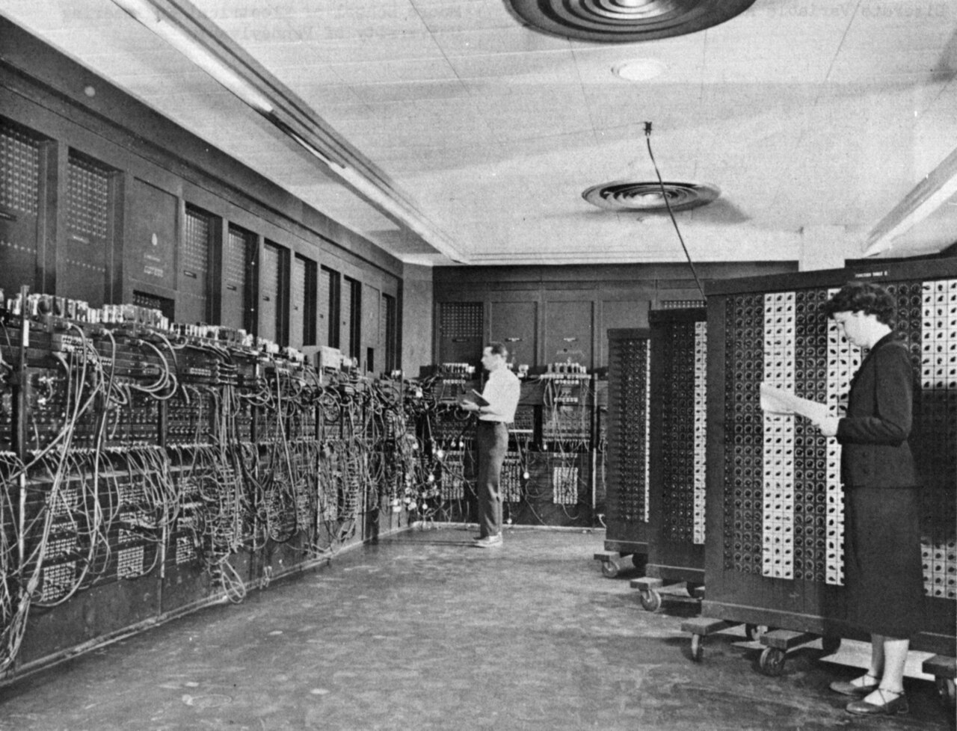
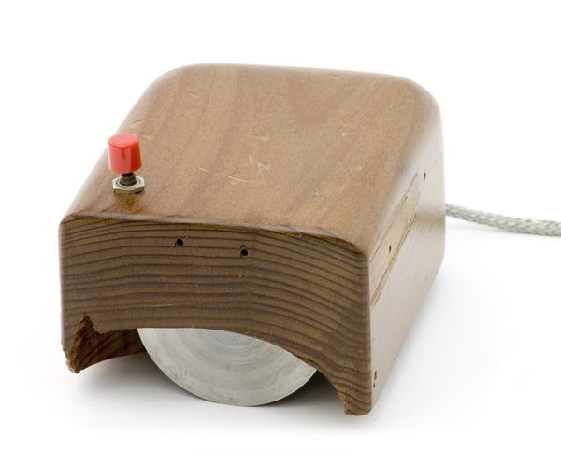
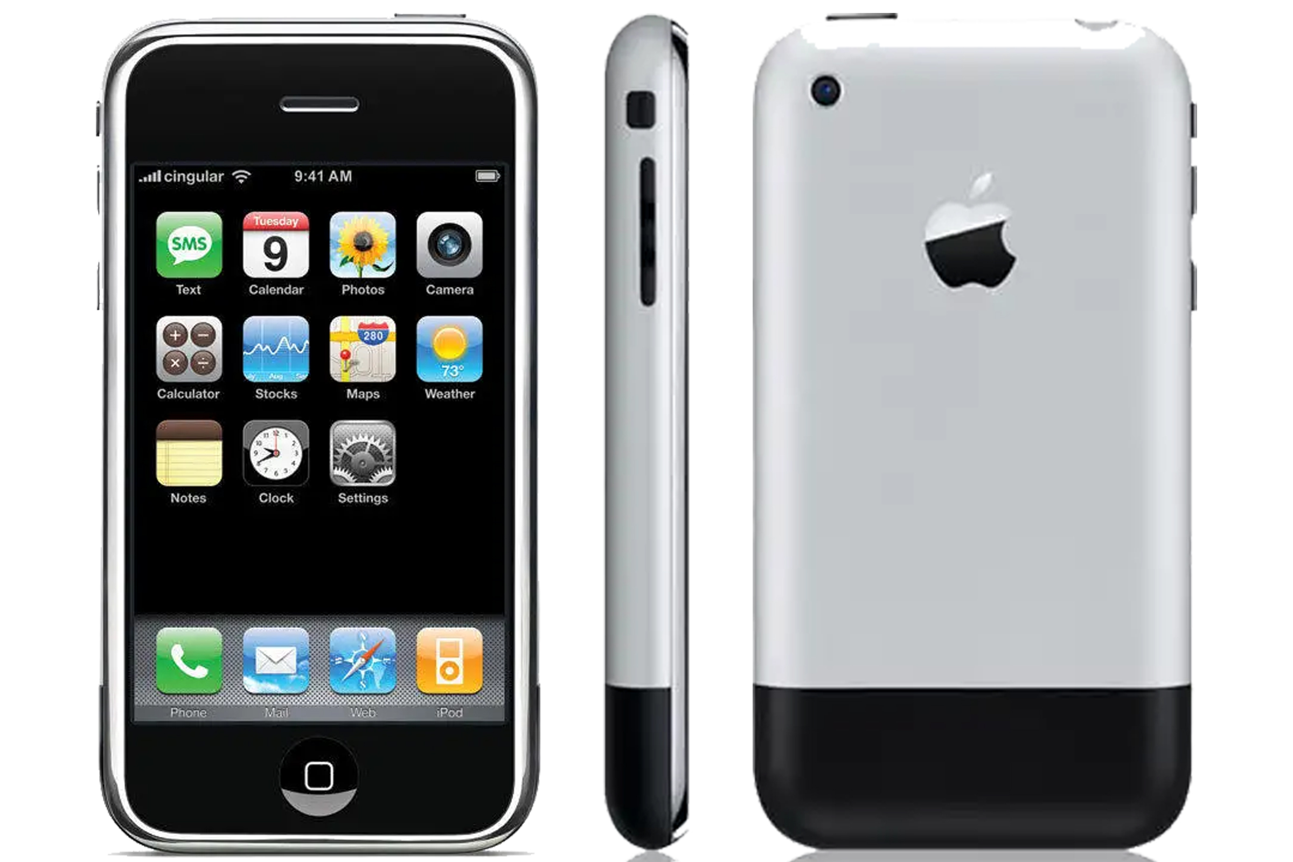

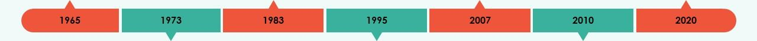
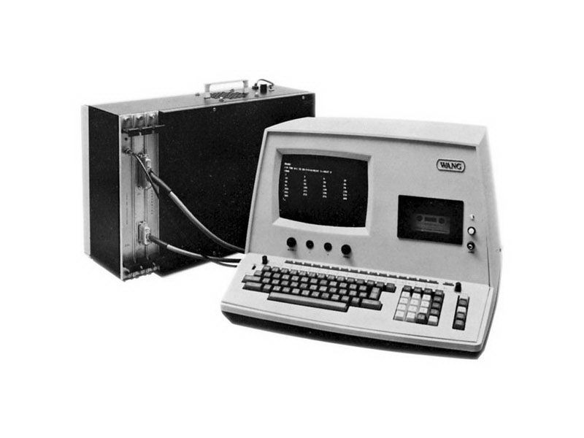
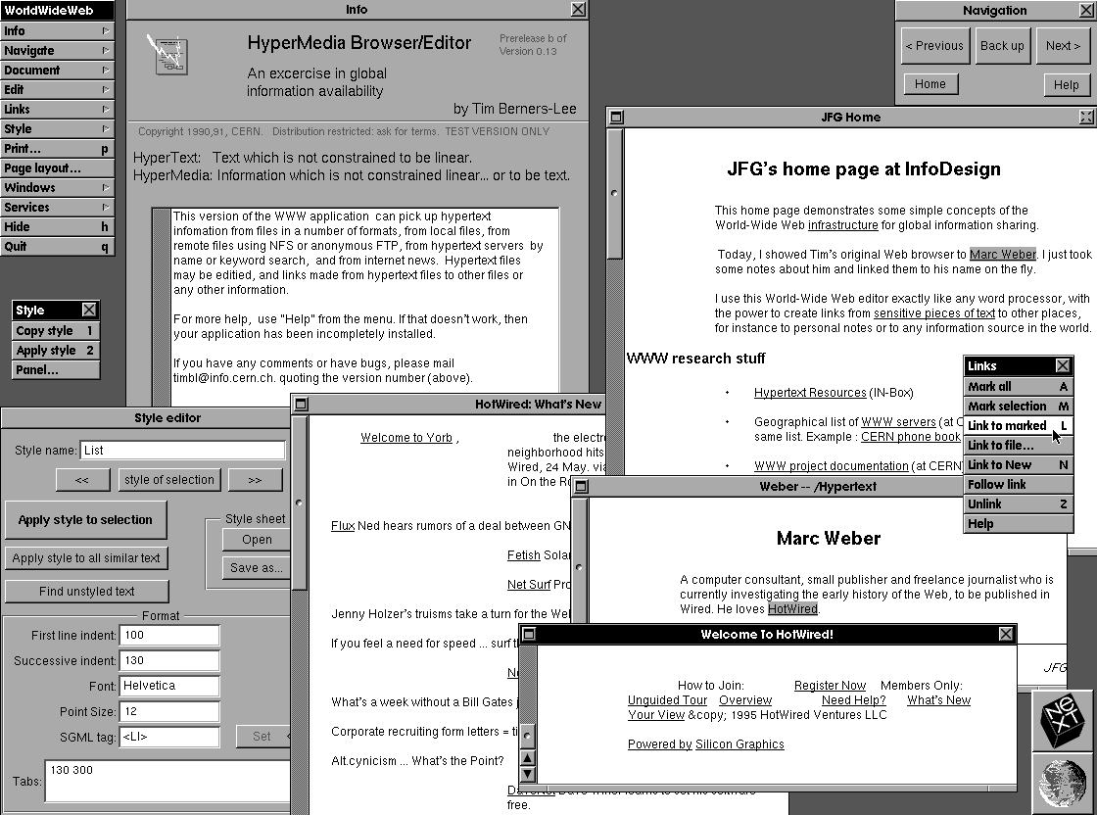
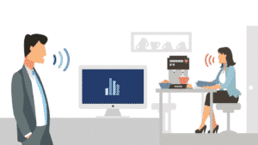
Historical Evolution of HMI
Historical Evolution of HMI
First GUI
Computer mouse
Touchscreens
AI Interaction
Keyboard
Web Browsers
Voice commands

Slide 5
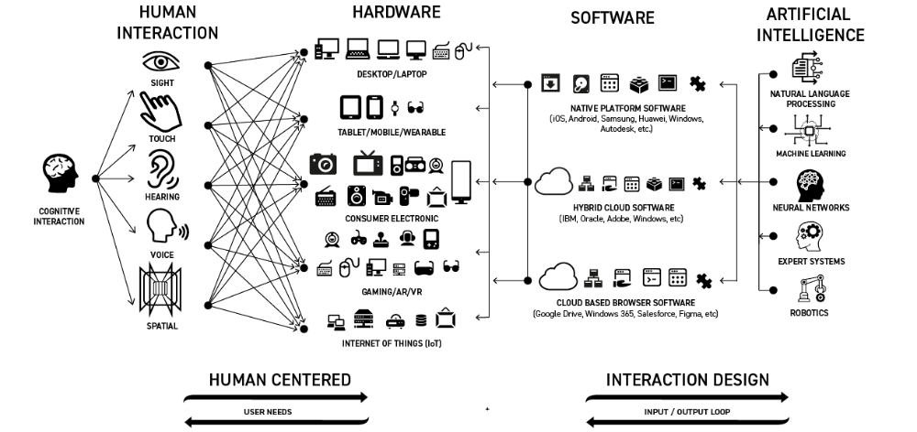
Interaction Design Paradigms

Slide 6
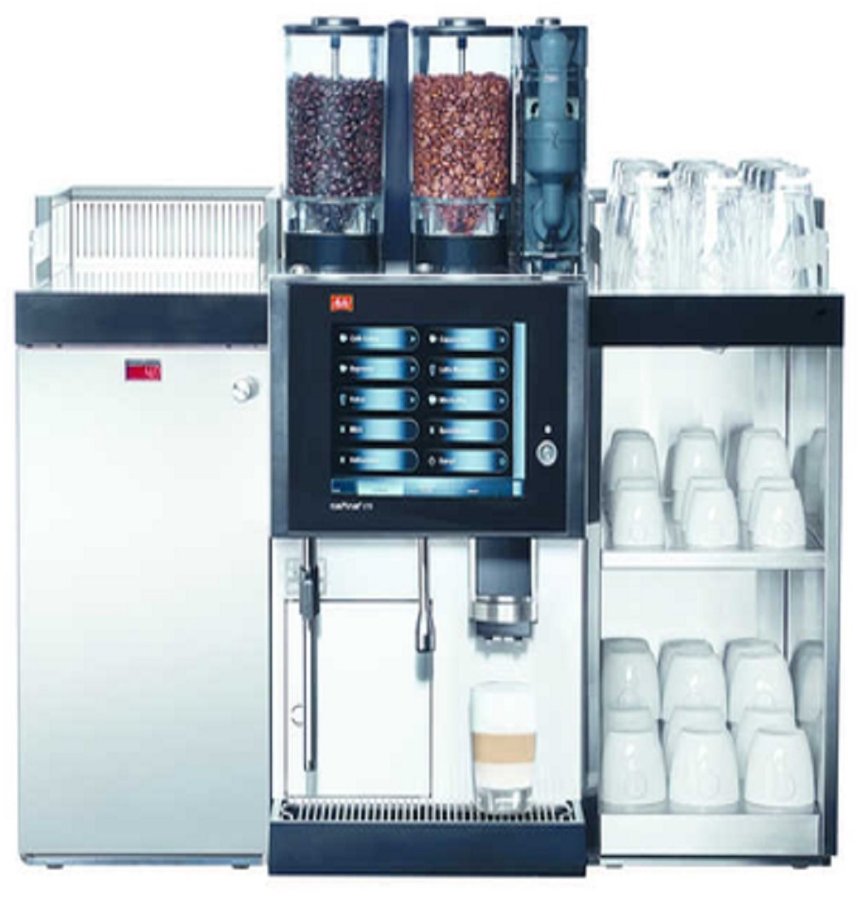

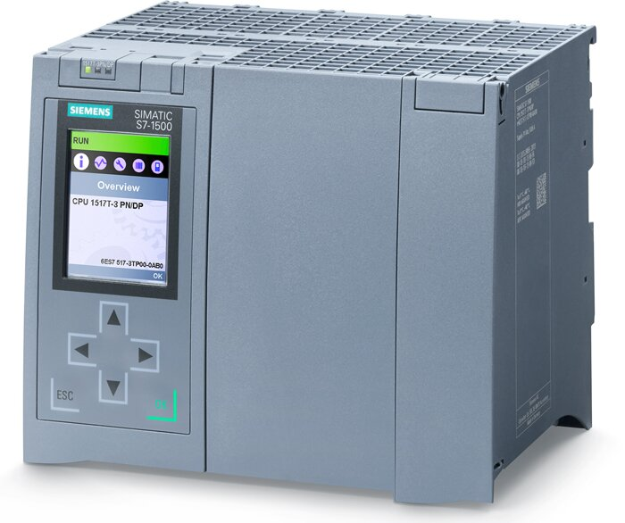
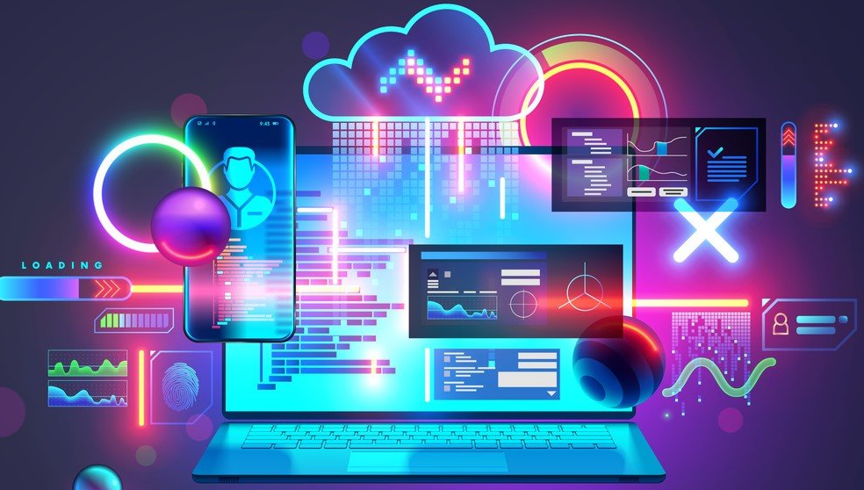
Machine communication
Modbus
PROFIBUS
PROFINET
EtherNet/IP
EtherCAT
OPC UA
MQTT
HTTP/HTTPS
Machine
Programming
logic control (PLC)
Industrial Protocols
Software

Slide 7
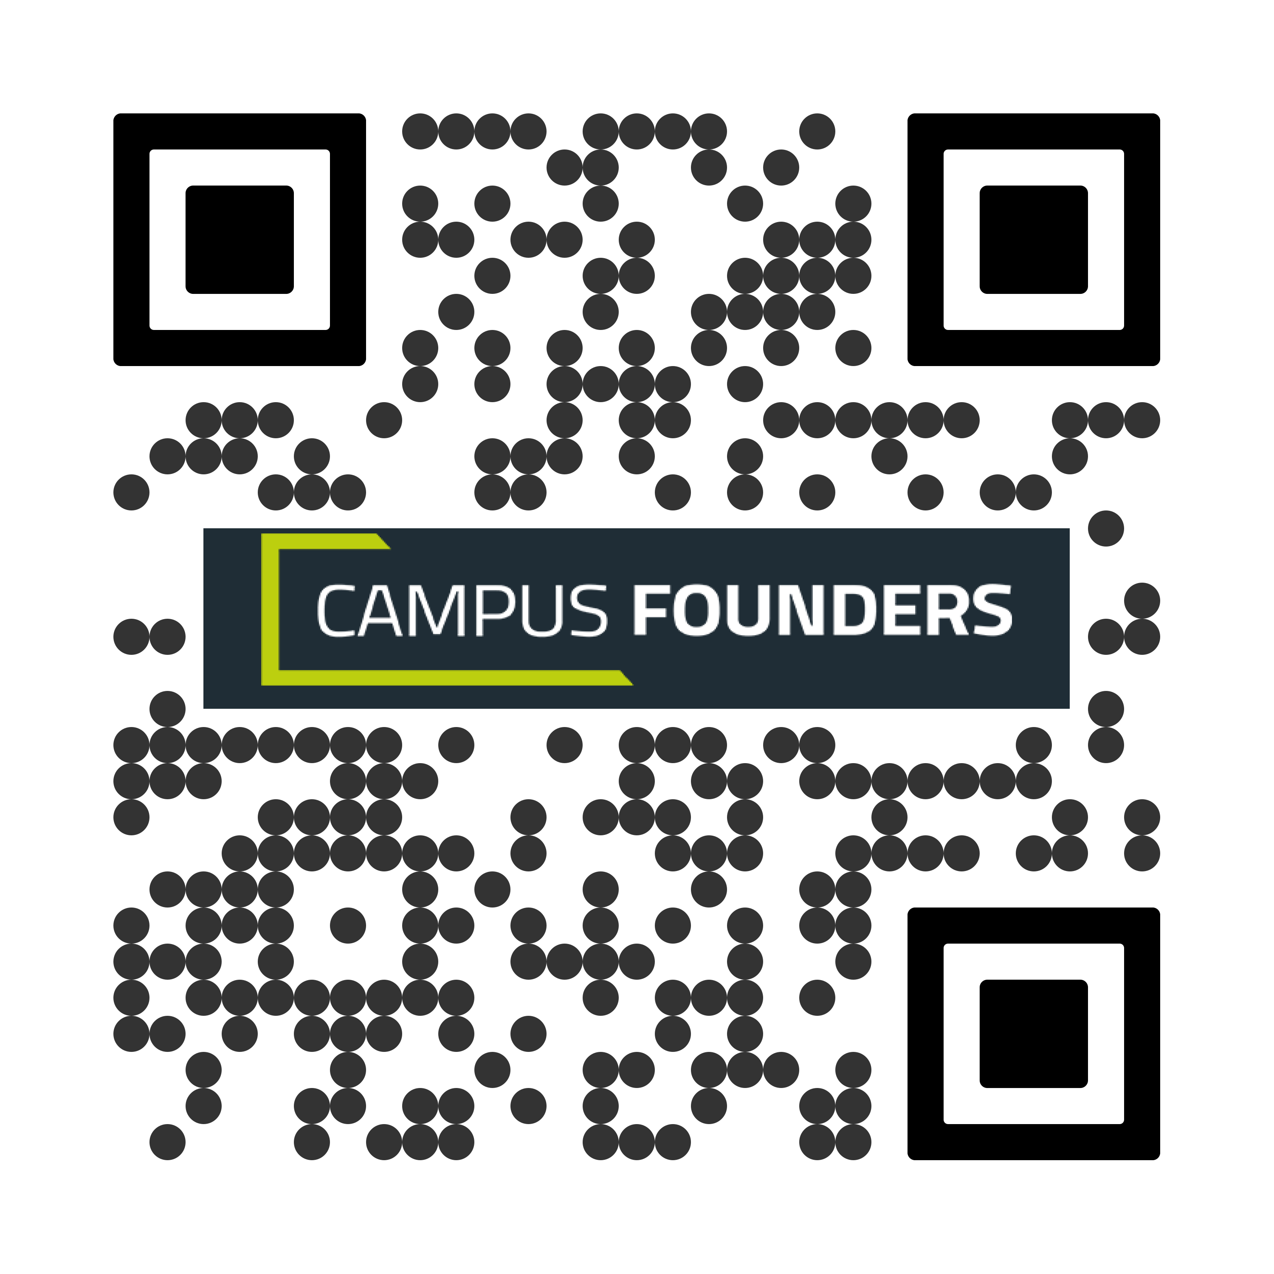
GIT Repository
https://github.com/azhaksylyk/campus_founders
Download Repository
Open folder in VS Code
Create virtual environment:
python –m venv venv
Install libraries:
pip install –r requirements.txt

Slide 8

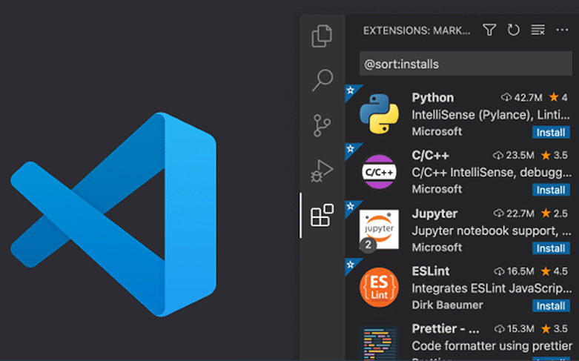
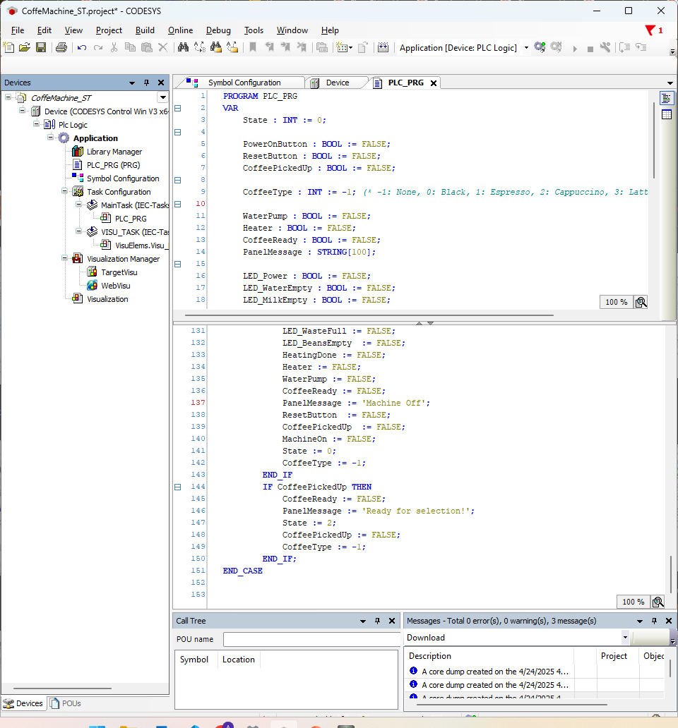
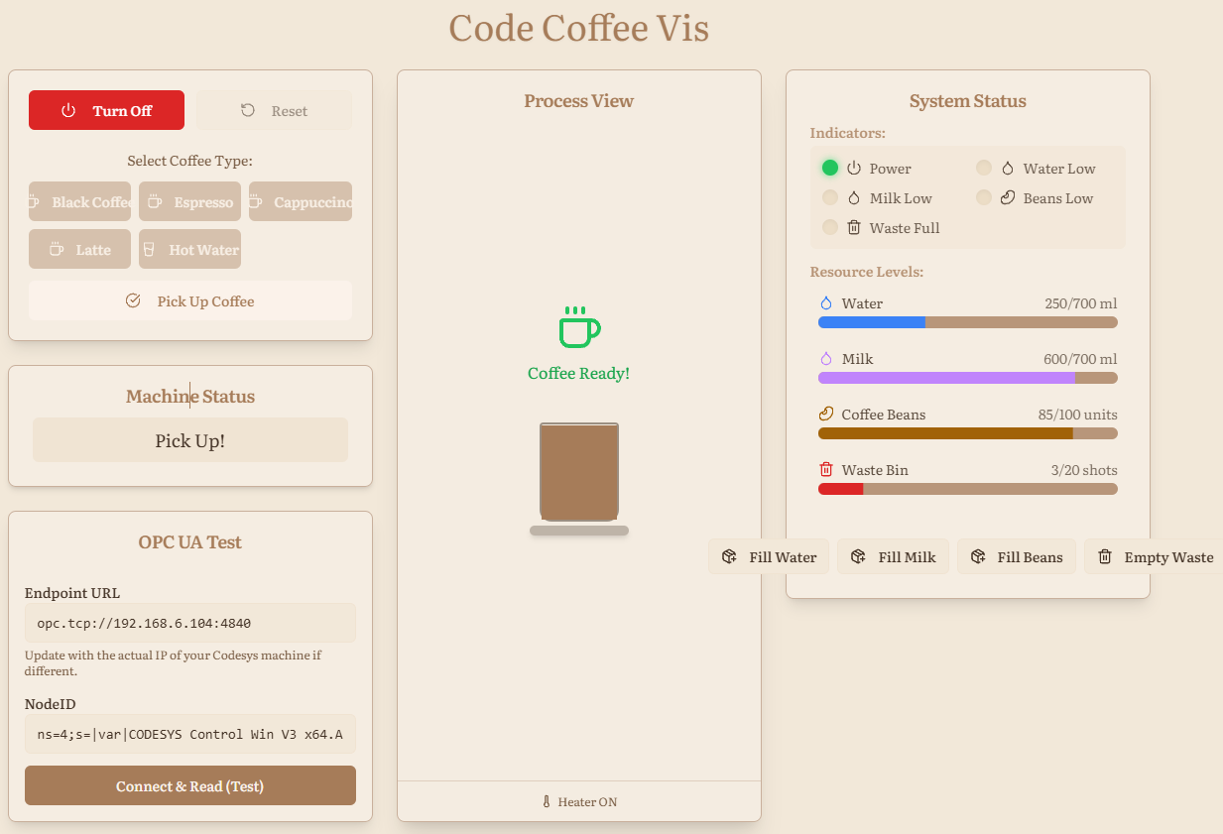
Слайд 3 с информацией о кадрах
Codesys
Visualization
VS Code
Speech recognition:
Language Model (LLM) – Gemini API
asyncio library — Asynchronous I/O

Slide 9
Слайд 10 с информацией о кадрах
THANK YOU!
LinkedIn: azhaksylyk
GitHub: azhaksylyk

