Slide 1
Performance Dashboard – Financial Sales KPI Analysis
Monitoring Actual vs Target Sales using Power BI

Slide 2
Objective & Dataset
Objective:
- Track KPIs (Sales, Targets, Variance, Growth)
Dataset:
- Financial Sales performance dataset with salesperson-level data
Tool:
- Power BI

Slide 3
KPI Highlights
- Total Sales Actual: $5M
- Target Sales: $5.15M
- Variance: -$152K
- Variance %: -2.8%
- Months Target Reached: 5 out of 14

Slide 4
Sales Trend Analysis
- Bar + Line chart showing Actual vs Target by Month
- Highlight: July 2023 (+13.4%) peak vs Dec 2023 decline

Slide 5
Salesperson Performance
- Table of Actual vs Target by salesperson
- Green for overachievers, Red for underperformers
Examples:
- Top Performer: Marney O’Breem (+9.6%)
- Lowest Performer: Madeleine Upcott (-4.7%)

Slide 6
Insights & Recommendations
- Sales declined 17.51% YoY
- Support underperforming salespeople with training/incentives
- Focus marketing efforts on low-performing months
- Replicate strategies of top performers (e.g., Marney O’Breem)

Slide 7
Conclusion
- Dashboard enables continuous monitoring of sales performance
- Stakeholders can make data-driven business decisions on strategy, salesforce management, and revenue targets

Slide 8
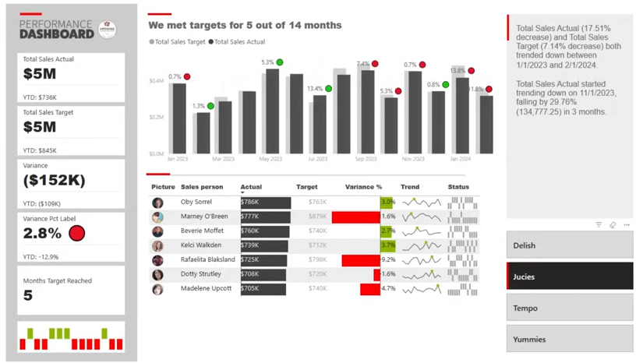
Sales Trend Analysis

