Slide 1

Notes:
Chris M’s

Slide 2
Roles
Project Manager, Scrum Master, & Git Master: Chris Morikawa
Backend:
Chris Banci
Greg Seda
Malia Taupule
Andrew Zhang
Frontend:
Esmond Liang
Zena Nuhaily
Katherine Mayo
Chris Morikawa
Notes:
Chris M’s

Slide 3
Sprints
Total of (5) sprints, lasting two weeks each.
Start Date: September 17, 2017
End Date: November 25, 2017
Process used: Agile
Notes:
Chris M’s

Slide 4
SRS
Background
As a team, we struggled to find appropriate meeting times that would cater to each member. This application would be the solution to our problem, because its purpose is to organize both individual and group schedules.
Purpose
The purpose of our application is to act as a personal secretary that helps the user, plan schedules, organize tasks/reminders, and keep track of their work. The application will use tools such as a calendar with reminder notifications to help manage their personal schedules.
Notes:
Zena’s

Slide 5
Requirements Analysis
Uses Cases we accomplished
Accomplished:
Create account
Log In
Calendar
Add/Delete/Edit event
Highlights Group/Personal Events
Friends
Repurposed to be the online list
Group
Chat
Repurposed to be a bulletin
How we prioritized
What use cases would you work on if you had more time
Chat system was difficult to implement for time we had left. If we about another month we could have a one to one chat.
Notes:
Zena’s Slide

Slide 6
Sprint 1 (9/17-9/30)
Review QT and SQL DataBase
Flesh Out Use Cases
Work on UML
Notes:
Katherine’s

Slide 7
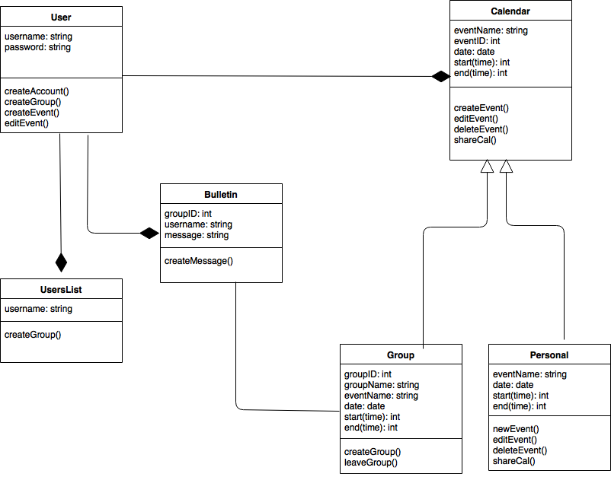
UML Diagram (Initial)
Notes:
Katherine’s

Slide 8
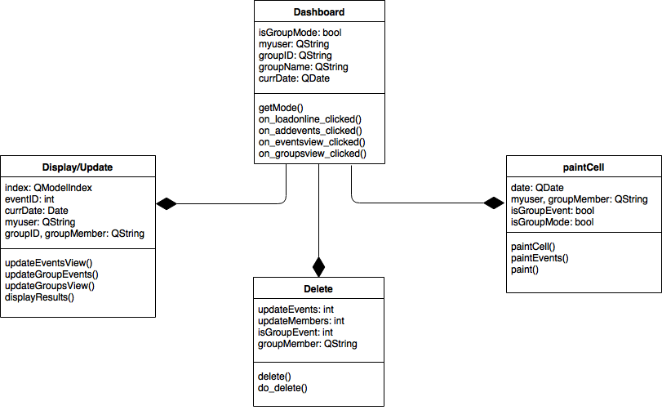
UML Diagram (Revised)
Notes:
Katherine’s

Slide 9
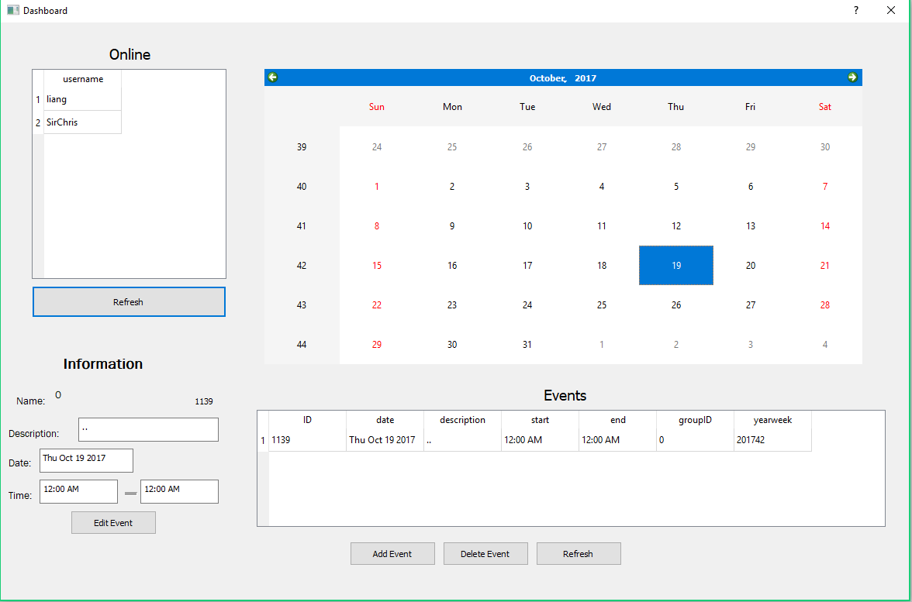
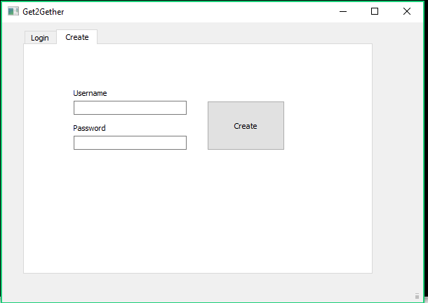
Sprint 2 (10/1-10/14)
System Requirements
Work on Prototype of Application
ERD design
Notes:
Kathy’s

Slide 10
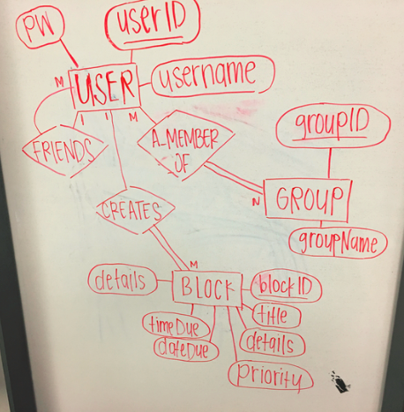
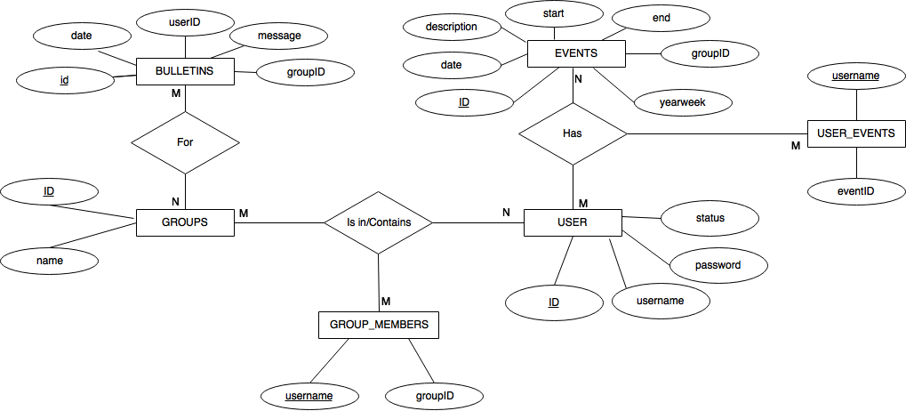
ERD
Initial Design
Revised Design
1
Notes:
Kathy’s

Slide 11
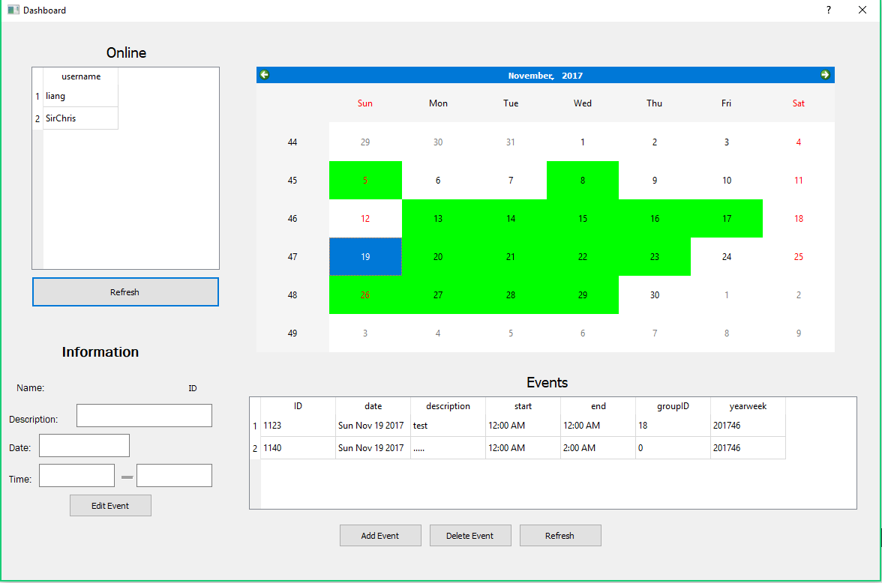
Sprint 3 (10/15-10/28)
Create Database Tables
Button Functions
Show events in Tableview of Specific day
Highlight Calendar days that have events
Notes:
Malia’s

Slide 12
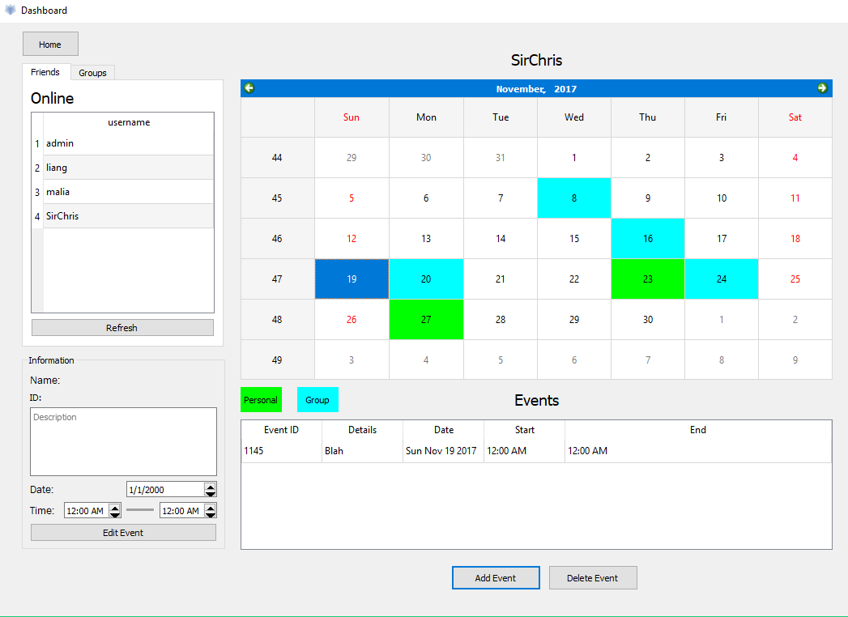
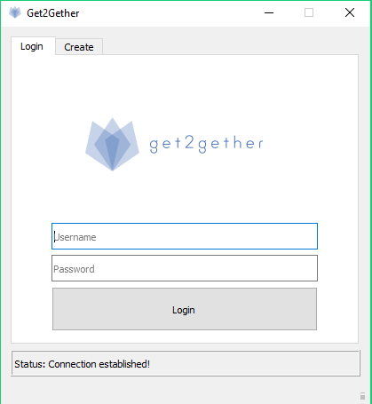
Sprint 4 (10/29-11/11)
Create Group, Group List, and show Group Calendar
Update Database for Group
Make the UI differentiate between group and user’s personal calendar
Notes:
Malia’s

Slide 13
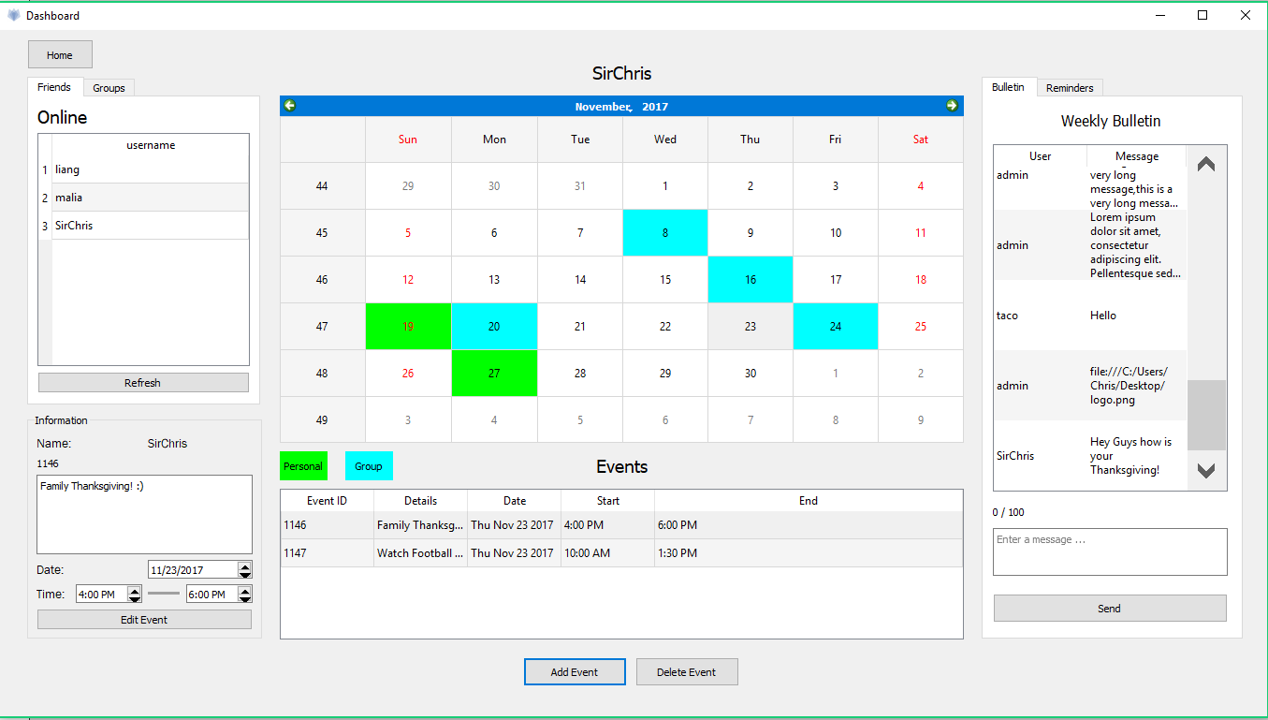
Sprint 5 (11/12-11/25)
Discussion Board and Reminders
Refactor and Debug code
Prepare Powerpoint Presentation
https://docs.google.com/spreadsheets/d/1nXXERTlw48uzajCu-19xtFG5CNnlDX5yxfqjsbIOUo8/edit#gid=0 (Link to Sprint Backlog)
Notes:
Malia’s

Slide 14
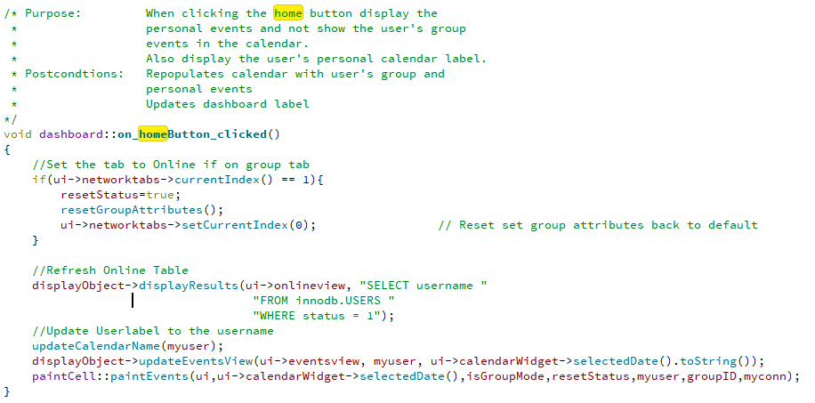
Design
Design Patterns Used
Observer Pattern
Home button function:
Notes:
Greg’s

Slide 15
Tools
Framework: Qt Creator
Database: MySQL Workbench
Version Control: GitHub
https://github.com/CodingMorry7/Get2gether
-Created Branches for each sprint/latest merges
Communication: Slack & Google Hangouts
Other: Google Docs, Google Sheets, Google Slides
Notes:
Esmond’s

Slide 16
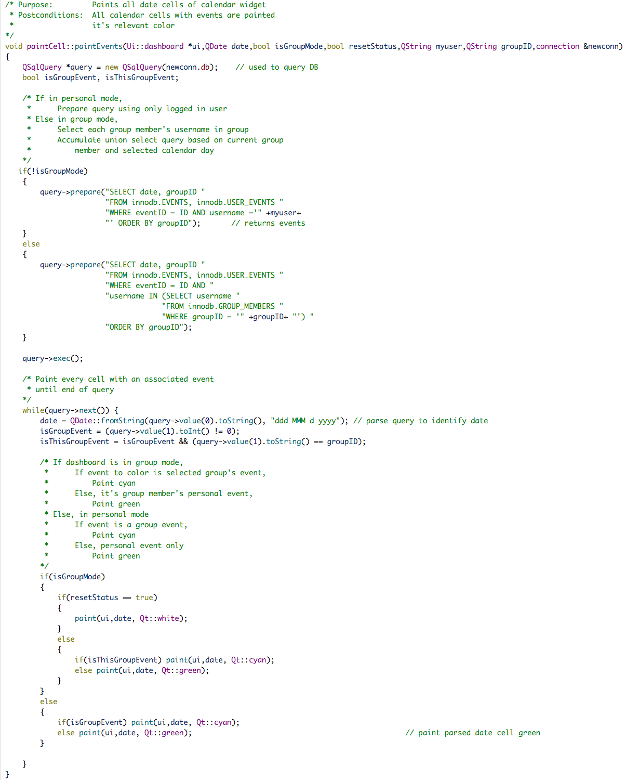
Implementation
PaintCell class: PaintEvents Function
Notes:
Andrew’s

Slide 17
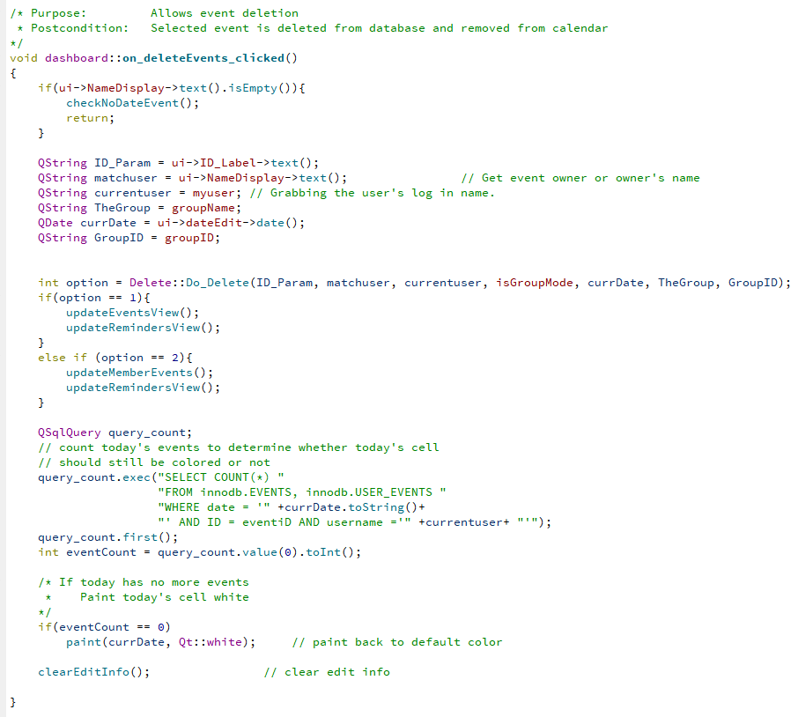
Refactoring
Initial code all in dashboard.cpp
Refactored into class files:
delete.cpp
paintCell.cpp
Display.cpp
Notes:
Andrew’s

Slide 18
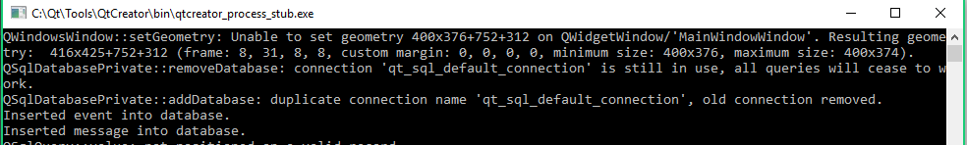
Test Plan
What was your strategy?
Using qDebug/Debug Console Window
Modular testing
https://docs.google.com/spreadsheets/d/1nXXERTlw48uzajCu-19xtFG5CNnlDX5yxfqjsbIOUo8/edit#gid=0 (Link to Backlog of Bugs)
Notes:
Chris B’s

Slide 19
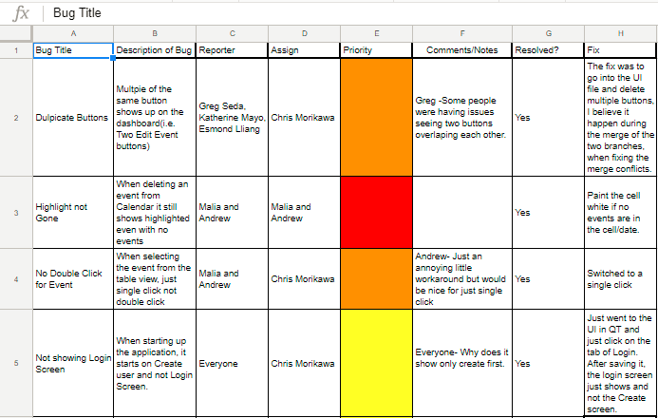
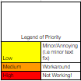
Backlog of Bugs
Notes:
Chris B’s

Slide 20
Demo
Notes:
Greg’s

