Slide 1
Comparison of two means

Slide 2
In many cases, a researcher is interesting in gathering information about two populations in order to compare them.
It involves…..
Comparison of two population means using large samples.
Comparison of two population means using small samples.
Comparison of paired samples.
confidence intervals and tests of significance are useful statistical tools
for the difference between two population parameters

Slide 3
Main aim in comparing
estimating the difference between the means of two distinct populations.
how to construct a confidence interval for the difference in the means of two distinct populations.
perform a test of hypotheses.

Slide 4
Comparison of Two Population Means:
Large, Independent Samples
The samples must be independent of each other. That is, there can be no relationship between the subjects in each sample.
ex:
Using 12 cars, have each car use Brand A and Brand B. Compare the differences in mileage for each car.
Is the expected drying time for one type of paint lower than that of another type of paint?
The populations from which the samples come must be (approximately) normally distributed or the sample sizes of both groups should be n≥30.

Slide 5
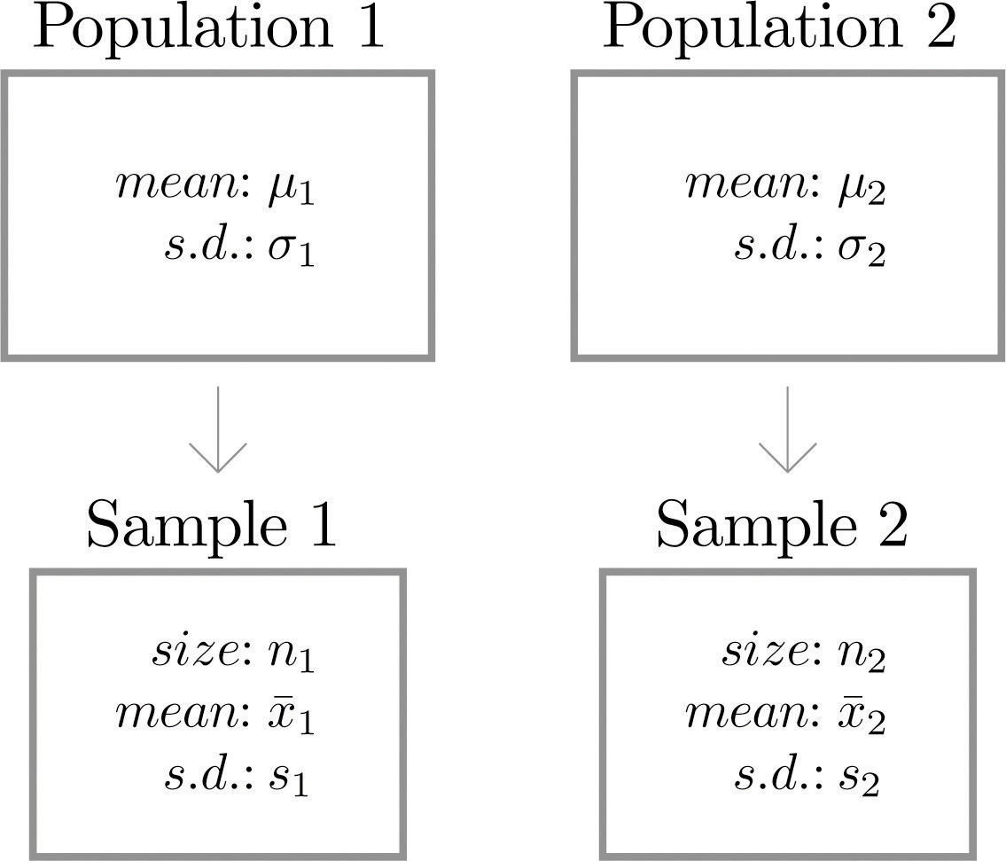
Independent Sampling from Two Population

Slide 6

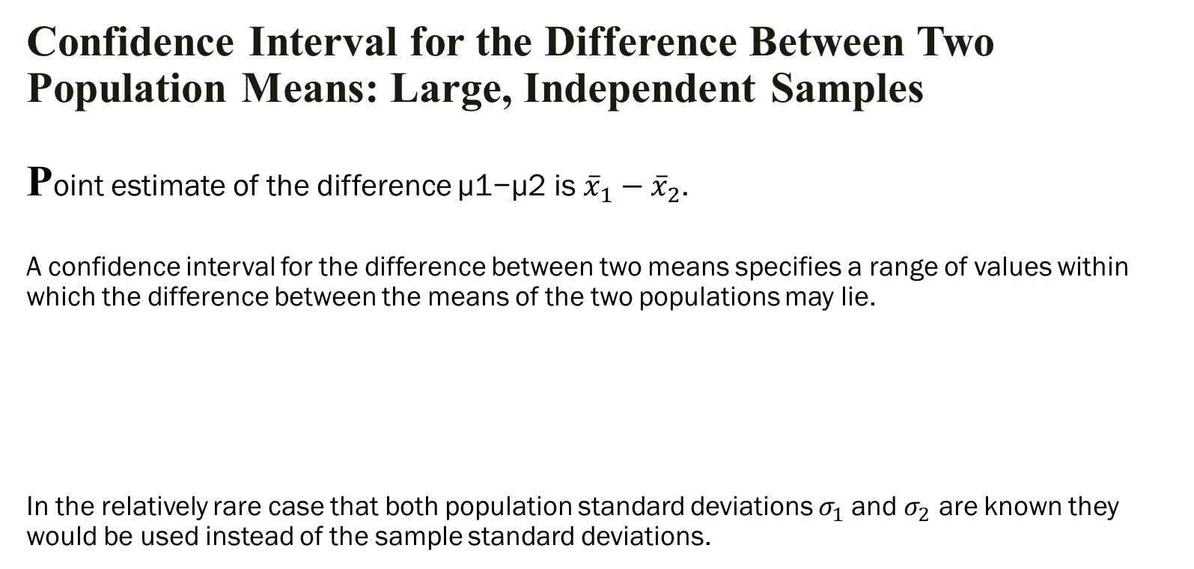
Confidence Interval for the Difference Between Two Population Means: Large, Independent Samples Point estimate of the difference μ1−μ2 is ${\overline{x}}_{1}−{\overline{x}}_{2}$. A confidence interval for the difference between two means specifies a range of values within which the difference between the means of the two populations may lie. In the relatively rare case that both population standard deviations $σ_{1}$and $σ_{2}$ are known they would be used instead of the sample standard deviations.

Slide 7
Hypothesis testing
A hypothesis test is rule that specifies whether to accept or reject a claim about a population depending on the evidence provided by a sample of data.
if μ1>μ2, This formula can be written as μ1−μ2>0.
if μ1<μ2, write the formula as μ1−μ2<0.
if μ1≠μ2, write the formula as μ1−μ2≠0.
Hypothesis testing,,,,
test using the critical value and test statistics procedures.
express the null and alternative hypotheses
If test statistic value falls in to rejection region we simply reject null hypothesis, if not we fail to reject null hypothesis.

Slide 8
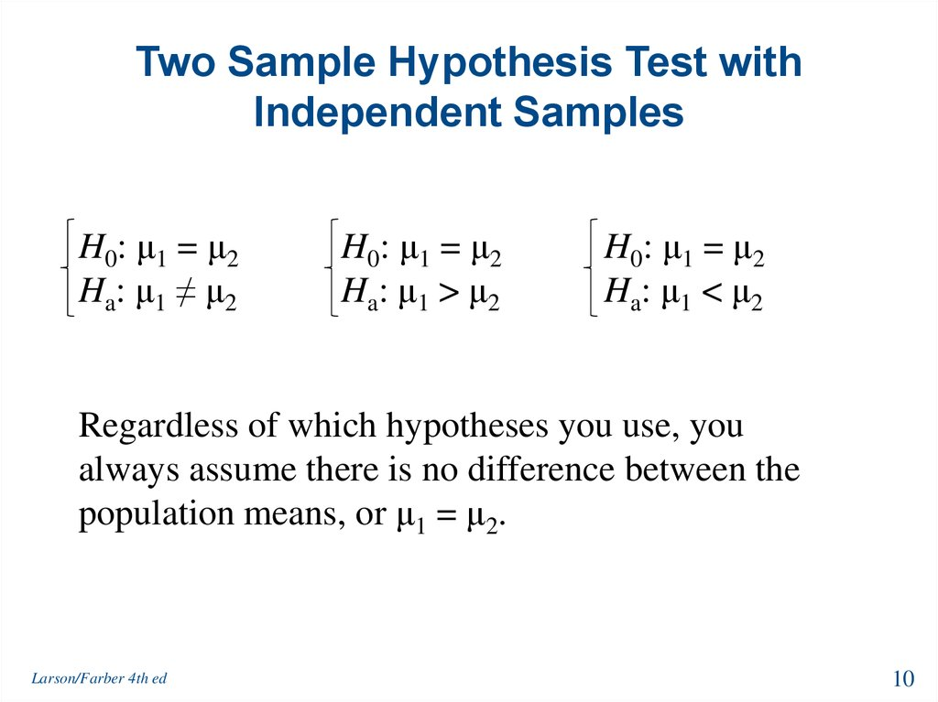

Slide 9
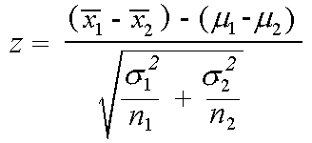

Test Statistic is given by
n₁ and n₂ samples from two normal populations of size
$σ_{1}$ and $σ_{2}$ are standard deviations
μ1 & μ2 are means of two populations respectively

Slide 10
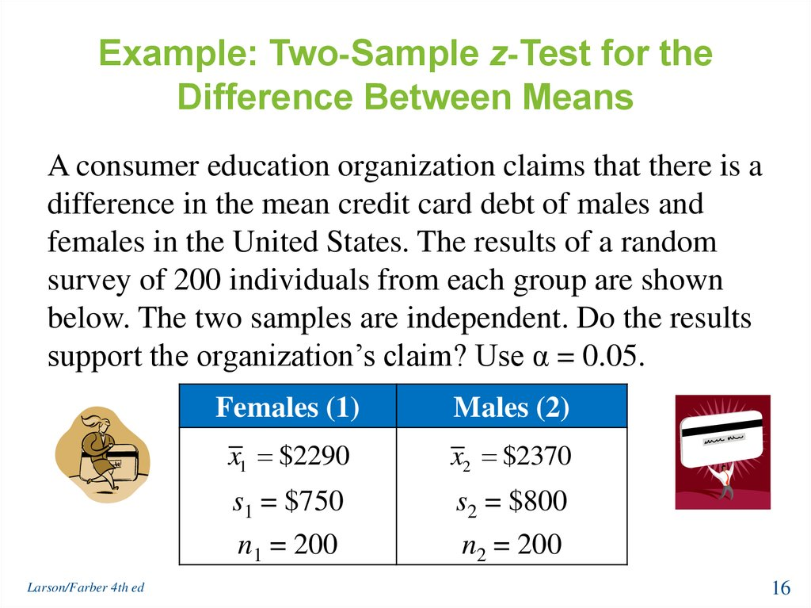
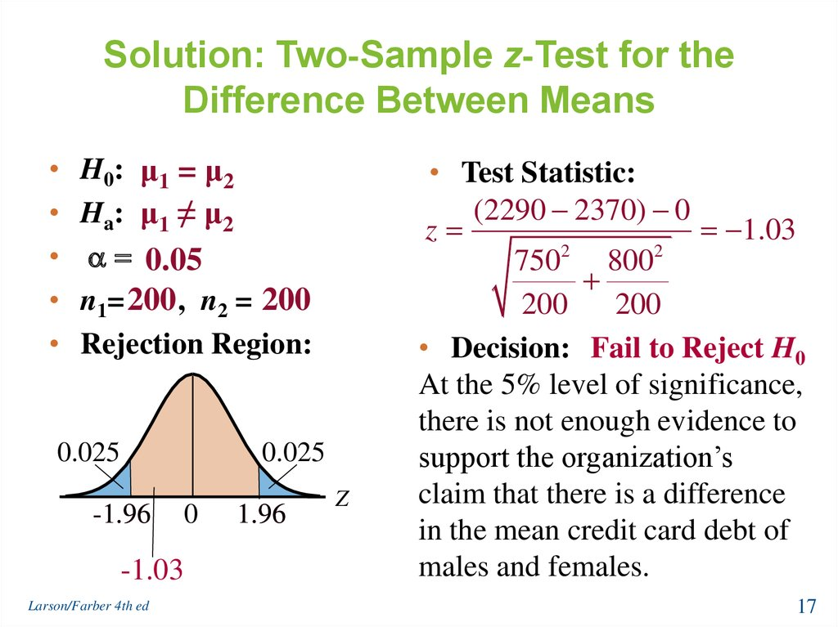

Slide 11
Comparison of Two Population Means - Small, Independent Samples
“Small” samples means that either n1<30 or n2<30
The samples must be independent, the populations must be normal.
There are two cases to consider when working with the above statistic:
— The unknown population variances are equal.
— The unknown population variances are not equal

Slide 12



Equal Variances
pool data(weighted average) for both samples together to produce a pooled variance estimate, defined as:
Confidence Interval is given by
Test Statistic
Degrees of freedom=(n₁ + n₂ -2)

Slide 13
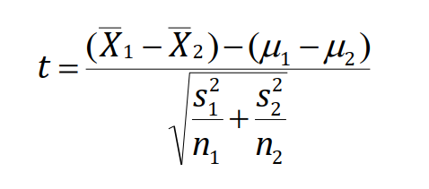
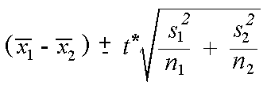
Unequal variances
Test statistic
Confidence interval

Slide 14
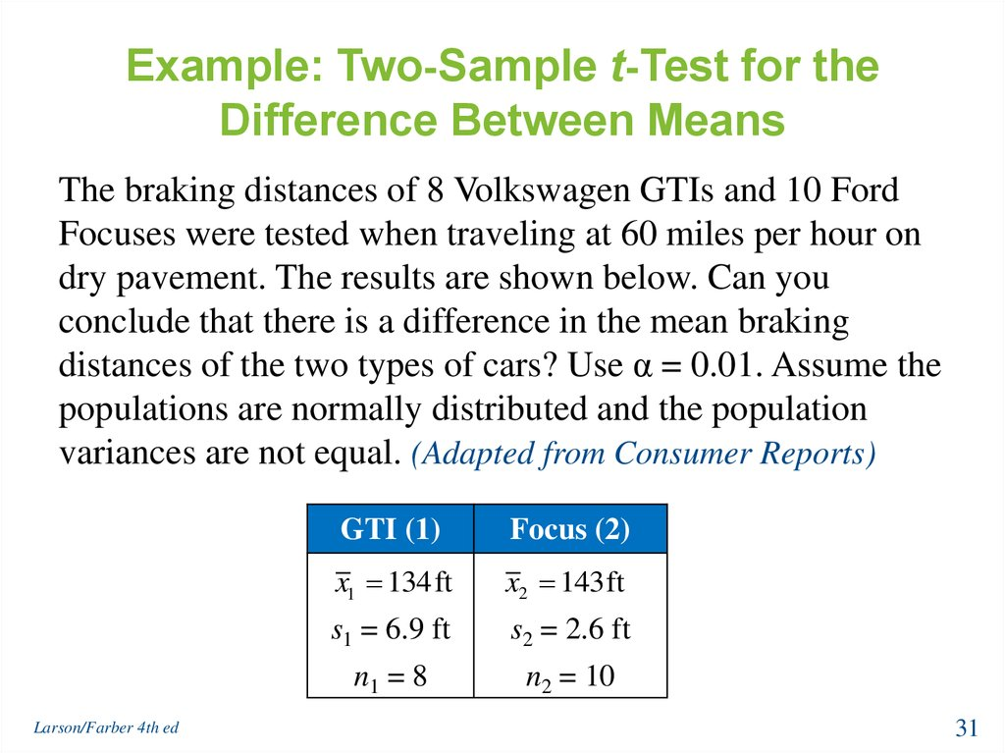
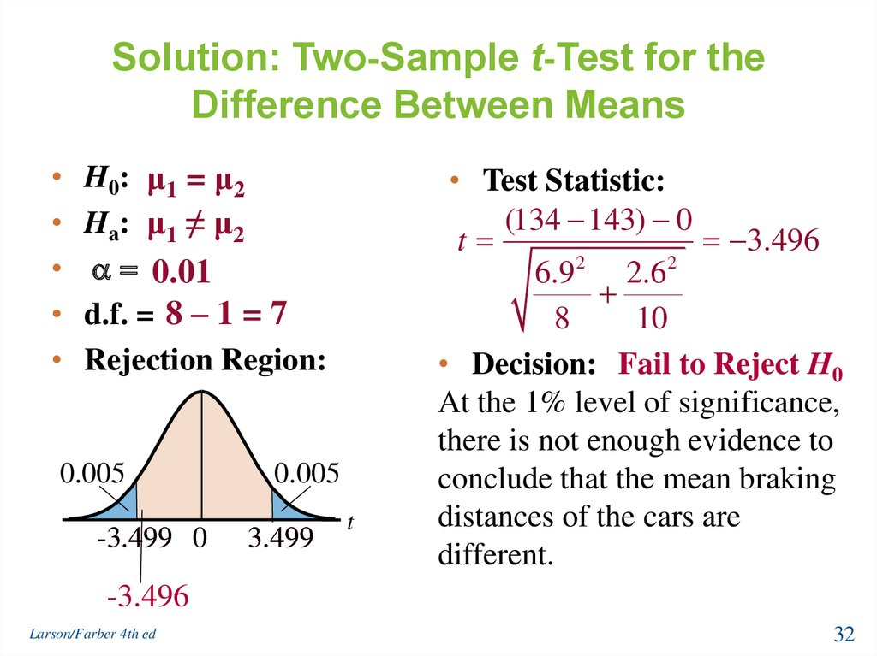

Slide 15
Comparison of Two Population Means - Paired Samples
Decide on the basis of weights “before and after” whether a certain diet is really effective.
Decide on the basis of salaries “before and after” receiving an MBA whether that degree contributes to financial well being.
Example
Resting heart rates of 35 individuals before drinking coffee.
Resting heart rates of the same individuals after drinking two cups of coffee.

Slide 16



Confidence interval
D.F=n-1
where there are n pairs, $\overline{d}$ is the mean and sd is the standard deviation of their differences.
Test Statistic

Slide 17
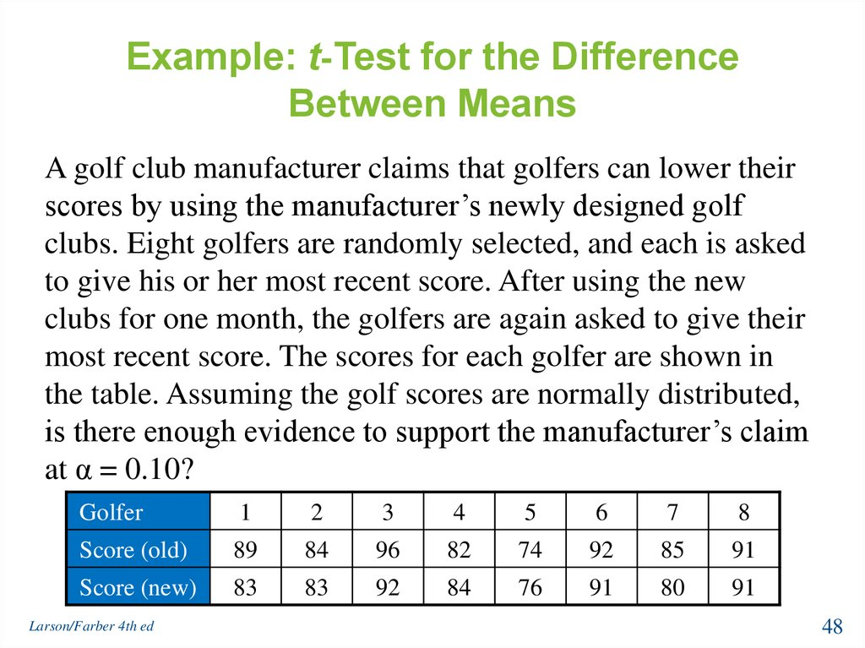
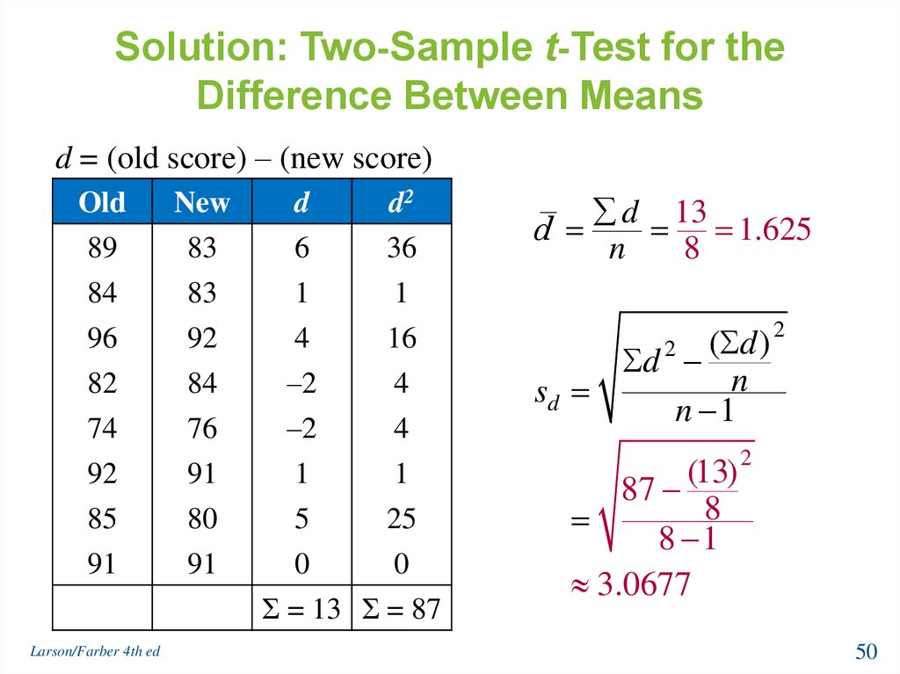

Slide 18
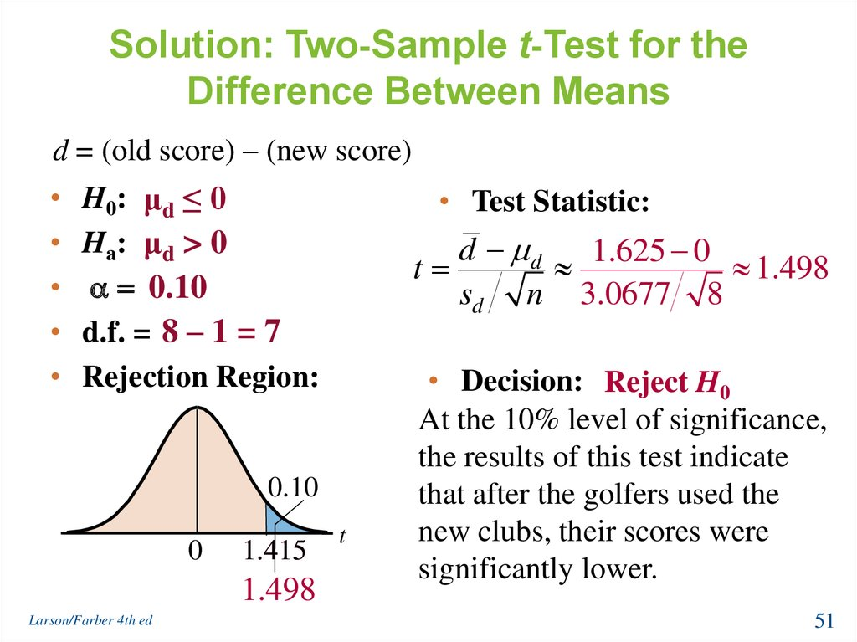

Slide 19
