Slide 1
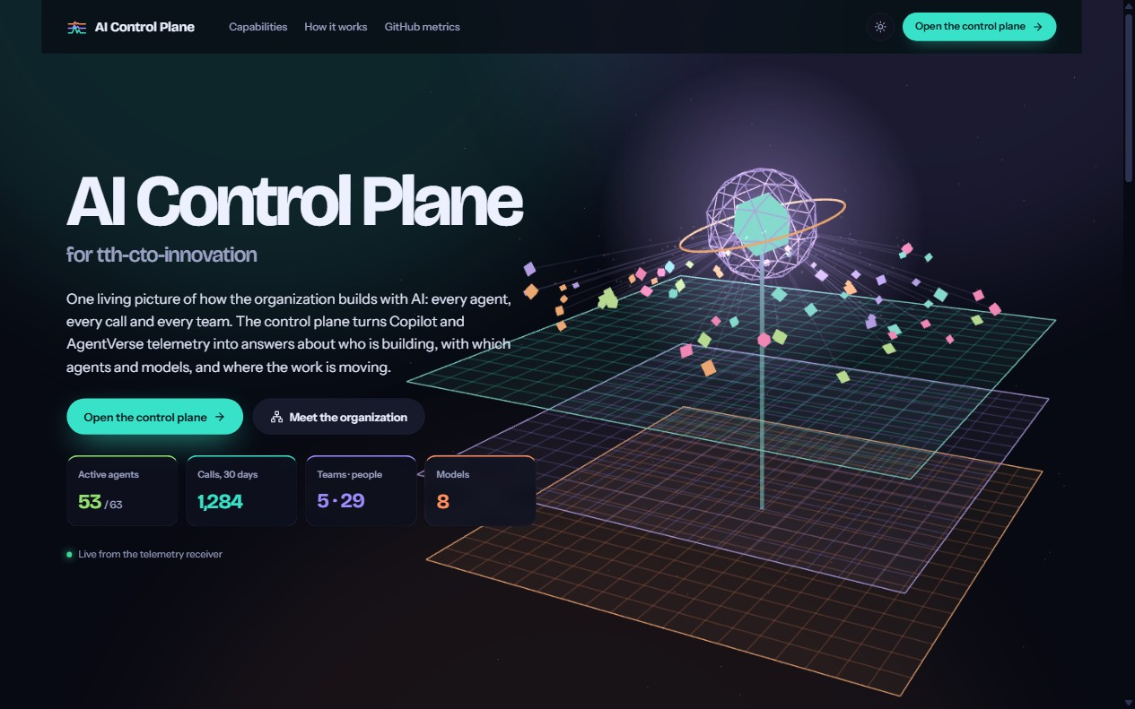
Client presentation · tth-cto-innovation
AI Control
Plane
See how your organization really builds with AI: every agent, every call, every team, live.
Agents
People & teams
Models
Built on Copilot and AgentVerse telemetry. Live product screenshots throughout.
AI Control Plane
Notes:
Open with the landing page running live behind you.
"Your teams use AI every day. Today we will show you what that actually looks like, live, and the decisions it lets you make."
Let the 3D scene play for a few seconds: three control planes (cost, tokens, calls), the AI core, and the agents orbiting it with data flowing in.

Slide 2
02
What the world has today
AI moved from a few people trying Copilot to whole teams working with agents.
63
8
29 · 5
agents in our DevJourney catalogue
models used in 30 days
people across five teams
Development, Assurance & testing, Modernisation, Data
GPT-4o, GPT-4o mini, Claude Sonnet and more
Data, AI, Cognitive core, Rapid labs, Innovation
The hard part is no longer using AI. It is seeing it, managing it and proving its value.
Live snapshot from the AI Control Plane, 31 Oct 2026, last 30 days. Team memberships are demo assignments; cost is an estimate.
AI Control Plane
Notes:
"Adoption is not the problem anymore. Look at our own numbers: 63 agents in the catalogue, 8 models in use within 30 days, 29 people across 5 teams."
"With that much AI in play, leaders lose sight of what is really happening. The hard part is no longer using AI; it is seeing it, managing it and proving its value."

Slide 3
03
The questions leaders cannot answer today
Each one needs per-call data joined to people, teams and our own agent catalogue.
Adoption
We built 63 agents. Which ones are actually used, and which are shelfware?
Teams
Which teams are adopting AI, and which are falling behind?
Cost
What does it cost, and who or what is driving that cost?
Models
Which models do we depend on, and are they fast enough?
Now
What happened today, not two days ago?
Today this data is spread across tools, or simply not collected.
AI Control Plane
Notes:
Walk through the five questions. Ask the client: "How many of these can you answer right now, with data, for today?"
"Every one of them needs data at the level of a single agent call, joined to people, teams and your own agent catalogue. That data usually is not in one place."

Slide 4
04
What exists today, and where it stops
Option
Good at
Where it stops
GitHub Copilot usage metrics
Adoption: active users, acceptance rates, lines of code; breakdowns by model, feature and IDE
Daily reports, usually 1–3 days behind. Built around Copilot features, not our own agent catalogue. No per-call tokens or latency per custom agent; no team hierarchy built in.
LLM app observability
(LangSmith, Langfuse, Helicone, Datadog LLM Obs.)
Tracing production LLM apps that developers instrument themselves
Built for one app's developers, not for leaders steering AI use across an organization. They do not know our teams or our agent catalogue.
Spreadsheets and surveys
Cheap and familiar
Manual, slow, and based on opinion rather than measurement.
The gap: nothing shows leadership how the whole organization uses its own agents, live.
GitHub Copilot metrics: GitHub Docs and changelog (metrics GA, Feb 2026). Our GitHub Metrics page shows those reports side by side.
AI Control Plane
Notes:
Keep this respectful: we complement these tools.
"GitHub tells you whether people use Copilot. Observability tools tell developers whether their app works. Nothing tells leadership how the whole organization uses its own agents, live. That is the gap we fill."
If asked: GitHub's metrics are daily with a 1–3 day lag and focus on Copilot features; we include them on our GitHub Metrics page.

Slide 5
05
Our solution
The AI Control Plane turns Copilot and agent telemetry into a live map of agents, people, teams and models, so leaders act on facts the same day.
1 Capture
2 Understand
3 Act
VS Code Copilot sends each AI call as it happens using OpenTelemetry, the industry standard. Our own Python agents send the same with one small wrapper.
A receiver records tokens, latency, model and person for every call, links it to the right team and catalogue agent, and estimates cost.
One dashboard: Overview, Organization, Catalog, Models and Activity, with GitHub's own metrics side by side.
AI Control Plane
Notes:
"In one sentence: the AI Control Plane turns Copilot and agent telemetry into a live map of agents, people, teams and models, so leaders can act on facts the same day."
Then the three layers: capture with open standards, understand by joining calls to teams and our catalogue, act through one dashboard.

Slide 6
06
How it works
From a prompt in VS Code to a decision in the control plane, in seconds.
1
2
3
4
Copilot in VS Code
OTLP receiver
Ledger
AI Control Plane
Agents and chat export OpenTelemetry spans as people work
Calls, tokens, latency and identities are recorded and priced
Usage is joined with teams and the DevJourney catalogue
One live picture of agents, people, teams and models
One org-wide policy
Private by design
Live
A single GitHub managed-settings policy turns on capture and identity for everyone. Nobody configures their own machine.
Prompt and code content are never captured (captureContent is off and locked). We measure activity, not content.
New calls appear on the next refresh, every 30 seconds by default.
AI Control Plane
Notes:
Explain the pipeline left to right.
Stress privacy: "Your code and prompts never leave the developer. We record who, which agent, which model, how many tokens and how long, never what was written."
Roll-out is one organization policy, not per-developer setup.

Slide 7
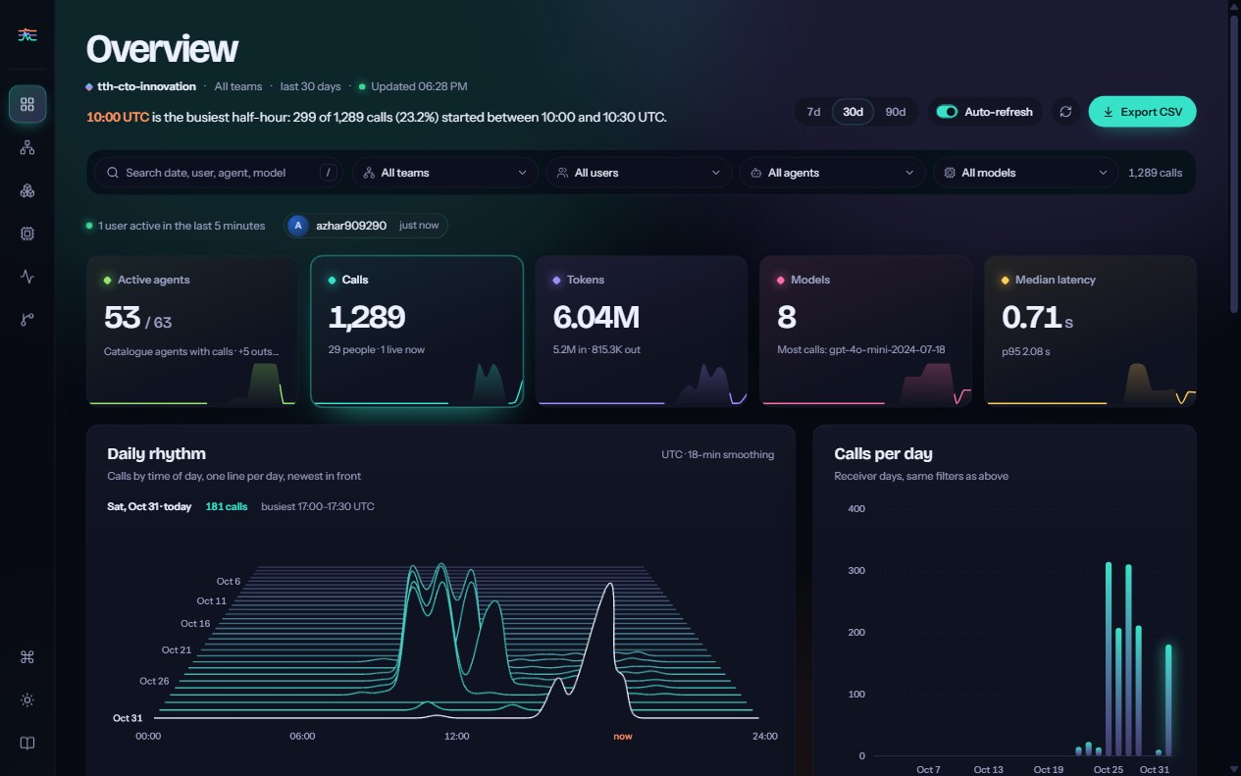
07
Overview: the morning briefing
Five cards answer how much of our AI investment is used, how heavily, on what, and how fast.
● Active agents 53 / 63: 84% of the catalogue in use
● ≈1,290 calls from 29 people
● 6.0M tokens: 5.2M in, 0.8M out (about 6 : 1)
● 8 models; GPT-4o mini handles the most calls
● 0.71 s median latency; slowest 5% above ≈2.1 s
Example: 10 agents had no calls in 30 days: a training gap or candidates to retire.
Live snapshot from the AI Control Plane, 31 Oct 2026, last 30 days. Team memberships are demo assignments; cost is an estimate.
AI Control Plane
Notes:
Demo: /dashboard.
"In ten seconds you know how much of your agent investment is used, how heavily, on which models, and whether it is fast enough."
Point to Active agents 53/63: "Ten agents had no calls this month. That is either a training gap or agents we can retire. Before, nobody could tell."
Click Calls and Tokens to switch the 3D daily rhythm and the per-day bars.

Slide 8
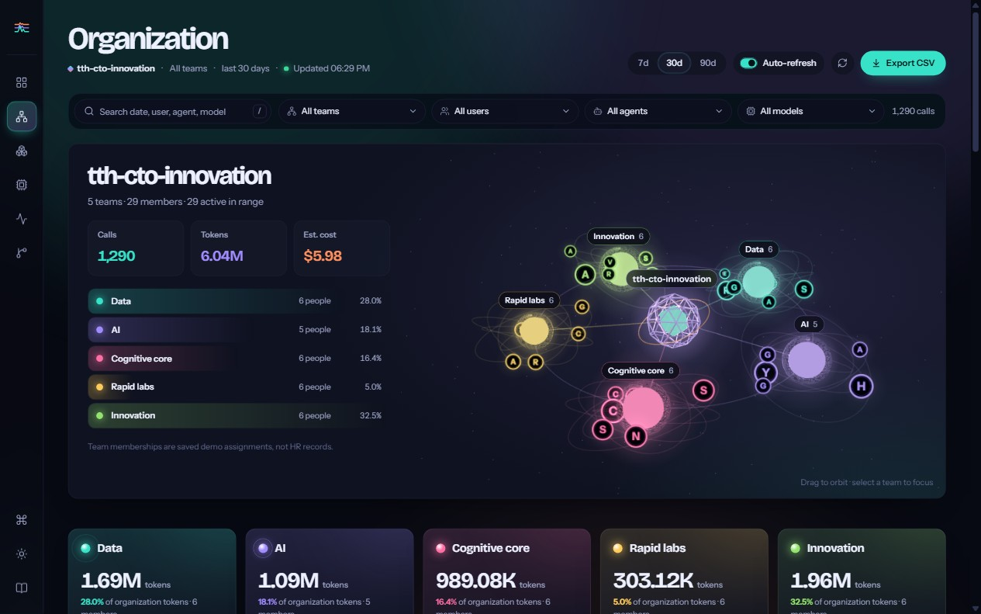
08
Organization: adoption by team
tth-cto-innovation at the core, five teams in orbit, every person a badge circling their team.
● Innovation ≈32% of tokens
● Data ≈28%, AI ≈18%, Cognitive core ≈16%
● Rapid labs ≈5%: six people, only a dozen calls
● One click on a team focuses the whole dashboard
● Team pulse, leaders and members below the map
Example: Pair an Innovation power user with Rapid labs, then watch their pulse rise next week.
Live snapshot from the AI Control Plane, 31 Oct 2026, last 30 days. Team memberships are demo assignments; cost is an estimate.
AI Control Plane
Notes:
Demo: Organization view. Drag to orbit, then click Rapid labs.
"Low usage is not bad in itself, but now it is a conversation with data: do they need training, different agents, or is AI not useful for their work yet?"
Example action: pair a strong Innovation user with Rapid labs for an enablement session, then watch the Team pulse chart next week.
Note: team memberships here are demo assignments; production uses the real team directory.

Slide 9
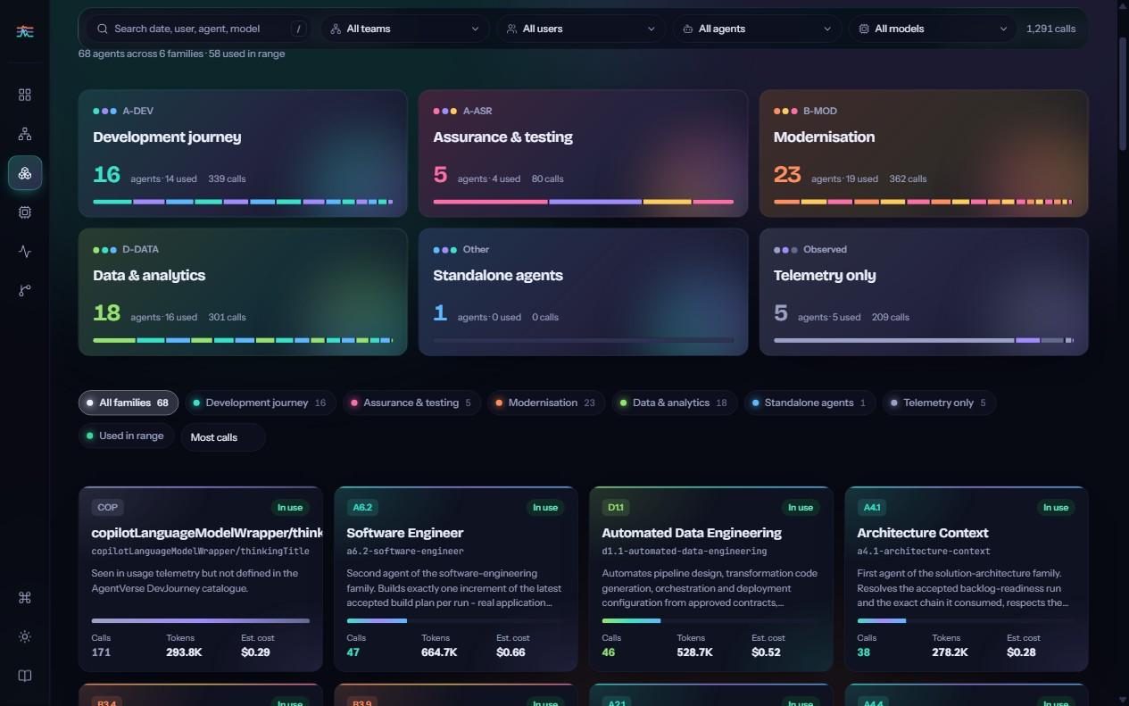
09
Catalog: return on our agent investment
Every DevJourney agent, grouped into families, with the calls, tokens and people behind it.
● Modernisation (B-MOD): 19 of 23 agents used, ≈360 calls
● Development journey (A-DEV): 14 of 16 used
● Assurance & testing (A-ASR): 4 of 5 used
● Software Engineer (A6.2): among the busiest agents
● 5 agents outside the catalogue are in use: unregistered tools
Example: Demand is in Modernisation: fund the next agents there first.
Live snapshot from the AI Control Plane, 31 Oct 2026, last 30 days. Team memberships are demo assignments; cost is an estimate.
AI Control Plane
Notes:
Demo: Catalog. Click the Modernisation family, then open an agent tile to show its details panel and who uses it.
"This is product management for internal AI: which agents earn their place, which need promotion, and where people are building their own."
Example action: "Modernisation is busy, so fund the next Modernisation agents first; review the idle ones before building more of that kind."

Slide 10
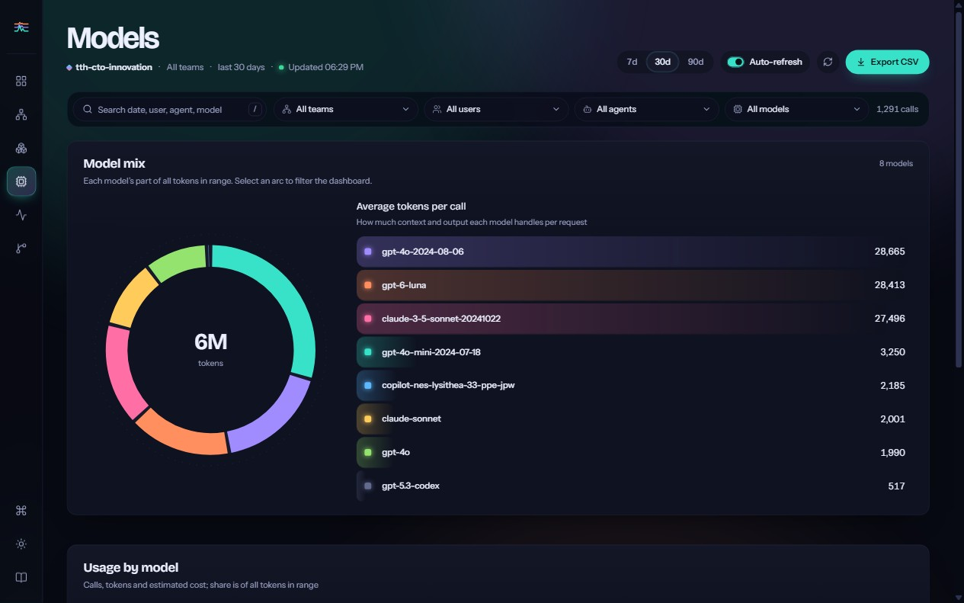
10
Models: cost and performance
Token mix, average tokens per call and latency for every model in use.
● Token share per model at a glance
● ≈28,000 tokens per call on the heaviest models
● ≈3,500 per call on GPT-4o mini
● 8× more context drives cost and wait time
● Cost is an estimate for comparing models, not an invoice
Example: Route routine work to lighter models; keep premium models for complex tasks.
Live snapshot from the AI Control Plane, 31 Oct 2026, last 30 days. Team memberships are demo assignments; cost is an estimate.
AI Control Plane
Notes:
Demo: Models. Hover the donut arcs; point at average tokens per call.
"If one model uses eight times more context per call, that is where cost and wait time come from. Now you can decide which work deserves the premium model."
If asked: cost uses a flat $0.99 per million tokens; real provider pricing can be added.

Slide 11
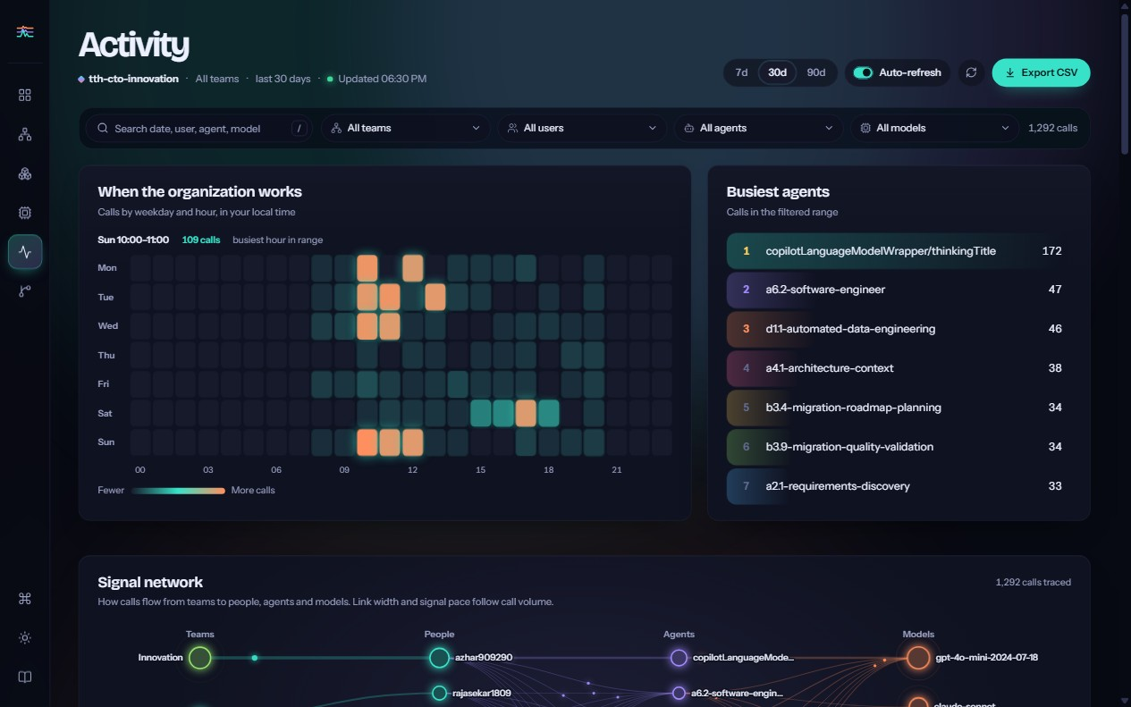
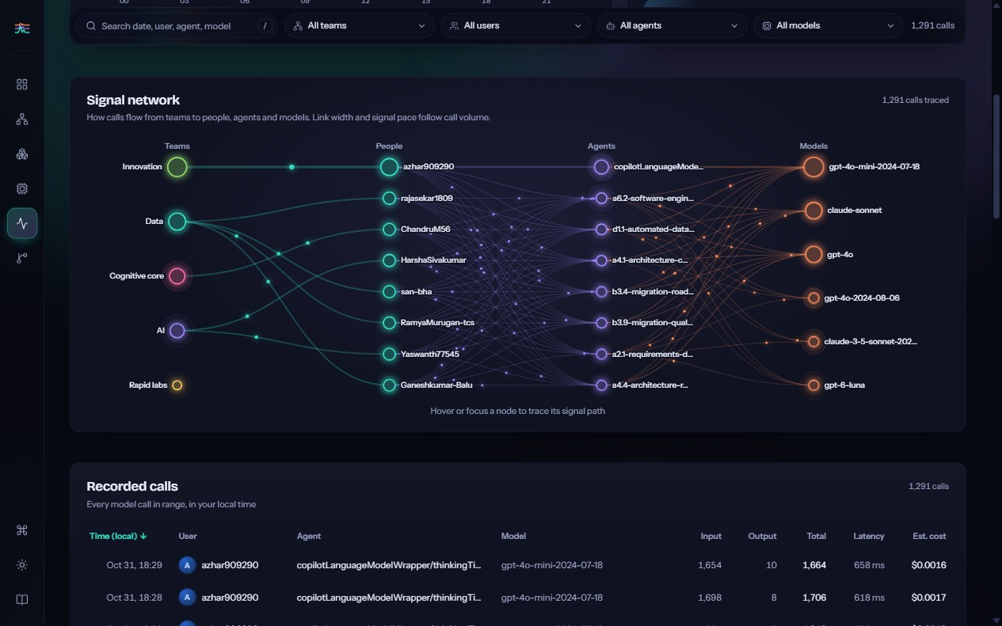
11
Activity: when and how the work flows
A weekday × hour heat field and a live signal network from teams to people, agents and models.
● Busiest hour: Sunday 10:00–11:00, a sign of deadline crunches
● Hover a person: trace their path, e.g. Data → rajasekar1809 → agents → models
Live snapshot from the AI Control Plane, 31 Oct 2026, last 30 days. Team memberships are demo assignments; cost is an estimate.
AI Control Plane
Notes:
Demo: Activity.
Heat field: "The busiest hour (for example Sunday 10:00–11:00) points to deadline crunches and unusual working patterns."
Signal network: hover a person to light up their exact path through teams, agents and models. Link width and signal pace follow real call volume.
Recorded calls below: every call with time, person, agent, model, tokens, latency and cost, exportable to CSV.
"When something spikes or slows down, you can find who, which agent and which model in seconds."

Slide 12
12
What makes it different
Built around your agents
Built around your organization
Usage matched to the AgentVerse catalogue: coverage like 53 of 63, not just "agent mode was used".
Organization → team → person, with one-click focus and team exports.
Live, not days late
Detail on every call
Calls appear within about 30 seconds instead of daily reports 1–3 days behind.
Tokens, latency and estimated cost per call, person, agent and model.
Private
Open standards
No prompt or code content is collected, by policy.
OpenTelemetry: the same receiver serves Copilot and our own Python agents.
Works alongside GitHub
GitHub's official metrics sit in the same app.
AI Control Plane
Notes:
Seven reasons, the first three matter most: our own agents, our own organization, and live data.
"We are not replacing GitHub's metrics; we add the layer leadership is missing."

Slide 13
13
Who uses it, and how
CTO and leadership
Monthly review of adoption, return on agents and model mix
Engineering managers
Team adoption, enablement, spotting who needs help
AI platform team
Which agents to build next or retire, unregistered tools, model performance
Finance and FinOps
Cost trends by team, agent and model; CSV exports for chargeback
Governance
Which models are in use and by whom, with a call-level audit trail and no content
AI Control Plane
Notes:
Map each audience to a view: leadership → Overview; managers → Organization; platform team → Catalog and Models; finance → CSV exports; governance → Activity and Models.

Slide 14
14
A day with the AI Control Plane
Every decision below used to be a guess. Now each one takes a minute.
9:00
CTO opens the Overview: 53 of 63 agents active, calls up this week.
9:05
Organization view shows Rapid labs at 5%; a 30-minute enablement session is booked.
11:00
Platform team sees Modernisation is busiest and two Assurance agents idle; the backlog is reprioritized.
15:00
Latency rises; Models and Activity show one model slowing, so routine work moves to a faster model.
Month end
Finance exports the team CSV for cost allocation.
AI Control Plane
Notes:
Tell it as a story. Pause on 9:05 and 11:00: these are the decisions clients care about most (enablement and agent investment).

Slide 15
15
Roll-out and next steps
1
2
3
4
5
Pilot
Real data
Harden
Extend
Review
1–2 weeks: turn on the organization policy and connect the receiver.
Load actual team memberships and the full agent catalogue.
Add sign-in and HTTPS before exposing the receiver beyond localhost.
Wrap custom Python agents; add real model pricing in place of the flat estimate.
Hold a monthly AI adoption review driven by the dashboard.
You have invested in AI agents. The AI Control Plane shows you, live, whether that investment is working, and what to do next.
AI Control Plane
Notes:
Close with the plan and the line: "You have invested in AI agents. The AI Control Plane shows you, live, whether that investment is working, and what to do next."
Ask for the pilot: one organization, one policy, two weeks.

Slide 16
16
Questions we expect
Do you read our code or prompts?
No. Content capture is off and locked by policy; we record activity only.
Is the cost exact?
No. It is an estimate for comparing relative cost; exact billing comes from the provider invoice.
Why not just use GitHub's metrics?
We include them. They show Copilot adoption; we add our own agents, teams, per-call tokens and latency, live.
What if someone turns telemetry off?
Their calls will not appear, which is why the organization policy matters.
Are the teams real?
In this demo they are assigned at random. In production they come from your team directory.
AI Control Plane
Notes:
Keep answers short and honest. The two most common: privacy (no content) and cost accuracy (estimate, comparable, not an invoice).

Slide 17
See the whole
organization
at once
Agents, people, teams and models, live from the receiver.
Live demo: /dashboard
Thank you · Questions
Suggested 10-minute demo: Landing → Overview → Organization (Rapid labs) → Catalog (Modernisation) → Activity (signal network) → GitHub metrics.
AI Control Plane
Notes:
Suggested 10-minute demo order:
1. Landing page (1 min)
2. Overview (2 min)
3. Organization: click Rapid labs (2 min)
4. Catalog: Modernisation and unregistered agents (2 min)
5. Activity: hover a node in the signal network (2 min)
6. GitHub metrics side by side (1 min)

