Slide 1


ESTUDENT
FYP-II MID EVALUTAION
MUDASSIR WAHEED
ABDUL ALEEM
AZHAR ALI

Slide 2



OVERVIEW
Student Authentication
Timetable Management

Slide 3





GOALS AND OBJECTIVES
Objective n° 1
Objective n° 2
Objective n° 3
Ensuring security
Digitizing old concepts
Facilitating students through schedule management

Slide 4
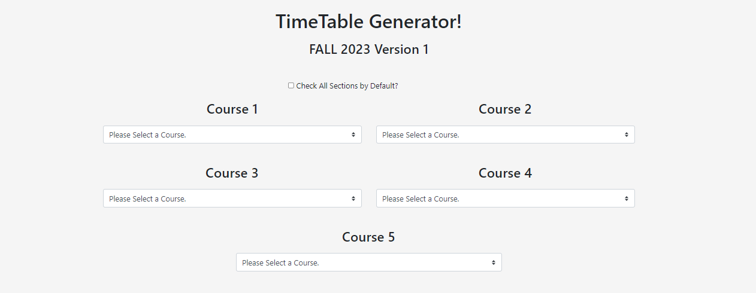

Slide 5
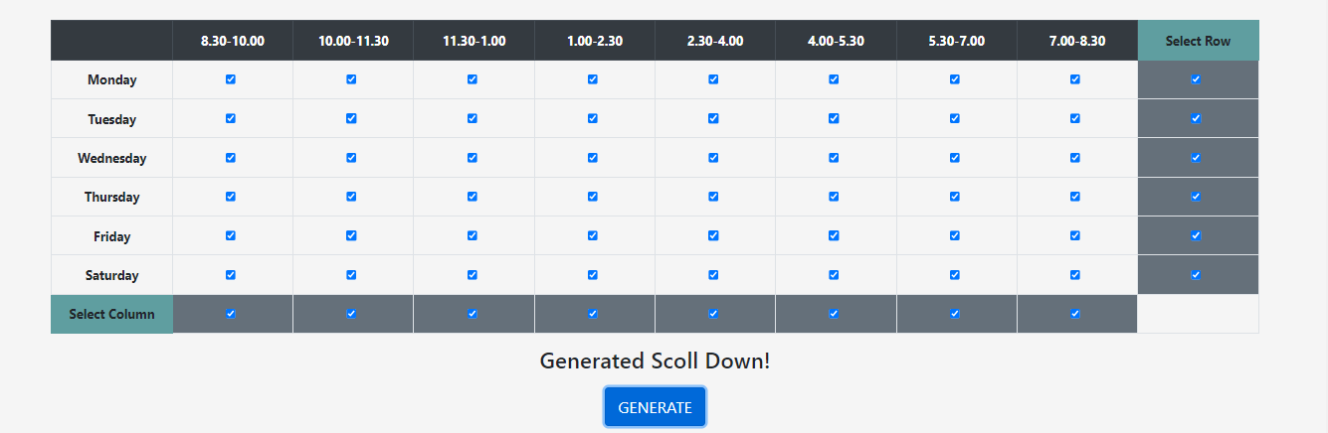

Slide 6
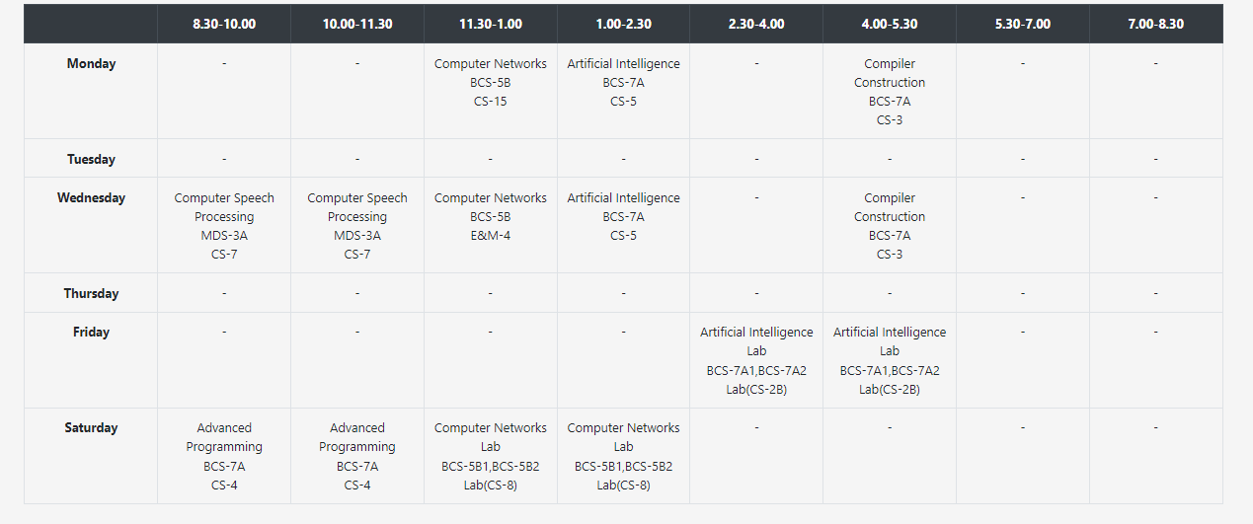

Slide 7

ITERATIONS
01
02
03
04
Diagrams (UML Diagram, Use Case Diagram)
Designed a Poster
Worked on Facial Recognition Module
Timetable management
App development
Integration
Testing
Deployment

Slide 8

DEMO

Slide 9
THANK YOU!
Ceo Of Ingoude Company

