Slide 1
Banking System
Father’s Bank

Slide 2
Team #04
Hosen Md Anwar (20243204)
Hossain Md Arafat (20243215)
Md Shoheb Islam (20243202)
Islam Taohidul (20243225)
Bahronov Javohir Bakhtiyor Ugli (20243289)
Azad Al-Rafi (20243233)

Slide 3
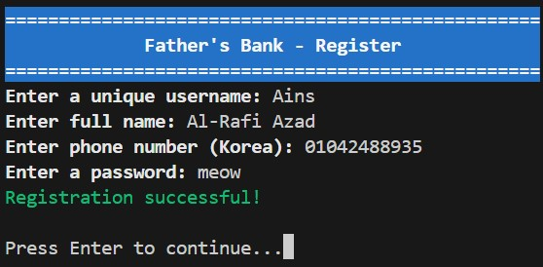
User Registration

Slide 4
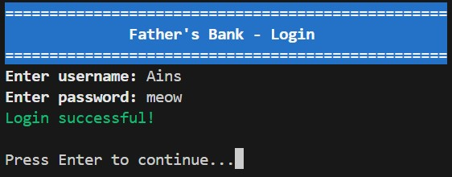
Users Login System

Slide 5
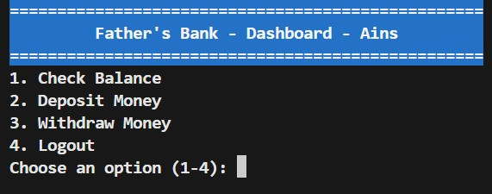
Logged in Users Menu

Slide 6
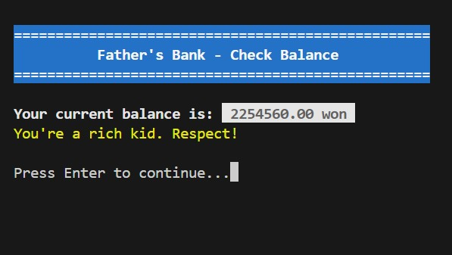
User Balance Check

Slide 7
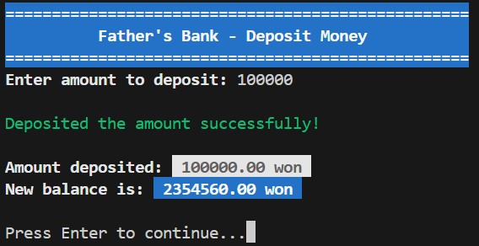
Money Deposit

Slide 8
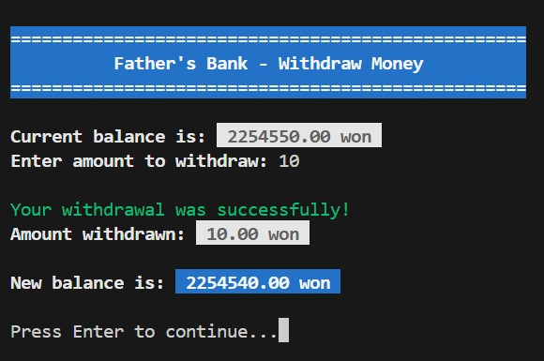
Money Withdraw

Slide 9
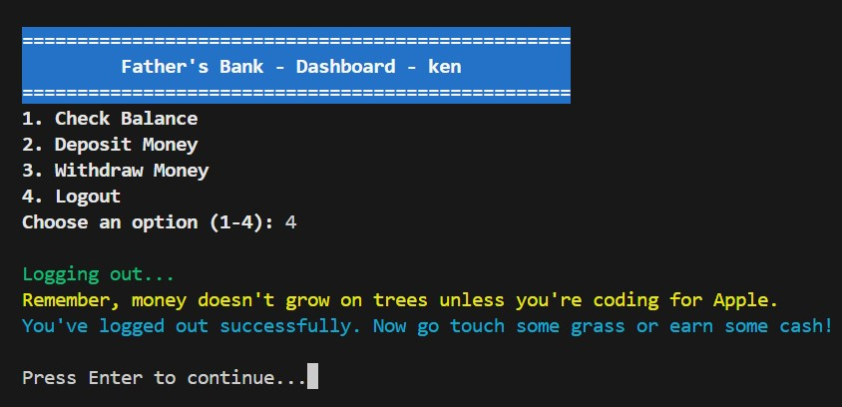
Log Out

Slide 10
Thank you

