Slide 1
Restaurant Management System with Voice Assistant
SmartPanda

Slide 2
Team #06 Parenthesis
Hosen Md Anwar (20243204)
Hossain Md Arafat (20243215)
Azad Al-Rafi (20243233)
Islam Taohidul (20243225)

Slide 3
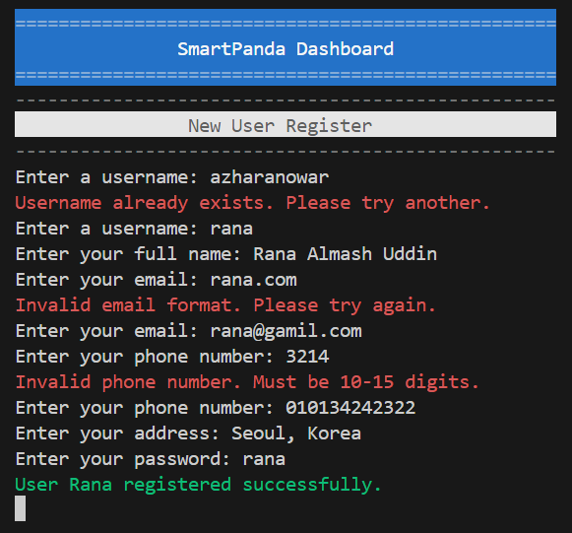
User Registration Error Handling

Slide 4
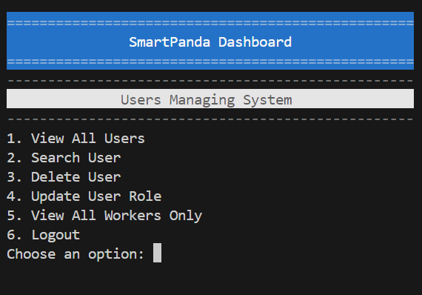
Users Management System (Admin only)
View All Users
Search User by Name, Username etc.
Delete User
Update User
View Workers(Admin, Manager, Staff)

Slide 5
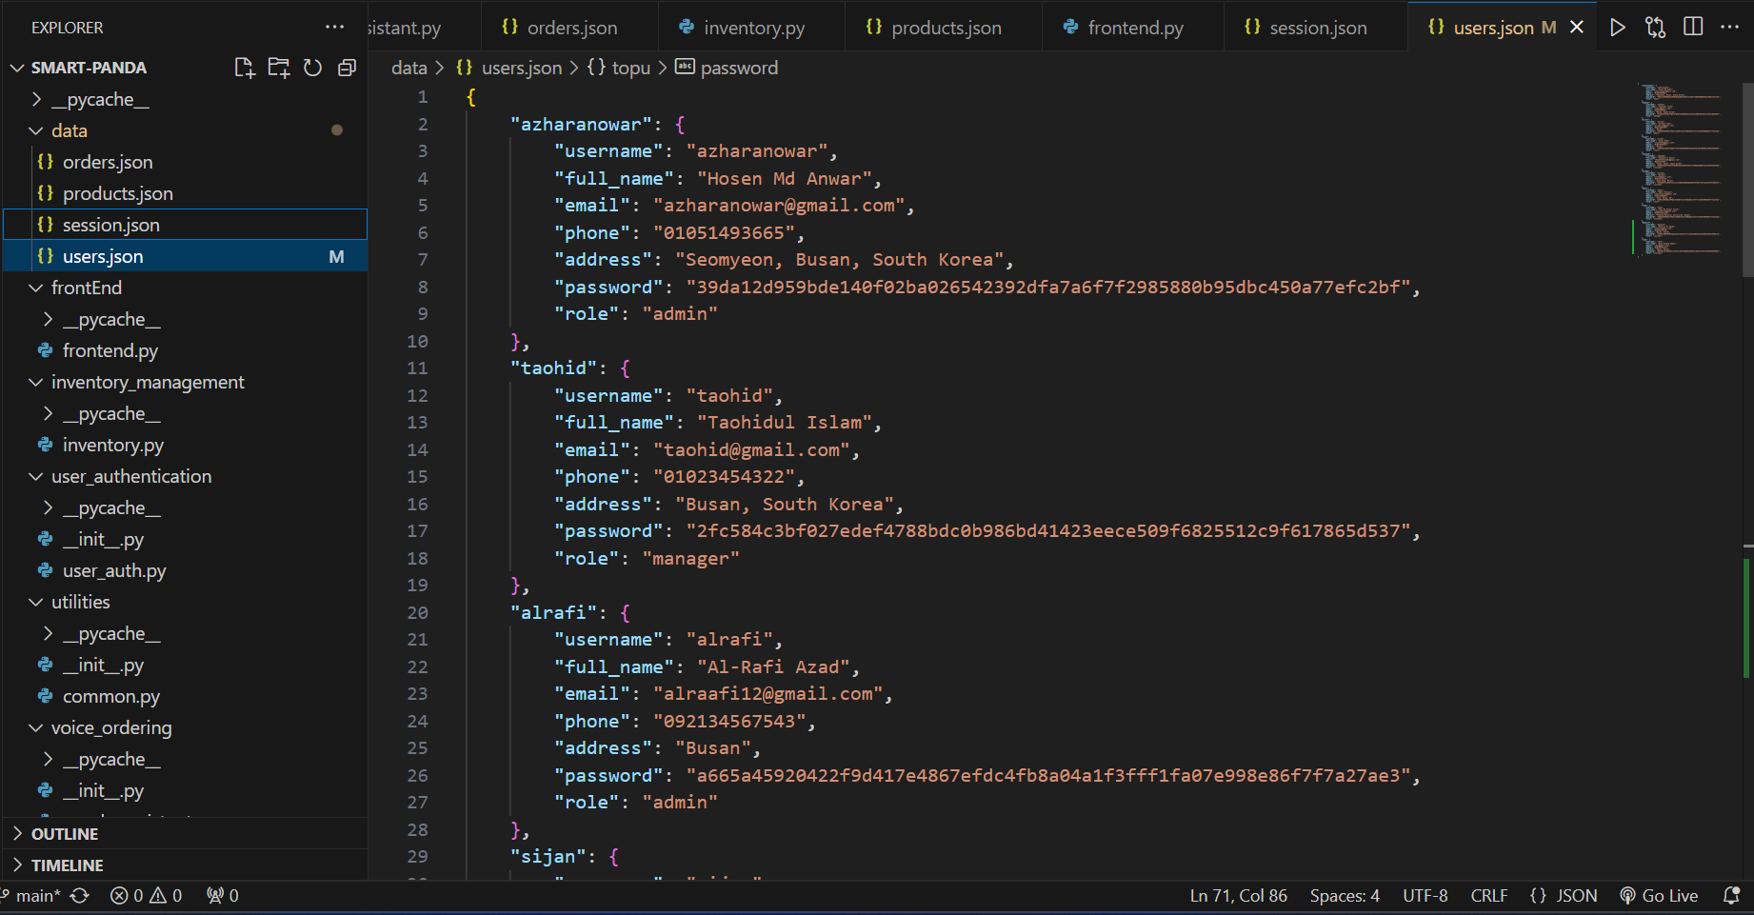
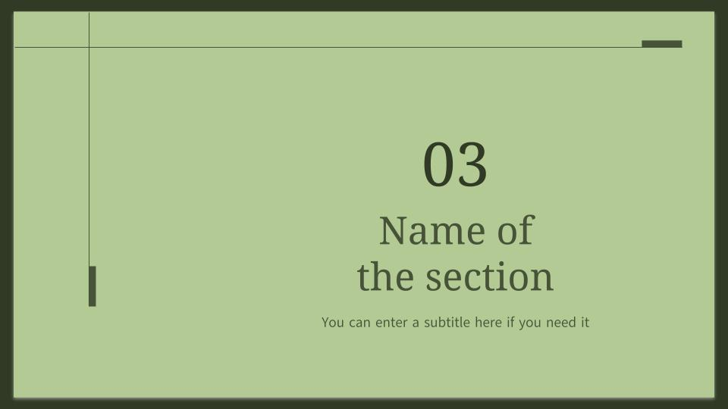
Users and Session Data Save

Slide 6
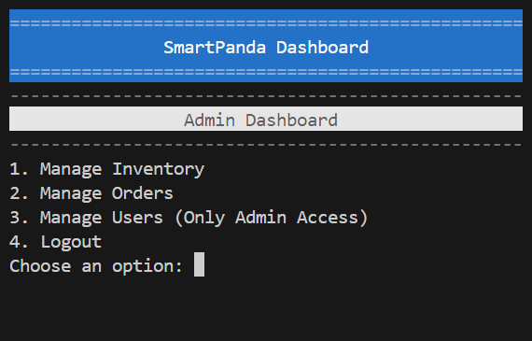
Inventory Management (Products BackEnd)

Slide 7
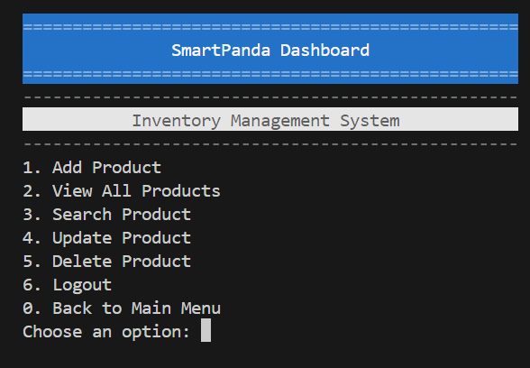
Inventory Management
Add Product
View All Products
Search Product
Update Product
Delete Product

Slide 8
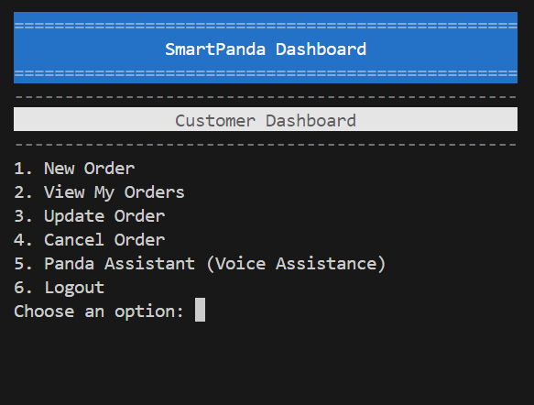
Customer Dashboard (FrontEnd)
Placing New Order
View My Orders (current users)
Update Order(Cancelling current and placing new one
Cancel Order

Slide 9
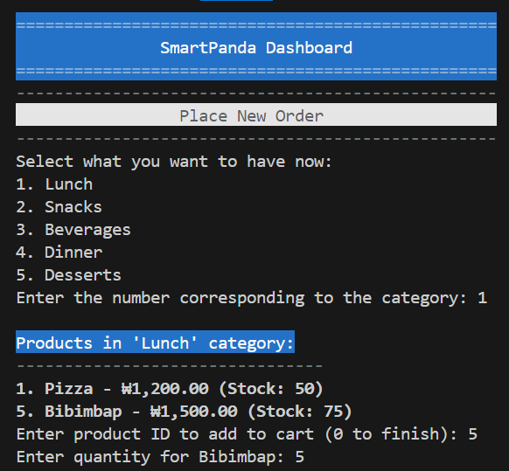
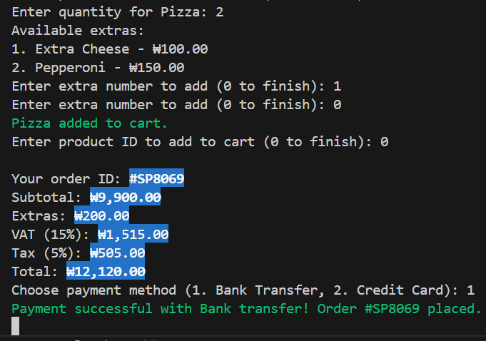
Order Placing with Unique ID #SP****

Slide 10
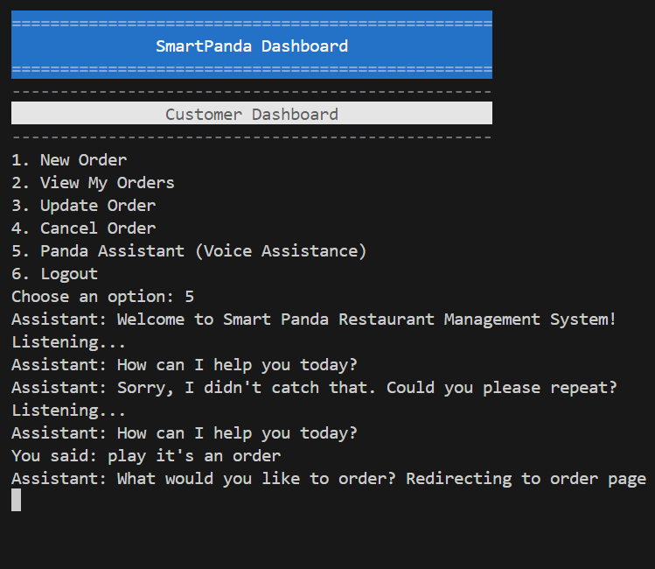
Voice Assistant for Guiding User
Redirecting to menu page
Redirecting to order page
Redirecting to my orders page
Redirecting to Update, and
Redirecting to Cancel order page

Slide 11
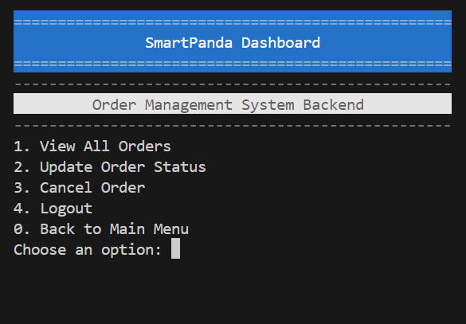
Order Management for Backend
View all Orders with Total Sell Amount
Update Status: Pending, Completed, and Cancelled
Cancel Order from Admin

Slide 12
Thank you

