Slide 1
Breast Cancer Diagnostic Assistant
Advanced Machine Learning for Clinical Decision Support
Dataset: Wisconsin Breast Cancer (Diagnostic)
Presented by: [Your Name]

Slide 2
Presentation Outline
1. Problem Definition & Dataset
2. Exploratory Data Analysis (EDA)
3. Data Preprocessing & Pipeline
4. Model Selection & Training
5. Performance Evaluation
6. Clinical Application (Streamlit)
7. Conclusion & Future Scope

Slide 3
Step 1: Problem Definition
Objective: Early and accurate detection of breast cancer.
Clinical Significance: Breast cancer is the most common cancer among women globally.
Machine Learning Goal: Binary classification (Malignant vs. Benign).
Target Audience: Clinicians and healthcare providers.

Slide 4
Dataset: Wisconsin Breast Cancer
Source: UCI Machine Learning Repository
Total Instances: 569 patients
Total Features: 30 numeric diagnostic features
Feature Categories: Mean, Standard Error, and 'Worst' measurements of cell nuclei.
Class Distribution: 212 Malignant, 357 Benign.

Slide 5
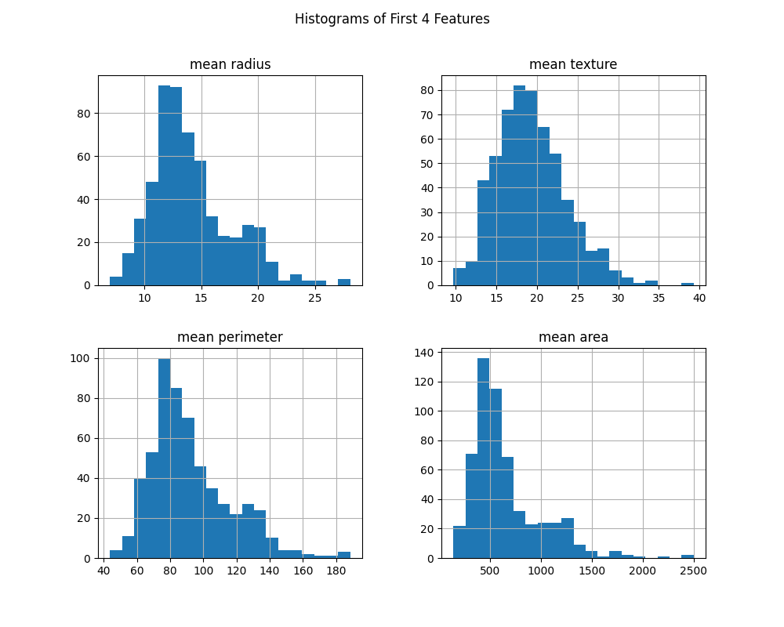
Step 2: EDA - Feature Distributions
Analysis: Most features exhibit normal or log-normal distributions. Scaling is required due to varying magnitudes.

Slide 6
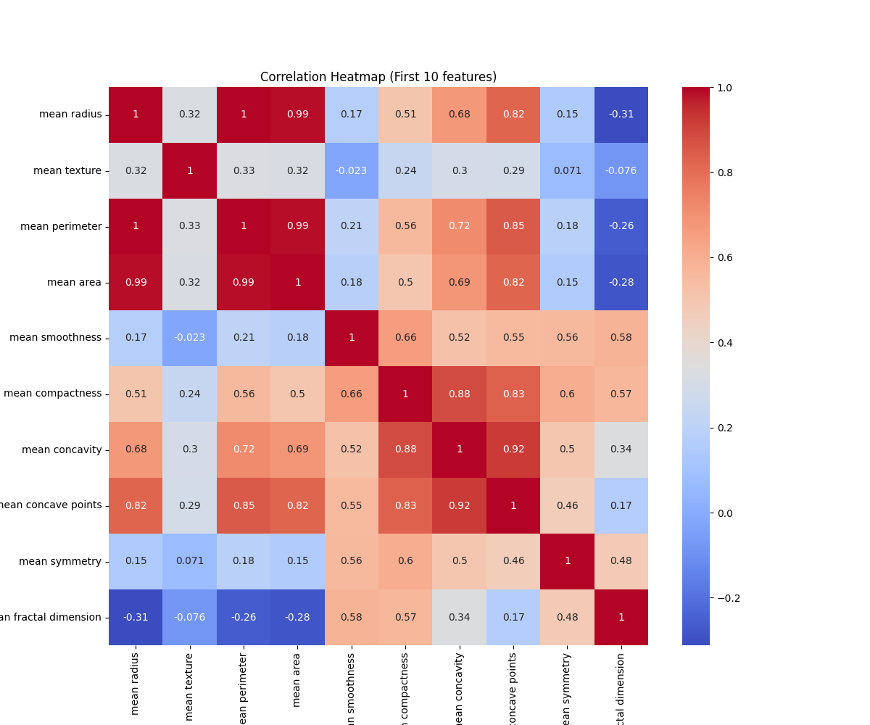
Step 2: EDA - Correlation Heatmap
Insight: High correlation observed between 'radius', 'perimeter', and 'area'. This suggests multicollinearity which we must handle.

Slide 7
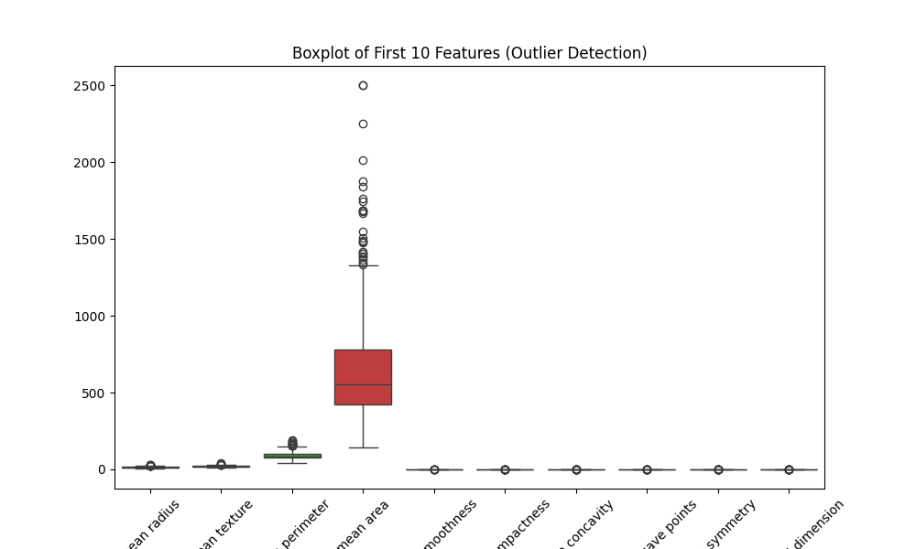
Step 2: EDA - Outlier Detection
Observation: Presence of outliers in several features. Robust models or proper scaling are necessary.

Slide 8
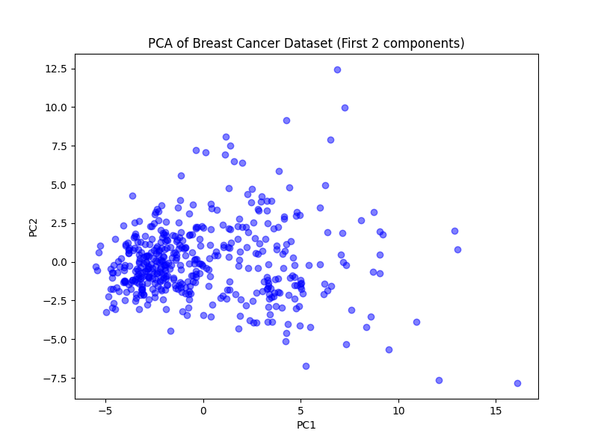
Step 2: EDA - PCA Visualization
Result: Clear separation between Malignant and Benign clusters in 2D space using PCA.

Slide 9
Step 3: Data Preprocessing Pipeline
1. Data Cleaning: No missing values detected.
2. Feature Engineering: Separation of 30 clinical features.
3. Data Scaling: Used StandardScaler (Z-score normalization).
4. Data Splitting: 80/20 train-test split with stratification.

Slide 10
Step 4: Model Selection & Training
Multiple models were evaluated to find the most reliable classifier:
Logistic Regression: Baseline model with L2 regularization.
Random Forest: Ensemble of decision trees to capture non-linearities.
Soft Voting Ensemble: Combining both for robust predictions.
Optimization: Hyperparameter tuning via GridSearchCV.

Slide 11
Step 5: Performance Evaluation
Best Performing Model: Logistic Regression (C=1)
Accuracy: 97.4%
Precision: 97.2% (Minimizing False Positives)
Recall: 98.6% (Minimizing False Negatives - CRITICAL)
F1-Score: 0.98

Slide 12
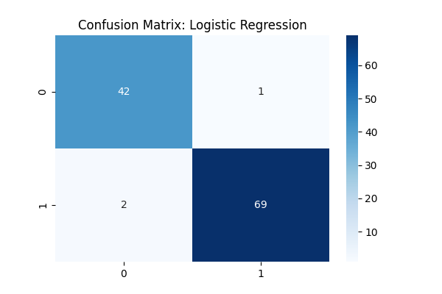
Evaluation: Confusion Matrix
Interpretation: High recall ensures very few malignant cases are missed, which is vital in medical diagnostics.

Slide 13
Step 6: Clinical Deployment
The model is deployed as an interactive web application.
Features: Real-time prediction and diagnostic confidence scores.
Ease of Use: Interactive sliders for all 30 diagnostic metrics.
Transparency: Integration of performance metrics for clinical trust.

Slide 14
Conclusion
Project Summary:
Achieved 97.4% accuracy in classification.
Developed a fully functional, deployment-ready diagnostic tool.
Established a robust ML pipeline from data to deployment.

