Slide 1
Job Portal System
Presented by
Md Azhar

Slide 2
Introduction
The Job Portal System is designed to connect job seekers and employers efficiently. It streamlines job searching, applications, and hiring processes with a user-friendly interface.

Slide 3
Objectives
- Provide an intuitive job search and application experience
- Enable efficient job posting and applicant management
- Facilitate skill-based hiring
- Streamline interview scheduling and hiring process

Slide 4
Technologies Used
- Eclipse (IDE for Java development)
- MySQL (Relational Database)
- Java (Core programming language)
- Hibernate (ORM framework for database interactions)

Slide 5
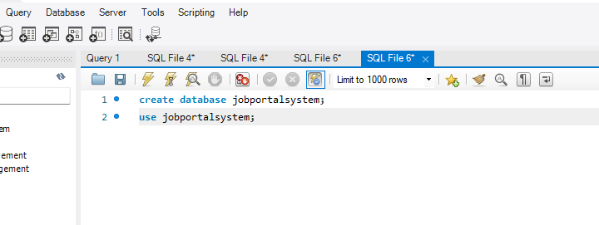
Creating database in MySQL

Slide 6
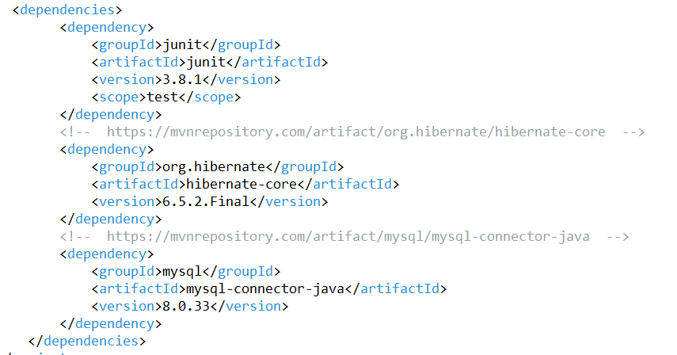
Providing dependies in pom.xml

Slide 7
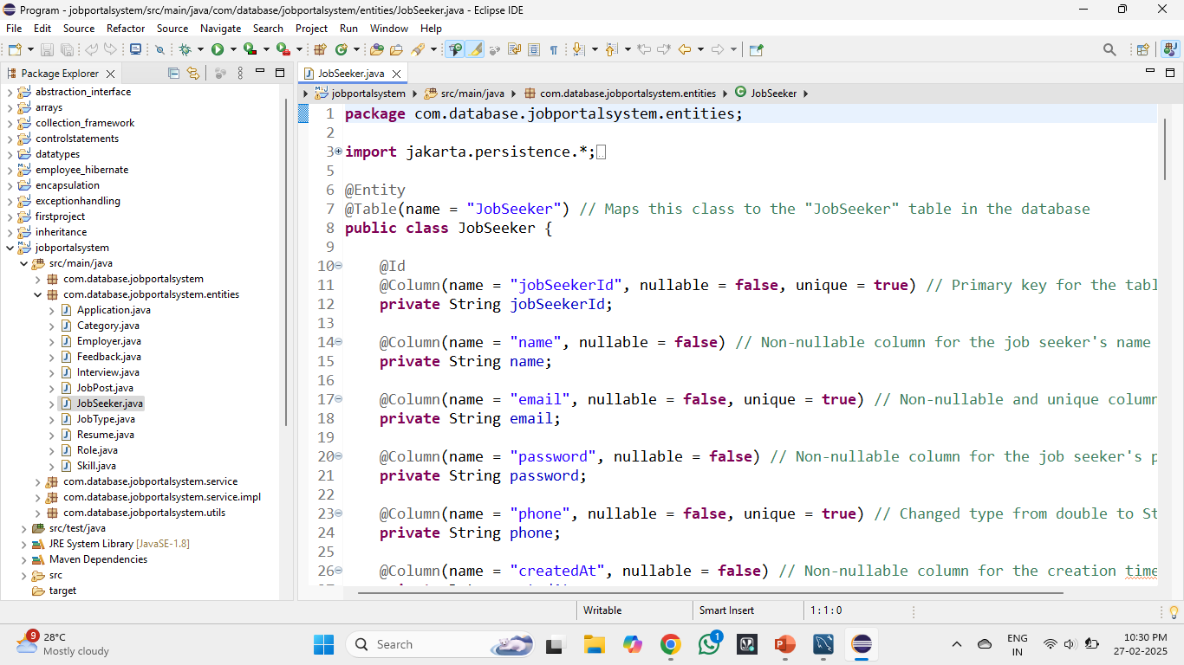
Creating Entities in EntityPackage

Slide 8
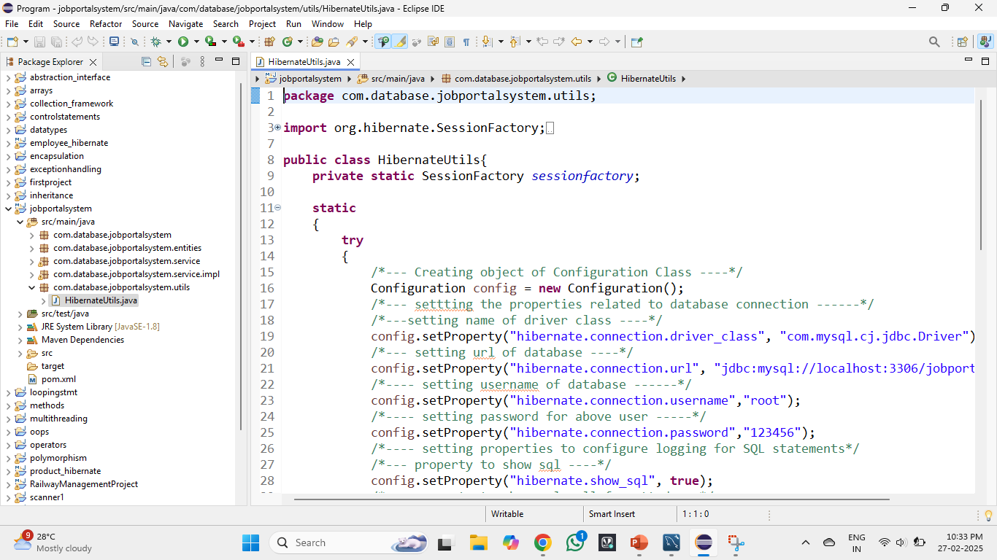
Creating a Utils Package

Slide 9
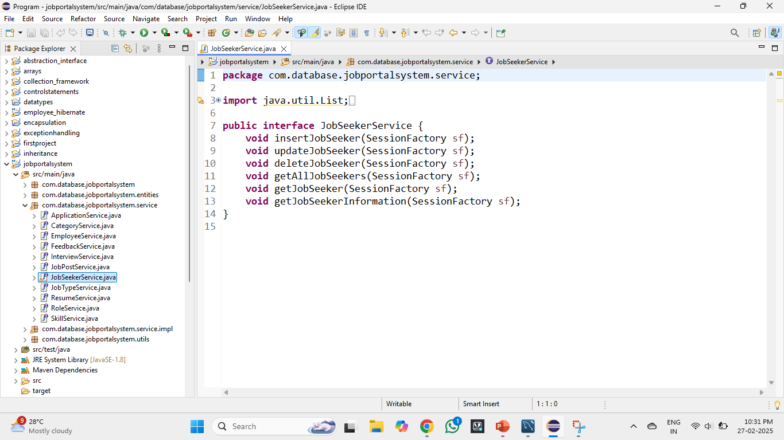
Creating Service Layer

Slide 10
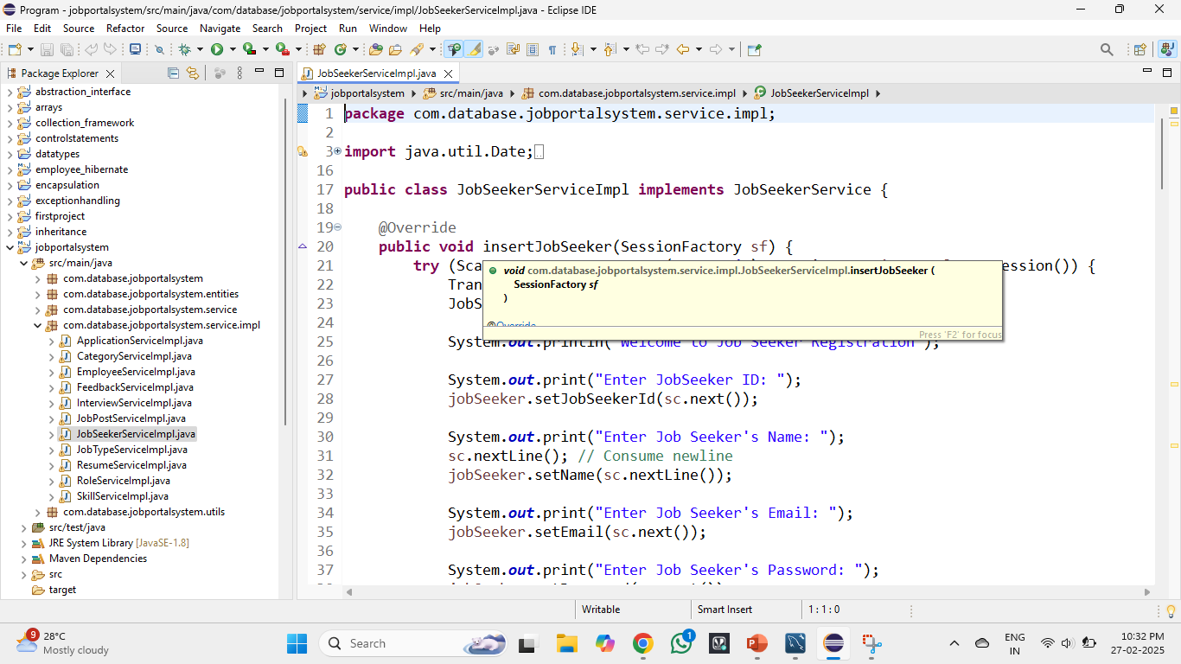
Now the ServiceImplementation

Slide 11
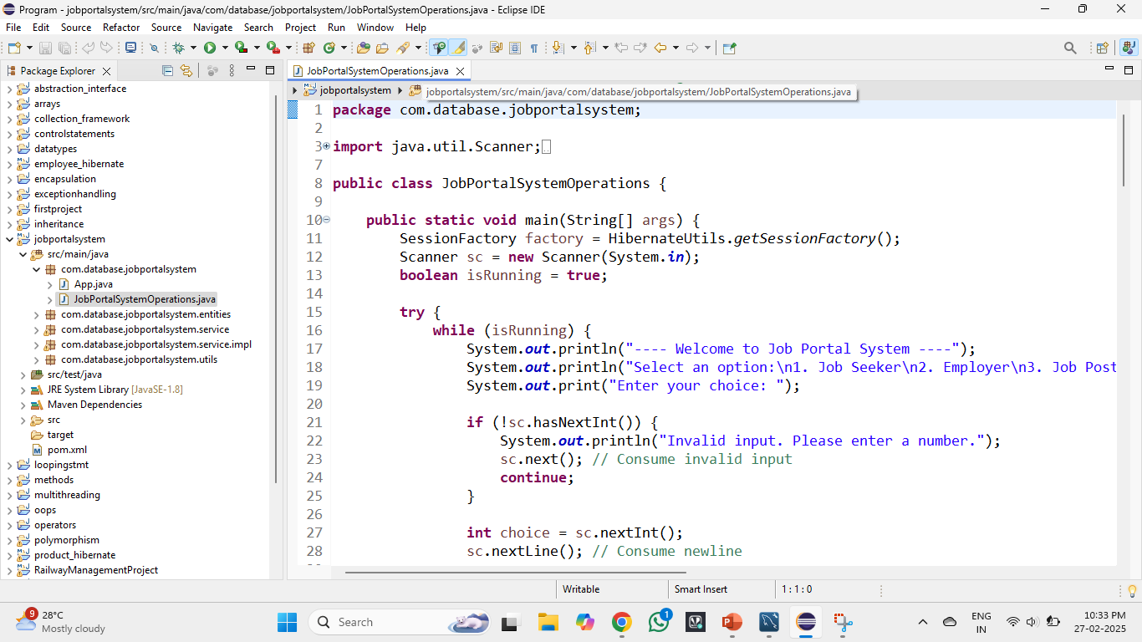
A Main Program for all operations to manage CRUD Operations

Slide 12
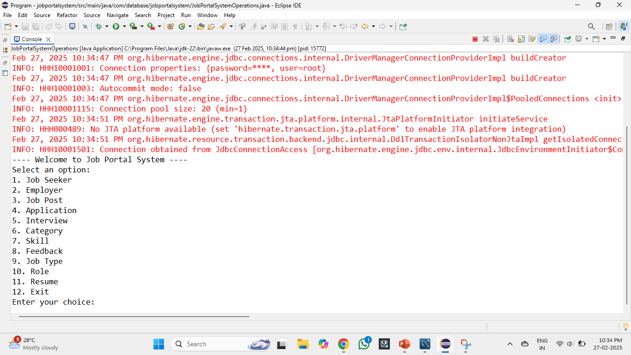
OUTPUT

Slide 13
Conclusion
The Job Portal System simplifies recruitment by providing an efficient platform for job seekers and employers. With an organized structure and user-friendly interface, it enhances job search and hiring experiences.

Slide 14
Thank You
For more queries visit :
https://github.com/azharstar

