Slide 1
Surfaceflinger thread_loop
Sure_yan

Slide 2
Surfaceflinger is a class and also is a thread,This thread is belong to SystemServer process.So, SystemServer process bring up Surfaceflinger thread.
So, we must know something about Android Thread. Each thread need two interface, one is readyToRun() and to init the info. Another is threadLoop() and this funciton is to execute surfaceflinger actions.If this function return true and this thread will call threadLoop(). If return false, thread will exit.

Slide 3
(1) Added this treadpool to system
A executable surfaceflinger in framework/base/cmds/surfaceflinger/main_surfaceflinger.cpp
main()-> publishAndJoinThreadPool()
(2) Start all system threadloop
The entry for android framework thread is framework/base/cmds/system_server
start system_server when system boot in init.rc
main->system_init();->SurfaceFlinger::init();
(3) SurfaceFlinger init.in frameworks/base/services/surfaceflinger/SurfaceFlinger.cpp
Firstly Surfaceflinger class will execute the init() function and show some info.
(4) Surface flinger extend a threads in frameworks/base/libs/utils/Threads.cpp
Thread::run to start the thread running.
run() -> ﻿﻿createThreadEtc(_threadLoop, ...)

Slide 4
__________________________________________________________
| -> readyToRun()
| -> threadLoop() < < < < < < < < < < <
| ^
_threadLoop | -> return true
| ->if threadLoop
| -> return false -> clear thread ID and called by a new thread using the same thread ID as this one.
|
|
__________________________________________________________

Slide 5
(4)SurfaceFlinger readyToRun in frameworks/base/services/surfaceflinger/Surfaceflinger.cpp
___________________________________________________________________
| -> new DisplayHardware(this, dpy) -> init Framebuffer and EGL and get the info. of OpenGL ES
| inframeworks/base/services/surfaceflinger/DisplayHardware/DisplayHardware.cpp
| ->MemoryHeapBase /* create the shared control-block */
|
| ->glEnable /*Initialize | openGL|ES*/
readyToRun |
| ->property_set("ctl.start", "bootanim") Show boot animation
| ____________________________________________________________________

Slide 6
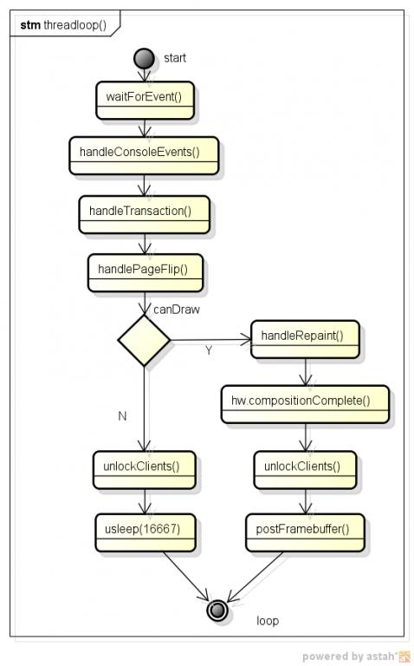
(5)threadLoop()

Slide 7
[Android][DISP][Surfaceflinger][readyTorun]
start SurfaceFlinger::readyToRun in Thread::_threadLoop();-SurfaceFlinger.cpp
DisplayHardware * consthw = new DisplayHardware(this, dpy);-SurfaceFlinger.cpp
DisplayHardware::init() -DisplayHardware.cpp
[Surfaceflinger][DisplayHardware]
1 void DisplayHardware::init(uint32_t dpy)

Slide 8
readyTorun
(1) FramebufferNativbeWindow
__________________________________________________________________________________________________
|
| FramebufferNativeWindow() in frameworks/base/libs/ui/FramebufferNativeWindow.cpp
| -> framebuffer_open()
|FramebufferNativeWindow::FramebufferNativeWindow() -> ->gralloc_device_open in /hardware/libhardware/modules/gralloc/gralloc.cpp
| -> gralloc_open()
| gralloc_device_open in /hardware/libhardware/modules/gralloc/gralloc.cpp
|
| -> malloc(gralloc_context_t); I did`t know the context for this struct
| gralloc_device_open ->
| -> fb_device_open in hardware/libhardware/modulss/grolloc/framebuffer.cpp
| -> open("dev/fbx");
| -> ioctl(FBIOGET_FSCREENINFO) // get fix screen info
| fb_device_open -> mapFrameBuffer() ->->mapFrameBufferLocked()-> ->ioctl(FBIOGET_VSCREENINFO) // get variable screen info
| -> ioctl(FBIOPUT_VSCREENINFO) // put variable screen info
| -> mmap
|__________________________________________________________________________________________________________________________________

Slide 9
readyTorun
FramebufferNativeWindow -> framebuffer_open -> gralloc_open
buffers[0] = new NativeBuffer( fbDev->width, fbDev->height, fbDev->format,GRALLOC_USAGE_HW_FB); buffers[1] = new NativeBuffer( fbDev->width, fbDev->height, fbDev->format,GRALLOC_USAGE_HW_FB); err = grDev->alloc(grDev, fbDev->width, fbDev->height, fbDev->format, GRALLOC_USAGE_HW_FB, &buffers[0]->handle,&buffers[0]->stride); LOGE_IF(err, "fb buffer 0 allocation failed w=%d, h=%d, err=%s", fbDev->width, fbDev->height, strerror(-err)); err = grDev->alloc(grDev, fbDev->width, fbDev->height, fbDev->format, GRALLOC_USAGE_HW_FB, &buffers[1]->handle,&buffers[1]->stride); LOGE_IF(err, "fb buffer 1 allocation failed w=%d, h=%d, err=%s",fbDev->width, fbDev->height, strerror(-err));

Slide 10
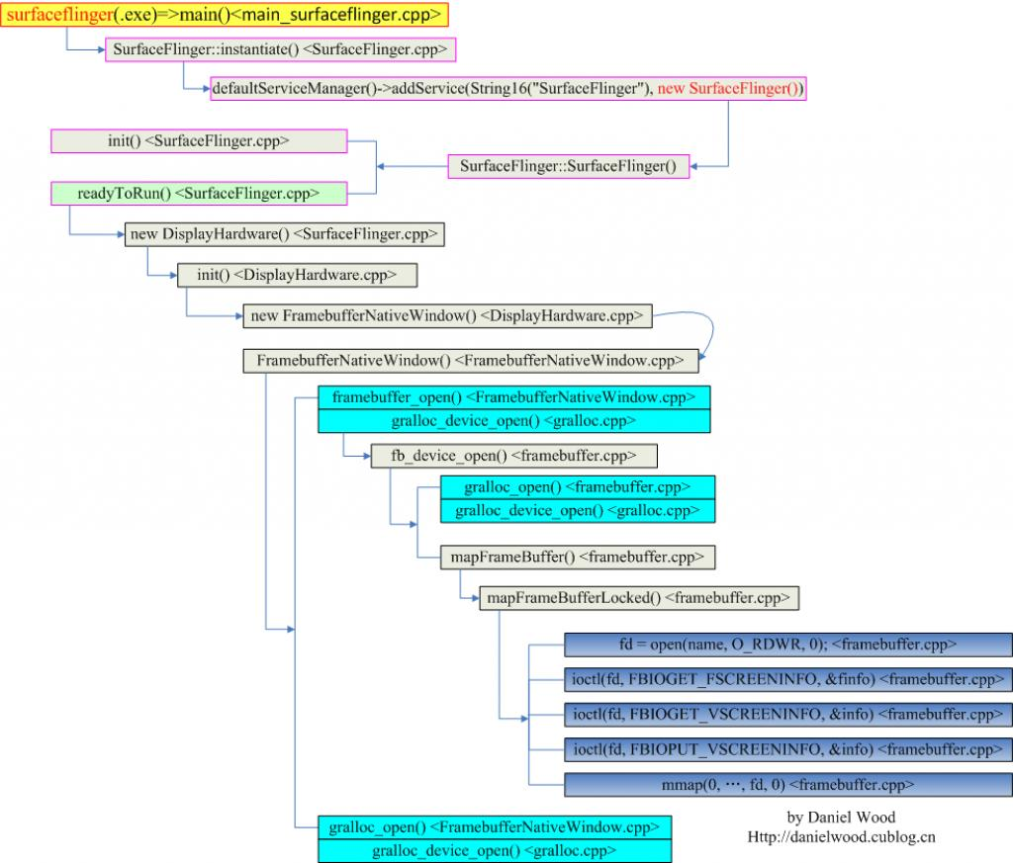
readyTorun

Slide 11
readyTorun
(2) overlay_control_open(module, &mOverlayEngine);
did`t find this character in code.
(3) GLDisplay display = eglGetDisplay(EGL_DEFAULT_DISPLAY)
________________________________________________________________________________________________
| EGLDisplay display = eglGetDisplay(EGL_DEFAULT_DISPLAY);(implement in ligagl.si or libhgl.so)
| eglGetDisplay -> egl_init_drivers() ->egl_init_dervers_locked()
|_________________________________________________________________________________________________
To fill the array of [IMPL_SOFTWARE]和gEGLImpl[IMPL_ HARDWARE] so, we could use the libGLES_android.so functions.
/*Create our main surface*/
surface = eglCreateWindowSurface(display, config, mNativeWindow.get(), N ULL);
/*Create our OpenGL ES context*/
eglCreateContext(display, config, NULL, contextAttributes); (Create our OpenGL ES context in ligagl.so or lighgl.so)

Slide 12
readyTorun
2 new MemoryHeapBase(4096,MemoryHeapBase::READ_ONLY, "SurfaceFlinger read-only heap");
3. initialize primary screen
init the width and height and format.
4initalize the share control block
initialize the struct dcblk
5.Initialize OpenGL | ES
glPixelStorei(GL_UNPACK_ALIGNMENT, 4); glPixelStorei(GL_PACK_ALIGNMENT, 4); glEnableClientState(GL_VERTEX_ARRAY); glEnable(GL_SCISSOR_TEST); glShadeModel(GL_FLAT); glDisable(GL_DITHER); glDisable(GL_CULL_FACE);

