Slide 1
Sensor System
SSD2_SensorTeam

Slide 2
Outline
1. Sensor System
2. Light System
3. MicroP

Slide 3
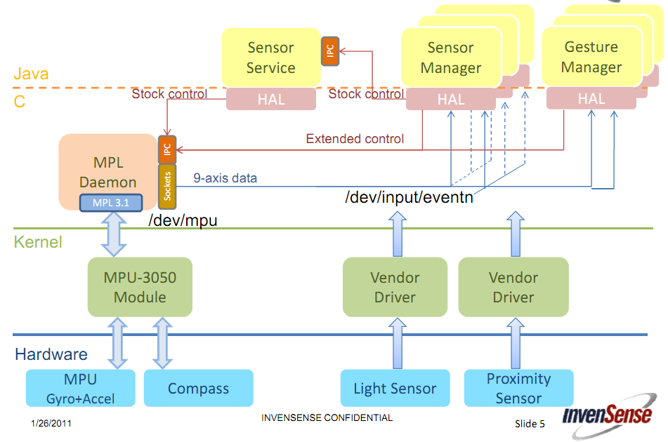
1.Sensor System

Slide 4
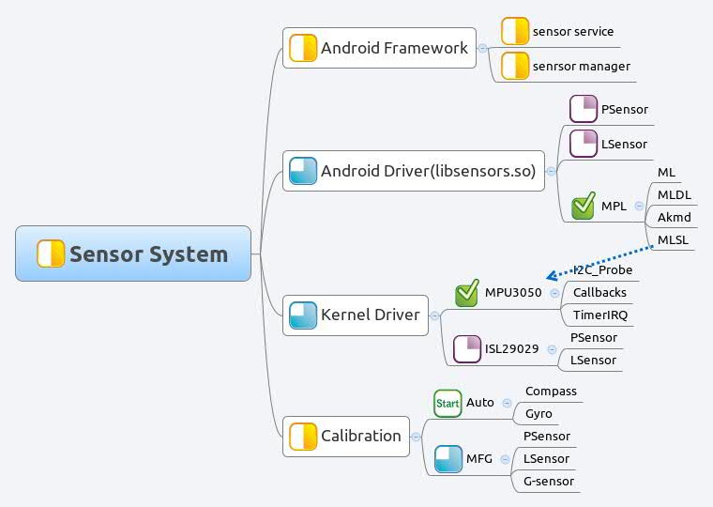
1.Sensor System – Knowledge Map

Slide 5
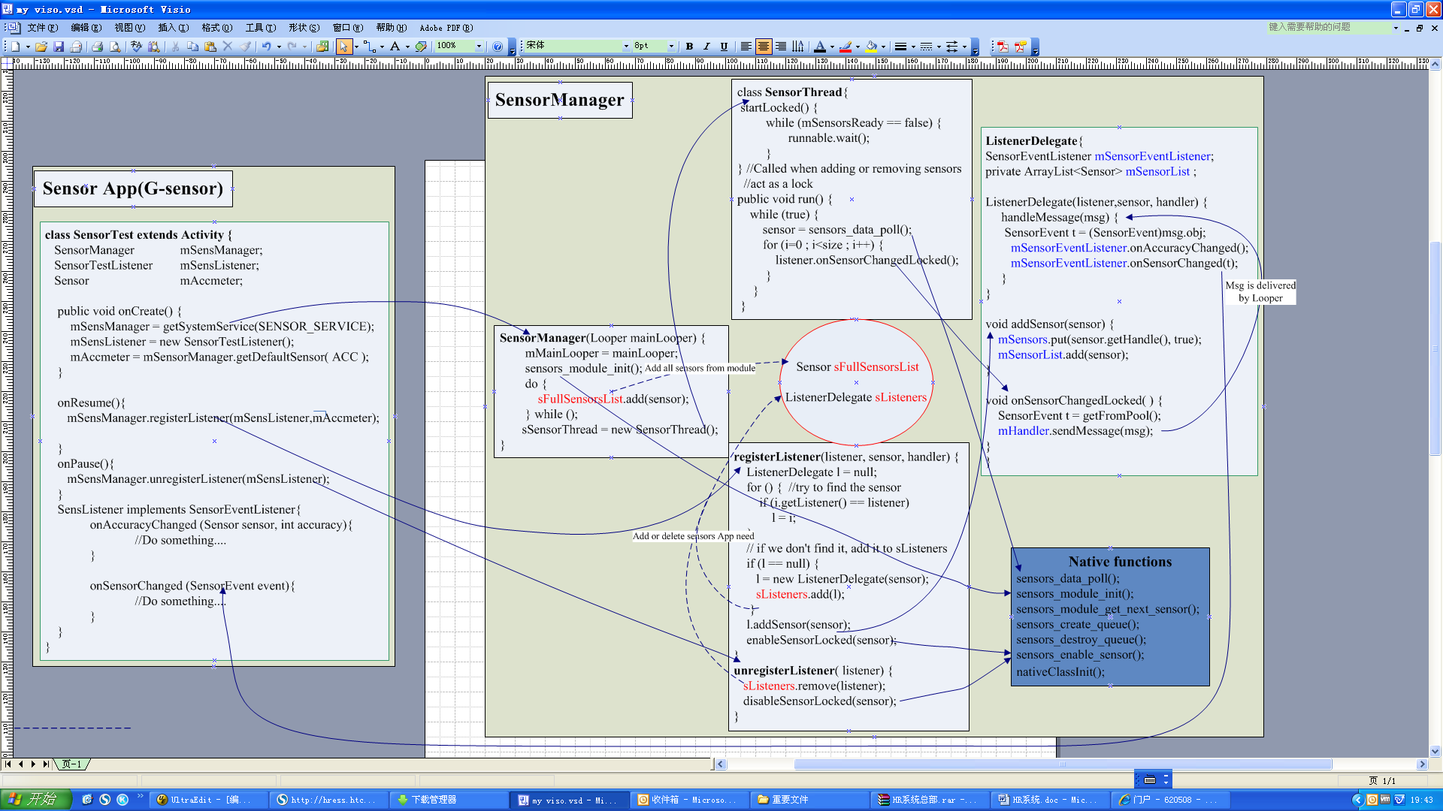
1.1 Android Framework – Sensor Manager & Service

Slide 6
1.2 Android Driver
HAL
MPL
P/L-Sensor

Slide 7
1.2.1 HAL
struct sensors_poll_context_t {
struct sensors_poll_device_t device; // must be first
sensors_poll_context_t();
int activate(int handle, int enabled);
int setDelay(int handle, int64_t ns);
int pollEvents(sensors_event_t* data, int count);
};

Slide 8
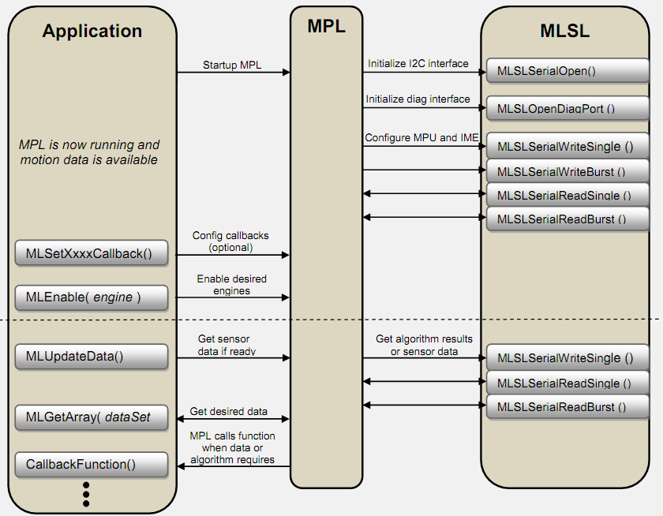
1.2.2 MPL

Slide 9
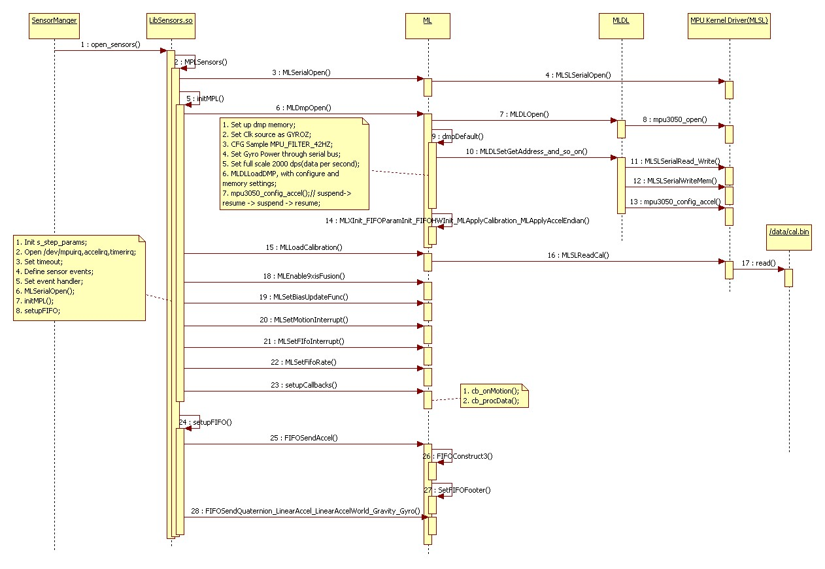
1.2.2.1 open_sensors

Slide 10
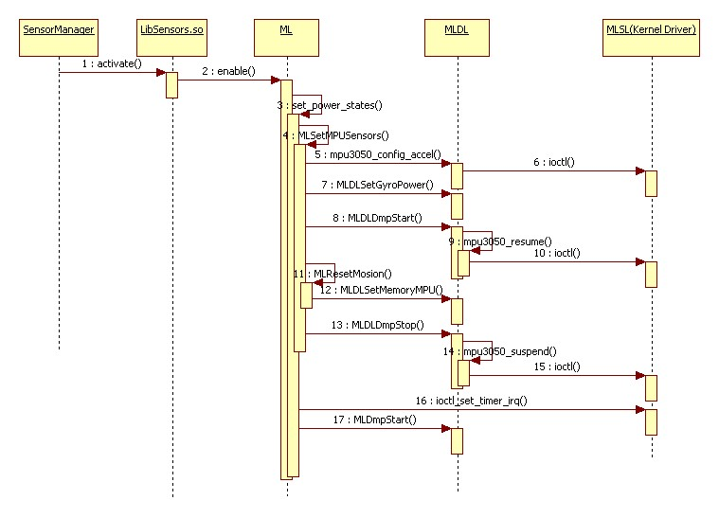
1.2.2.2 activate

Slide 11
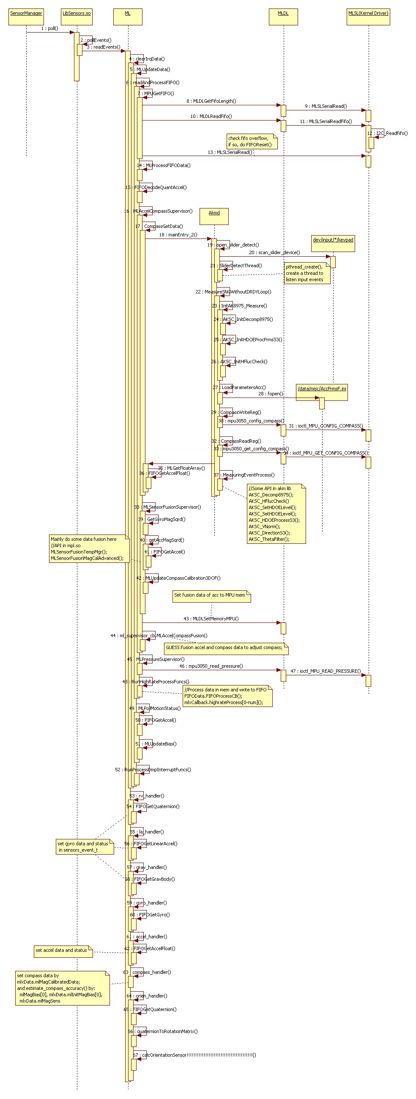
1.2.2.3 pollEvent

Slide 12
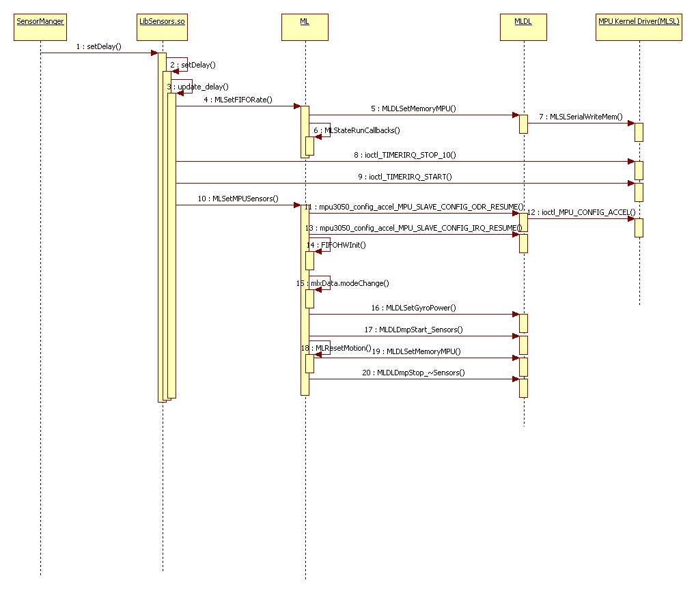
1.2.2.4 setDelay

Slide 13
1.3 Android Driver (L/P Sensor)

Slide 14
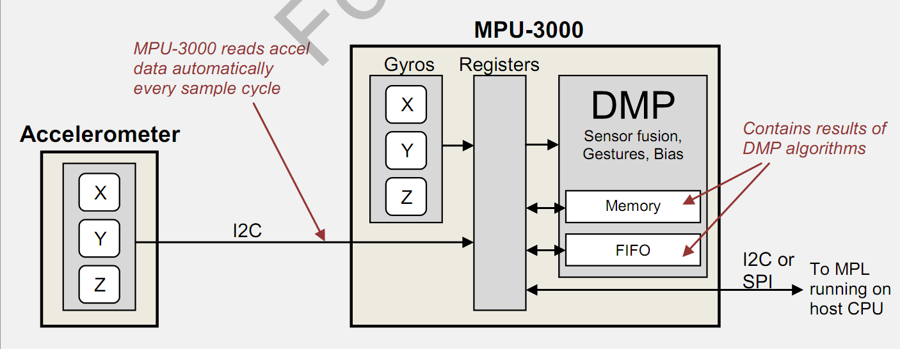
1.3 Kernel Driver (MPU3050)

Slide 15
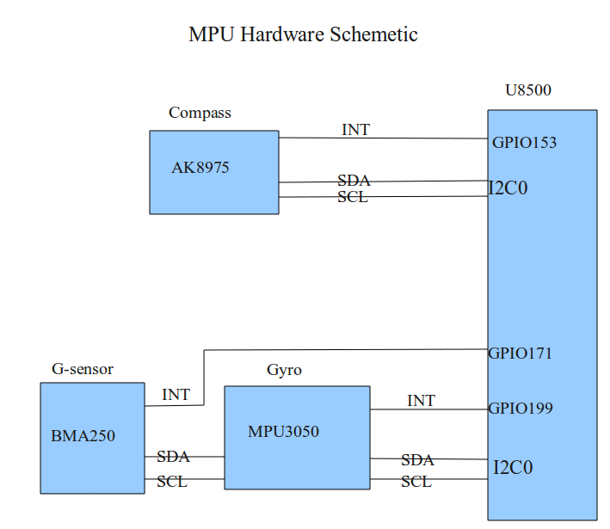
1.3 Kernel Driver (MPU3050)

Slide 16
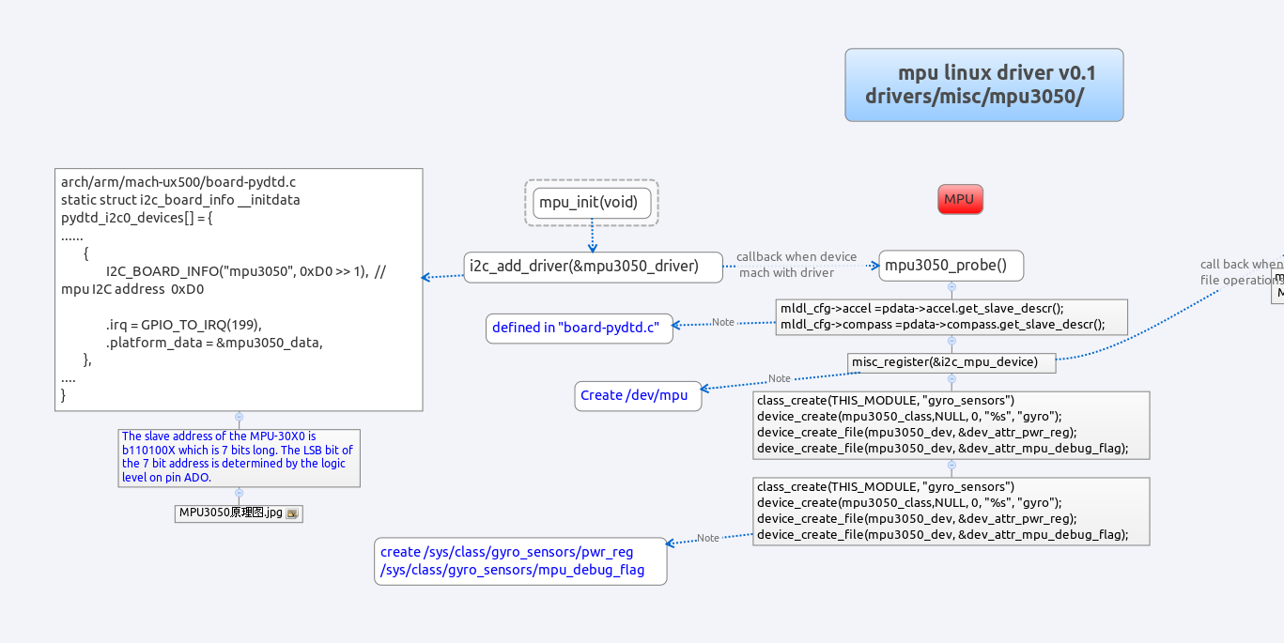
1.3 Kernel Driver (MPU3050)

Slide 17
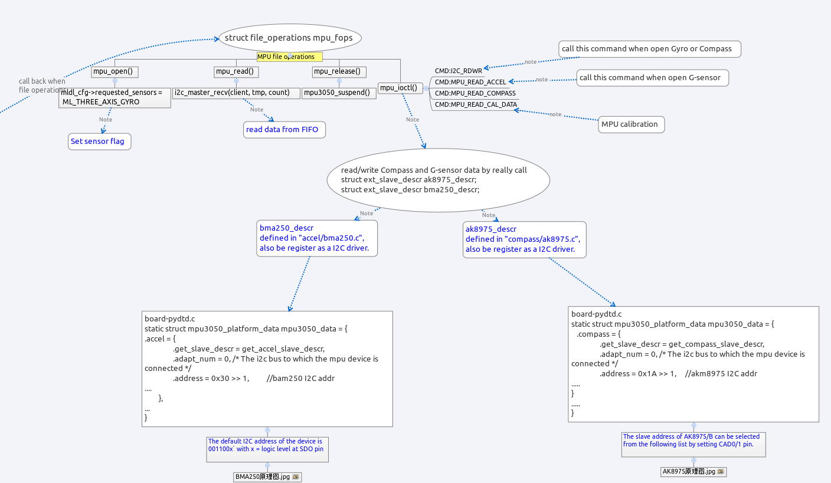
1.3 Kernel Driver (MPU3050)

Slide 18
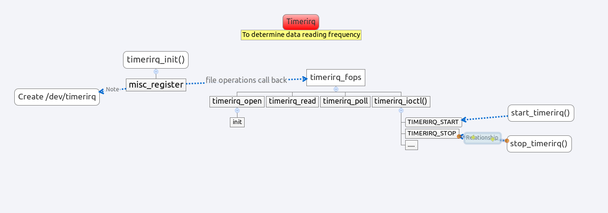
1.3 Kernel Driver (MPU3050)

Slide 19
1.4 Calibration (TBD)

Slide 20
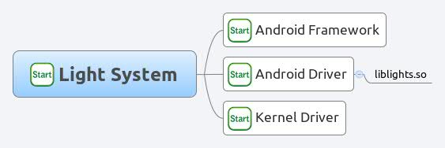
2. Light System (TBD)

Slide 21

2. MicroP (TBD)

