Slide 1

Elina build manual
Version 0.1
Yuanzhe Liu
Dec, 2012
Notes:
11/07/12

Slide 2

Agenda
About Yocto
Get start
Build
Appendix
Notes:
11/07/12

Slide 3
1. About Yocto
What’s yocto?
The Yocto Project provides open source, high-quality infrastructure and tools to help developers create their own custom Linux distributions for any hardware architecture and across multiple market segments.
What’s benefit of yocto?
The Yocto Project solves re-use problems by providing a single focus for embedded development, requiring less time to get a working and up-to-date distribution together.
What is the difference between OpenEmbedded and the Yocto?
OpenEmbedded provides a comprehensive set of metadata for a wide variety of architectures, features, and applications. The Yocto Project focuses on providing powerful, easy-to-use, interoperable, well-tested tools, metadata, and board support packages (BSPs) for a core set of architectures and specific boards.

Slide 4
2. Get start
Host:
Ubuntu12.04 32bit or 64bit
Required software
sudo apt-get install gawk wget git-core diffstat unzip texinfo build-essential chrpath libsdl1.2-dev xterm

Slide 5
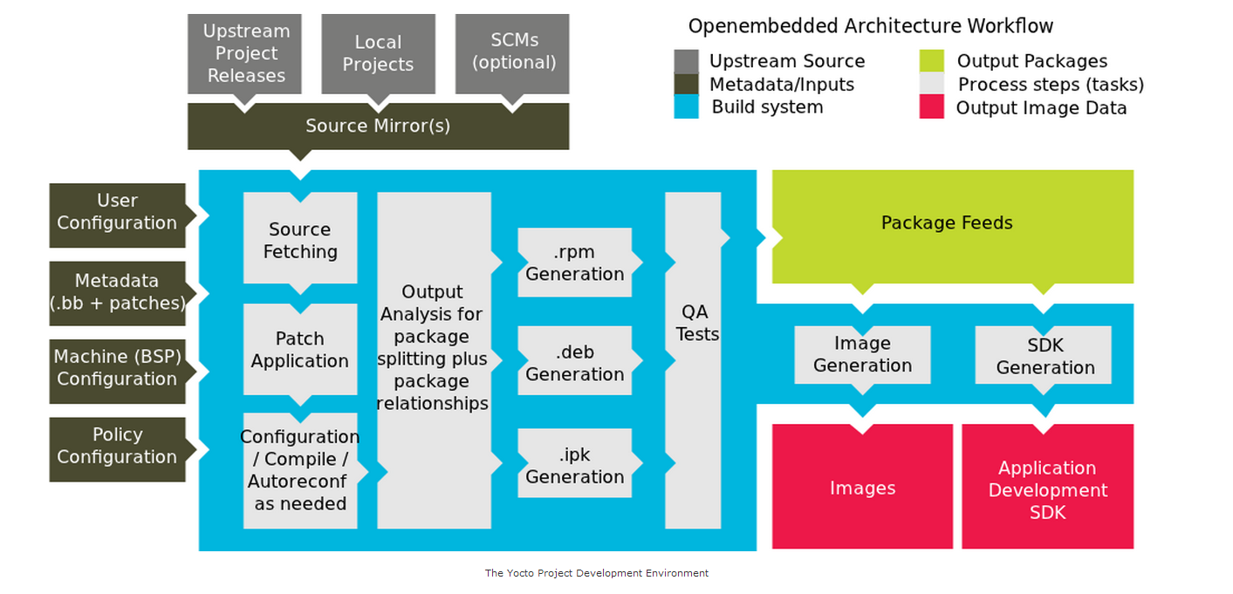
2. Get start

Slide 6
ELINA OSS
//ELINA
/OSSRepositiory
/oss-pkg
/connectivity
/core
/dbus
/dbus-1.6.0.tar.gz
/multimedia
…
//ELINA
/OSSDK
/Development
/Default
/poky
/bitbake
/build
/documentation
/meta
/meta-hob
/meta-skeleton
/meta-yocto
/meta-yocto-bsp
/meta-linaro
/meta-harman
/meta-harman-core
/scripts
/toolchain-layer
Workspace PC
<workspace>
/config
/kernel
/LTPFramework
/OSSRepositiory
/poky
/bitbake
/build
/documentation
/meta
/meta-hob
/meta-skeleton
/meta-yocto
/meta-yocto-bsp
/meta-linaro
/meta-harman
/meta-harman-core
/scripts
/toolchain-layer
/toolchain
/tools
build.sh
//ELINA _Binaries
/Binaries
/ Private
/OSSDK
/host
/target
/<variant>_linux_<kernel_version>_gcc_<gcc_ver>-<project>-<board>-<rev>-<cpu>-<buildopt>
/rmp -> release if needed
/rootfs
/sysroot
/toolchain

Slide 7
3. Build
Work dir architecture
build.sh
toolchain/
OSSRepositiory/
poky/
Run P4 //ELINA/OSSDK/Development/Default/config/SyncComposition.p4sm in 10.80.98.24:3500. Then you should ensure you workspace architecture is the same with above picture.
2. run command
$cd $(workspace)
$./build.sh
3. Generate elina-image-minimal
Rootfs : poky/build/tmp/deploy/image/
Sysroot: poky/build/tmp/sysroots/

Slide 8
4. Appendix
Yocto project websit:
https://www.yoctoproject.org/
Yocto development manual:
http://www.yoctoproject.org/docs/current/dev-manual/dev-manual.html#usingpoky-extend-addpkg
Yocto reference manual:
http://www.yoctoproject.org/docs/1.3/poky-ref-manual/poky-ref-manual.html#how-does-the-yocto-project-obtain-source-code-and-will-it-work-behind-my-firewall-or-proxy-server
Yocto quick start:
http://www.yoctoproject.org/docs/current/yocto-project-qs/yocto-project-qs.html

