Slide 1
The Android Sensor System

Slide 2
Sensor types
#define SENSOR_TYPE_ACCELEROMETER 1
#define SENSOR_TYPE_MAGNETIC_FIELD 2
#define SENSOR_TYPE_ORIENTATION 3
#define SENSOR_TYPE_GYROSCOPE 4
#define SENSOR_TYPE_LIGHT 5
#define SENSOR_TYPE_PRESSURE 6
#define SENSOR_TYPE_TEMPERATURE 7
#define SENSOR_TYPE_PROXIMITY 8

Slide 3
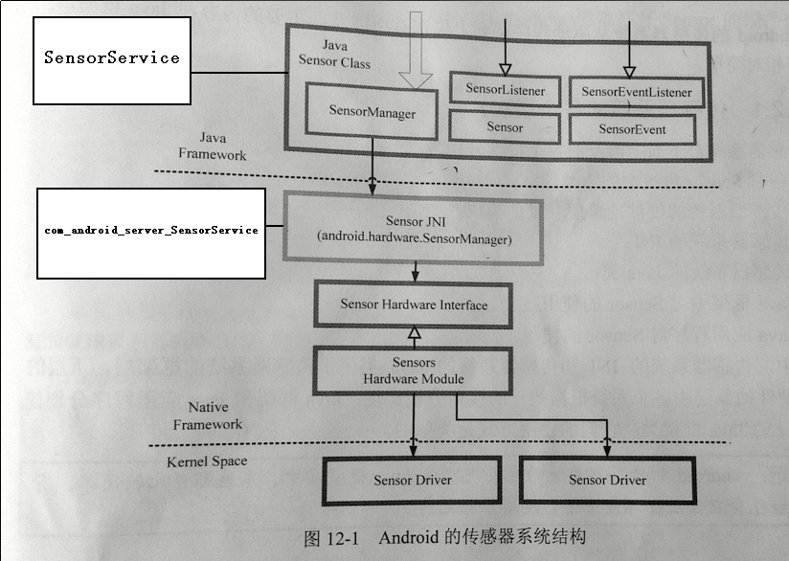
Architecture

Slide 4
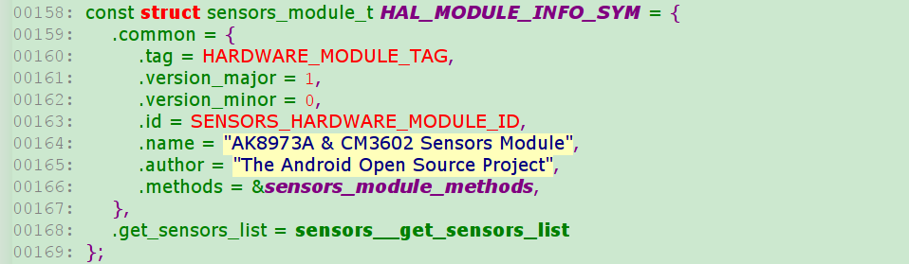

Slide 5
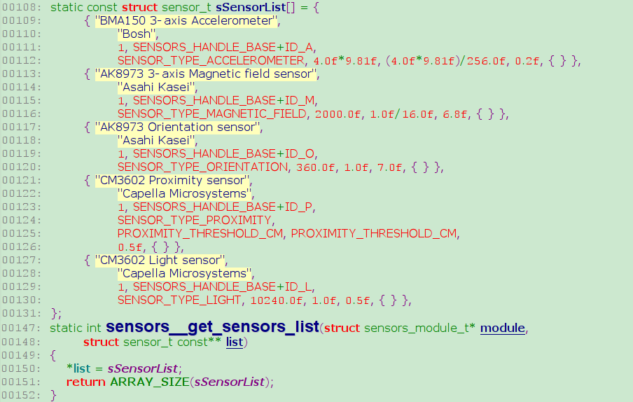

Slide 6
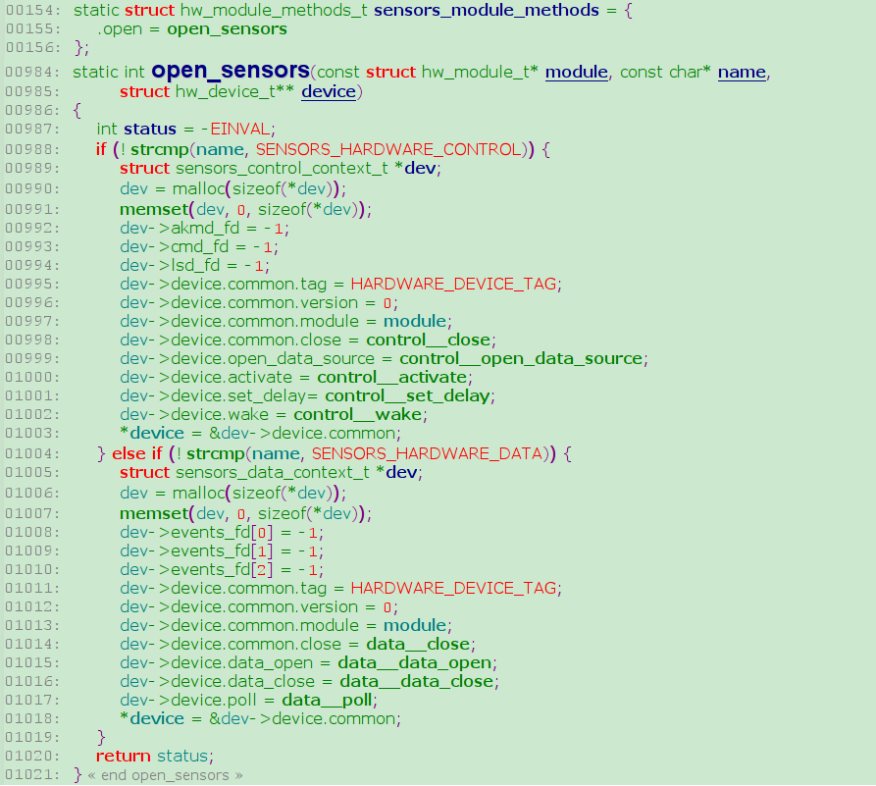

Slide 7
Java
public class MySensors extends Activity implements SensorListener {
private SensorManager mSensorManager;
private static final String TAG = "MySensors";
@Override
public void onCreate(Bundle savedInstanceState) {
super.onCreate(savedInstanceState);
mSensorManager = (SensorManager) getSystemService(SENSOR_SERVICE);
setContentView(R.layout.main);
}
public void onSensorChanged(int sensor, float[] values) {
//Log.d(TAG, "sensor: " + sensor + ", x: " + values[0] + ", y: " + values[1] + ", z: " + values[2]);
if(sensor == SensorManager.SENSOR_ACCELEROMETER) {
} else if(sensor == SensorManager.SENSOR_MAGNETIC_FIELD) {
} else if(sensor == SensorManager.SENSOR_ORIENTATION) {
}
}
public void onAccuracyChanged(int sensor, int accuracy) {
}
protected void onResume() {
super.onResume();
mSensorManager.registerListener(this,
SensorManager.SENSOR_ACCELEROMETER
| SensorManager.SENSOR_MAGNETIC_FIELD
| SensorManager.SENSOR_ORIENTATION
| SensorManager.SENSOR_PROXIMITY,
SensorManager.SENSOR_DELAY_FASTEST);
}
protected void onPause() {
super.onPause();
mSensorManager.unregisterListener(this);
}
}

Slide 8
public class MySensors extends Activity implements SensorEventListener {
private SensorManager mSensorManager;
private static final String TAG = "Mysensors";
private Sensor mProximity;
@Override
public void onCreate(Bundle savedInstanceState) {
super.onCreate(savedInstanceState);
mSensorManager = (SensorManager) getSystemService(SENSOR_SERVICE);
mProximity = mSensorManager.getDefaultSensor(Sensor.TYPE_PROXIMITY);
setContentView(R.layout.main);
}
protected void onResume() {
super.onResume();
mSensorManager.registerListener(this, mProximity,
SensorManager.SENSOR_DELAY_NORMAL);
}
protected void onPause() {
super.onPause();
mSensorManager.unregisterListener(this);
}
public void onAccuracyChanged(Sensor sensor, int accuracy) {
}
public void onSensorChanged(SensorEvent event) {
Log.d(TAG, "sensor: " + event.values[0]);
}
}

Slide 9
public boolean registerListener(SensorListener listener, int sensors, int rate) {
if (listener == null) {
return false;
}
boolean result = false;
result = registerLegacyListener(SENSOR_ACCELEROMETER, Sensor.TYPE_ACCELEROMETER,
listener, sensors, rate) || result;
result = registerLegacyListener(SENSOR_MAGNETIC_FIELD, Sensor.TYPE_MAGNETIC_FIELD,
listener, sensors, rate) || result;
result = registerLegacyListener(SENSOR_ORIENTATION_RAW, Sensor.TYPE_ORIENTATION,
listener, sensors, rate) || result;
result = registerLegacyListener(SENSOR_ORIENTATION, Sensor.TYPE_ORIENTATION,
listener, sensors, rate) || result;
result = registerLegacyListener(SENSOR_TEMPERATURE, Sensor.TYPE_TEMPERATURE,
listener, sensors, rate) || result;
return result;
}
private boolean registerLegacyListener(int legacyType, int type,
SensorListener listener, int sensors, int rate)
{
// Are we activating this legacy sensor?
if ((sensors & legacyType) != 0) {
…...
result = registerListener(legacyListener, sensor, rate);
}
return result;
}

Slide 10
public boolean registerListener(SensorEventListener listener, Sensor sensor, int rate}
{
reutrn registerListener(listener, sensor, rate, null);
}
public boolean registerListener(SensorEventListener listener, Sensor sensor, int rate,
Handler handler) {
…...
switch (rate) {
case SENSOR_DELAY_FASTEST:
delay = 0;
break;
case SENSOR_DELAY_GAME:
delay = 20;
break;
case SENSOR_DELAY_UI:
delay = 60;
break;
case SENSOR_DELAY_NORMAL:
delay = 200;
break;
default:
return false;
}
…...
String name = sensor.getName();
int handle = sensor.getHandle();
result = mSensorService.enableSensor(l, name, handle, delay);
…...
}

Slide 11
SensorService :
enableSensor()
_sensors_control_activate(true)
_sensors_control_activate(false)
_sensors_control_set_delay(delay)
_sensors_control_wake()
_sensors_control_close()

Slide 12
SensorManager :
nativeClassInit();
sensors_module_init();
sensors_module_get_next_sensor();
new SensorThread();
sensors_data_init();
sensors_data_open();
sensors_data_poll();
error/stop
sendMessage();
sensors_data_close();
sensors_data_uninit();

Slide 13
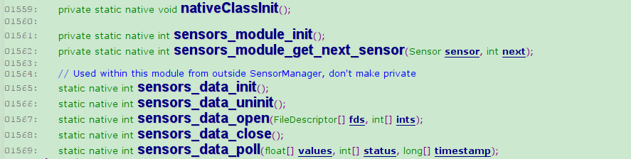
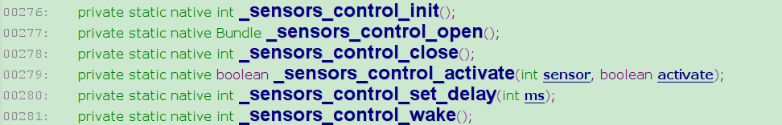

Slide 14
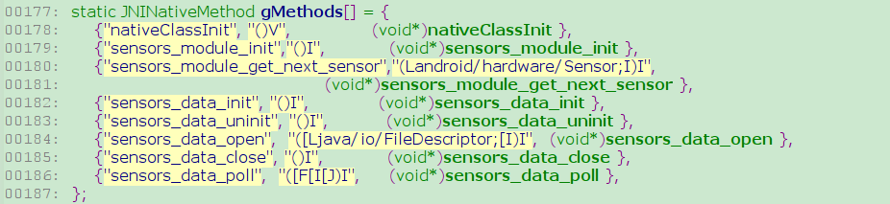
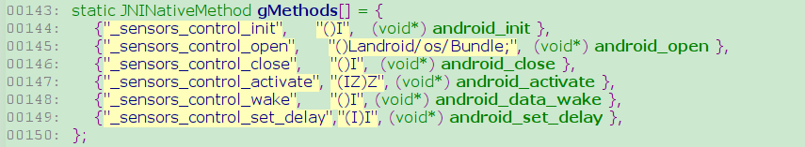

Slide 15
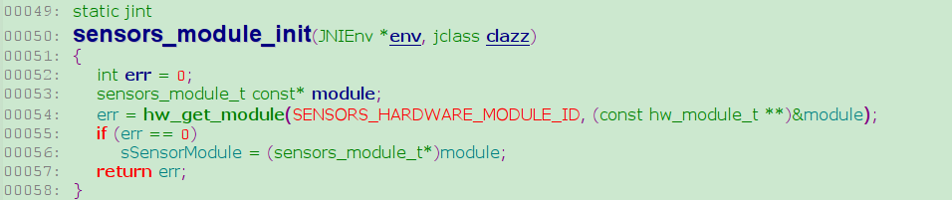
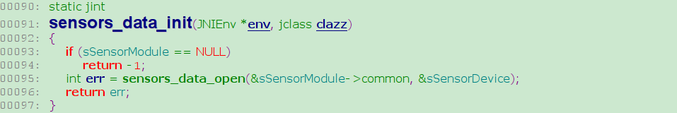
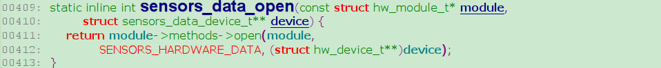
/lib/hw/sensors.xxx.so

Slide 16
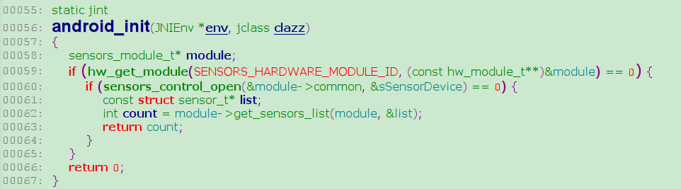
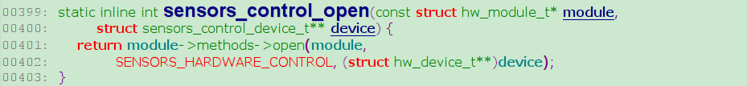

Slide 17
register a input device:
input_dev->name = "proximity";
set_bit(EV_ABS, input_dev->evbit);
input_set_abs_params(input_dev, ABS_DISTANCE, 0, 1, 0, 0);
rc = input_register_device(input_dev);
driver
report data:
/* 0 is close, 1 is far */
input_report_abs(data->input_dev, ABS_DISTANCE, val);
input_sync(data->input_dev);
data__poll:
#define EVENT_TYPE_PROXIMITY ABS_DISTANCE
read(cm_fd, &event, sizeof(event));
if (event->type == EV_ABS) {
if (event->code == EVENT_TYPE_PROXIMITY) {
dev->sensors[ID_P].distance = (float)event->value;
}
}
hal

Slide 18
register a misc device:
static struct file_operations akm_aot_fops = {
.owner = THIS_MODULE,
.open = akm_aot_open,
.release = akm_aot_release,
.ioctl = akm_aot_ioctl,
};
static struct miscdevice akm_aot_device = {
.minor = MISC_DYNAMIC_MINOR,
.name = "akm8973_aot",
.fops = &akm_aot_fops,
};
misc_register(&akm_aot_device);
static int
akm_aot_ioctl(struct inode *inode, struct file *file,
unsigned int cmd, unsigned long arg)
{
…...
switch (cmd) {
case ECS_IOCTL_APP_SET_MFLAG:
atomic_set(&m_flag, flag);
break;
case ECS_IOCTL_APP_GET_MFLAG:
flag = atomic_read(&m_flag);
break;
…...
control__activate:
int fd = open_akm(dev);
ioctl(fd, ECS_IOCTL_APP_SET_MFLAG, &flags);

Slide 19
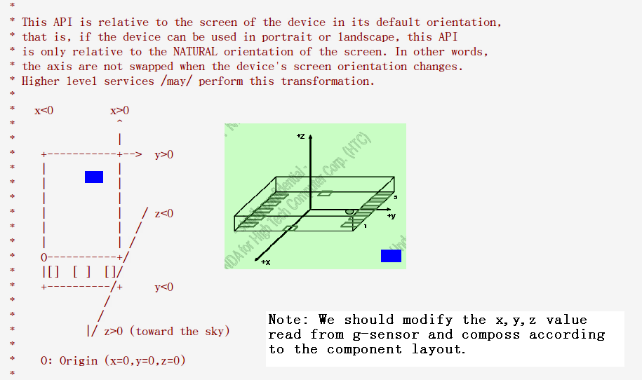
Definition of the axis

