Slide 1
Vagrant
A Crash Course

Slide 2
An overview

Slide 3
What is Vagrant?
A tool for developers
A VM management tool
Automate the setup of your development environment

Slide 4
Has this happened to you?

Slide 5
New starter
Someone joins your project…
They pick up their laptop…
Then spend the next 1-2 days following instructions on setting up their environment, tools, etc.

Slide 6
Instead, lets do this.

Slide 7
New starter
Someone joins your project…
They pick up their laptop…
Then spend the next 10 minutes running a script which sets their environment up for them.

Slide 8
Step by step

Slide 9
Prerequisites
Virtualbox
Vagrant
Both Virtualbox and Vagrant have great, simple installation instructions.

Slide 10
Setting up the box
Follow these steps once Virtualbox and Vagrant are installed.

Slide 11
Getting set up
Add a Vagrant box
Create the VM
Configure the VM
Set up your project environment

Slide 12
Adding a box*
*What’s a box? We’ll cover that shortly.

Slide 13
Setting up Ubuntu Precise
vagrant box add ubuntu-precise http://cloud-images.ubuntu.com/precise/current/precise-server-cloudimg-vagrant-i386-disk1.box
vagrant init ubuntu-precise
vagrant up

Slide 14
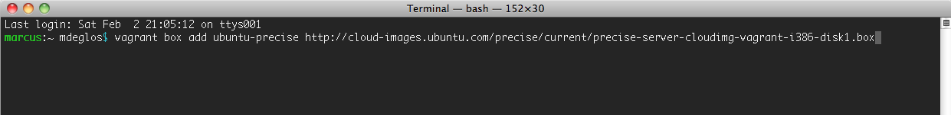
Adding the box
vagrant box add ubuntu-precise http://cloud-images.ubuntu.com/precise/current/precise-server-cloudimg-vagrant-i386-disk1.box

Slide 15
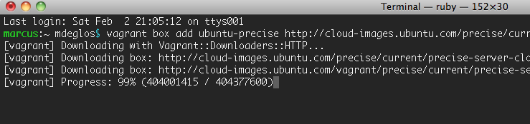
Adding the box
vagrant box add ubuntu-precise http://cloud-images.ubuntu.com/precise/current/precise-server-cloudimg-vagrant-i386-disk1.box

Slide 16
Adding the box
vagrant box add ubuntu-precise http://cloud-images.ubuntu.com/precise/current/precise-server-cloudimg-vagrant-i386-disk1.box
385 MB.
Most boxes are 350 – 500MB.

Slide 17
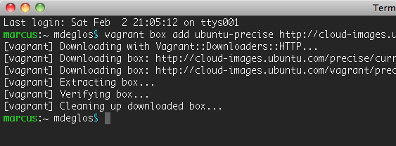
Adding the box

Slide 18
Getting set up
Add a Vagrant box
Create the VM
Configure the VM
Set up your project environment

Slide 19
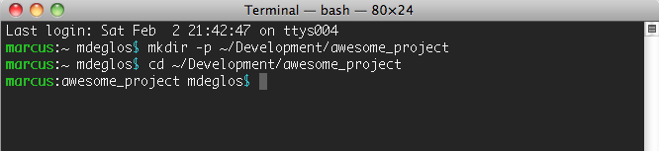
Start with a working dir.
mkdir –p ~/Development/awesome_project
cd ~/Development/awesome_project

Slide 20
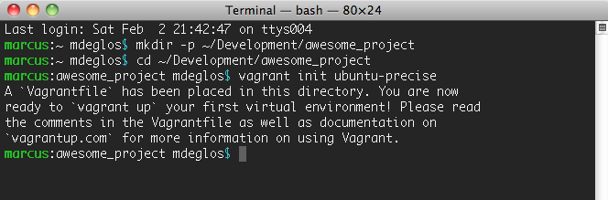
Initialise the Vagrant setup
vagrant init ubuntu-precise

Slide 21
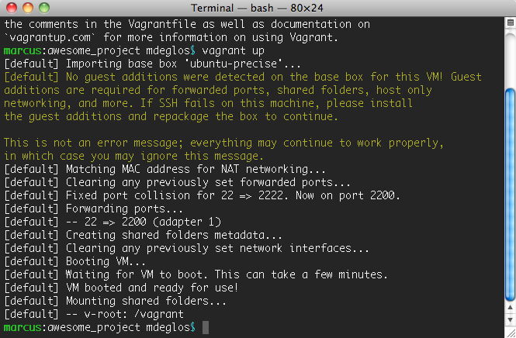
Launch the Vagrant VM
vagrant up

Slide 22
Launch the Vagrant VM
vagrant up
Your vagrant VM is built and ready to use.

Slide 23
Getting set up
Add a Vagrant box
Create the VM
Configure the VM
Set up your project environment

Slide 24
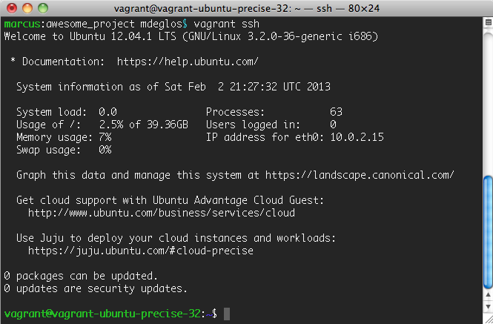
SSH to the VM
vagrant ssh

Slide 25
Install all the things!
sudo apt-get install curl apache2 avahi-daemon avahi-discover avahi-utils gcc git-core libapache2-mod-dnssd make mysql-server samba subversion unzip vim php5 php-apc php5-cli php5-curl php5-dev php5-gd php5-memcache php5-memcached php5-mysqlnd php5-xdebug
These aren’t all essential, but make a good base for a good development environment.

Slide 26
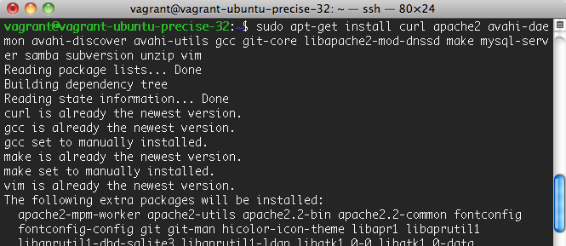
Install all the things!
sudo apt-get install curl apache2 avahi-daemon avahi-discover avahi-utils gcc git-core libapache2-mod-dnssd make mysql-server samba subversion unzip vim php5 php-apc php5-cli php5-curl php5-dev php5-gd php5-memcache php5-memcached php5-mysqlnd php5-xdebug

Slide 27
Getting set up
Add a Vagrant box
Create the VM
Configure the VM
Set up your project environment

Slide 28
Create a Drupal setup
sudo mkdir /srv/awesome_project
sudo chown vagrant:vagrant /srv/awesome_project
cd /srv/awesome_project
git clone git@github.com/example/awesome_project.git htdocs
mkdir /srv/awesome_project/conf
touch /srv/awesome_project/conf/httpd.conf
sudo ln –s /srv/awesome_project/conf/httpd.conf /etc/apache2/sites-available/awesome_project.conf
sudo ln –s ../sites-available/awesome_project.conf /etc/apache2/sites-enabled

Slide 29
Set up your environment
mysql –e “GRANT ALL ON *.* TO ‘vagrant’@’localhost’ IDENTIFIED BY ‘’ WITH GRANT OPTION”
Add whichever setup instructions are appropriate for your environment

Slide 30
Manual setup is baad, mmkay?
Manual
setup

Slide 31
Streamlining the setup
Manual installation is never efficient

Slide 32
A stream-lined setup
Option 1 – A magick box.

Slide 33
Start with a customised box
vagrant box add awesome_project http://boxes.example.com/supercool_drupal_project.box

Slide 34
Start with a customised box
vagrant box add awesome_project http://boxes.example.com/supercool_drupal_project.box
A magick box.
I’ll explain later!

Slide 35
Follow the standard setup
mkdir –p ~/Development/awesome_project
cd ~/Development/awesome_project
vagrant init awesome_project
vagrant up

Slide 36
Connect to the box
vagrant ssh

Slide 37
Verify what’s in the box
ls /srv/
which drush
mysql -e 'show databases;'

Slide 38
Verify what’s in the box
ls /srv/
which drush
mysql -e 'show databases;'
vagrant@vm-druprecise:~$ ls -l /srv/
total 4
drwxr-xr-x 3 root root 4096 Mar 10 18:28 foo.local

Slide 39
Verify what’s in the box
ls /srv/
which drush
mysql -e 'show databases;'
vagrant@vm-druprecise:~$ which drush
/usr/local/bin/drush

Slide 40
Verify what’s in the box
ls /srv/
which drush
mysql -e 'show databases;'
vagrant@vm-druprecise:~$ mysql -e 'show databases';
+--------------------+
| Database |
+--------------------+
| information_schema |
| foo_local |
| mysql |
| performance_schema |
| phpmyadmin |
+--------------------+

Slide 41
Recap of all those steps
vagrant box add awesome_project http://boxes.example.com/supercool_drupal_project.box
mkdir –p ~/Development/awesome_project
cd ~/Development/awesome_project
vagrant init awesome_project
vagrant up

Slide 42


Slide 43
A stream-lined setup
Option 2 – A vagrant config.

Slide 44
Start with a build directory
mkdir –p ~/Development/awesome_project
cd ~/Development/awesome_project

Slide 45
Checkout a Vagrant config
git clone git@github.com/Techito/vagrant_drupal_box.git .

Slide 46
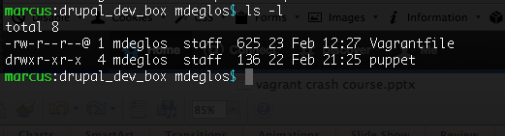
Verify the checkout
ls -l

Slide 47
Verify the checkout
ls -l
Vagrantfile is required

Slide 48
Verify the checkout
ls -l
Puppet/chef setup automates the box provisioning

Slide 49
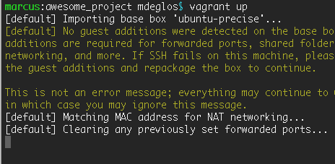
Get Vagrant going
vagrant up

Slide 50
Connect to the box
vagrant ssh

Slide 51
Verify what’s in the box
ls /srv/
which drush
mysql -e 'show databases;'

Slide 52
Verify what’s in the box
ls /srv/
which drush
mysql -e 'show databases;'
vagrant@vm-druprecise:~$ ls -l /srv/
total 4
drwxr-xr-x 3 root root 4096 Mar 10 18:28 foo.local

Slide 53
Verify what’s in the box
ls /srv/
which drush
mysql -e 'show databases;'
vagrant@vm-druprecise:~$ which drush
/usr/local/bin/drush

Slide 54
Verify what’s in the box
ls /srv/
which drush
mysql -e 'show databases;'
vagrant@vm-druprecise:~$ mysql -e 'show databases';
+--------------------+
| Database |
+--------------------+
| information_schema |
| foo_local |
| mysql |
| performance_schema |
| phpmyadmin |
+--------------------+

Slide 55
Recap of all those steps
mkdir –p ~/Development/awesome_project
cd ~/Development/awesome_project
git clone git@github.com/example/awesome_project.git .
vagrant up

Slide 57
Automated provisioning
= super-quick setup

Slide 58
Vagrant vocabulary

Slide 59
Vagrant Vocabulary
Virtualbox
An application to run "Virtual machines" on your laptop/desktop.
Vagrant
An application that automates the setup of VMs.
Host
The laptop/desktop that runs Virtualbox + Vagrant.
Guest / Guest VM / Instance
The virtual machine running within the host.

Slide 60
Vagrant Vocabulary
Mount
A way of sharing files between the host and guest (this is a simplification – search for "disk mount" for a more detailed explanation).
Provision / Provisioning
Setting up the VM, installing packages, configuring users, etc.
Box / Base box
A template for a Virtual Machine.
Vagrantfile
A set of instructions to Vagrant on how to build and configure a VM.

Slide 61
Two approaches
A "magick" pre-packaged box, or a vagrant config structure.

Slide 62
Standard practice
Start with a base-box of choice.
  Ubuntu, CentOS, Debian…?
  32 bit vs 64 bit

Slide 63
Standard practice
Start with a base-box of choice.
  Ubuntu, CentOS, Debian…?
  32 bit vs 64 bit
Add a Vagrantfile.
  `vagrant init` will give you a template

Slide 64
Standard practice
Start with a base-box of choice.
  Ubuntu, CentOS, Debian…?
  32 bit vs 64 bit
Add a Vagrantfile.
  `vagrant init` will give you a template
Configure the Vagrantfile.
  Hostname, network adapters, config paths…

Slide 65
Standard practice
Start with a base-box of choice.
  Ubuntu, CentOS, Debian…?
  32 bit vs 64 bit
Add a Vagrantfile.
  `vagrant init` will give you a template
Configure the Vagrantfile.
  Hostname, network adapters, config paths…
Great docs at http://vagrantup.com/

Slide 66
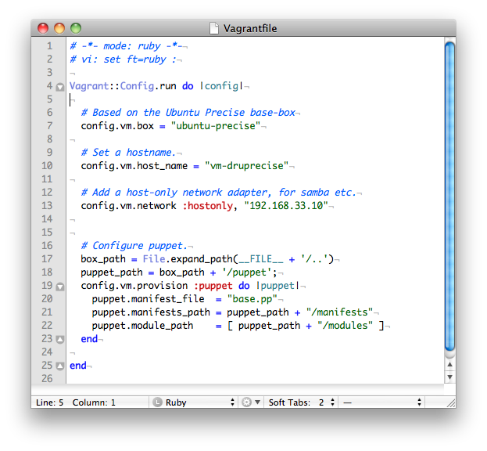
Standard practice
Start with a base-box of choice.
  Ubuntu, CentOS, Debian…?
  32 bit vs 64 bit
Add a Vagrantfile.
  `vagrant init` will give you a template
Configure the Vagrantfile.
  Hostname, network adapters, config paths…

Slide 67
Standard practice
Start with a base-box of choice.
  Ubuntu, CentOS, Debian…?
  32 bit vs 64 bit
Add a Vagrantfile.
  `vagrant init` will give you a template
Configure the Vagrantfile.
  Hostname, network adapters, config paths…
Add puppet/chef manifests

Slide 68
Standard practice
Start with a base-box of choice.
  Ubuntu, CentOS, Debian…?
  32 bit vs 64 bit
Add a Vagrantfile.
  `vagrant init` will give you a template
Configure the Vagrantfile.
  Hostname, network adapters, config paths…
Add puppet/chef manifests
I'll talk briefly on puppet + chef shortly

Slide 69
What's in the "magick" box?
vagrant box add awesome_project http://boxes.example.com/supercool_drupal_project.box
A magick box.

Slide 70
What's in the "magick" box?
I started with a standard Vagrant base-box
(I used the ubuntu-precise package, supplied by Canonical).
I tweaked the Vagrantfile, and added puppet config (in the same way as setting up a regular Vagrant VM).
I used a special packaging script to package the base-box, with the Vagrantfile and the puppet manifests included.

Slide 71
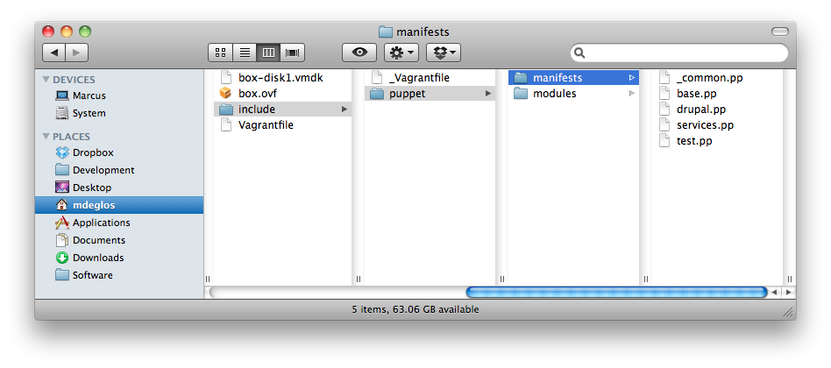
What's in the "magick" box?
I started with a standard Vagrant base-box
(I used the ubuntu-precise package, supplied by Canonical).
I tweaked the Vagrantfile, and added puppet config (in the same way as setting up a regular Vagrant VM).
I used a special packaging script to package the base-box, with the Vagrantfile and the puppet manifests included.

Slide 72
What's in the "magick" box?
I started with a standard Vagrant base-box
(I used the ubuntu-precise package, supplied by Canonical).
I tweaked the Vagrantfile, and added puppet config (in the same way as setting up a regular Vagrant VM).
I used a special packaging script to package the base-box, with the Vagrantfile and the puppet manifests included.
Vagrant will package:
the 'vmdk' (a virtual-disk standard)
the 'ovf' (a Virtualbox VM descriptor)

Slide 73
What's in the "magick" box?
I started with a standard Vagrant base-box
(I used the ubuntu-precise package, supplied by Canonical).
I tweaked the Vagrantfile, and added puppet config (in the same way as setting up a regular Vagrant VM).
I used a special packaging script to package the base-box, with the Vagrantfile and the puppet manifests included.
It also added:
My Vagrantfile
My custom puppet scripts

Slide 74
What's in the "magick" box?
I started with a standard Vagrant base-box
(I used the ubuntu-precise package, supplied by Canonical).
I tweaked the Vagrantfile, and added puppet config (in the same way as setting up a regular Vagrant VM).
I used a special packaging script to package the base-box, with the Vagrantfile and the puppet manifests included.
Essentially the same as a standard Vagrant config, except that everything is all packaged together.

Slide 75
Magick box vs standard config
Magick
Standard
Simpler for junior developers.
Puppet/chef config tucked away out of sight.
Base-box and config stored together in one place.
Streamlined setup.
Standard practice.
No surprises, everything visible.
Easily updateable (and version-controllable).
No special packaging required.

Slide 76
Magick box packaging
Two approaches: puppet/chef config only, or complete packaging.

Slide 77
Packaging practices
Puppet/chef only
Complete packaging
Smaller base-box.
Requires internet access to build.
Always fetches latest version of the packages.
Larger base-box.
Ready to go without needing internet access.
Packages may become out-of-date.

Slide 78
Creating your own base box

Slide 79
Why create a base box?
More flexibility than puppet/chef alone
Trusted source
Specific version of O/S (maybe you really want to run Slackware as your O/S of choice!)

Slide 80
How to create a base box
Start by creating the VM in Virtualbox* as usual.
Follow community standards where possible (sizing of VM, disk, RAM, etc).
Add several Vagrant-specific tools (an SSH key, etc). Instructions on http://vagrantup.com/.
OR: use Veewee to build it for you.
* Vagrant is becoming less Virtualbox-specific, so you may be able to use a different provider, such as VMWare.

Slide 81
Choosing a basebox

Slide 82
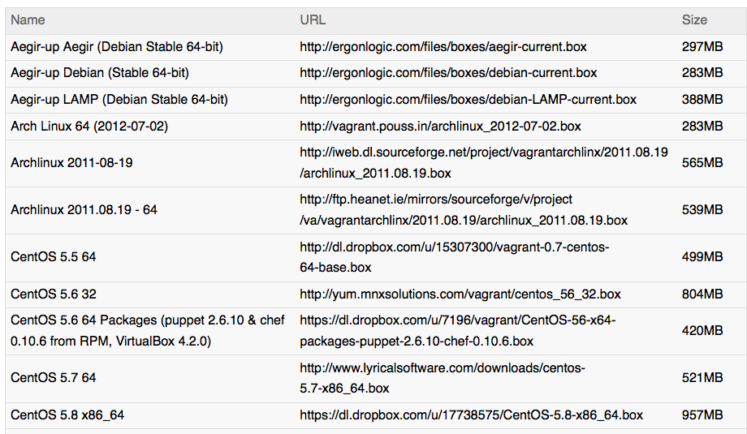
Choosing a base box
http://vagrantbox.es/
Notes:
Nearly 100 boxes.

Slide 83
Puppet or chef?

Slide 84
Puppet or Chef?
Puppet and Chef do the same thing –automated provisioning:
  Installing packages (apt-get install / yum install)
  Creating users + groups
  Managing config files
  Any provisioning task imaginable
  (but you might have to write the plugin)
Both are Ruby applications.
Both have an active open-source community.

Slide 85
Puppet or Chef?
How do you choose?
  Is anyone in your team familiar with either of them?
  Do you use any modules/packages/vagrant setups which expect one or the other?
  Can you easily find support (either paid-for or free) in your community?

Slide 86
Puppet or chef resources
Puppet
Chef
The Drupal.org testbots
http://drupal.org/project/drupaltestbot-puppet
Demo from this talk
https://github.com/Techito/vagrant_drupal_box
Project Oscar
https://github.com/manarth/oscar
Megalodon
https://github.com/msonnabaum/megalodon
(native install, rather than VM).
Drupal Vagrant project
http://drupal.org/project/vagrant

Slide 87
Key resources
Virtualbox
https://www.virtualbox.org/
Vagrant
http://vagrantup.com/
Base-box list
http://www.vagrantbox.es/
Puppet resources
http://puppetlabs.com/
Chef resources
http://www.opscode.com/chef/

Slide 88
Other resources
Drush Vagrant
http://drupal.org/project/drush-vagrant
Veewee (to build base boxes)
https://github.com/jedi4ever/veewee
IRC: #vagrant

Slide 89
Beyond Vagrant & dev VMs

Slide 90
Beyond Vagrant & dev VMs
Vagrant is expanding to cover other provisioning tools:
  VMWare Fusion
  ESXi
  Amazon
  ???
Puppet and Chef can manage your test/stage/CI/production environments too.
Tools like Cobbler and Satellite can fully-automate the build of new VMs

Slide 91
A quick summary

Slide 92
Vagrant…
Automates the setup and installation of a local dev VM.
Create a fully-configured ready-to-go VM in minutes.
Basic usage doesn't need any new skills.
Advanced configuration possible with Veewee, Puppet and Chef.
To get started: download an open-source Vagrant setup, or build your own.

Slide 93
Thanks for coming!
Marcus Deglos
Blog: http://deglos.com
Email: marcus@techito.co.uk
Slides: http://slideshare.net/manarth
Twitter: @manarth
Questions?

Slide 94
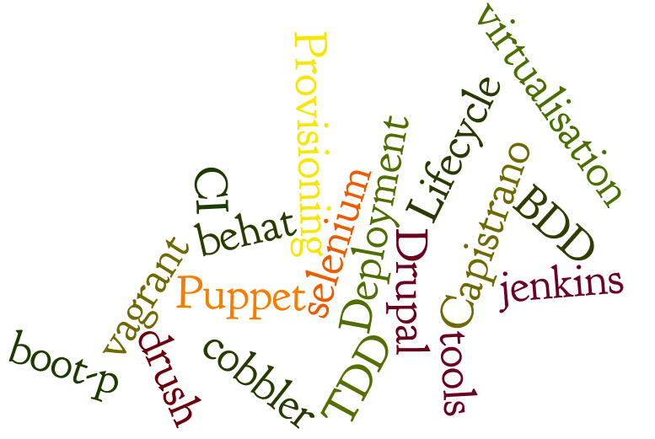

Build websites
Develop modules
Offer technical consultancy
http://techito.co.uk/

