Slide 1
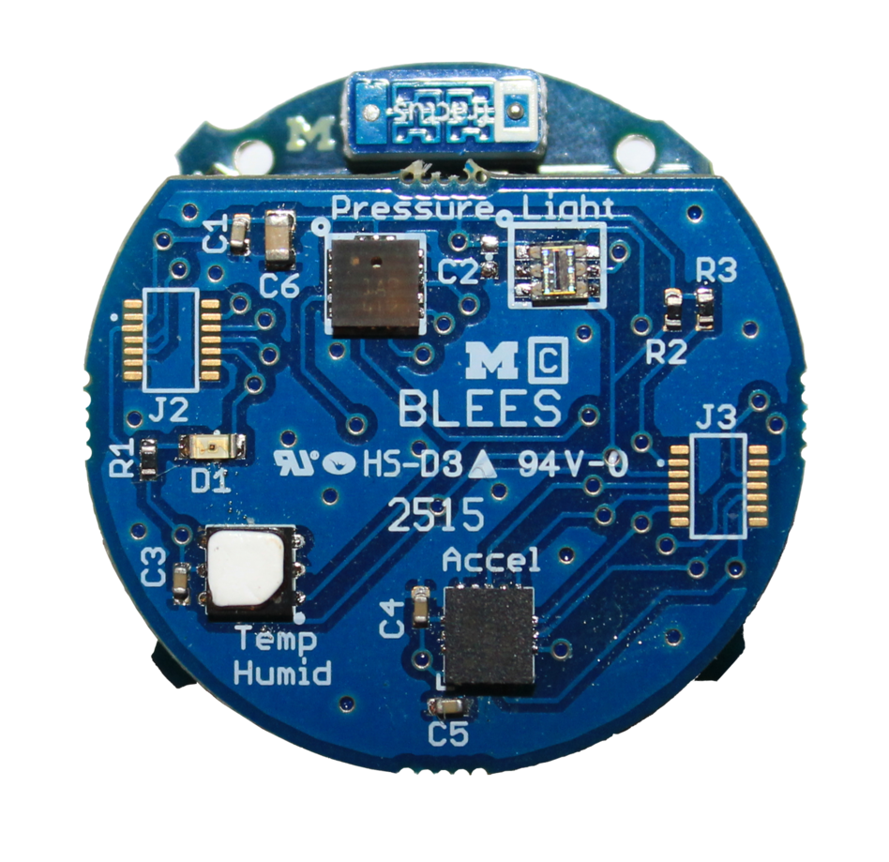









BLEES
Indoor Ambient Sensing
Download the app!
Summon App for Android
UI discovery for the IoT
Also works with
PowerBlade
PolyPoint
https://play.google.com/store/apps/details?id=edu.umich.eecs.lab11.summon

