Slide 1
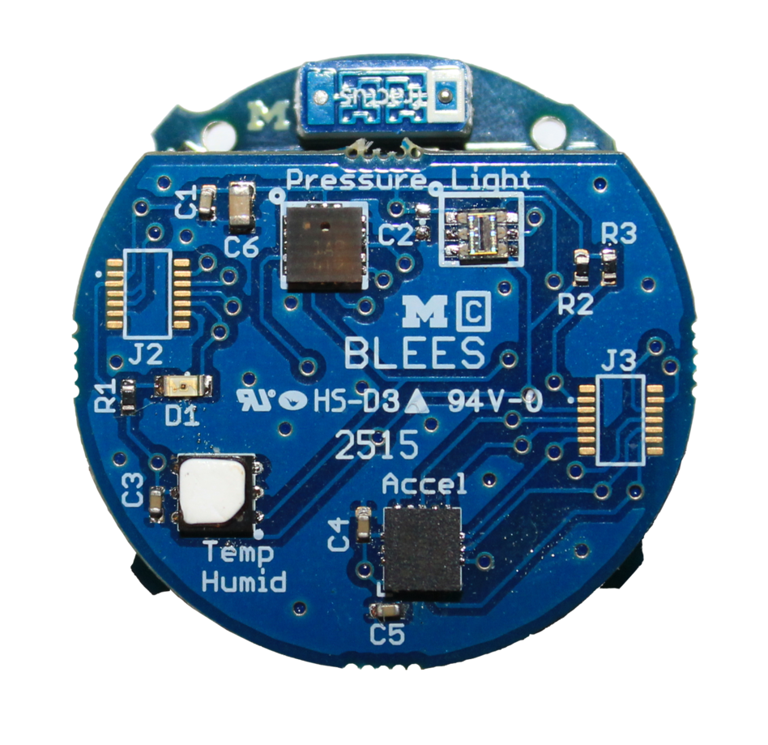









BLEES
Indoor Ambient Sensing
Download the app!
Summon App for Android
UI discovery for the IoT
Also works with
PowerBlade
PolyPoint
Search “Summon Lab11” on the Google Play store
https://github.com/lab11/blees
https://github.com/lab11/summon

