Slide 1
Dallas, Texas COVID-19, Unemployment, Uninsured Healthcare
Andrew Zhou
Notes:
The goal of this presentation is to demonstrate that you are able to effectively communicate your research questions, methods, conclusions, and implications to a non-data-scientist audience.

Slide 2
Problem
How did COVID-19 and mask mandates impact Dallas, Texas’s Unemployment and Uninsured Health Insurance Rates?
Main Goal: How does COVID impact Unemployment and Health Insurance and in return impact the death rate in Dallas, Texas?
How did mask mandates help with the COVID-19 cases and unemployment?
Hypothesis:
COVID-19 daily cases is positively correlated with unemployment.
As COVID-19 cases increases, unemployment increases.
As unemployment increases, Uninsured Health Insurance rates increase.
More people are likely to not to get their needed medical attention.

Slide 3
Problem
How did COVID-19 and mask mandates impact Dallas, Texas’s Unemployment and Uninsured Health Insurance Rates?
Main Goal: How does COVID impact Unemployment and Health Insurance and in return impact the death rate in Dallas, Texas?
How did mask mandates help with the COVID-19 cases and unemployment?
Hypothesis:
COVID-19 daily cases is positively correlated with unemployment.
As COVID-19 cases increases, unemployment increases.
As unemployment increases, Uninsured Health Insurance rates increase.
More people are likely to not to get their needed medical attention.

Slide 4
Why it matters?
Dallas, Texas has a history of having one of the highest rates of uninsured health insurance in the United States.
In the past few years, Dallas, Texas has held the largest uninsured health insurance rates of any city in the United States several times.
Out of 10 most uninsured cities in the country, 7 cities are in Texas.
“Hospital leaders have said that these uninsured patients put off preventable care until something is wrong, and end up in the emergency room with costly uncompensated care for hospitals to deal with.”

Slide 5
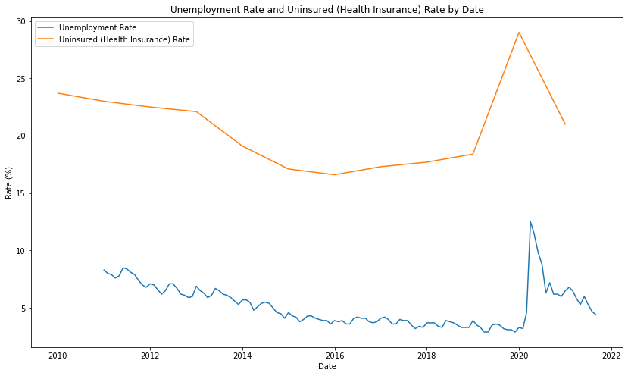
Unemployment and Uninsured Health Insurance Rates
Dallas, Texas’s history of unemployment and uninsured health insurance rates.
Uninsured health insurance rates hover around the 16-25% rate, which is very high.
Unemployment is decreasing before COVID
Both Unemployment and uninsured insurance rates spike when COVID starts
Notes:
Unemployment and Uninsured Health Insurance rates are highly correlated

Slide 6
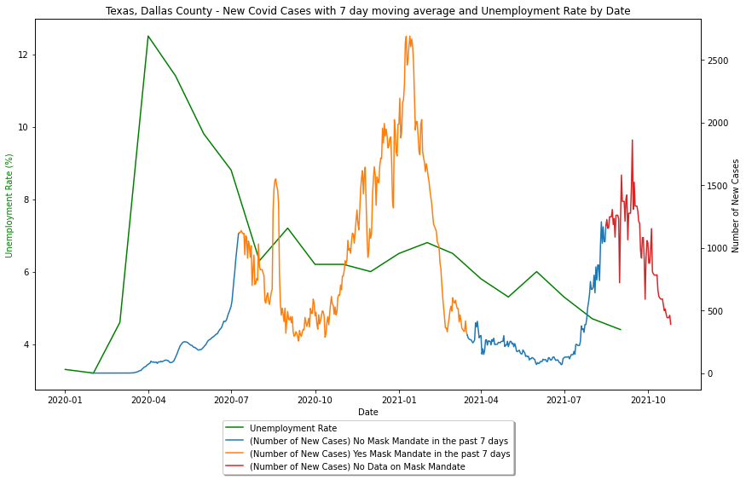
Unemployment plotted with COVID cases
Dallas, Texas unemployment rate along with COVID-19 new daily cases
We can see there is a large spike in unemployment at the beginning of the pandemic, then steadily drop back down
It is difficult to determine if there is any correlation through this graph

Slide 7
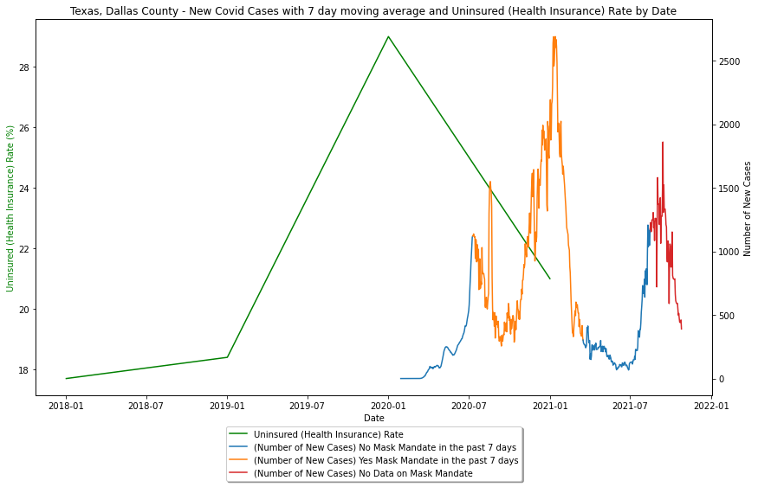
Uninsured Rates plotted with COVID cases
Dallas, Texas uninsured health insurance rate along with COVID-19 new daily cases
The graph is very similar to the unemployment graph
The uninsured rate spikes at the pandemic, then drops

Slide 8
Unemployment and COVID cases Correlation
Regression model with Unemployment Rate as the dependent variable.
New Covid Cases as the independent variable.
There is not enough evidence for a correlation.
COVID-19 only caused a spike in unemployment in the beginning, but it turns out they are not correlated afterwards.
Residuals:
Min 1Q Median 3Q Max
-5.5081 -0.7392 0.3505 1.6163 3.8356
Coefficients:
Estimate Std. Error t value p value
_intercept 7.035601 0.726765 9.6807 0.000000
New_Cases -0.000632 0.000637 -0.9928 0.333299
---
R-squared: 0.02285, Adjusted R-squared: -0.03144
F-statistic: 0.42 on 1 features

Slide 9
How does Mask Mandates impact COVID?
ANOVA with Mask Mandate and New COVID Cases.
Mask Mandates and New COVID Cases are highly correlated.
However, they are positively correlated.
With Mask mandates, there is more New COVID Cases.
This means Mask mandates were put in the worst periods of COVID and the New COVID Cases increased regardless of the Mask mandates.
Residuals:
Min 1Q Median 3Q Max
-5024.62 -124.62 198.3588 358.3588 1092.38
Coefficients:
Estimate Std. Error t value p value
_intercept 358.358779 35.349940 10.1375 0.0
Mask Mandate 691.021221 60.006186 11.5158 0.0
---
R-squared: 0.16181, Adjusted R-squared: 0.16051
F-statistic: 123.75 on 1 features

Slide 10
Dallas, Texas Death Rate
Dallas, Texas has a death rate of 200.6 deaths / 100,000 people.
That’s actually ranked 2004 out of 3227 counties under analysis.
Dallas, Texas actually has a relatively low death rate, despite having one of the highest uninsured health insurance rates in the United States.

Slide 11
Conclusion
My Hypothesis is completely wrong!
Masks mandates were positively correlated with COVID cases, meaning COVID cases increased regardless of the mandates.
This in turn did not end up impacting unemployment rate and uninsured health insurance rates at all
COVID actually did not impact unemployment rate and uninsured health insurance rate except for the initial spike at the start of COVID.
Unemployment and Uninsured health insurance rates both steadily decreased after the initial spike
It is likely the people who were insured through their employment got their insurance back after being employed again shortly.
Despite Dallas having high uninsured health insurance in general, the county seems to be doing well in terms of death rate.

Slide 12
Conclusion
My Hypothesis is completely wrong!
Masks mandates were positively correlated with COVID cases, meaning COVID cases increased regardless of the mandates.
This in turn did not end up impacting unemployment rate and uninsured health insurance rates at all
COVID actually did not impact unemployment rate and uninsured health insurance rate except for the initial spike at the start of COVID.
Unemployment and Uninsured health insurance rates both steadily decreased after the initial spike
It is likely the people who were insured through their employment got their insurance back after being employed again shortly.
Despite Dallas having high uninsured health insurance in general, the county seems to be doing well in terms of death rate.
Notes:
Despite not having enough evidence to conclude that there is an correlation between

