Slide 1
Online auditory training for people with hearing loss and cochlear implants
Evan Currier
Christopher Guevara
Analil Mamucod

Slide 2
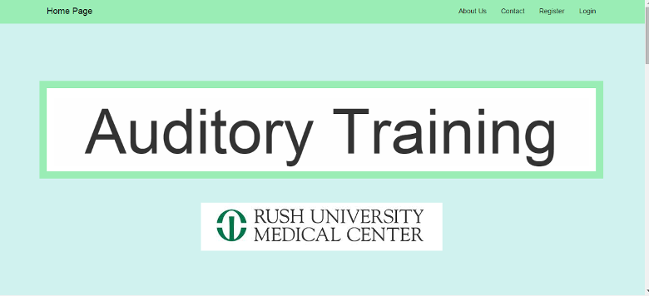
Homepage

Slide 3
About Us

Slide 4
Contact

Slide 5
Register

Slide 6
Login

