Slide 1


OFFICIAL DOCUMENTATION · V1.1 · ISSUED
APN Opportunity — Lark Base guidelines
From 18 September 2026, type the opportunity in Lark. Lark still sends it to APN. Do not create a live customer opportunity until then.
GAP sales · Malaysia, Indonesia, Vietnam
Knowledge Transfer 14 September 2026
Internal · v1.1 · © G-AsiaPacific

Slide 2

WHY LARK
A different door into the same APN
AWS launched a new APN. That new APN has limits for our team.
You type the opportunity in Lark. Lark still sends it to APN.
You are not keeping a second set of books.
Internal · v1.1 · © G-AsiaPacific

Slide 3
WHAT YOU WILL SEE
Only Submission is typed. Ignore Client management and funding.
APN Oppt Submission Table
APN Oppt Status Table
The only table you type into. Draft with Grid + Add Record. Send from Form. Watch Sync_Status on Grid.
View only. Check AWS_Review_Status and deadlines. Do not add rows.
Docs
APN AWS Invitations
Process guide in the APN folder if you forget a click.
Sales admin (Vietnam and Indonesia). Referral accept / reject. Extra for AMs.
Internal · v1.1 · © G-AsiaPacific

Slide 4

WHICH JOB?
Pick one path. Do not mix Form, Add Record send, Retry, and Update.
Draft
Send
Change
Referral
Every AM
Every AM
Every AM
Sales admin
Grid → + Add Record
Leave Submit unticked
Form → Submit
or tick Submit on a draft
Only if Status is Approved
Grid → Update
Invitations table
No Form
Sales admin for referrals: Michael Nguyen (Vietnam) and Alvindo (Indonesia).
Internal · v1.1 · © G-AsiaPacific

Slide 5
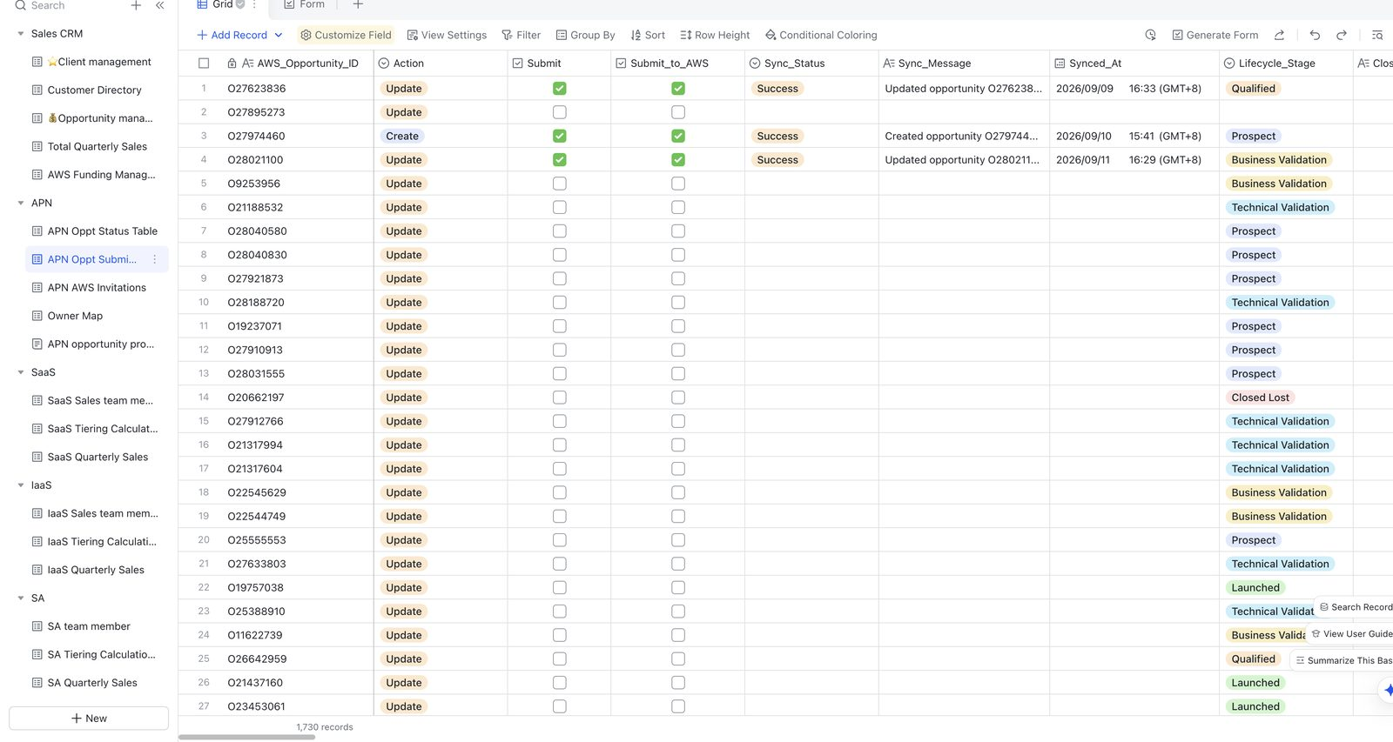
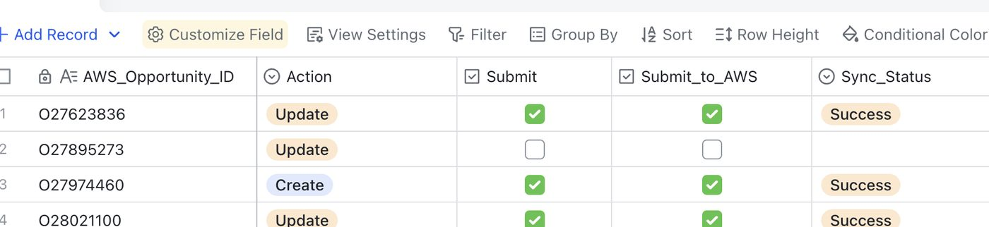
DRAFT — GRID + ADD RECORD
Click + Add Record. Leave Submit off.
Open Submission → Grid.
Click + Add Record on the toolbar. Not + New under the table list.
Fill the row. Leave Action as Create.
Leave Submit and Submit_to_AWS unticked. Sync_Status empty = draft. AWS has not received it.
When ready: tick both. Set Pending if it does not move. Keep Action = Create.
Internal · v1.1 · © G-AsiaPacific

Slide 6
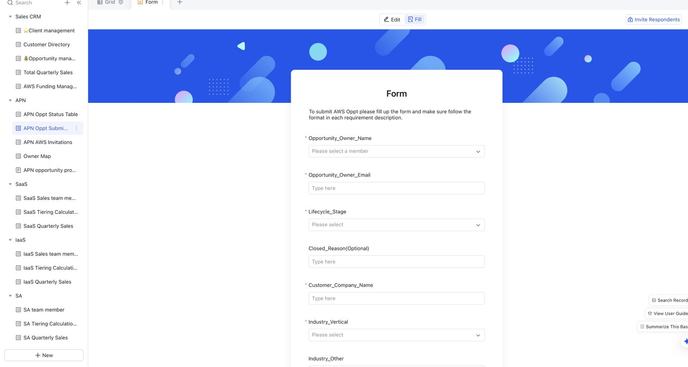
SEND NOW — FORM
One-shot Create. Fill, then Submit.
Form
Use Fill, not Edit. Fill required fields. Follow the format rules.
Submit
Click Submit. Then open Grid.
Wait one minute
Sync_Status: Pending becomes Success or Failed.
If Failed
Side Peek → Sync_Message → fix that field → Retry. Leave Action = Create. Do not click Update.
Internal · v1.1 · © G-AsiaPacific

Slide 7

UPDATE
Only if Status is Approved. Do not type in Status.
Go
Stop
Stop
Approved. Edit on Submission. Click Update. Leave Action as Update.
Pending submission. Do not Update. Wait on Status.
Create still Failed. Retry first. Do not Update.
If Update then Failed
Read Sync_Message. Fix that field. Click Update again. Do not click Retry on an Update.
Internal · v1.1 · © G-AsiaPacific

Slide 8

REFERRAL — SALES ADMIN
No Form. The invitation row already exists.
Open APN AWS Invitations.
Find the row (country + engagement title).
Set Decision to Accept (or Reject).
Set Assignee to the account manager.
Set Sync_Status to Pending. Then wait.
AWS_Opportunity_ID appears. Status still takes about six hours.
Internal · v1.1 · © G-AsiaPacific

Slide 9
TWO CLOCKS AND BUTTONS
Draft with ticks off does not start the 1-minute clock.
After Form Submit or Update
After Success create
1 min
6 hours
Look at Submission → Sync_Status
Look at Status → AWS_Review_Status
If this happened
Click
Leave Action as
New Form submit Failed
Retry
Create
Approved opportunity needs a change
Update
Update
Update then Failed
Update again
Update
Internal · v1.1 · © G-AsiaPacific

Slide 10
FORMAT — WHY ROWS FAIL
Read Sync_Message and fix that field.
Problem ≥ 20 characters
Phone E.164
Launched Stage
Customer need must be a real sentence or Sync_Status Fails.
+601121555525 — plus, country code, no spaces.
You must have AWS Account ID. Missing ID = Failed.
Internal · v1.1 · © G-AsiaPacific

Slide 11

EXISTING OPPORTUNITIES AND GO-LIVE
18 September 2026
Open opportunities from 2025 to now will be moved into this Base. Do not recreate those deals.
All GAP sales use this Lark Base from 18 September.
Until then you may practise Add Record. Do not tick Submit on a real customer.
Internal · v1.1 · © G-AsiaPacific

Slide 12

IF YOU ARE STUCK
Error, bug, or unclear Sync_Message?
APN TroubleShoot
APN flow
Ask in this group. Always send three things:
Ask Eylia
+6016-4244515 · or Azib / APN champions
Your Oppt ID
Your Status (Sync_Status / AWS_Review_Status)
Your Sync_Message
Do not patch AWS_Review_Status by hand.
Internal · v1.1 · © G-AsiaPacific

