Slide 1
Bmail
“ Applied Cryptography in Communication”
Project Members Supervisor
Bijaya Pokhrel Binod Sharma
Chetan Rijal Mentor
Dipesh Bhandari Deep Sharma

Slide 2
Table of Contents
Introduction
Problem Statement
Objectives
Scope and Limitation
Development Methodology
Background Study and Literature Review
System Analysis
Feasibility Analysis
System Design
Algorithm Details
Unit testing and System testing
Conclusion and Recommendation

Slide 3
Introduction
“Bmail” is a web based tools that help every
user secure their message from unauthorized access. It mainly apply encryption and decryption method to secure text which is send by user to the receiver in a open Network.

Slide 4
Problem Statement
People give their credential information in email. Many people have less knowledge about the importance of their data. People can easily see other mail in insecure channels.
To overcome this problem, we developed the Bmail desktop application through this application data can be encrypted and decrypted while transferring.Eavesdrop cannot find our real text because of encryption.

Slide 5
Objectives
Confidentiality: To protect data from unauthorized access.
Integrity: To ensure that data has not been tampered with.
Availability: To ensure that data is accessible when needed.
Security: To ensure strong encryption, secure protocols
and key management.

Slide 6
Scope and Limitation
Scope
The mail application will be designed to be user-friendly and easy to use.
The email application will use cryptography techniques, encryption and Decryption
Limitation
It may provide no security if the users devices password is compromised.
Failure in key management and key leakage can compromise the security of the system.

Slide 7
Development Methodology
Waterfall Model
Requirement Analysis
System
Design
Implementation
Testing
Deployment
Maintenance

Slide 8
Background Study and Literature Review
Backgroung Study
In context of Nepal, the need of Cryptography is increasing day by day with growing use of digital technology and internet, which leads to increase in cyber threats such as data theft, identity theft and cyber attacks. With rapid advancement in web technology there is a growing needs to protect sensitive information, and other confidential information from these threats.
Literature Review
we will examine some of other cryptographic communication application that are available.
Signal
Telegram
Photon mail

Slide 9
System Analysis
System analysis is a process of studying and evaluating the security of cryptographic communication system. It involves analyzing the system’s architecture, protocols and algorithm to identify potential vulnerabilities and threats to the system’s security.

Slide 10
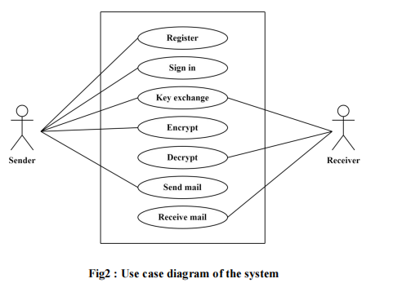
Use Case Diagram

Slide 11
Feasibility Analysis
There are three main types of feasibilities to be considered under this analysis. They are:
Technical
Operational
Economic

Slide 12
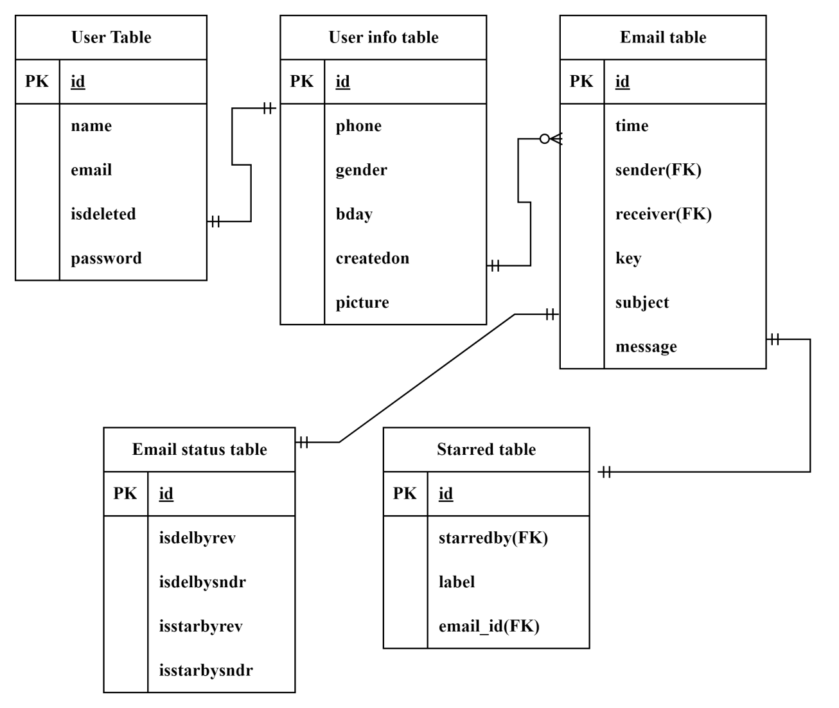
Database Schema
Table: Database Schema

Slide 13
System Design
System Design
System design is an essential step in software development that requires significant effort and cost. To minimize errors and reduce costs, a prototyping model is often used to test software. The goal of system design is to plan and implement a practical solution to a problem, accomplished through two phases: logical design and physical design.

Slide 14
Encryption and Decryption
Encryption is the process of converting data into an unreadable format, also known as ciphertext.
Decryption is the process of converting ciphertext back into its original readable format, also known as plaintext.

Slide 15
Implementation of Diffie-Hellman key exchange Algorithm
Algorithm
Alice and Bob agree on p and g
Alice
Bob
Selects private key (a)
Public channel
Selects private key (b)
Computes his public key
(g^a mod p)
Computes his public key
(g^b mod p)
Computes
(g^b mod p)^a mod p=
g^ba mod p
Computes
(g^a mod p)^b mod p=
g^ab mod p
k = g^ab mod p
Shared secret key

Slide 16
Key used
Keylist list used
[b”a@1234ed”]
[b”$5frcddd”]
[b”$cnj2nfc”]
[b’’@1k4cvqu”]
[b”2@9nb$rq”]
[b”10@b8bn1”]

Slide 17
Tools Used (CASE tools, Programming languages, Database platforms)
Python
Python is a general-purpose, high-level programming language.
Tkinter
Tkinter is the Python binding to the Tk GUI toolkit.
Socket programming
Socket programming is a way of creating applications that can communicate with each other over a network.
PostgreSQL
PostgreSQL is an open-source, object-relational database management system (ORDBMS).

Slide 18
Unit Testing and System Testing
Unit testing: Testing individual components or units of code to ensure their correctness and functionality.
System testing: Testing the entire software system to verify its behavior, functionality, and compliance with requirements.

Slide 19
Test cases for unit testing
Test for sign up
Test for sign in
Test for sending and receiving mail
Test for starred mail
Test for delete mail
Test for profile management
Test for delete account from the system
Test for logout

Slide 20
Test cases for System testing
Test for user authentication
Testing the entire email sending and receiving process
Integration of GUI with backend functionality
Encryption and Decryption of mails

Slide 21
Conclusion and Recommendation
The project has gone through a series of activities to develop a complex solution for applied cryptography in communication in Bmail.
There are several areas for future enhancement and expansion:
Use strong encryption algorithm for secure communication.
Implement secure key exchange protocols.
Authenticate communication participants to ensure
identity.

Slide 22
Thank you

