Slide 1
B. Sc. CSIT Final Year Project Work
Tribhuvan University
Some idea and Trends
Bikash Balami
Lecturer
CDCSIT, TU

Slide 2
Today’s Plan
Discussion about B.Sc.CSIT Final year project
TU Perspectives
College Practices
Trends
Discussion about Your mind
Report Writing

Slide 3
You can ask the question at any time, please don't wait for the end

Slide 4
Project
  Existing Situation Desired Situation
  A Project
Pursuing a project within academia is not the same as performing a project within industry.
Academic projects should provide evidence of a much deeper understanding of what you are doing. They require some form of justification and contextualization.
Set of Actions

Slide 5
Why... ???
The idea behind the project work s to familiarize students more extensively with the methodology of their chosen subject and also to allow them to interact with examples of the real world practical problems that always occur during research/project work.
Learning more: The project is an opportunity for studying a subject in more depth and work independently.
A stepping stone towards professional career: You may view the project as preparation for working life, by practicing your skills and knowledge on real world problems.
A stepping stone towards graduate studies: You may use the project as preparation for graduate studies, by exploring a research problem and learning about the research process.

Slide 6
Why... ??? : University Expectation
University probably sees your project as serving two further purposes:
  “educational” part of the project: The project should (1) develop your critical thinking; (2) enhance your ability to work independently; (3) increase your understanding of how to use and appreciate scientific methods as tools for problem solving; and (4) develop your presentation skills, oral as well as written.
  The second goal is the “research” part of the project, in which you will deepen your understanding of the subject area, and contribute to the common knowledge and understanding of the subject area. However, to attain this goal, your project must have aspects that are original.
  Developing Team work culture.
  Developing report writing and communication skills.

Slide 7
What to do and how to …
Subject area: What is the topic and scope of your project?
Aim: What is the goal of your project?
Arguments: Why is it important to investigate the chosen topic?
Objectives: Preliminary ideas for how you intend to achieve the aim.
No project is completed until its objectives has been achieved.

Slide 8
What to do and how to: Prepare Proposal
  1. Introduction
  2. Problem Statement (Why have you chosen this topic?)
  3. Objective
  4. Scope and limitation
  5. Methodology
        5.1. Requirement Identification
5.1.1.Study of existing system
5.2.2. Requirement Collection
        5.2. Feasibility Study
5.2.1.Technical
5.2.2. Operational
5.2.3. Economical
5.3.3. Schedule
        5.3. Tools
5.3.1. Analysis and Design tools
5.3.2. Implementation tools ( Front End , Back End)
  6. High level design of Proposed System (By system flowcharts, use cases or other appropriate diagrams)
  7. Expected Outcome
  Based on syllabus of Tribhuvan University

Slide 9
What to do and how to …
Programming in project?
You are expected to write a program.
Sometimes programming is the main emphasis of your
project, for example, if you are on a software engineering
approach. At other times, you may need to write a
program as a ‘vehicle’ for testing and demonstrating one
thing or another, for instance, to test out some ideas,
demonstrate a technique or algorithm, or evaluate some
concepts.
Even though not all of the approaches involve programming; to write a program for you is highly recommended as you have to demonstrate project prototype!

Slide 10

How to choose a subject area !

Slide 11
How to choose a subject area !
Which subject area to choose is a decision that only you can make; nobody else will make this decision for you !
You should strive to choose the subject area that you are most interested in. This will have a positive effect on the entire project.
You focus your interest by identifying a problem within the subject area that you would like to explore. Then have a significant Literature Review!

Slide 12
How to choose a subject area !.....
Don’t go for others’ interest, go for your own
The work must be research oriented
Choose the topics from your interested domain
Select the appropriate supervisor, who has knowledge on the domain you chose
Discuss with your supervisor, collect the papers related to your work
Design the proposal

Slide 13
Some Research Areas
Natural Language Processing
Information Retrieval
Data Mining
Optimization
Scheduling
Machine Learning
Neural Network
Search Engine
Social Network
Android Apps
Cryptography (Web Security, Network Security)

Slide 14
Some Research Topics
Intrusion detection
Reality Mining
  Sense Network
  Path Intelligence
Web usage mining
Web Mining
Fraud detection using Neural Network
Article Mining (Group the similar news articles from different newspapers like GoogleNews)

Slide 15
Some Research Topics…
Morphological Analysis of Nepali Words
Word Net for Nepali words
Recommender system like book recommender movie recommender
Learning by Web
Fact checking chat room or electronic forum on social networks
Opinion Mining (finding the market analysis on a particular product)

Slide 16
Some Research Topics…
Text Mining (Spam Filtering)
Query Optimization
Optimization in scheduling in cloud computing
Statistical Machine Translation (English Language to Nepali Language Translation)
Chatbot (Turing test) like Eliza - "a friend you could never have before”
Name entity recognition in NLP (Semantic Web)
Gesture Mining (E-Mail Sorting, Prioritizing friends in smart phone)
Information Extraction from web
Spelling corrector

Slide 17
Some Research Topics…
Handwriting recognition
Mining social network
OCR

Slide 18
Sample Projects
Automated Text Summarizer
Fingerprint Verification System
Spam Mail Filtering
Stock Market Analyzer
Intrusion Detection System
Movie Recommender
Disease Prediction System
Do not Limit your project just to simple information Systems like Hospital Management System, School Management System, etc. Even if you prefer, don’t forget to add Computer Science theories and algorithm in your project, as much as possible!!

Slide 19
Sample Projects
Choosing Platforms like Android / Web based / Desktop based is not a big deal !
Main thing is the concept .. !!
Automated Text Summarizer
Fingerprint Verification System
Spam Mail Filtering
Stock Market Analyzer
Intrusion Detection System
Movie Recommender System
Disease Prediction System

Slide 20

Areas
  Machine Learning
  Data Science
  Security
  Cloud Computing
  Intelligent Systems
  NLP and many more…
Platforms
  Python, R, Java, .NET, ROR, PHP, JavaScript with frameworks such as Angular, React, and many more…

Slide 21
College Trends in My Focus Justifiable to B.Sc.CSIT….

Slide 22
Some projects that have been done in previous years
Local Search Engine
Nepali Text to Speech
Lost and Found
Job Recommender
Face Detection and Recognition
Article Mining
Traffic Management
Thread Recommendation
Helping Friends
Finding Blood Donor
Intelligent Proxy
Fraud Detection/Intrusion Detection
Natural Language Query
Process Hibernation
Birthday Calendar

Slide 23
Continue…
Image Classification
Prediction (Disease, Weather,…..)
Sentiment Analysis
Disaster Management
NLP
  Machine Translation
  Spelling Correction
  Text Summarization
Optical Character Reader (OCR)
Comparative Analysis of Clustering and Classification Algorithms

Slide 24
Bitter Truth

Slide 25


Slide 26


Slide 27
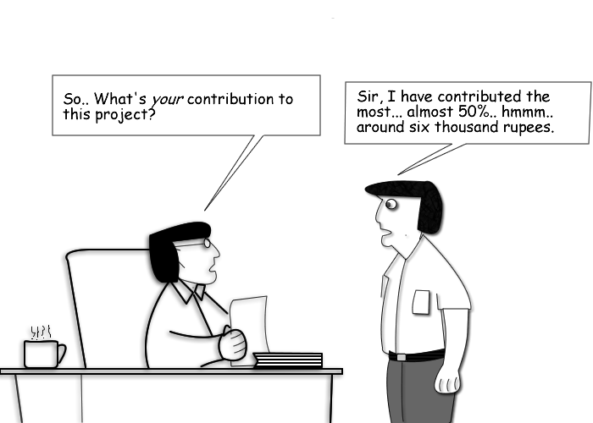

Slide 28
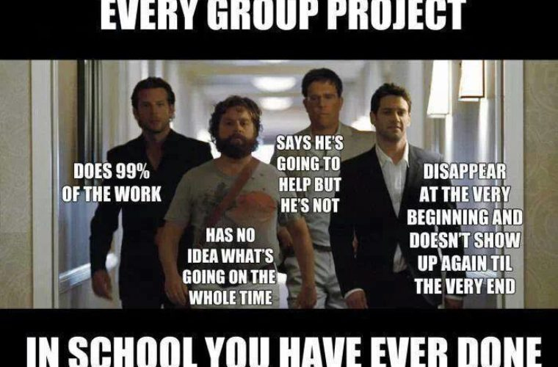

Slide 29
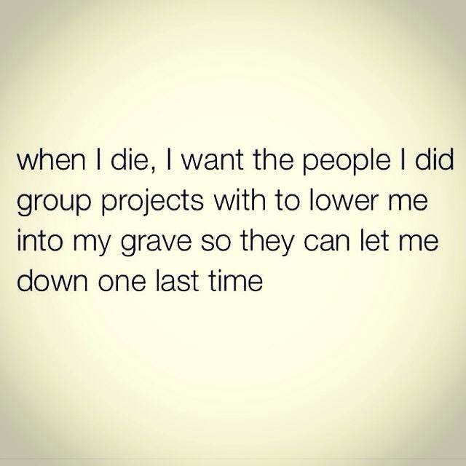

Slide 30
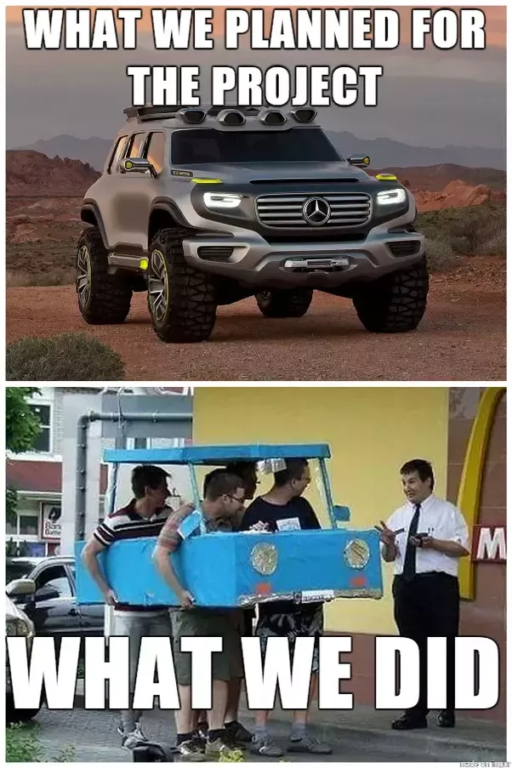

Slide 31


Slide 32


Slide 33
Project Evaluation
Marks distribution in percentage (out of 100):
Proposal 10%.
Mid Term Defense 30%
Final Defense 60%
Evaluators:
Project Supervisor 60%
Internal ( HOD/Program Coordinator/Faculty) 20%
External 20%
(A fair evaluation should be done by internal, supervisor and external.
Marks should be justifiable )

Slide 34
Project Evaluation
Focus of the evaluation
    Scope of the Project (Value Added)
    Analysis and Design of Project
    Project Report Documentation
    Presentation
    Project Implementation (followed by demo session)
    Viva/Question Answer

Slide 35
Results and Contributions of the Project: Don’t forget to revise!
How far you are involved in each activities of project?
Have you critically evaluated your own solution / approach / development?
What is the overall contribution of your project?
Have you evaluated your work with respect to your original aims and objectives?
Have you documented your work appropriately?
Is your system ready to execute?
How many times your were in contact with your supervisor? Follow up your supervisor continuously! Have as much meeting as possible and get appropriate feedbacks!
(Don’t limit your role!)

Slide 36
In-Semester Minor Projects: Recommend Juniors!
Don’t ever wait for seventh semester
Better practice is to go through minor projects during each
semester in individual subjects where it is possible

Slide 37




Funds and Awards : Motivation factor
Funds and awards from
  University Grants Commission,
  Nepal Academy of Science and Technology,
  Nepal Telecom Authority
  Department of IT, Nepal Government
  Your own College Administration / CSIT Club.

Slide 38
Suggested Readings
Christian W. Dawson, “Projects in Computing and Information Systems: A Student’s Guide”, 2nd Edition, Addison Wesley.
Hossein Hassani, “How to do Final Year Projects: A Practical Guideline for Computer Science and IT Students”.
Mikael Berndtsson, Jörgen Hansson, Björn Olsson, Björn Lundell “Thesis Projects: A Guide for Students in Computer Science and Information Systems”, 2nd Edition, Springer.

Slide 39
Ethical Issues
Good practice for report writing
If you copied something from others’ recourses like papers, book, you have to cite that resources

Slide 40
So, lets start with ……. Self studying behavior !!!

Slide 41
Lets Move to Second Session

Slide 42
Project Report
A detailed documentation of your project work
As the report represents your project, remember that the good work you have performed can be ruined by a poor report.
Is the major evidence of your project when it is finished
Reflection of the project.

Slide 43
Writing and Structuring the report: Basic Requirements
A report should be:
    Well structured ( As per the standard set by the University)
    Well written
    Concise and focused
    Clear
    Properly typeset (As per the standard set by University)
    Well referenced and cited properly (IEEE Standard)

Slide 44
Writing and Structuring the report: Considerations
What is the purpose of the report?
  To present your work in best light,
  To disseminate your ideas to others
  To get better evaluated! ☺
Who is going to read it?
  What do they already know?
  What do you want them to learn?
  What do you want them to gain from your report?
  Will it be read by people other than your examiners (junior and students, academics and experts,…..)

Slide 45
Writing and Structuring the report: Approaches
  Creating chapter breakdown hierarchy and then after student can go on to complete these sections at an appropriate point in their project when results are obtained and information is acquired.
  Equally distribute chapters to each participant. All of group members should have equal contribution and knowledge about the chapters in the report.

Slide 46
Writing and Structuring the report: When to start?
Don’t ever wait for deadlines!
Parallel documentation with project work activities.
Chapter write-up, reviews by students and feedbacks by supervisors. This will mean students do not have to endure the stress of a prolonged writing phase when their project nears completion.

Slide 47
Writing and Structuring the report: Order
Order to writing that you are suggested to follow:
  Identify Structure: Chapter Breakdown
  Identify Presentational style: Formatting
  Write Abstract
  Develop Main Body
  Articulate Conclusion and Recommendations
  Add References and Appendices
  Proof Read, Check and Correct

Slide 48
Writing and Structuring the report: Structure
  Title Page (Make sure its uniform)
  Supervisor's Certificate/ Recommendation
  Internal, External Examiners' Approval
  Acknowledgements
  Abstract
  Table of Content
  List of Figures / Tables / Listings
  Main Body
  References / Bibliography
  Appendix

Slide 49
Writing and Structuring the report: Writing Abstract
  Briefly summarize the nature of your research project, its context, how it was carried out, and what its major findings were.
  The abstract provides the reader with an overview of your project and is the basis on which many readers will decide whether or not to read your report at all.
  With this in mind your abstract should be concise (preferably no more than one paragraph long), clear and interesting.

Slide 50
Writing and Structuring the report: Main Body
Chapter 1: Introduction
  1.1 Introduction:
- A good report requires a good introduction which sets the scene by putting the work into a bigger perspective. The introduction gives the reader an idea of the report’s content so it should also help you to clarify your own ideas of project.
This section should reflect concepts in project title.

Slide 51
Writing and Structuring the report: Main Body
Chapter 1: Introduction
  1.2 Problem Definition:
  The problem you attempted to solve. It should present the problem in a non-ambiguous way. What the problem is? How and Why the problem is important, justifying why it should be studied?.
  1.3 Objectives:
  - List the objectives to overcome the problem statement. - Better list in points.
  - Concise and specific to project

Slide 52
Writing and Structuring the report: Main Body
Chapter 1: Introduction
  1.4 Scope and Limitation
  Scope and Limitation of the project: technologies/ features / domains / algorithms
  1.5. Background study (if needed, optional, depends on project)
  1.5 Report Organization

Slide 53
Writing and Structuring the report: Main Body
Chapter 2: Requirement Analysis and Feasibility Analysis
  2.1 Related Works / Existing Work / Literature Review
  - Provide the reader with more information about what the project is about before setting it in a wider context. Review of research works (Articles/ Books/….) done on the relevant field of study.
  - Appropriate citation is essential.

Slide 54
Writing and Structuring the report: Main Body
Chapter 2: Requirement Analysis and Feasibility Analysis
  2.2. Requirement Analysis
  2.2.1. Functional Requirements
  (Use usecase diagram for reflecting the functional requirements)
  2.2.2. Non-functional Requirements
  2.3. Feasibility Analysis
  2.3.1. Economic
  2.3.2. Operational
  2.3.2. Technical
  2.3.2. Schedule (Reflection using PERT Chart / Gantt Chart)

Slide 55
Writing and Structuring the report: Main Body
Chapter 2: Requirement Analysis and Feasibility Analysis
  2.4. Structuring System Requirements
  2.4.1. Data Modeling
  - ER Diagram
  2.4.2. Process Modeling
  - DFD (Context Level, Level 1, 2 ..)
Structured Approach
  Either go for Structured or Object Oriented not their mixture!
  (Let them to use appropriate case tools available)
Notes:
Class Diagram

Slide 56
Writing and Structuring the report: Main Body
Chapter 3: System Design
  3.1. System Design
  3.2.1. Database Schema Design: (Schema structures / tables), normalization
  3.2.2. Interface Design
  3.2.3. Input Output Design (Data inputs, Controlling data inputs, data errors)
  3.2.4. Dialogue Design (Using dialogue diagrams)
  3.2.5. Process Design (Modular Decomposition: Decomposition Diagram, flowchart for each models, physical dfd)
The analysis and design chapter depends on the nature of project!
We should be flexible to content and models.
Notes:
Class diagram with data types, visibility, Adding interface class, data access layer classes, sequence diagram, activity diagram

Slide 57
Writing and Structuring the report: Main Body
Chapter 4: Implementation and Testing
  4.1 Implementation:
  A bit description about how implementation is done. Overview of development methodology adapted.
  4.1.1 Tools Used: Description about the tools and technologies. But never forget to relate them with your project. Contextualize their use in the project implementation.
  (Avoid Basic definitions!)
  4.1.2 Description / Listing of major classes / methods / data structures or any other modules implemented.

Slide 58
Writing and Structuring the report: Main Body
Chapter 4: Implementation and Testing
  4.2. Testing
  4.2.1. Unit Testing
  4.2.2. Integration Testing
  4.2.3. System Testing
  List the probable test cases you attempted during testing phase.
  Sample test cases for each testing strategy.
  Both positive and negative test cases.
  Again, avoid the basic definitions !

Slide 59
Writing and Structuring the report: Main Body
Chapter 5: Maintenance and Support
  Possible/ Prospective strategies for maintenance and support of the project implemented (if any).

Slide 60
Writing and Structuring the report: Main Body
Chapter 6: Conclusion and Recommendation
  6.1. Conclusion:
Summarize how project is done? What the project has achieved? What has been its contribution? How the project has met its initial aims and objectives and if not, explains why? What are the major results and findings?
  6.2. Recommendations

Slide 61
Writing and Structuring the report: References
References and Bibliography
  References list only those articles that have been referred to within the report itself.
  A bibliography will list all the articles you have used in your project but are not necessarily referred to in the body of the report. Bibliographies are useful for the reader in that they identify all material that is relevant for taking your work forward or understanding it in more depth.
  Referencing: There are two aspects to referencing. The first aspect to consider is how to use references correctly within the body of your report – in terms of their presentation and appropriateness – called citing/citation. The second aspect is how to present these references correctly at the end of your report.

Slide 62
Writing and Structuring the report: References
Citing References and Bibliography
  There are numerous variations on these techniques that have their own structures.
  We are prescribed to follow IEEE format for project report.
  APA is prescribed for internship report.

Slide 63
Writing and Structuring the report: Appendix
Appendix
    Snap shots
    Source Code
    Annex Tables

Slide 64
Writing and Structuring the report: Styling/ Format
  The entire document should be in Times New Roman font.
  The font size has to be 12 throughout in paragraphs.
  Font size for the headings will be 16,14,12 (As per the levels)
  Figure captions should be centred below the figures.
  Table captions should be centred above
  Paragraphs must be justified alignment with 1.5 spacing
  The margins to be set as follows:
Top = 1"
Bottom = 1"
Left = 1.25 "
Right = 1"
    Snap shots
    Source Code
    Annex Tables

Slide 65
Writing and Structuring the report: Avoid Plagiarism
  Plagiarism can be performed accidentally or deliberately, but in either case it is deemed a serious academic offence.
  This is one reason why students should perform an extensive literature survey – to ensure that they are not merely repeating the work of others.
  Have proper citation and referencing.
  Supervisors need to stay alert!
  Let’s initiate for a common repository!

Slide 66
Examiners Perspective: Assessment Criteria for Report
  Clarity of content presentation in the report, typos, mistakes
  Hierarchical Structure / Chapter distribution / Content Placement
  Consistency between different parts of the report
  How far the content is relevant and supporting the project work
  Ability to differentiate between others’ thoughts and own
  Ability to handle references and citations
  General stylistic impression

Slide 67
Don’t let the students to Forget !
  Review
  Proof Read,
  Check and Correct
  Not to be much conscious about volume of the report
  Pre-submission ( A week before final defense!)
  Make sure that students read their report thoroughly beforehand so that it is fresh in their mind !

Slide 68
Structuring the Presentation
A number of considerations go into the development of an oral presentation: preparation, content, visual aids, the delivery of the presentation itself and dealing with questions.

Slide 69
Structuring the Presentation …
Introduction: One or two slides that introduce you and your talk.
Main body: The slides that constitute the bulk of your presentation and cover the main points that you wish to get across. How many slides you use within this section will depend on the length of the presentation and the information you wish to convey. (As per the report hierarchy)
Summary/conclusion. A few slides that summarize your presentation and perhaps identify areas of further work.

Slide 70
Structuring the Presentation: Effective Speaking
Communicate Well: Standard language
Dress Well: Be formal.
Voice Projection: Voice level and Clarity
Eye Contact: Eye contact with entire audience
Coordination: Between the team members
Starting / Closing statement: Introduction/ Thank you / Queries

Slide 71
Project Evaluation
Focus of the evaluation
    Scope of the Project (Value Added)
    Analysis and Design of Project
    Project Report Documentation
    Presentation
    Project Implementation (followed by demo session)
    Viva/Question Answer

Slide 72
Thank you ! Keep Learning.

