Slide 1
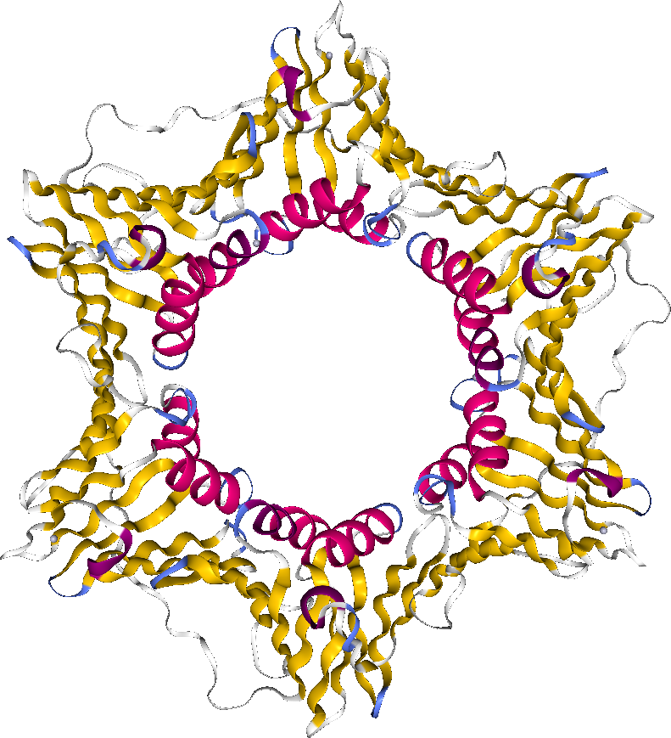
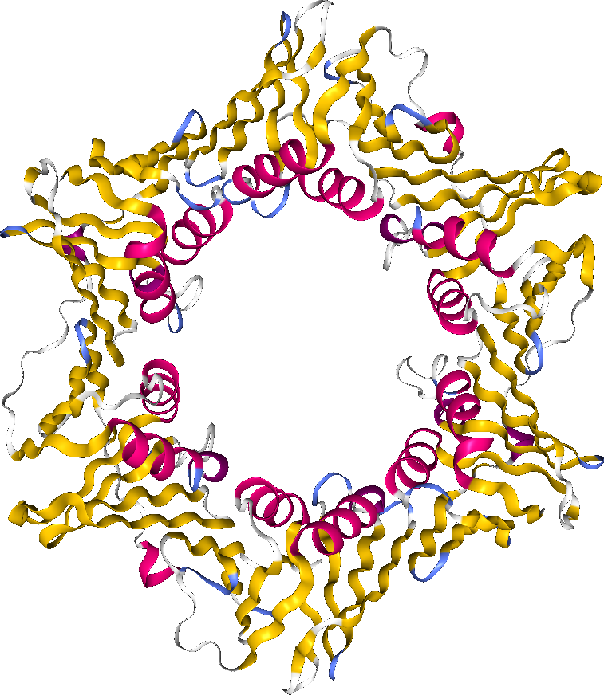

Przyrównanie sekwencji
Mało wiarygodne dla dalekich homologów (<35% ident. sekw.)
SLIDING CAMP PROTEIN
12% identyczności
E. coli
1PLQ
1PLQ MLEAKF--EEASLFKRIID------GFKDCVQLVN---FQCKEDGIIAQA
| | | || | | | | |
2POL --EVEFTLPQATM-KRLIEATQFSMAHQDVRYYLNGMLFETEGEELRTVA
1PLQ VDDSRVLLVSLEIGVEAFQEYRCDHPVTLGMDLTSLSKILRCGNNTDTLT
| | | || | | | | |
2POL TDGHRLAVCSMPIG----QSLPSHSVIVPRKGVIELMRMLDGGDNPLRVQ
1PLQ LIADNTPDSI-ILLFEDTKKD-RIAEYSL-------KLMDIDADFLKIEE
| | | | | | | ||
2POL IGSNNIRAHVGDFIFTSKLVDGRFPDYRRVLPKNPDKHLEAGCDLLK---
1PLQ LQYDSTLSLPSSEFSKIVRDLSQLSDSINIMITKETIKFVADGDIGSGSV
| | | || | |
2POL -QAFARAAILSNEKFRGVR----------LYVSENQLKITAN--------
1PLQ IIKPFVDMEHPETSIKLEMDQPVDLT---------FGAKYLLDIIKG---
|| | | | | | ||
2POL ---------NPEQE---EAEEILDVTYSGAEMEIGFNVSYVLDVLNALKC
1PLQ ----SSLSDRV-GIRL---SSEAPALFQFDLKSGFLQFFLAPKFNDEE
| | | | |
2POL ENVRMMLTDSVSSVQIEDAASQSAAYVVMPMRL---------------
S. cerevisiaea
2POL
Notes:
Alignment can’t detect homologous sequences which share low identity.
Any two unrelated protein sequences can match at 25% when gaps are allowed. So, in practical applications, the area of 20–35% identity is commonly regarded as the “twilight zone”, where remote homologs mix with random sequences. So implying homology at this level of identity is very risky.
For example, here is a sequence alignment of sliding clamp protein from yeast and E. coli. Sliding camp is a protein fold that binds DNA polymerase III. It prevents this enzyme from dissociating from the template DNA strand. By looking at the alignment and not knowing it, I would say this is a joke - only 12% of amino acids are conserved.
However, when you can look at the 3D structures of these two sliding camps, you can see a clear resemblance. 12% of sequence identity is even less than twilight zone. When dealing with this low identity, we say that proteins are in “midnight zone” where homologous relationships cannot be determined with plain pairwise alignments.
This example isn’t just a special case, there are thousands of other gene/protein families that remain structural and functional similarity with lack of sequence identity. Another example: family of proteins with WG/GW domains. This domain is required for Argonaute binding in all eukaryotes. However, the sequence is extremely divergent even between closely related organisms.

