Slide 1


Using R and form{´r} for short polls ‘on the fly’
R-ladies Göttingen meetup March 2021
@annikaziereis

Slide 2
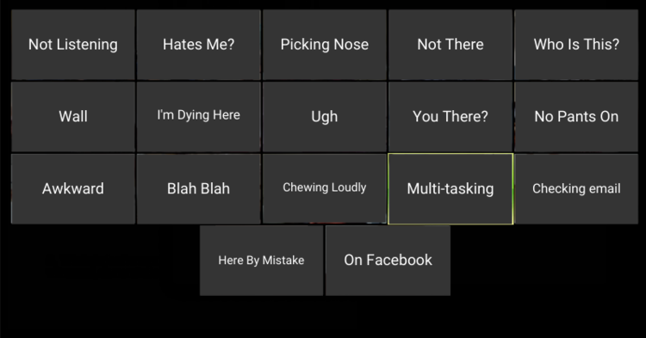
Motivation
Notes:
Online Online teaching via zoom
New content and format
No real face-to-face interaction

Slide 3




…in 4 steps
1. Create survey
2. Upload items and create run
3. Prepare analysis code
4. Run survey and show

Slide 4
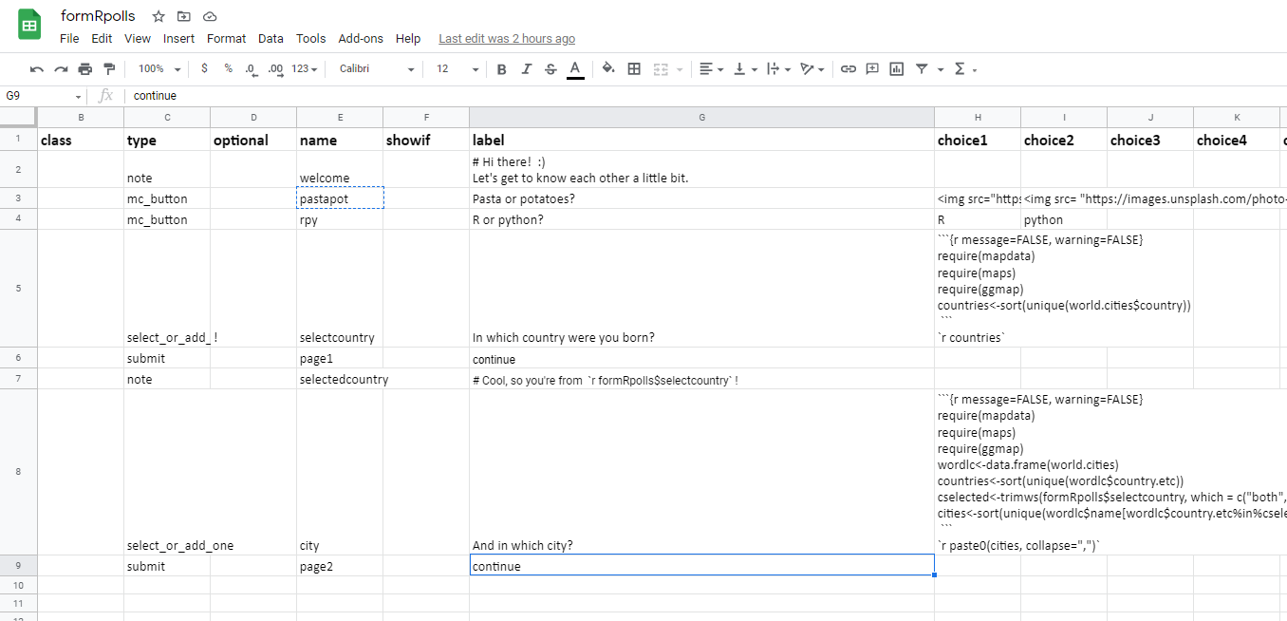
Step 1: Create survey (items) with a spread sheet

Slide 5
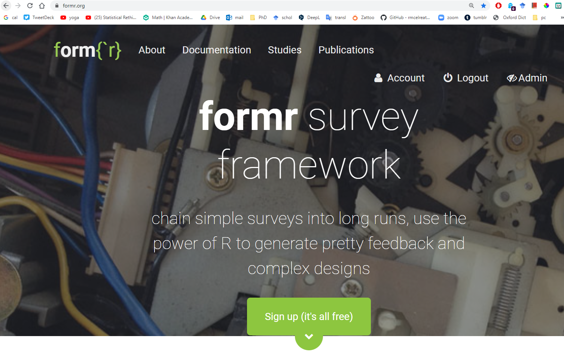
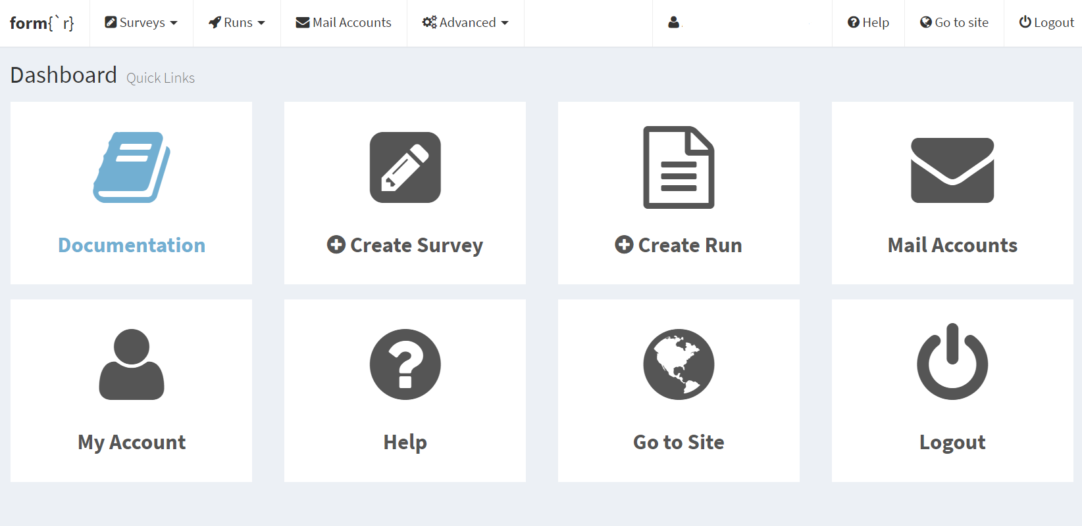
Step 2: Upload on form{´r} and create run

Slide 6
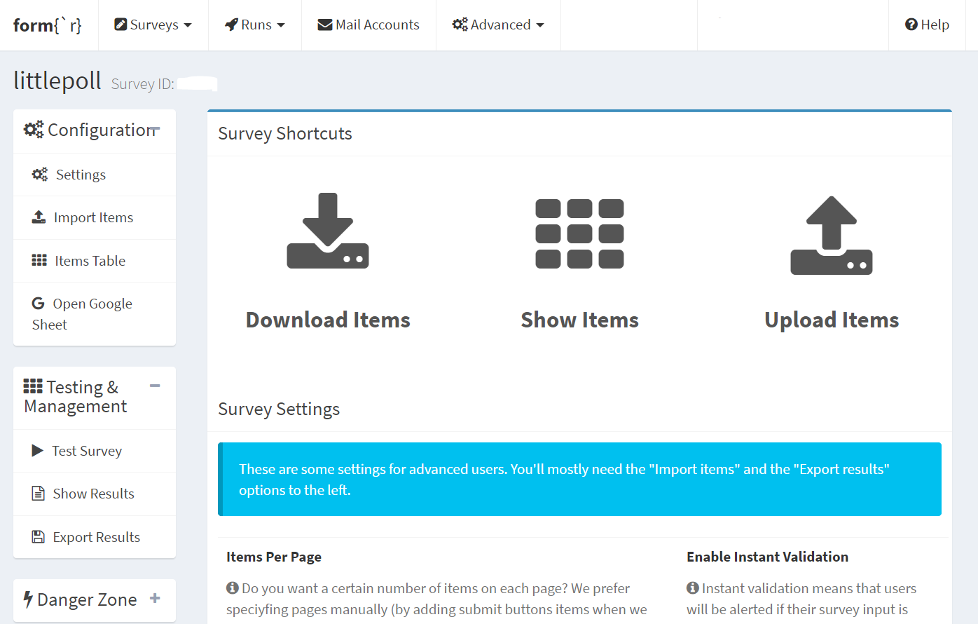
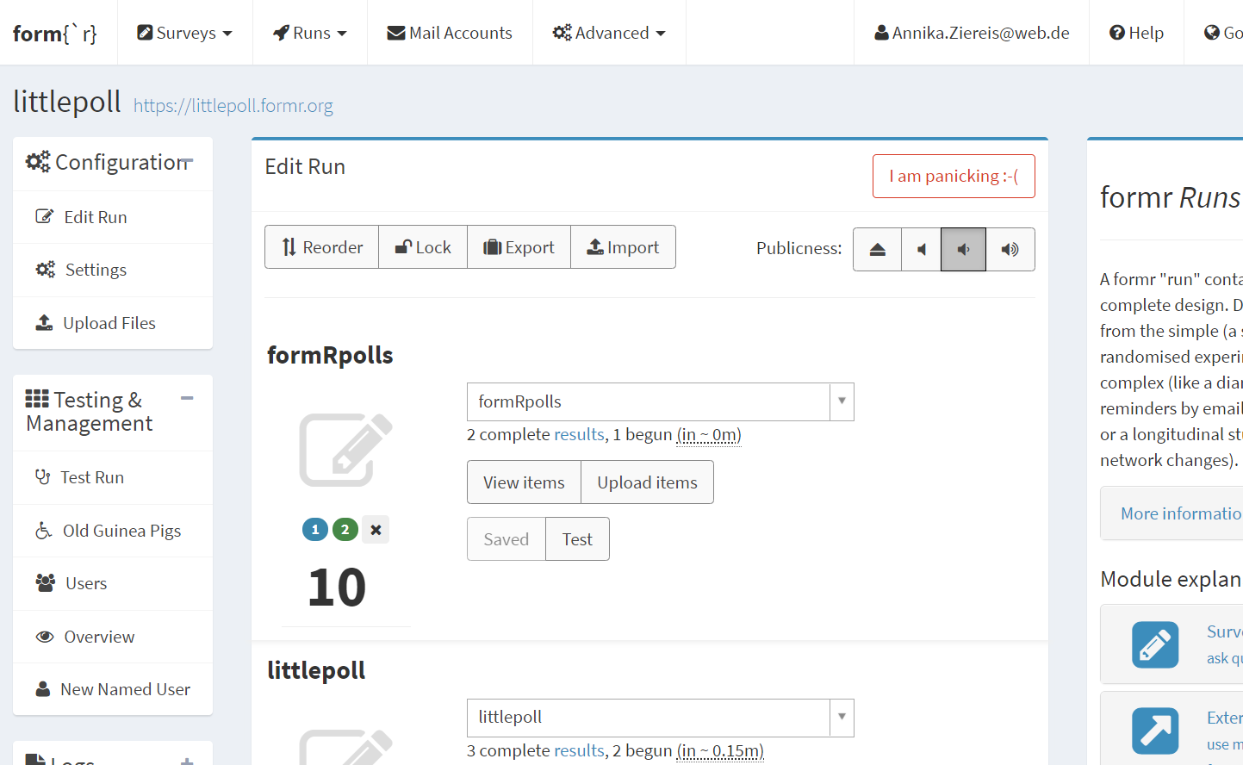
Step 2: Upload on form{´r} and create run

Slide 7
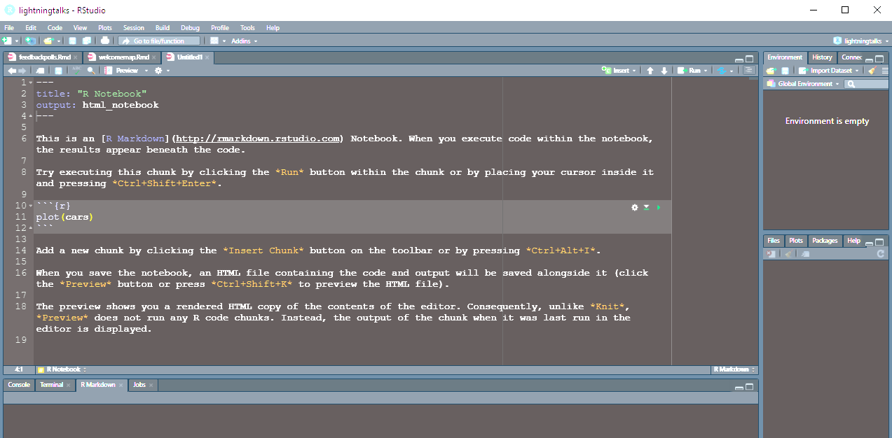

Step 3: Prepare code for analysis/visualization

Slide 8

littlepoll.formr.org
Step 4: Run survey and show results

