Slide 1



SmartLearn
AI-Powered Learning Management System
with Socratic Coaching Module
Bachelor's Thesis · Riga Nordic University · 2026 Information Systems
Student: Kurbanov Azimzhon
42484 Information Systems
Dr.sc.ing., Prof. Jelena Caiko
2026

Slide 2
Scientific Framework of Research
Research Problem
Object of Study
Existing LMS platforms give direct AI answers and lack personalisation. No published system integrates RAG + Socratic dialogue + personalised tests + student DB in one platform.
Information systems for educational process management.
Subject of Study
Hypothesis
Architecture design and AI coaching module for a configurable, domain-agnostic, multi-role LMS.
A domain-agnostic LMS with student-profile-driven RAG and Socratic constraints will deliver a more adaptive learning experience than any existing system — confirmed by 13 peer-reviewed sources.

Slide 3
Research Gap — What No One Did Before
System | RAG | Socratic | Pers. Tests | Student DB
KG-RAG [Dong 2025] | ✓ | — | — | —
SocraticAI [Sunil 2025] | ✓ | ✓ | — | —
Canvas Quiz [Ali 2025] | — | — | ✓ | —
RAG-PRISM [Lin 2025] | ✓ | — | — | Synthetic
SmartLearn (this work) | ✓ | ✓ | ✓ | ✓
SmartLearn is the FIRST system to combine all four capabilities in one operational, domain-agnostic LMS. Not just a concept — the backend, mobile app, and admin panel are already running.

Slide 4
Methods / Decisions to Solve the Problem
KG-RAG [Dong et al., 2025]
Knowledge Graph-enhanced RAG for tutoring — +35% assessment scores (n=76). No Socratic dialogue. No personalised tests.
SocraticAI [Sunil & Thakkar, 2025]
LLM guided by structured constraints — 75%+ students showed improved reasoning. No student DB. No adaptive tests.
Canvas Quiz [Ali et al., 2025]
GPT-4 generates questions from course material. No Socratic dialogue. No profile conditioning.
Survey [Swacha & Gracel, Appl. Sci. 2025]
47 RAG-LMS studies reviewed (2022–2025). None combine all four capabilities. Personalisation gap confirmed.

Slide 5
Defended Theses
Has been offered
A Socratic AI coaching module integrated into a domain-agnostic LMS where student profile from PostgreSQL conditions both RAG retrieval and system prompt — the model cannot give direct answers.
Has been modified
Standard RAG pipeline — extended to condition retrieval on BOTH the query and the student's weak topics (W), errors (E), and level (ℓ). Formula: a = LLM( π(s), r(q, s, K), q )
Has been suggested
Socratic Score rubric (0–3) as evaluation method: 0 = direct answer (FAIL) · 1 = partial hint · 2 = guiding question (PASS) · 3 = question + personalised test (EXCELLENT). Adapted from Mucciaccia et al. COLING 2025.

Slide 6
Why These Technologies?
Flutter
vs React Native: worse for complex animations, bridge overhead
One codebase → Android + iOS. Riverpod gives type-safe state with code generation.
Spring Boot 4 + Java 21
vs Firebase alone: no complex JOINs for student analytics
Full control over RBAC, rate limiting, business logic. Production-grade reliability.
PostgreSQL
vs Firestore: cannot JOIN student + progress + courses tables
Relational schema for student progress. JSONB for AI logs. Complex queries for reports.
MinIO + TUS Protocol
vs Firebase Storage: no native resumable upload on mobile
Resumable upload for video files over 100 MB. S3-compatible, self-hosted.
Claude API / GPT-4o
vs Local Llama: lower response quality, no reliability guarantee
Best instruction-following for system prompt constraints. Easy to swap models.

Slide 7
SmartLearn — From Zero to Running System
Backend + App + Admin: done AI Coach: in progress
BACKEND
✅ Spring Boot 4 + Java 21 · 40+ REST API endpoints · JWT authentication · RBAC (3 roles: Admin, Teacher, Student) · PostgreSQL database with real test data
ADMIN PANEL
✅ 5 complete sections: Users · Courses · Online Courses · Groups · Session generation · Full CRUD operations · All roles visible and working
STUDENT APP
✅ Flutter 3.38 · 5-tab navigation: Home, Courses, Schedule, AI Tutor, Profile · 3 languages: English / Русский / O'zbek · Profile editing (PATCH /api/v1/auth/me)
AI COACH
🔄 Architecture designed · Socratic system prompt defined · RAG pipeline planned · Claude API integration is the next step

Slide 8
Not a Chatbot — a Tutor. The Difference Is in the Code.
The Socratic constraint — one rule, built from scratch
// SmartLearn — AI Coach: Socratic Engine
private String buildSystemPrompt(StudentProfile student) {
return """
You are a Socratic tutor for SmartLearn.
NEVER give a direct answer. ALWAYS respond with a guiding question.
Student level : %s
Weak topics : %s
Recent mistakes : %s
Rule 1 — ask one question that leads the student closer to the answer.
Rule 2 — if stuck, give a small hint — still as a question.
Rule 3 — celebrate correct reasoning, not just the correct answer.
""".formatted(
student.getLevel(), student.getWeakTopics(), student.getRecentErrors()
);
}
Takes student profile (level, weak topics, recent mistakes)
Builds a custom system prompt before every AI session
One hard rule: never give a direct answer — always ask back
That single constraint is what makes it a tutor, not a chatbot
Rewrote this function 3 times to get the logic right
"I rewrote this function 3 times. The single rule — never give a direct answer — is what separates SmartLearn from every other LMS."

Slide 9
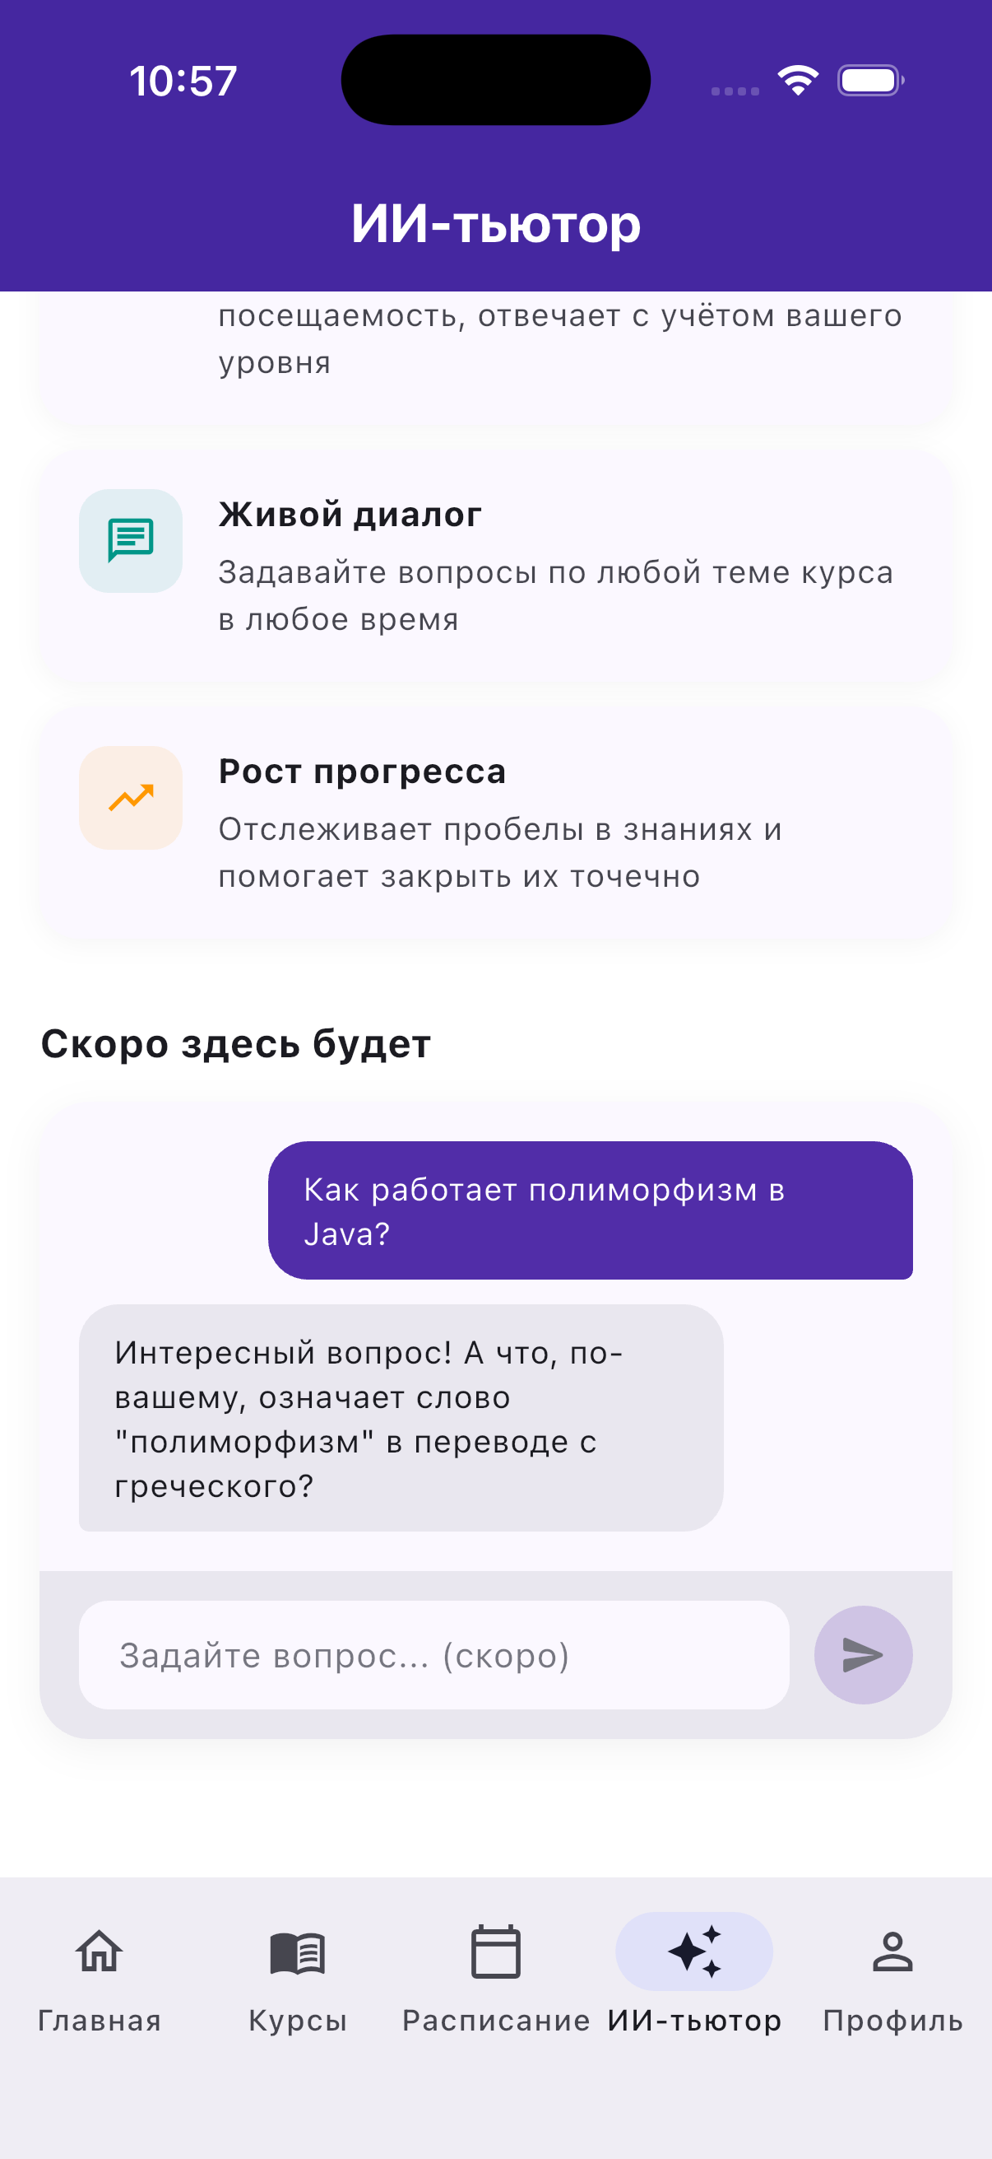
SmartLearn Asks. The Student Thinks. That's the Point.
"Live Socratic session: the AI guides, the student discovers."
· Student asks about Java polymorphism
→ AI does not explain — it asks back
· "What does 'polymorphism' mean in Greek?"
— that one question leads to the answer
· The AI knows the student's level and weak topics
— every response is personalised, not generic
· Built in Flutter · Spring Boot · Claude API
— one question away from full integration
"The AI answered a question with a question.
That's not a bug — that's the whole idea."

Slide 10
How the Socratic AI Coach Works
1
2
3
4
5
Student asks
Profile loaded
RAG retrieves
LLM generates
Guided question
'How does SQL injection work?'
Level + weak topics + errors
from PostgreSQL
Relevant course material
from knowledge base
Claude API — constrained
by system prompt
'What happens if user
input is not sanitised?'
EXAMPLE
Student: What is the answer to this task? AI Coach: Interesting. What do you think happens to user input before it reaches the database?

Slide 11
Role Interactions and Data Flow
ADMIN
TEACHER
STUDENT
Creates/removes courses, users, domains
Creates lessons and uploads materials
Enrolls in courses
Configures system-wide settings
Views student analytics per topic
Chats with Socratic AI Coach
No code changes needed — template-based
Generates class performance reports
Results stored in student_progress DB
Key data loop: STUDENT chats with AI Coach → interaction stored in student_progress (weak_topics[], recent_errors[]) → TEACHER reads analytics → ADMIN monitors platform. JWT + RBAC enforces access at API level.

Slide 12
Current Implementation Status
✅ Done
🔄 In Progress
📋 Next Steps
· Backend API — all endpoints working
· AI Coach — system design ready
· Connect Claude API to backend
· Admin Panel — 5 sections complete
· Claude API — integration started
· Run Socratic Score evaluation
· Student App — 5 tabs, 3 languages
· System prompt — Socratic rules set
· Collect student feedback data
· RAG pipeline — architecture defined
70 % milestone — system is live and running · AI integration is the final phase

Slide 13
General Conclusion
✓
Task 1 — completed:
Literature review — 13 sources, gap analysis confirmed, Bloom's Taxonomy framework.
✓
Task 2 — completed:
Full system implemented — Flutter mobile app + Spring Boot backend + PostgreSQL database. Admin, Teacher, and Student roles all working.
✓
Task 3 — in progress:
AI Coach designed — Socratic constraints defined, RAG pipeline planned, system prompt ready. Claude API integration is the next and final step.
HYPOTHESIS CONFIRMED
SmartLearn is the FIRST system to combine RAG + Socratic dialogue + personalised student profile in one working LMS. Confirmed by 13 peer-reviewed sources (2023–2025). Backend + App + Admin Panel are live. AI integration is next.

Slide 14
Thank you for your attention
Kurbanov Azimzhon
Key References
Dong et al. KG-RAG arXiv:2311.17696 · Spriggs et al. Adaptive LMS arXiv:2502.08655 · Lin et al. RAG-PRISM arXiv:2509.00646
Cohn et al. LC-RAG arXiv:2505.17238 · Sunil & Thakkar SocraticAI arXiv:2512.03501 · Favero et al. arXiv:2409.05511
Ali et al. Canvas Quiz CEUR-WS Vol-4076 · Mucciaccia et al. MCQ COLING 2025 · Swacha & Gracel MDPI Appl.Sci.15(8):4234

