Slide 1
Intuition for Linear Support Vector Machines
Adam Zika
17/3/2017
Source: https://pythonprogramming.net/support-vector-machine-intro-machine-learning-tutorial/

Slide 2
Overview
Supervised learning
Handles both classification and regression
Pros
handles quite well large amount of features (e.g., good for research in medicine)
both work for linear and non-linear (i.e., kernel trick)
Classification is almost instant (unlike e.g. k-NN)
Cons
not suited to larger datasets as the training time can be high
less effective on noisier datasets with overlapping classes
Class 2
Class 1

Slide 3
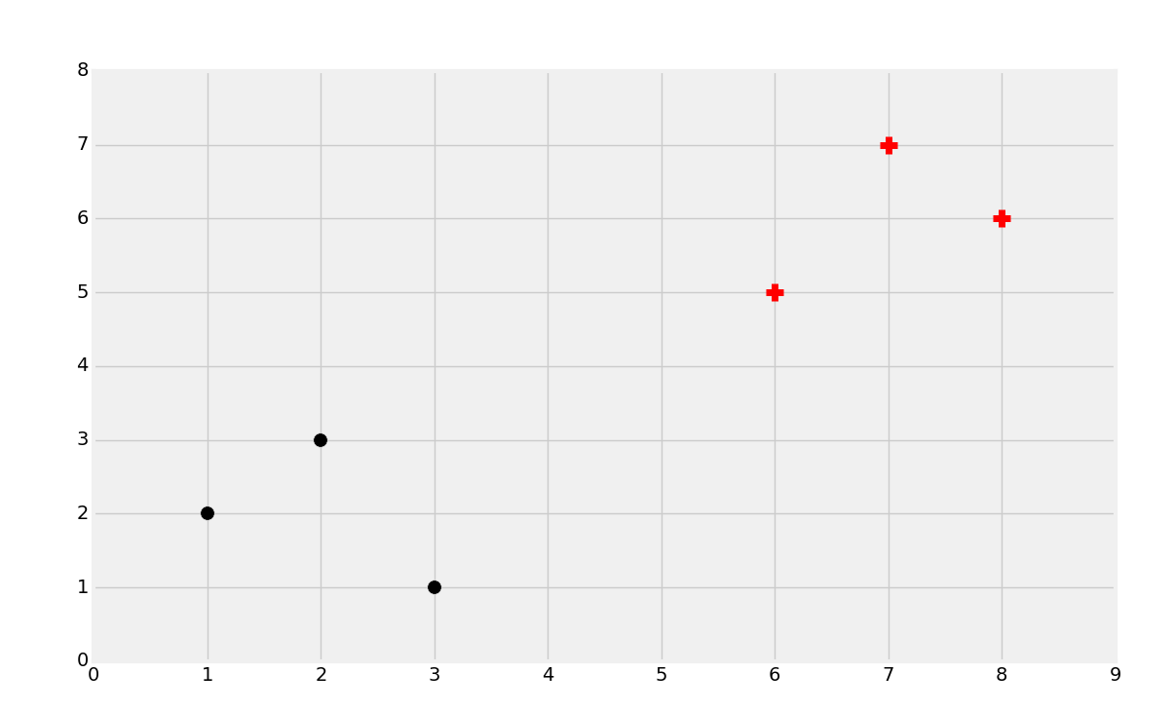
How it works?
Goal of SVM:
To find an optimal decision boundary (i.e., hyperplane) separating data.

Slide 4
“To find an optimal decision boundary separating data.”
Optimal decision boundary has the biggest margin between data.
Margin = distance between the closest point(s) to the boundary.
How to do this formally?

Slide 5
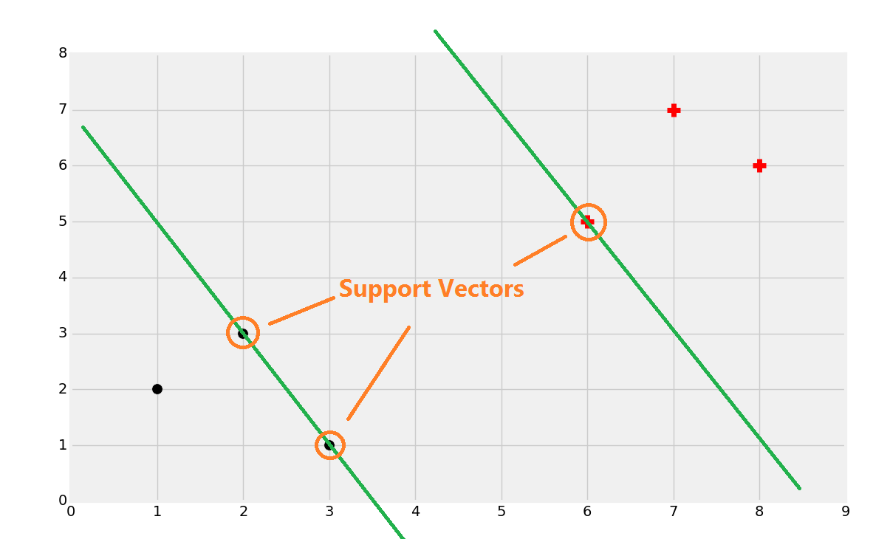
Support Vectors
Support vectors
= the data points that lie closest to the decision surface
Influence on the position of the surface
Next step:
Search for lines that are going though support vectors and …

Slide 6
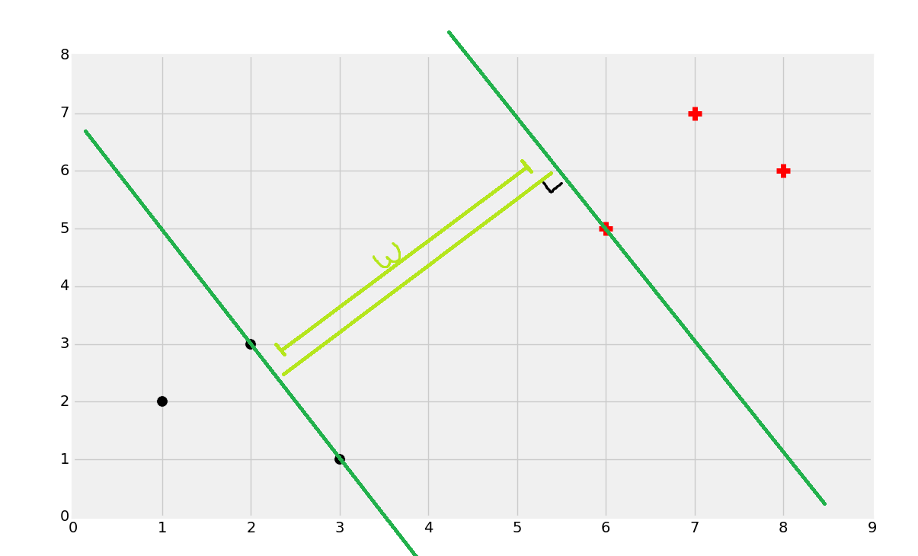
“… are maximally separated between each other.”

Slide 7
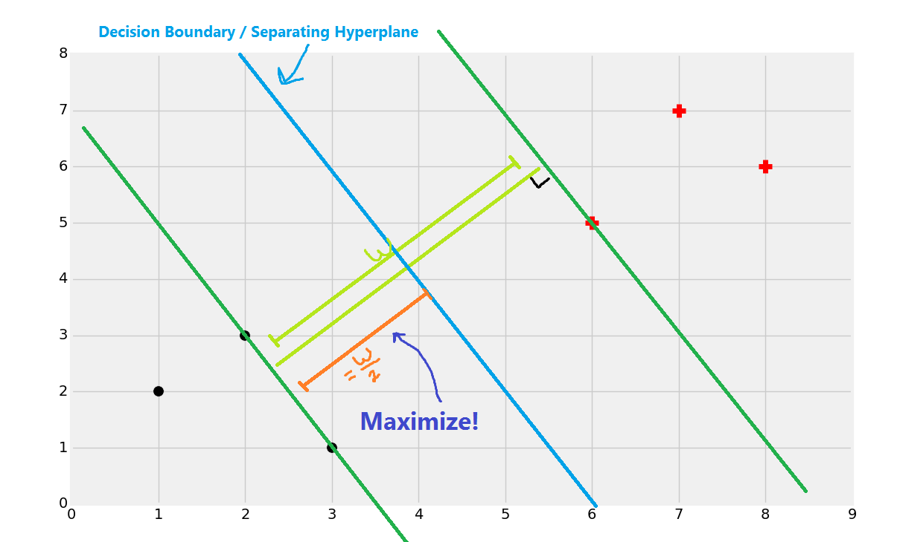

Goal of SVM
We want to maximize $\frac{w}{2}$

Slide 8
Safety check (of understanding)

Slide 9
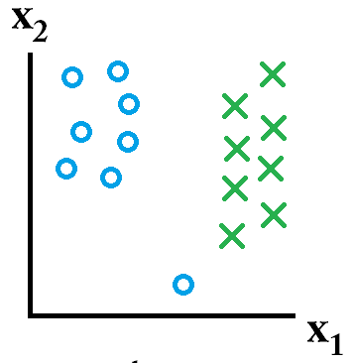
Where to draw the decision boundary?
Source: http://stats.stackexchange.com/questions/31066/what-is-the-influence-of-c-in-svms-with-linear-kernel
Notes:
The allowance of softness in margins (i.e. a low cost setting) allows for errors to be made while fitting the model (support vectors) to the training/discovery data set. Conversely, hard margins will result in fitting of a model that allows zero errors.

Slide 10
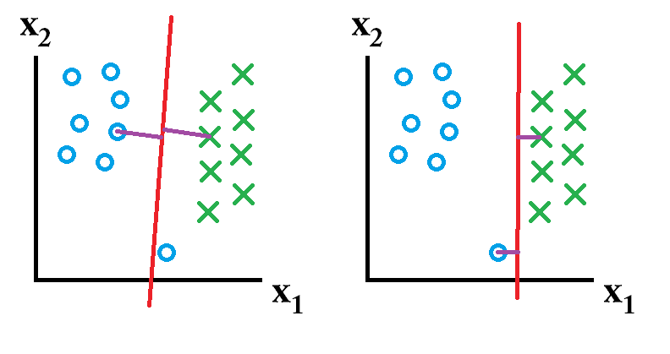
Soft vs hard margin
When to use which?
Soft margin
Errors can be made during model training.
Hard margin
Errors cannot be made during model training.
Notes:
When to use which? That depends on future data.

Slide 11
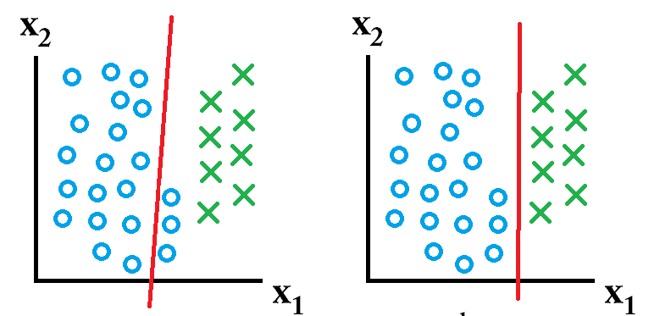

Hard-margin better
Soft margin
Hard margin
.

Slide 12
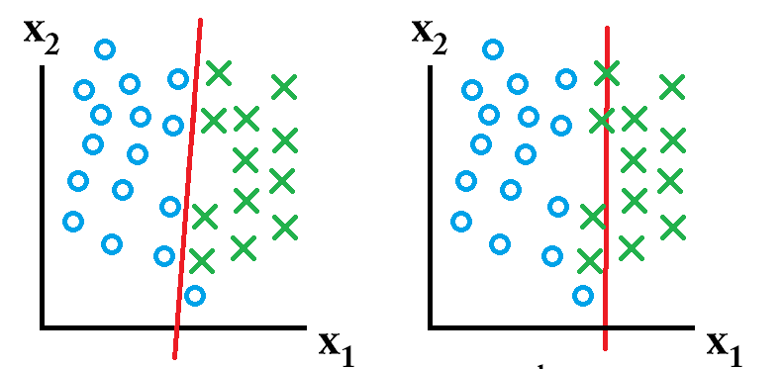

Soft-margin better
Soft margin
Hard margin
Low C
Large C
Notes:
C is a regularization parameter. Higher the C, higher the penalty for a misclassification error.

Slide 13
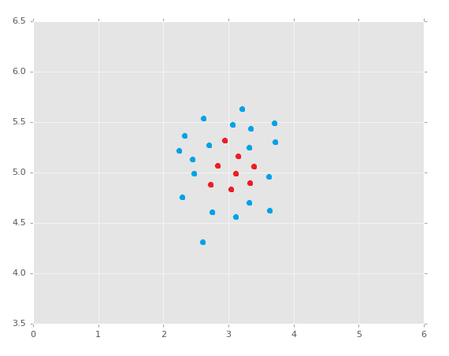
Where to draw the decision boundary?
➔ kernel trick
Notes:
In the middle

Slide 14
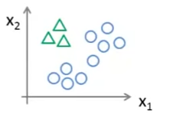
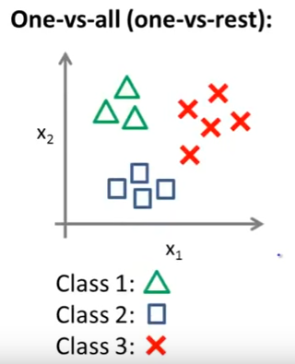
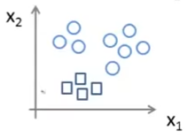

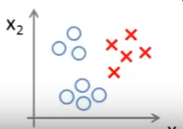
Multi-class classification
-3.5
max
0.2
2.4
Source: https://www.youtube.com/watch?v=6B1okbgfw8E

