Slide 1
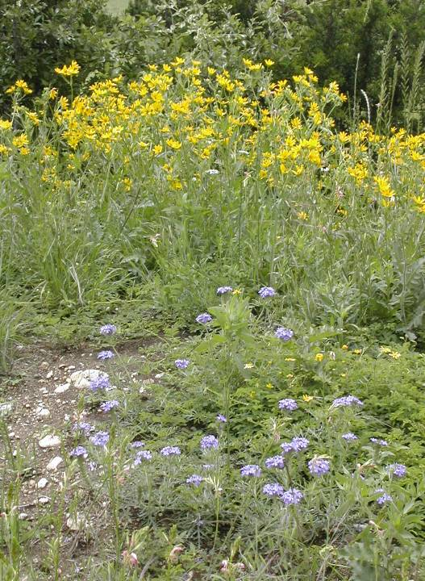
Spring
In
Central
Texas
To everything there is a season, and a time to every purpose under heaven.
Ecclesiastes 3:1
www.forgive490.com

Slide 2
I often tell people how blessed I am in my daily commute to Central Texas College. While it is a long drive (nearly an hour one way), I am fortunate enough to pass through some of the most beautiful countryside God ever created. This is never more true than when the wildflowers literally blanket the roadsides and fields. I wanted to share with others a glimpse of what I get to enjoy each day. I hope you enjoy these scenes from the drive between Georgetown and Killeen in April, and the verses that accompany them.
I hope you’ll consider passing the URL along to your friends.
Melissa Lea Leedom
www.forgive490.com

Slide 3
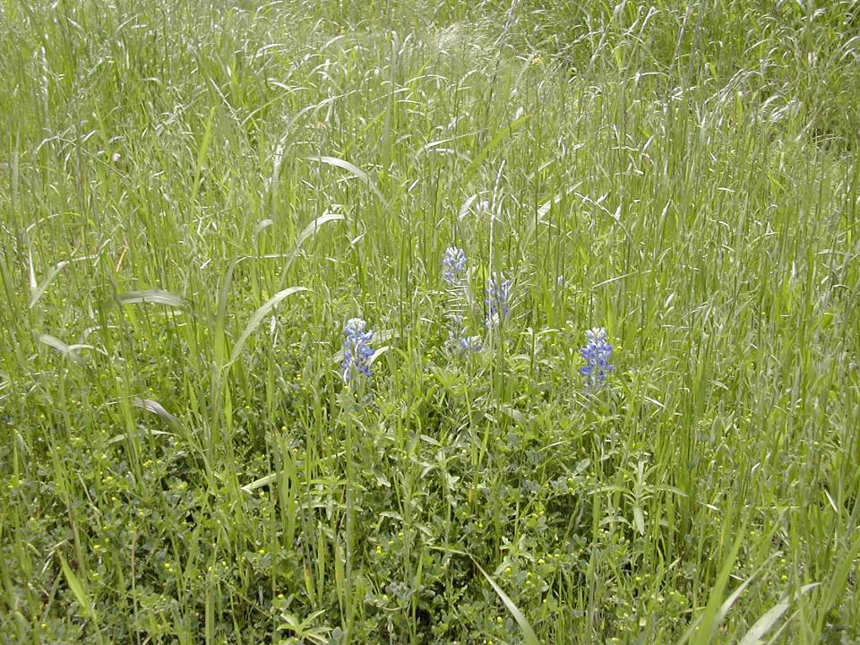
My voice shalt thou hear in the morning, O Lord; in the morning I will direct my prayer unto thee, and will look up.
Psalm 5:3
www.forgive490.com

Slide 4
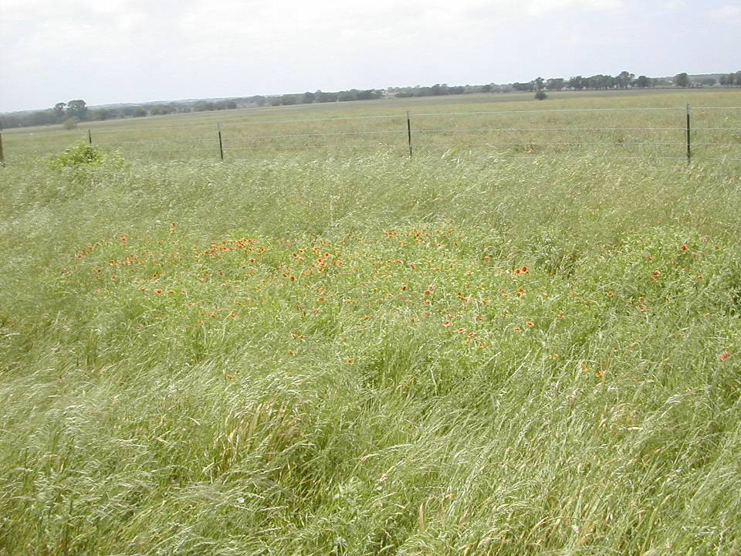
The grass withereth, the flower fadeth: but the word of our God shall stand forever.
Isaiah 40:7
www.forgive490.com

Slide 5
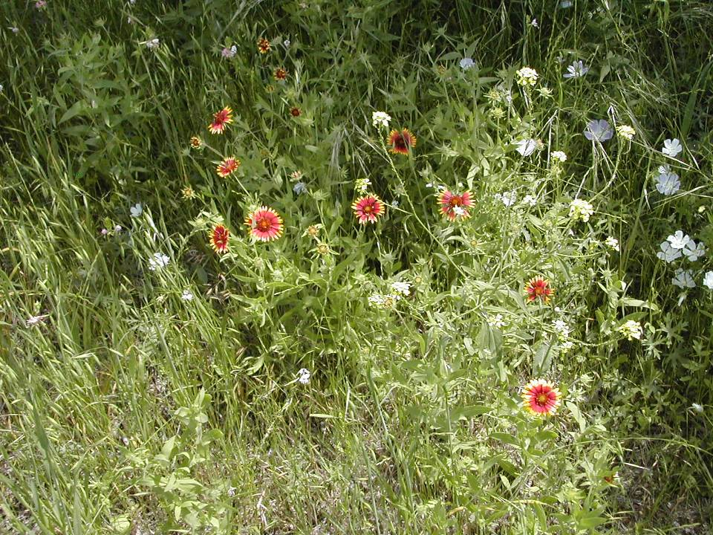
Blessed are they that dwell in thy house: they will be still praising thee.
Psalm 84:4
www.forgive490.com

Slide 6
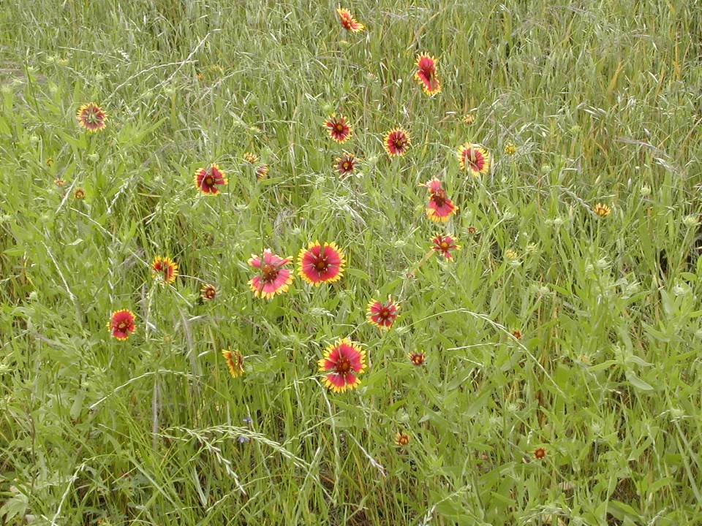
Cast thy burden upon the Lord, and he shall sustain thee.
Psalm 55:22
www.forgive490.com

Slide 7
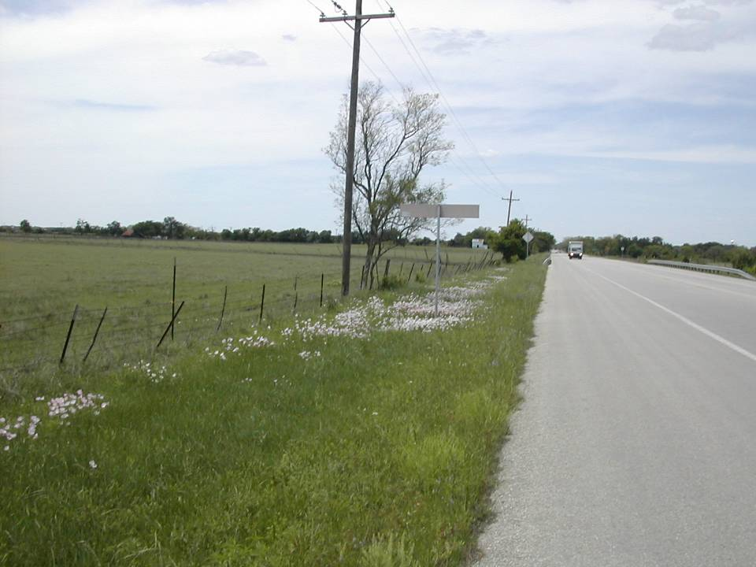
O Lord our Lord, how excellent is thy name in all the earth! Who hast set thy glory above the heavens.
Psalm 8:1
www.forgive490.com

Slide 8
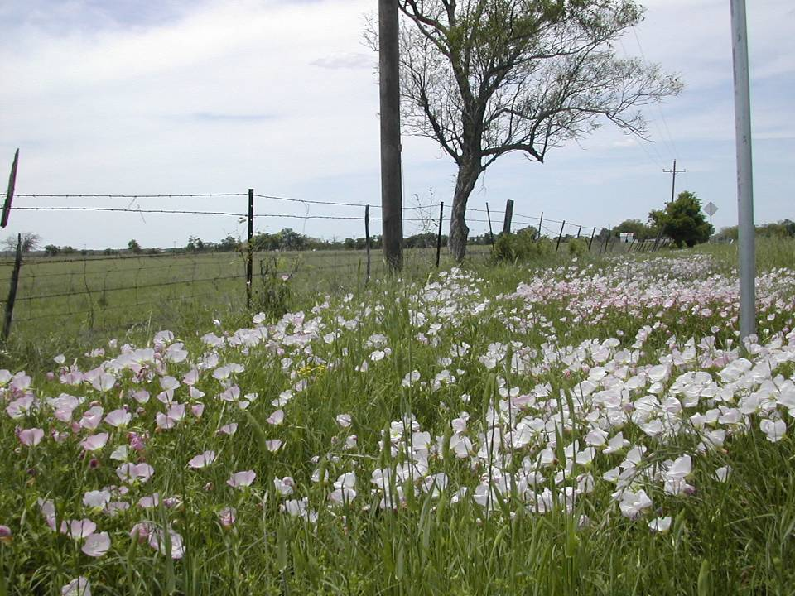
Consider the lilies of the field…even Solomon in all his glory was not arrayed like one of these.
Matthew 6:28-29
www.forgive490.com

Slide 9
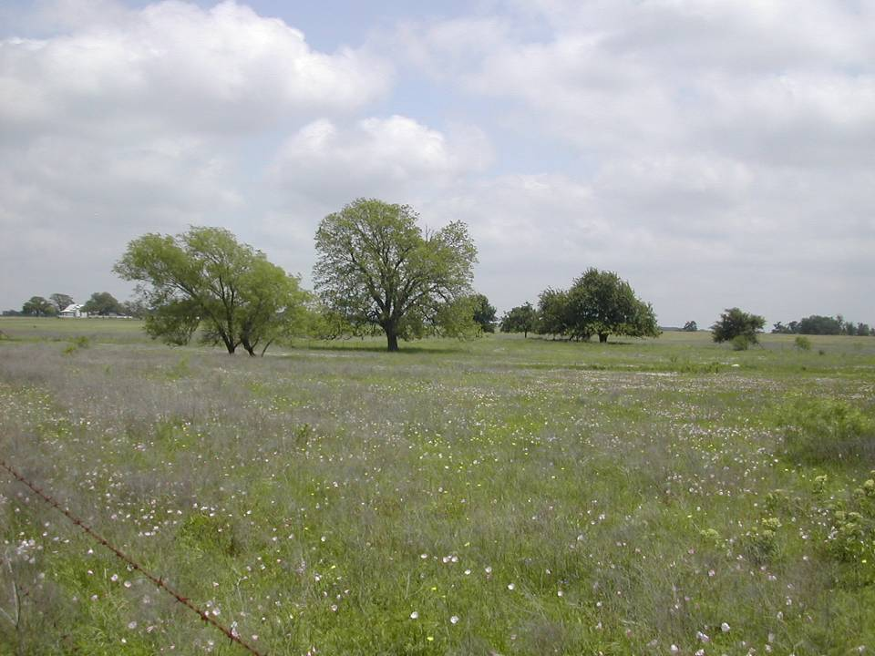
But let all those that put their trust in thee rejoice…let them also that love thy name be joyful in thee.
Psalm 5:11
www.forgive490.com

Slide 10
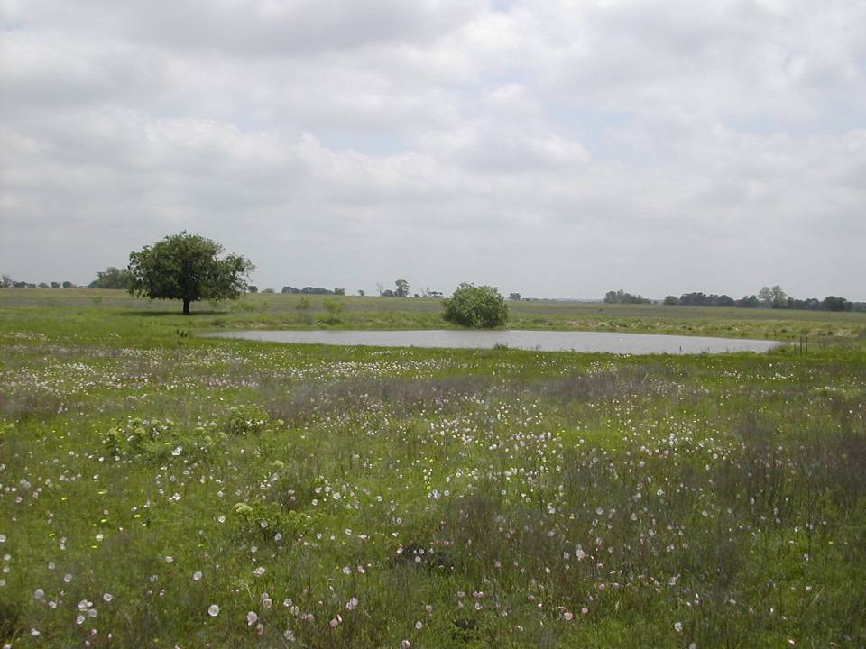
…he leadeth me beside the still waters.
Psalm 23:2
www.forgive490.com

Slide 11
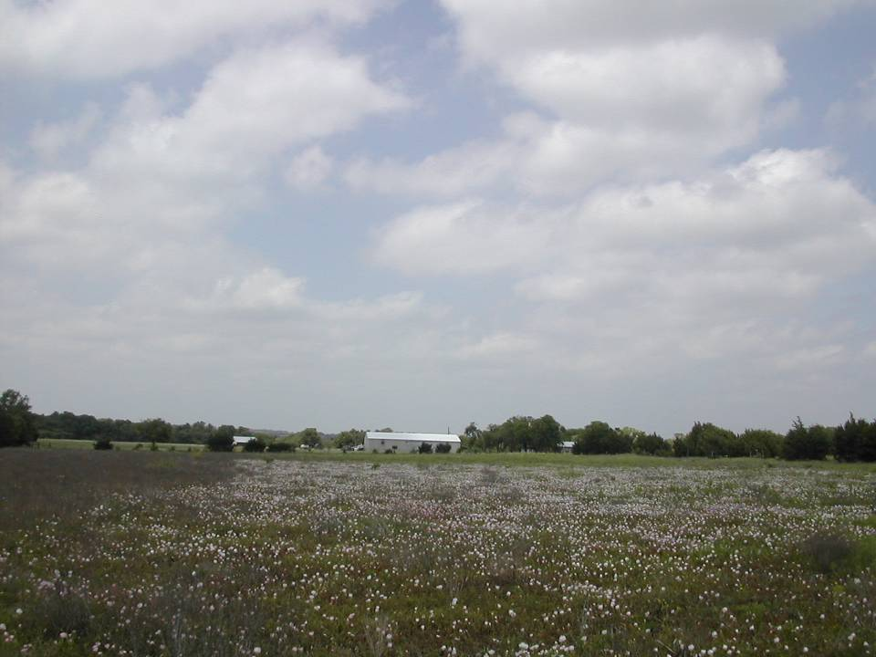
I will praise thee, O Lord, with my whole heart; I will shew forth all thy marvellous works.
Psalm 9:1
www.forgive490.com

Slide 12
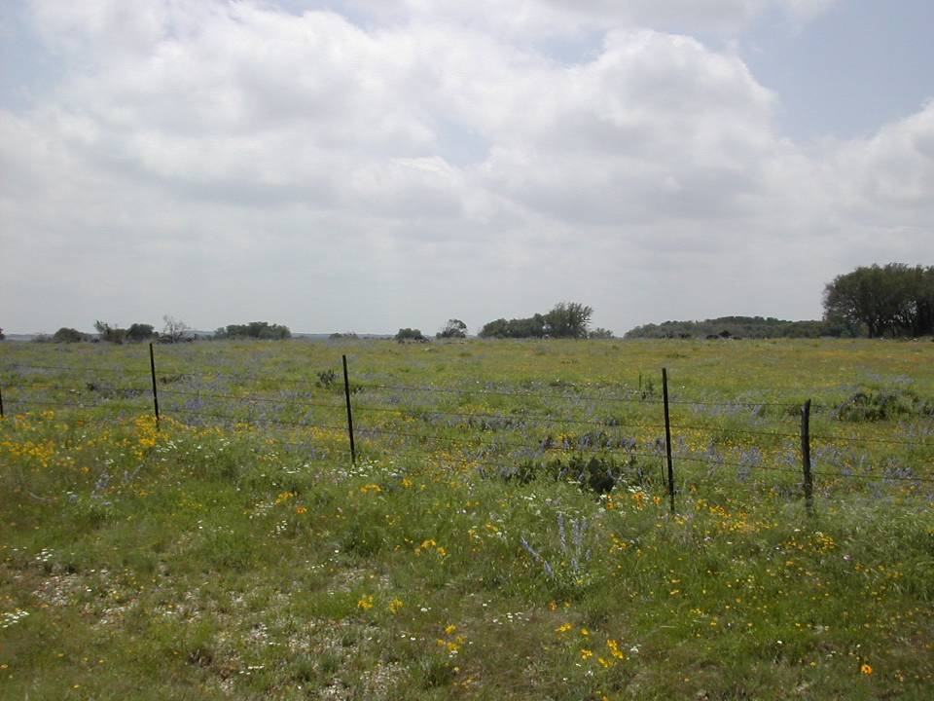
The earth is the Lord’s, and the fulness thereof; the world, and they that dwell therein.
Psalm 24:1
www.forgive490.com

Slide 13
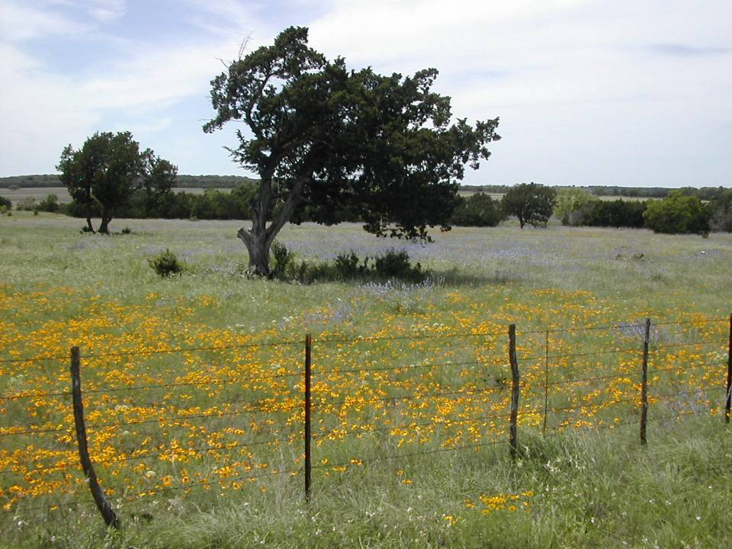
Be still, and know that I am God.
Psalm 46:10
www.forgive490.com

Slide 14
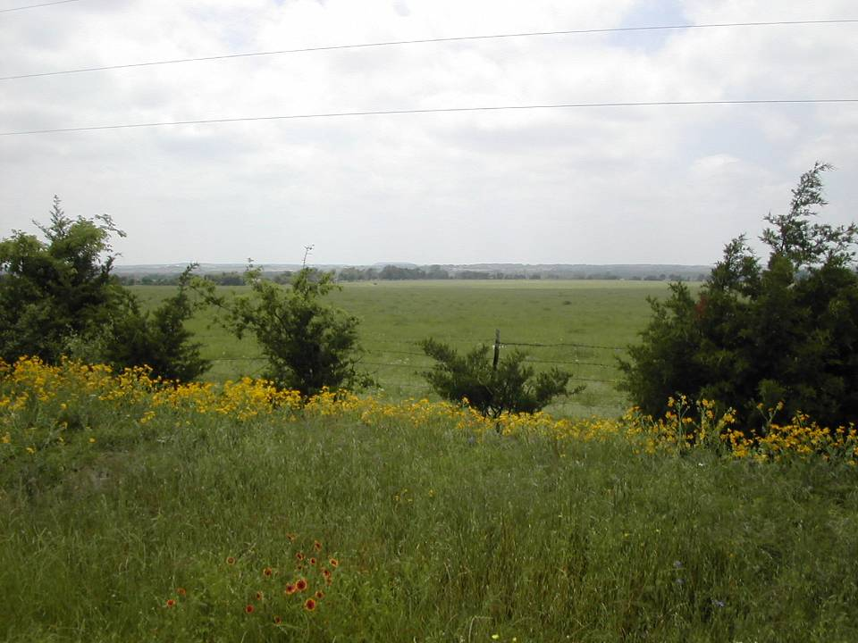
All the earth shall worship thee, and shall sing unto thee; they shall sing to thy name.
Psalm 66:3
www.forgive490.com

Slide 15
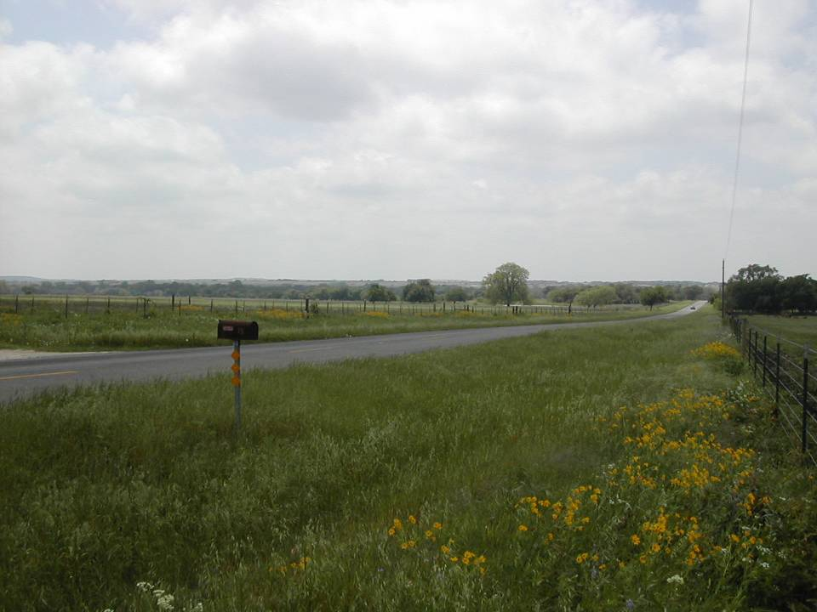
Trust in the Lord with all thine heart; and lean not unto thine own understanding. In all thy ways acknowledge Him, and He shall direct thy paths.
Proverbs 3:5-6
www.forgive490.com

Slide 16
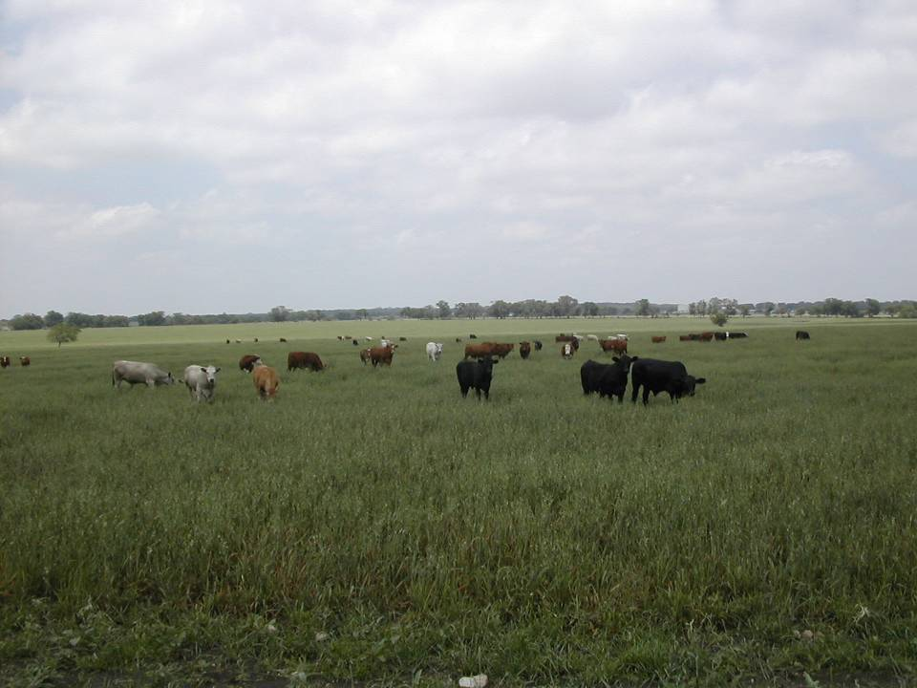
He causeth the grass to grow for the cattle, and herb for the service of man: that he may bring forth food out of the earth.
Psalm 104:14
www.forgive490.com

Slide 17
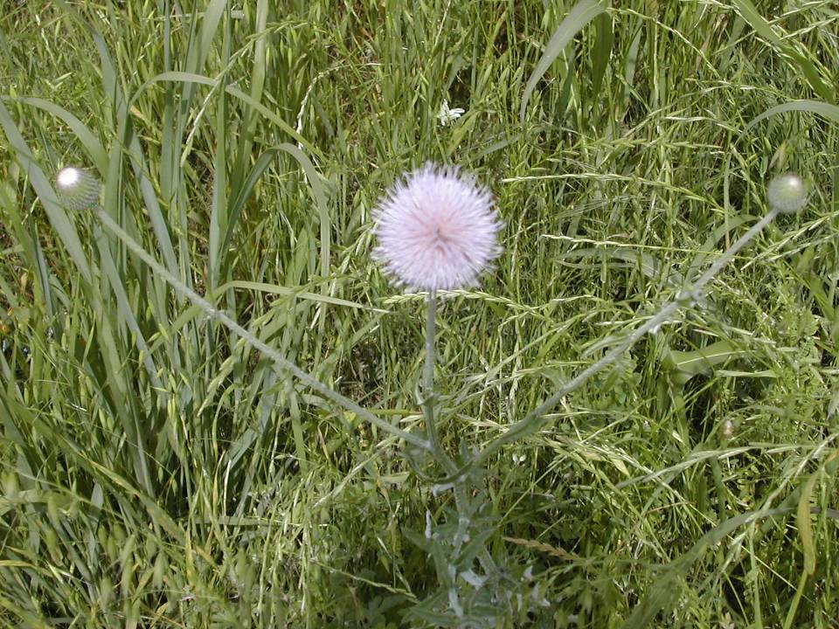
Whither shall I go from thy spirit? or whither shall I flee from thy presence?...thy right hand shall hold me.
Psalm 139:7, 10
www.forgive490.com

Slide 18
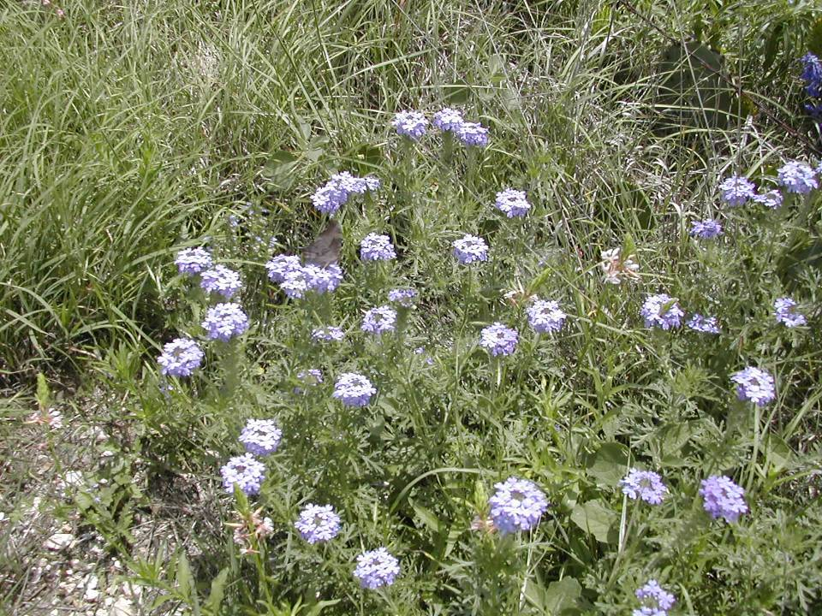
Remember his marvelous works that he hath done.
Psalm 105:5
www.forgive490.com

Slide 19
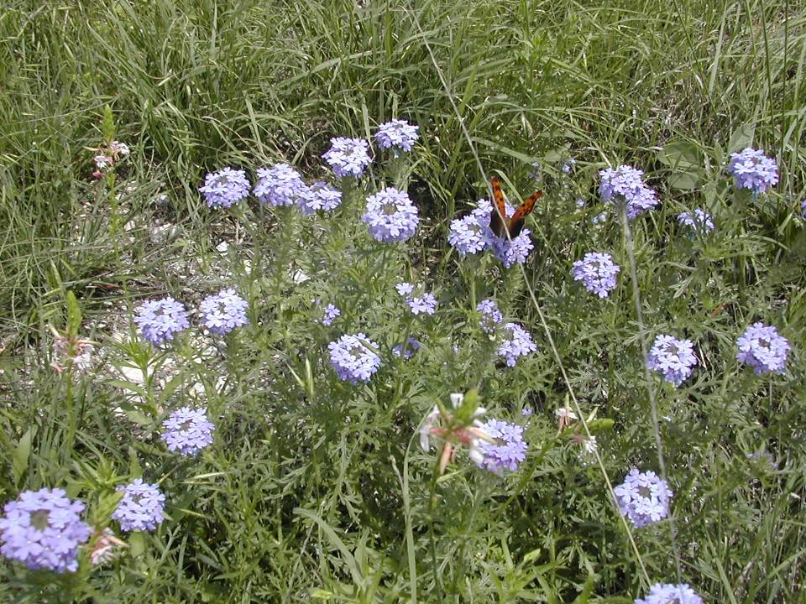
If the Son therefore shall make you free, ye shall be free indeed.
John 8: 36
www.forgive490.com

Slide 20
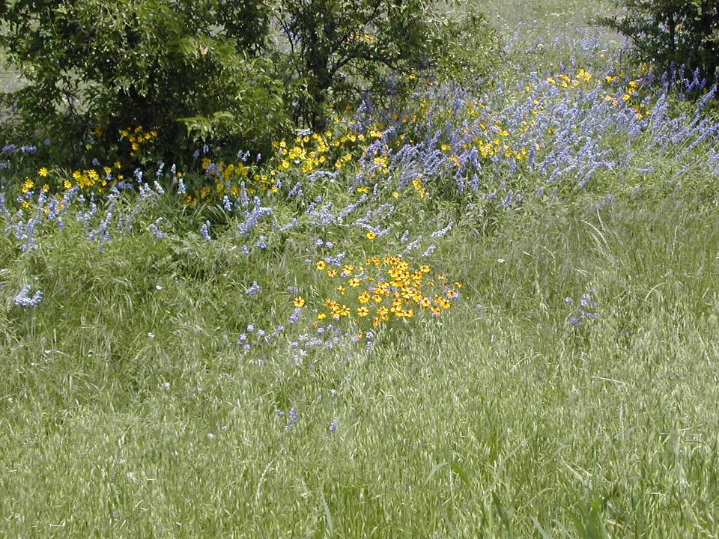
And the earth brought forth grass, and herb yielding seed after his kind…and God saw that it was good.
Genesis 1:12
www.forgive490.com

Slide 21
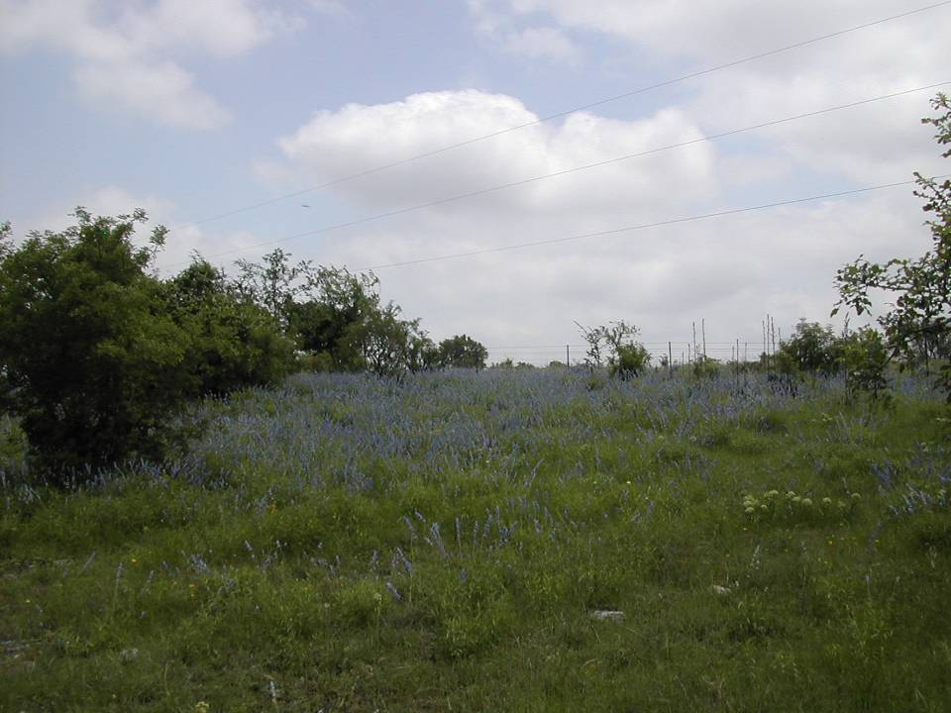
I will lift up mine eyes unto the hills, from whence cometh my help. My help cometh from the Lord, which made heaven and earth.
Psalm 121:1
www.forgive490.com

Slide 22
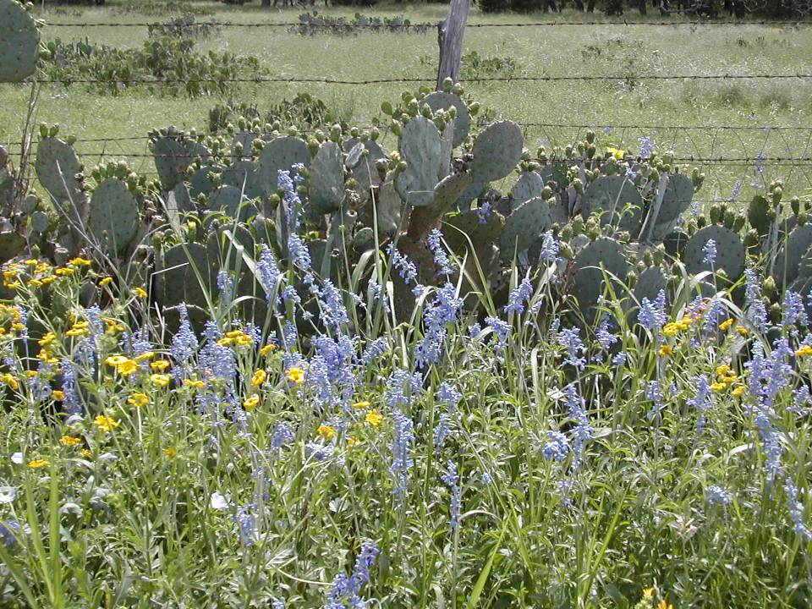
I have learned, in whatever state I am, therewith to be content.
Philippians 4:11
www.forgive490.com

Slide 23
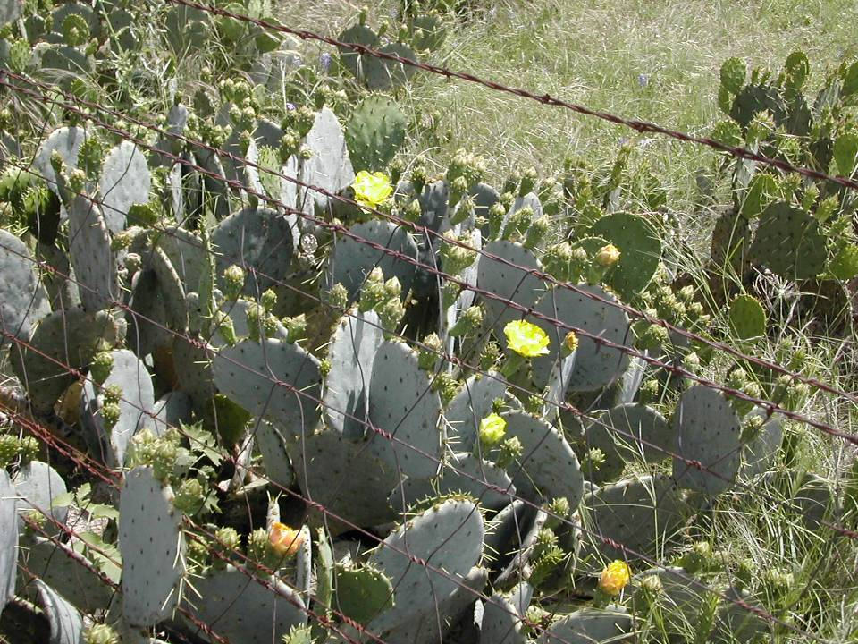
The wilderness and the solitary place shall be glad for them; and the desert shall rejoice, and blossom as the rose.
Isaiah 35:1
www.forgive490.com

Slide 24
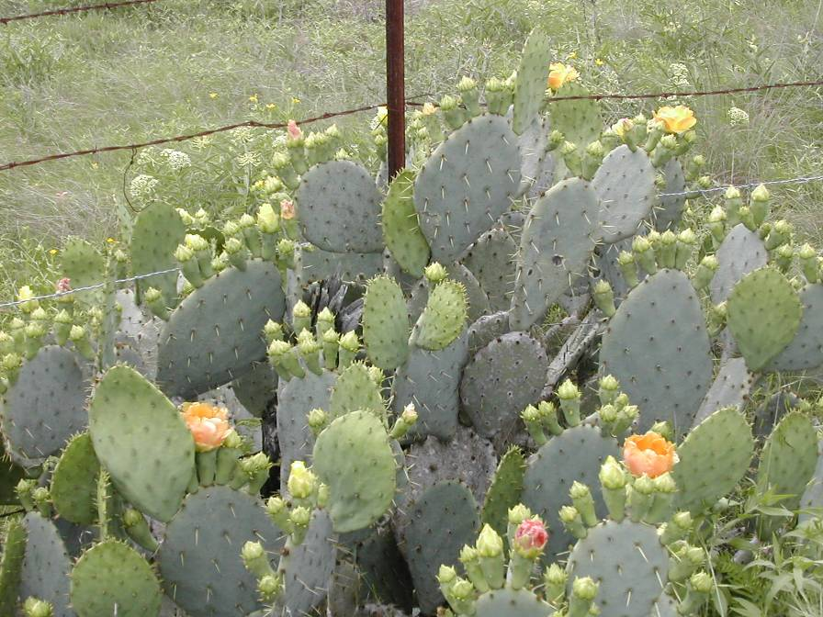
I am the vine, ye are the branches: He that abideth in me, and I in him, the same bringeth forth much fruit.
John 15:5
www.forgive490.com

Slide 25
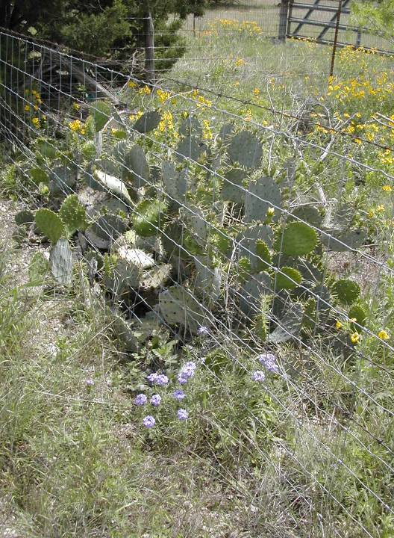
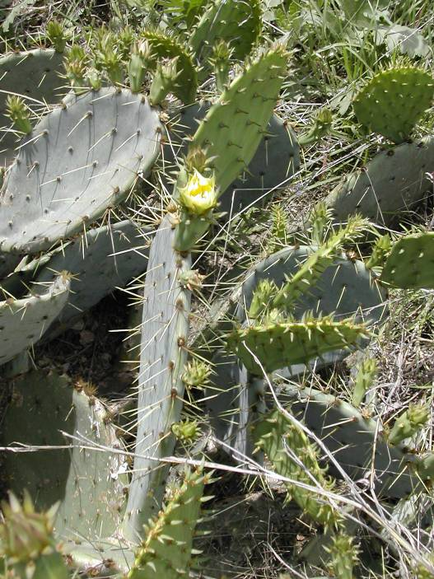
Text
Instead of the thorn shall come up the fir tree, and instead of the brier shall come up the myrtle tree: and it shall be to the Lord for a name, for an everlasting sign that shall not be cut off.
Isaiah 55:13
www.forgive490.com

Slide 26
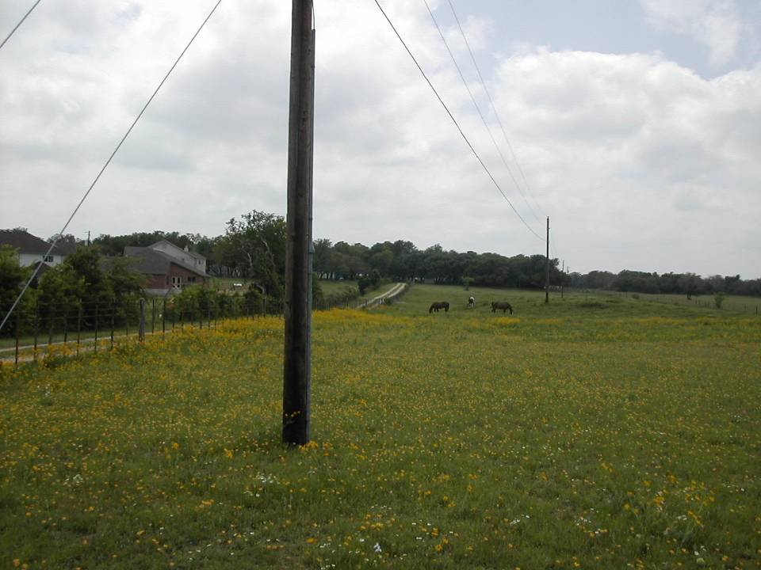
Text
…he leadeth me in the paths of righteousness for his name’s sake.
Psalm 23:3

Slide 27
www.forgive490.com

