Slide 1


Slide 2
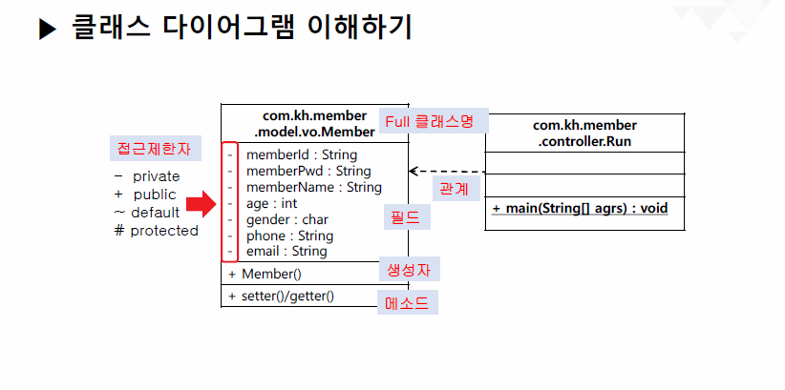
밑줄 : static
Italic체 : abstract
ex) private static final int IDX -> - IDX:int

Slide 3
