Slide 1
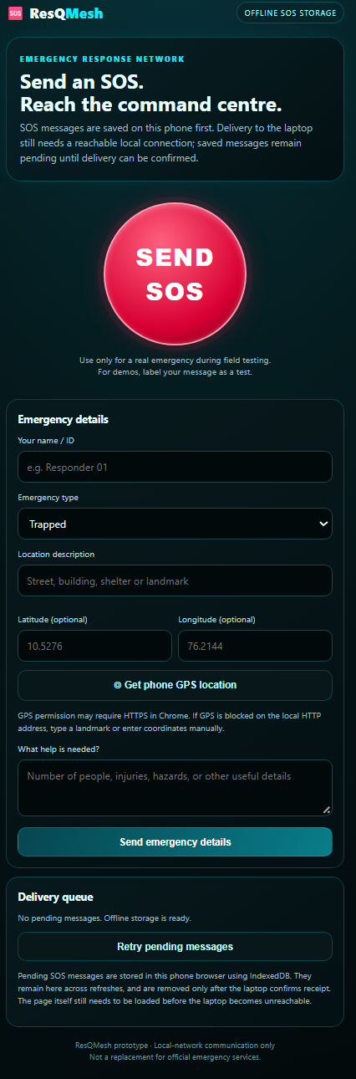
OPCODE IMPACT 2026
24-HOUR NATIONAL LEVEL HACKATHON
ResQMesh
Offline Disaster Response and SOS System
Secure Today, Sustain Tomorrow.
TEAM NAME
The Innovators
TRACK
SDG
9–10 OCTOBER 2026 • JYOTHI ENGINEERING COLLEGE
Proof of concept • hackathon prototype

Slide 2
1. Problem Statement
CHALLENGE
When networks fail, SOS requests and incident triage break down.
Problem
Existing Gap
During natural disasters, mobile internet and conventional networks may fail or become unreliable. People cannot request help, and responders lack a clear way to view, prioritise and manage reports.
What is missing today?
• Conventional channels depend on internet or cellular infrastructure
• No simple local-first way to capture SOS reports offline
• Responders lack one place to view and prioritise reports
• Usability: reporting should work from a phone browser
Who is affected?
Why does it matter?
• People needing rescue
• Responders / command centre
• Affected communities
• Local relief coordination
• Delayed or lost SOS requests
• Hard to prioritise incidents
• Lives and safety at risk
• SDG 11: disaster resilience
Note: ResQMesh addresses reporting and triage; it is not a certified emergency service.
OPCODE IMPACT 2026 • 24-Hour National Level Hackathon
02

Slide 3
2. Proposed Solution
SOLUTION
An offline-first SOS capture and response dashboard prototype.
ResQMesh
Offline-first SOS capture on a phone, with a laptop dashboard to organise incident response.
Capture
Retain
Respond
Sustain
Mobile SOS form with emergency type, details and optional location.
Unsent SOS stay in a browser pending queue, with manual retry.
Laptop stores reports in SQLite; Streamlit dashboard supports triage.
Supports SDG 11 disaster resilience; mesh relay is future work.
Key Innovation
Local-first reporting: the SOS interface and response dashboard stay on nearby devices, with a retry queue for failed delivery. A mesh simulator illustrates future relay routes.
OPCODE IMPACT 2026 • 24-Hour National Level Hackathon
03

Slide 4
3. System Architecture & Workflow
ARCHITECTURE
Phone browser to laptop over a local connection; no internet or cloud needed for this path.
PHONE
SOS PAGE
→
FLASK SERVER
(LAPTOP)
→
SQLITE
DATABASE
→
STREAMLIT
DASHBOARD
Phone: SOS form, optional location, pending queue and retry → local connection → Flask SOS endpoint → SQLite storage → Streamlit response dashboard.
Local Network Boundary
Phone and laptop share a local hotspot or network; the server should never be exposed to the public internet.
Mesh simulator is a separate demo component with simulated routes only (no physical relaying). End-to-end delivery is not yet verified.
OPCODE IMPACT 2026 • 24-Hour National Level Hackathon
04

Slide 5
4. Technology Stack & Security Design
ENGINEERING
Implementation choices and the current security status of the prototype.
Technology Stack
Security Controls (current status)
Frontend: HTML, CSS, JavaScript (mobile SOS page)
Backend / APIs: Python, Flask (local SOS endpoint)
Database / Storage: SQLite; browser pending queue
Cloud / Edge / IoT: none; one laptop + one phone
Libraries / Models: Streamlit dashboard; no ML models
Authentication: not implemented in prototype
Authorization: not implemented (future work)
Encryption: none; plain local HTTP
Integrity / Logging: reports kept in local SQLite
Threat Detection / Response: threat model planned
Security-by-design: now and planned
✓
Local-first data (no cloud)
✓
Not exposed to public internet
✓
Test-labelled SOS only
○
Input validation (planned)
○
Auth and encryption (planned)
○
Threat model (planned)
OPCODE IMPACT 2026 • 24-Hour National Level Hackathon
05

Slide 6
5. SDG Alignment & Societal Impact
IMPACT
Supporting disaster resilience through offline emergency reporting.
Resilience Impact
Social / Environmental Impact
PRIMARY SDG
• Risk: SOS cannot be sent when networks fail
• Capability: local capture, queue, retry, triage
• Expected: verified offline delivery (future)
• Who benefits: people in disaster zones and responders
• Sustainability: aims to keep help requests flowing during outages and strengthen community resilience
SDG 11
Sustainable Cities and Communities
Supports Target 11.5: reducing the impact of disasters, by exploring emergency reporting that keeps working when networks fail.
Impact Metrics
Baseline: no network, so no way to send or view SOS reports
Prototype: local SOS capture + dashboard (delivery unverified)
Target: verified offline delivery with acknowledgement, then multi-hop relay
No quantitative metrics have been measured yet.
OPCODE IMPACT 2026 • 24-Hour National Level Hackathon
06

Slide 7
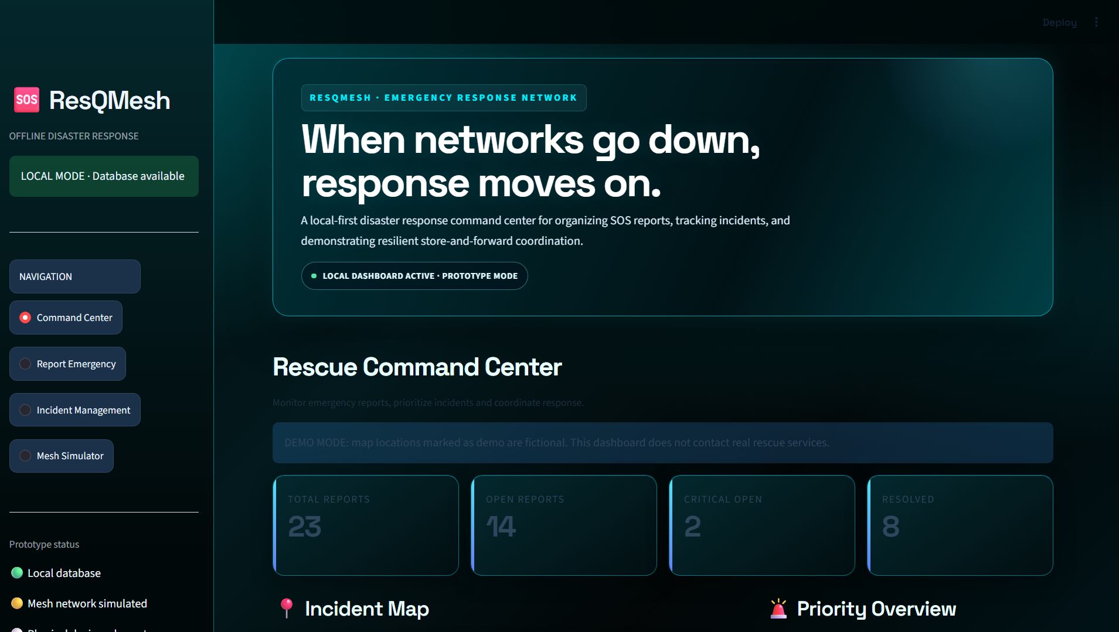
6. Prototype / Demo
DEMO
Phone SOS interface, laptop dashboard and a screen recording.
Screen recording
A trimmed, fast-forwarded screen recording (25 MB limit) is included with the submission for a clearer walkthrough of the project.
Dashboard counts in the screenshot are demo data.
Phone SOS form
Laptop response dashboard
Result / evidence
Demo Highlight
Mobile SOS interface with an offline pending queue and retry, plus a laptop dashboard for managing incident reports. Phone-to-laptop delivery is not yet verified end to end.
OPCODE IMPACT 2026 • 24-Hour National Level Hackathon
07

Slide 8
7. Results & Evaluation
VALIDATION
Honest evidence from the latest local test.
End-to-End Delivery
Response Time
Mesh Relay
Devices Tested
Unverified
Not measured
Simulated
2 devices
Test Setup
Limitations / Risks
Environment: one laptop + one phone on a local hotspot, no internet
Test case: a clearly labelled test SOS sent from the phone
Baseline / comparison: none measured
Key observation: the SOS stayed pending and did not reach the laptop inbox
• Current limitation: phone-to-laptop delivery is unverified
• Known edge case: phone GPS may be blocked on plain local HTTP
• Security assumption: trusted private local network only
• Needs validation: delivery, acknowledgement, duplicates and retry under outages
OPCODE IMPACT 2026 • 24-Hour National Level Hackathon
08

Slide 9
8. Future Scope
ROADMAP
From verified delivery to a tested offline mesh.
NOW
NEXT
LATER
BEYOND
Prototype
Pilot
Scale
Impact
Phone SOS page, local database and dashboard built; delivery path to be verified.
Fix and verify delivery, add acknowledgement and status; test with several phones.
Bluetooth or Wi-Fi Direct transport; multi-hop relay, deduplication, expiry, store-and-forward.
Security protections and a threat model, privacy controls, then controlled field tests.
Vision: a verified, secure offline relay that keeps emergency requests moving when networks fail.
OPCODE IMPACT 2026 • 24-Hour National Level Hackathon
09

Slide 10
9. Team & Responsibilities
TEAM
Role-focused team overview.
👤
👤
MEMBER 01
MEMBER 02
Mohamed Anas
Sathyaseelan
Concept, system design and frontend
Support throughout project development
Contact
GitHub / Demo: project repository and screen recording submitted with this entry
OPCODE IMPACT 2026 • 24-Hour National Level Hackathon
10

Slide 11
THANK YOU
Secure Today, Sustain Tomorrow.
ResQMesh
Team: The Innovators • Track: SDG
OPCODE IMPACT 2026 | 9–10 October 2026 | Jyothi Engineering College (Autonomous)
Questions?

