Slide 1
Query Name
Akhtamov Azimjon, 2024299010
2024-10-25

Slide 2

Problem Definition (1)
Source:
Title: Query Name
Difficulty: Easy
Type: Dictionary(python)

Slide 3
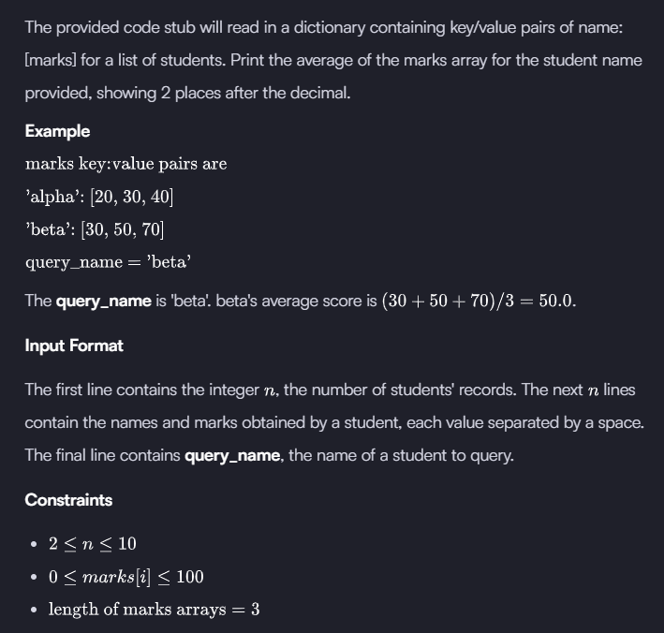
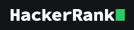
Problem Definition (2)

Slide 4
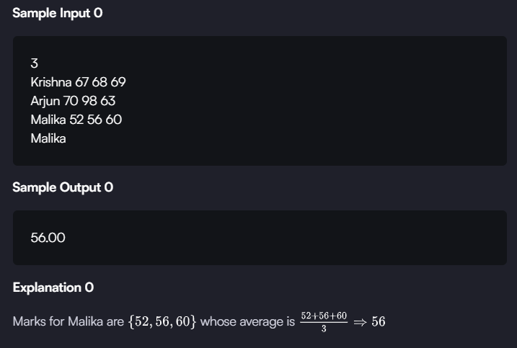
Problem Definition (3)

Slide 5
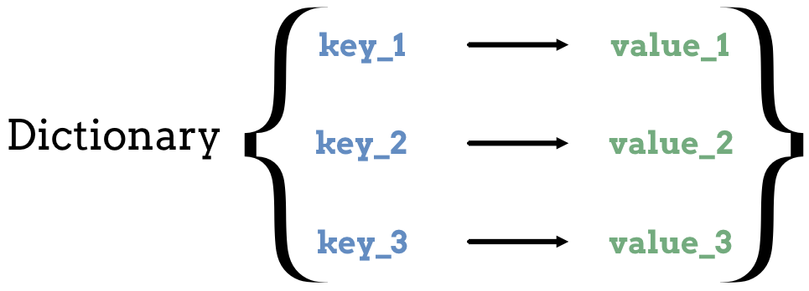
Solution (1)
step1: Input the number of students and initialize an empty dictionary.
step2: Stored each student's name as a key and their marks as the value.
step3: Query a specific student's marks using their name, then calculate the average.

Slide 6
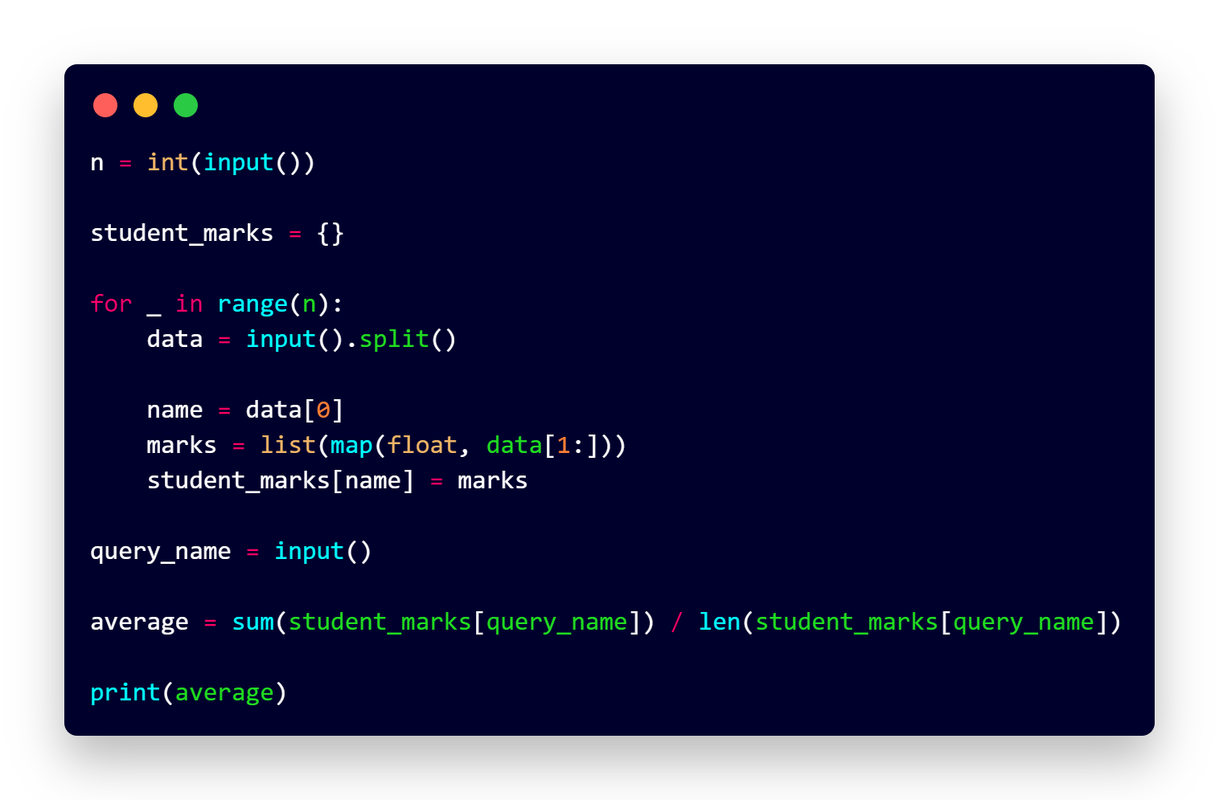
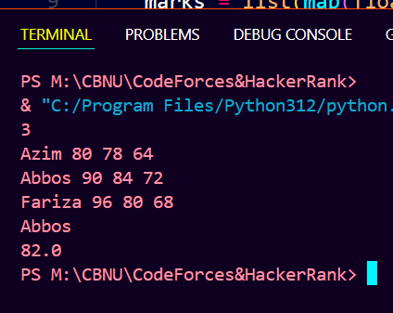
Solution (2)

Slide 7
What I have learned
Learned to use dictionaries for quick and organized data storage.

Slide 8
Questions and Answers

Slide 9
Greetings

