Slide 1
Leap Year
Akhtamov Azimjon, 2024299010
2024-10-18

Slide 2

Problem Definition (1)
Source:
Title: Leap Year
Difficulty: Easy
Type: Function

Slide 3
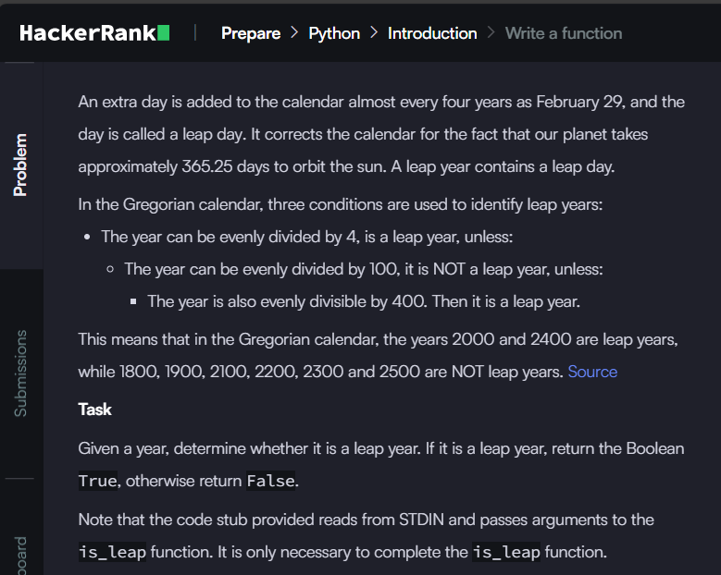
Problem Definition (2)

Slide 4
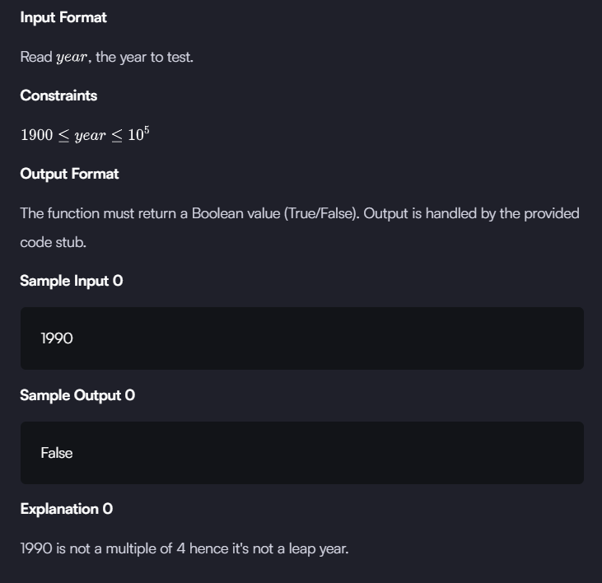
Problem Definition (3)

Slide 5
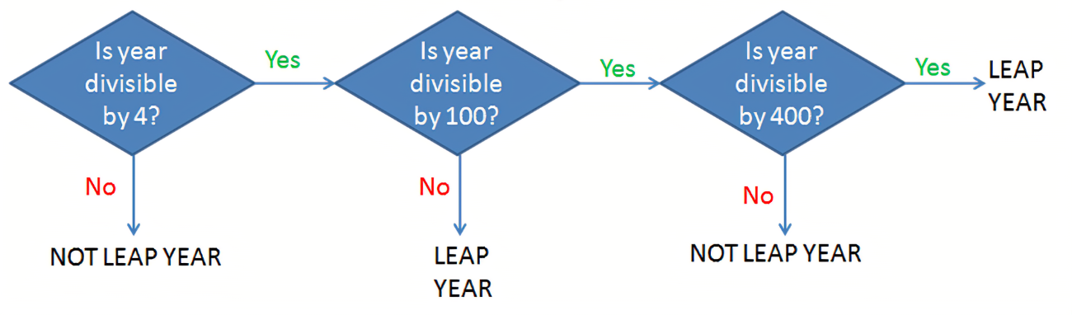
Solution (1)
The Leap Year Logic !

Slide 6
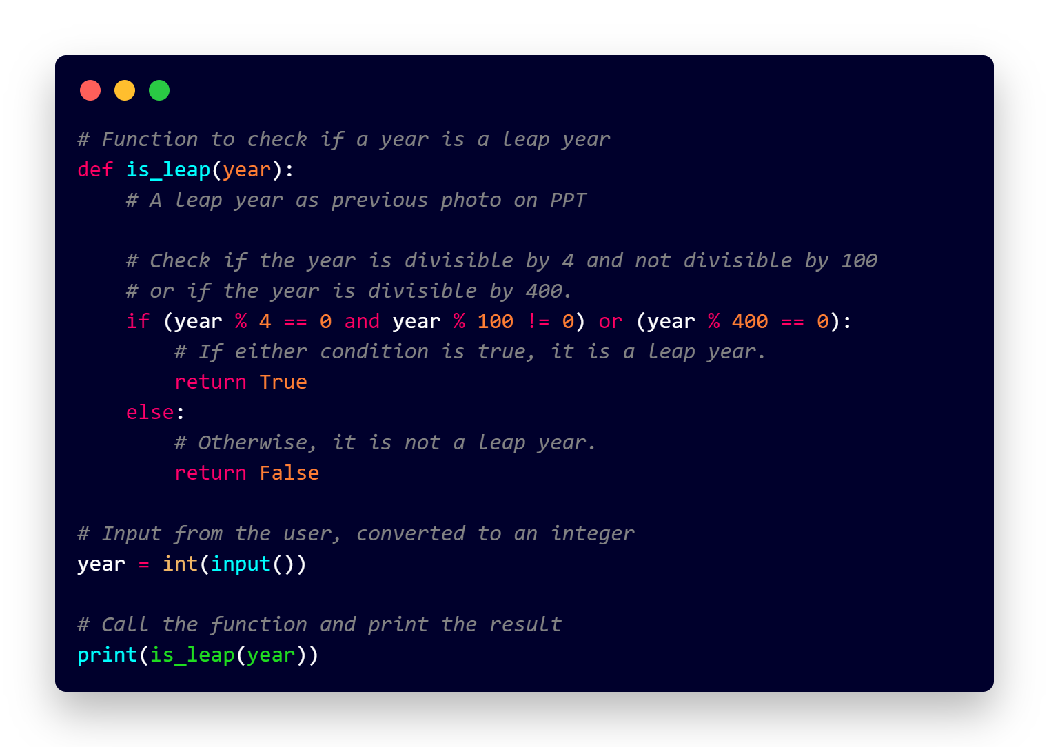
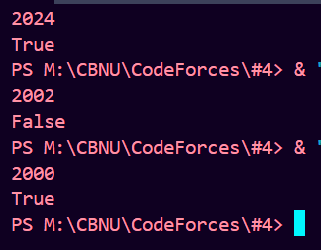
Solution (2)

Slide 7
What I have learned
Leap Year Logic: Understanding the rules for determining if a year is a leap year using conditions (% 4, % 100, and % 400).
Conditional Statements: Combining multiple conditions using if-else to implement logic in our function.
Function Definition: How to write and use a function that returns a boolean value (True/False).

Slide 8
Questions and Answers

Slide 9
Greetings

