Slide 1
Introduction to Containerisation
QACDEVPUP

Slide 2
Introduction
This course aim is to provide;
  An overview of containerisation
  Practical exposure to Docker
  Understanding and exposure to Kubernetes
The course begins with looking at an overview of;
  Overview of Containerisation Technology
  Exploration of Docker and Dockerfiles
  Utilising Kubernetes with Docker

Slide 3
Containerisation
Container technologies, built into the Linux kernel, play an increasingly important role in building and operating modern applications, both locally and in the cloud.
Organisations more and more are adapting key container technologies like Docker and Kubernetes, to not only build new, modern micro-service applications but also to package and deploy legacy applications
Containers mean environments are consistent. They provide a common set of building blocks which can be reused in any stage of development to recreate identical environments for development, testing, staging and production.

Slide 4
Containerisation
Containerisation is a lightweight alternative to full machine virtualisation which involves encapsulating an application in a container with its own operating environment.
This provides many of the benefits of loading an application onto a VM, as the application can be run on any suitable physical machine without any worries about dependencies.
Containers extend the idea of write once; deploy anywhere. They provide a disposable and reusable unit that can; execute a segment of a delivery pipeline,
Containers aren’t even a new concept - dating back to the early 2000’s.

Slide 5
Containerisation
Linux containers are part of the LXC namespace.
  Low Level
  Allow for containers to be built
  Layered systems - can have links to host file systems.
Allow for code to be run in self contained places
  Can’t interfere with the outside operating system.
  Only have access to what it is provided.
Lightweight
  Not hosting the entire operating system.
  Can share common files between host and guest.

Slide 6
Containerisation
Virtual machines need to emulate an entire operating system.
Complete separation between machines.
Better security - enforced from creation
1000 x 1GB machines = 1000GB
Containers are made up of layers, only the changes are stored in each layer.
Shared resources between containers where possible.
Fast start up time - seconds rather than minutes.
1000 x 1GB Machine = 1 Gig

Slide 7
Containerisation
Docker is a free and open source platform which can be used on any platform.
It is based on Linux standards and there are plans for Windows Server to support it natively in the future.
Docker is based on the idea of shipping containers;
  Self contained items
  Can store anything you want.
  Uses windows which allow the ability to see inside the containers.
  Ability to connect the containers together.
  They can be stacked, loaded, and unloaded independently.

Slide 8
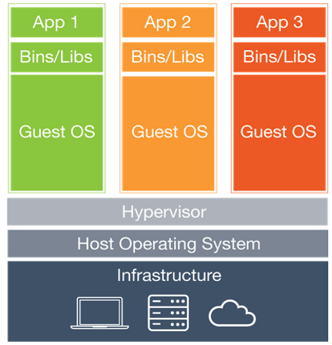
Containerisation
Containers have similar resource isolation and allocation benefits as virtual machines but a different architectural approach allows them to be much more portable and efficient.
Each virtual machine includes the application, the necessary binaries and libraries and en entire guest operating system – all of which may be tens of GBs in size.

Slide 9
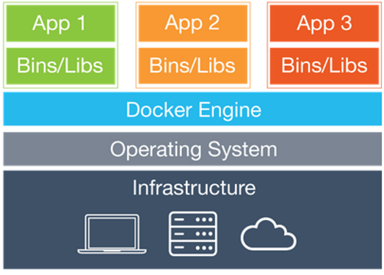
Containerisation
Containers have similar resource isolation and allocation benefits as virtual machines but a different architectural approach allows them to be much more portable and efficient.
Each virtual machine includes the application, the necessary binaries and libraries and en entire guest operating system – all of which may be tens of GBs in size.

Slide 10
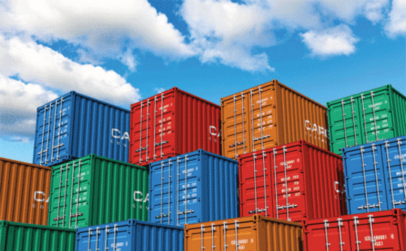
Containerisation
Standard Operations
  A set of operations has been predefined.
  Any container can be started, stopped, copied, snapshotted, downloaded, uploaded and tagged.
Content Agnostic
  All operations will have the same effect, regardless of the contents in the container.
Infrastructure Agnostic
  Containers can be built anywhere, and run anywhere else.

Slide 11
Containerisation
Designed for Automation
  Automate everything! Remove time consuming human error prone processes.
Industrial grade delivery
  Fast paced, Easy and Reliable

Slide 12
Containerisation
Fast to set up and start new containers
  Uses caching to avoid repeated steps of compilation and setup.
Avoids hardware emulation
  Much less overhead as compared with traditional virtual machines.

Slide 13
Containerisation
Sharing of common layers
  Docker images are created in layers
  Two or more applications can share the files from the same layer
  You only need to separate out the changes made
  Much more efficient than hypervisors.
Standardisation in containers
  You can build a docker container on any operating system and then run it on any other OS.
Notes:
Note currently not compatible windows to *nix. In the near future this will be resolved.

Slide 14
Containerisation
Depending on your system you can use any of the following commands
Ubuntu
  wget -qO- https://get.docker.com/ | sh
CentOS 7
  sudo yum install -y docker
Docker installs as a service, so be sure to start the service (if it hasn’t done so already)
  sudo service docker start

Slide 15
Containerisation
Look for the file “DockerToolbox.exe” that your trainer should have provided to you.
Run the executable, and step through the installation.
It will ask you to select what components to install for your system. Ensure you have at least selected;
Docker Client and Machine for Windows
On your desktop, double click on the Docker Quick start Terminal option. (You may be asked to allow virtualbox to make changes to the computer, do select yes to this option).
The first test to ensure it has installed is to type out the following command: docker run hello-world

Slide 16
Using a Docker Container
All Docker commands use the main Docker binary.
The run command will see if we have a copy of the container locally.
If we don’t it will download a copy from the docker hub (this can be internet intensive)
On the right here, you can see specific commands that we can begin using within docker.
$ docker run [flags] [containername] [command]
$ docker run -ti ubuntu bash
$ docker run centos:centos6 yum update
Finding images commands
$ docker images - images locally available
$ docker search [term] - search docker hub for more info
$ docker pull [image name] - pull a copy of the image

Slide 17
Using a Docker Container
The first command on the right will list any running containers. We can add the -l flag to the ps command to show the last running container (even if its stopped).
The second command allows us to stop a container (either with the container ID or container name)
The final command allows us to name an image being deployed.
$ docker ps
$ docker kill [name/id]
$ docker run -name db training/postgres

Slide 18
Using a Docker Container
We can see the command line terminal from any computer with the simple command on the right at the top.
The t flag tells docker we want a pseudo terminal
The i flag tells docker we want it to be interactive.
We can also connect to already running containers using the final commands.
# docker run -ti ubuntu bash
Running containers
# docker run --name academy \ -d academy/hello-world
Accessing the running container
# docker exec -ti academy bash

Slide 19
Using a Docker Container
The Docker logs command can be used to debug containers.
We can see what is being generated and displayed by the terminal.
The -f flag tells it to stay alive and update.
This is often better than having a bash terminal alive, as you can accidentally close down the container.
# docker logs [flags] [name]
# docker logs academy

Slide 20
Building a Docker Container
Docker containers are created from different layers.
  Each command ran creates a new layer on top of the existing structure.
  This means that common file bases can be shared between containers.
We can build a container in one of two ways
  Run commands and commit them one by one.
  Write a Dockerfile - which is a script to build the container for us.

Slide 21
Building a Docker Container - Adding Layers
We can run commands on the base containers created by Docker.
  If we don’t have the container it will be pulled from the repository.
  Unless we are in interactive mode, each comment must be able to run without any human assistance.
    # docker run centos:centos6 yum update -y
We can see completed containers by using docker ps -l
  This will give us the container ID
  We can then commit the changes to a container using the ID.
# docker ps -l
# docker commit --author=“Trainer” -m “message with commit” [containerid] [name:tag]
E.G # docker commit -author=“Trainer” -m “updated Centos” a3e8 academy/centos6:updated

Slide 22
Building a Docker Container - Adding Layers
You can continue to do this until you have built everything you need. If you consider the time spent to complete this, it can be quite tedious.
# docker run academy/centos6:updated yum install -y java
# docker ps -l
CONTAINER ID IMAGE COMMAND
8bb20f138 academy/centos6:updated …. …..
# docker commit --author “Trainer” -m “Installed Java” 8bb20 academy/centos6:java
ETC…..

Slide 23
The Alternative - Dockerfile
A Dockerfile is a script that builds the container for you.
It will run line by line, creating new layers each time.
The filename “Dockerfile” is used by convention. You can change this if you want, but you have to pass it manually to build a command.
FROM centos:centos6
MAINTAINER Trainer
RUN yum update -y
RUN yum install -y java
RUN yum install -y git
… … …

Slide 24
The Alternative - Dockerfile
The Dockerfile does come with a standard convention.
Capitalisation of the instruction is not a requirement - but it is convention.
Each line is executed in the order it is defined in the file.
You can optimise building containers by paying attention to the order of execution.

Slide 25
Using a Docker Container
FROM | The base container to use
MAINTAINER | Who is responsible for the container
RUN | Run a command in the container
CMD | Argument to pass the default shell on start up
LABEL | Add meta data to the image
EXPOSE | Ports to allow access through
ENV | Environment variables

Slide 26
Using a Docker Container
ADD | Copy files to the container, can be a URL, will decompress tar
COPY | Same as add but without the decompress or URL
ENTRYPOINT | Command to be run when the container is started
VOLUME | Mount a directory as a volume for the container
USER | Sets the current user from this point forward
WORKDIR | Changes the working directory from this point forward
ONBUILD | Trigger for a build event, not passed forward to children

Slide 27
Building the container
Once you are happy with the file, you need to trigger it to build. The dot at the end of the command is important.
The build will look for something called “Dockerfile” in the current directory.
If you want to change the file name use the --file flag
  docker build -t [imagename] .
  docker build - [imagename] --file=“filename” .
Each intermediate step of the build is given an ID
If something fails you can jump into the container at a given point with the ID and take a look around with bash.

Slide 28
Docker Hub
The docker hub acts as a repository for all the containers built by a large community.
  Official containers are uploaded, these usually will not have a username associated with them.
  Best practice is to use the official containers and build upon them.
You can use commands like docker search and docker pull to get the items you need from the registry.
Bare in mind using this to obtain images, means you will be directly downloading the image from the internet.

Slide 29
Volumes and Containers
The next series of slides looks into Volumes and Linking Containers together.
First we will look at Mounting Volumes
  Why use a volume
  Linking the volume to the container
  Sharing volumes
  Data only Containers
Then Linking Containers
  External and Internal Links

Slide 30
Mounting Volumes
Containers should be capable of being created and destroyed at will
  The data inside a container is lost when the container is removed
  Every time a file is changed it generates another layer in the container
  For persistent data we should be using volumes.
  Volumes persist as long as there is a container referencing it.
A volume is a directory mounted from outside of the container
  It can be on the local system
  Or from another container
File systems can be shared between containers
  Files contained in the volume are linked to the container

Slide 31
Using the Local File System
The -v flag will mount a volume
  This command will create a directory called /test inside the volume
  This is stored on the host system usually in /var/lib/docker/volumes/
  docker run -ti -v /test ubuntu bash
You can actually specify a location for the host directory, which is better practice.
  docker run -v hostDirectory:containerDirectory ….

Slide 32
Data only containers
Create a container that doesn’t run, but acts as a host for the volumes
  Access it via the -volumes-from flag
  Docker can now control the data volumes in an accessible way as well as the running containers.
The command on the right will create a container using the mysql image, it will run the echo command then stop.
# docker run
-d
-v /var/lib/mysql
--name data-container-mysql
mysql
echo data-only container for mysql

Slide 33
Volumes From
To connect other containers we use the --volumes-from flag.
This will mount the directories from the data-container-mysql image to this one.
We can create a database inside the container, stop the container, create a new one using the --volumes-from command and the database will still be there.
The container can then be stored in the registry with the current data.
# docker run
-d
--volumes-from data-container-mysql
-e MYSQL_ROOT_PASS=“root”
mysql

Slide 34
Exposing Ports
Using the Dockerfile layer system, we can expose ports to the outside world with the EXPOSE command.
On the command line we can use a flag to expose ports.
# bind a single port
-p host:container
# bind a range of ports
-p hostFrom-hostTo:containerFrom-containerTo
# bind all exposed ports in container to random host ports
-P

Slide 35
Linking Containers - Use Case
So we need to consider how we can link containers and need to know why we should be linking them. Consider the following use case.
“I want to have a php/mysql website. The database should be secure so only I have access to it.”
Now we need to remember best practices - one container per task.
  One running apache for the php webpages
  A second container for the MySQL Database.
We want to ensure that only the apache container can access the mysql database.

Slide 36
Linking Containers
We can link containers together
  Ports are only exposed to the other container.
  We create a host entry using the name of the container

Slide 37
TASK: Complete the 5 Docker Tasks

Slide 38
Kubernetes

Slide 39
What is Kubernetes?
With Docker our focus is around deploying applications to individual machines which can lock us into limited workflows.
Kubernetes allows us to abstract the weight in the individual machines and treat the entire cluster like a single logical machine.
We can describe a set of applications and how they should interact with each other and then let Kubernetes figure out how to make that happen.

Slide 40
The Pod
At the core of Kubernetes is the Pod which represents a logical application. They represent and hold a collection of one or more containers.
If you had multiple containers with a hard dependency on each other, they would be packaged together inside of a single pod.
Pods also have volumes, which are just data that lives as long as the pod does, and can be used by any of the containers within that pod.
Pods provide a shared namespace for their contents. It means the two containers within the pod can communicate with each other, and also share the attached volumes.

Slide 41
The Pod
172.10.1.100
Pods provide a shared namespace for their contents. It means the two containers within the pod can communicate with each other, and also share the attached volumes.
They also share a network namespace. Which means each pod will have one ip assigned to it.
nginx
monolith
Pod
GCE
iSCSI
NFS

Slide 42
Installing Kubernetes
The process to install and set up Kubernetes can be quite complex.
There are many guides depending on the environment you are setting up, be it in the cloud or locally.
Your first challenge, in groups of two, is to attempt installation of Kubernetes on Ubuntu using the guide in the link below.
https://kubernetes.io/docs/getting-started-guides/ubuntu/

Slide 43
TASK: Installing Kubernetes

Slide 44
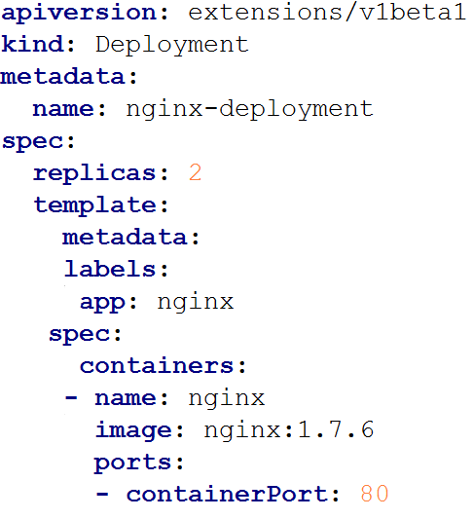
Creating Single-Container Pods
Pods can be created using pod configuration files.
The configuration file is based on YAML.
The example on the right, sets up a simple deployment running the Nginx docker image.
We can see the image name, the port being used and other bits of information.

Slide 45
TASK: Creating your first Single Container Pod

Slide 46
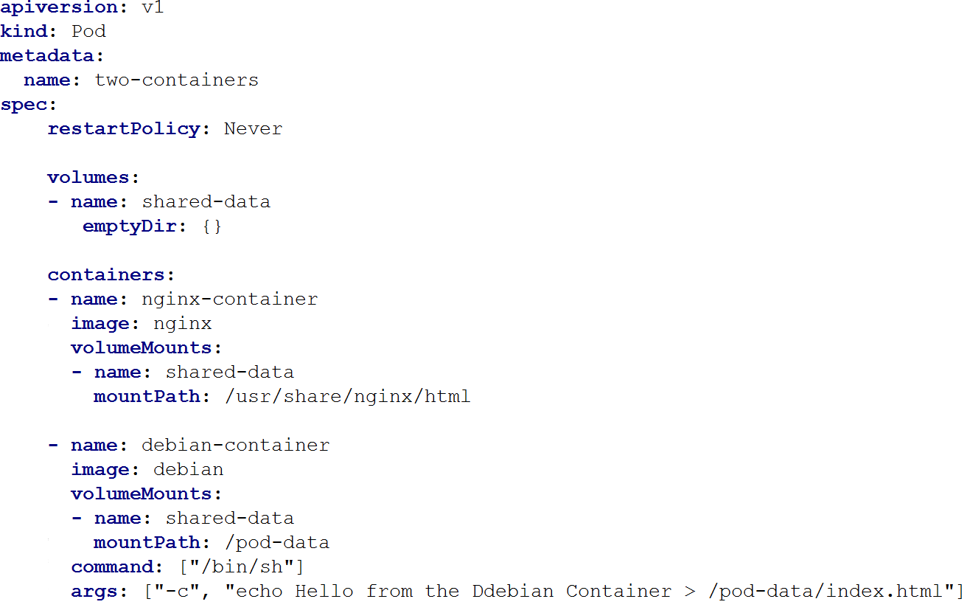
Creating Multi-Container Pods
This is an example of a Pod configuration file that makes use of two containers. One an nginx container, the other a Debian container.

Slide 47
TASK: Creating a Multi-Container Pod

