Slide 1
Introduction to Cloud Computing
QACDEVPUP

Slide 2
Introduction
This course aim is to provide;
An overview of what cloud computing is
Defining the specific terms within cloud computing.
The course begins with looking at an overview of;
Cloud Services
Cloud Deployment Models

Slide 3
What is the Cloud?
The terms ‘cloud computing’ and ‘the cloud’ have been used to describe all kinds of different technology.
Are we talking about Distributed computing? Networked Services? Virtualised Servers or Hosted services?
The actual definition of cloud computing as reported by NIST (National Institute of Standards and Technology) is;
“Cloud computing is a model for enabling ubiquitous, convenient, on-demand network access to a shared pool of configurable computing resources (e.g, networks, servers, storage, applications, and services) that can be rapidly provisioned and released with minimal management effort or service provider interaction.”

Slide 4
Characteristics of Cloud Computing
On-demand self-service.
Broad network access.
Resource pooling.
Rapid elasticity.
Measured service.
The NIST standard also defines:
Three service models (IaaS, PaaS, SaaS)
Four deployment models (public, private, hybrid and community)

Slide 5
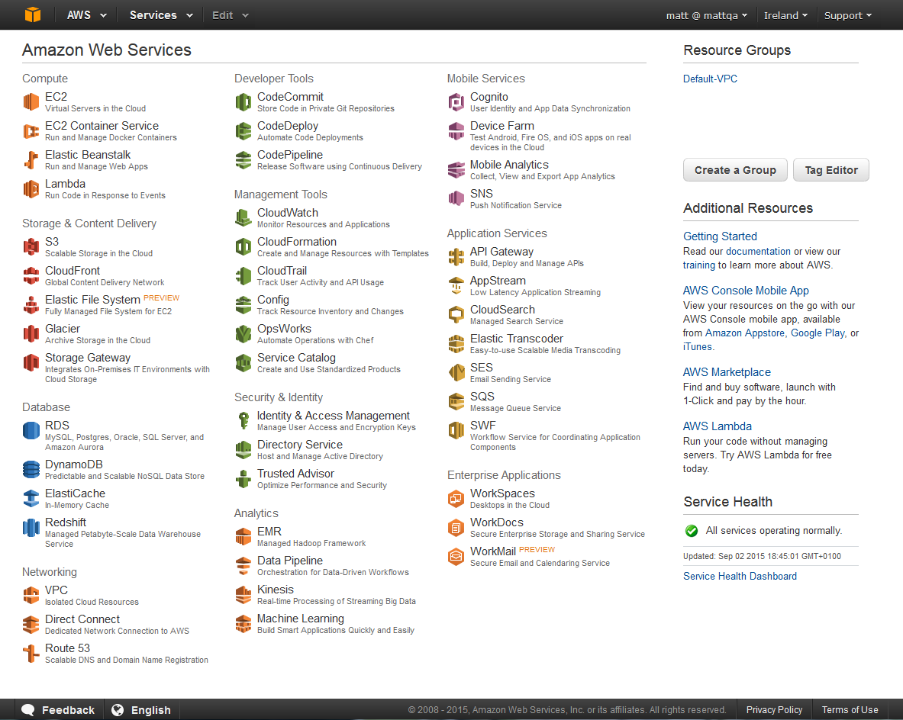
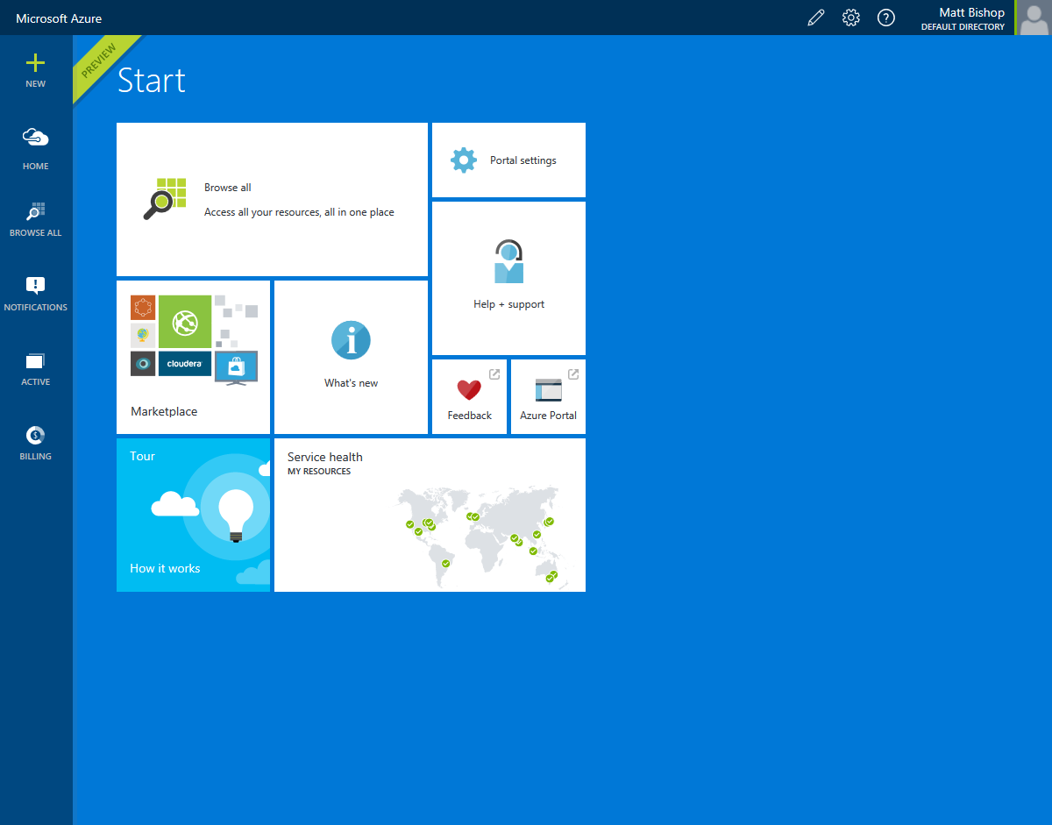
On-Demand Self-service
Notes:
The customer can separately provision computing capabilities
Usually via some kind of dashboard
e.g. Amazon Web Services, Windows Azure:

Slide 6
Broad network access
Access over network via ‘standard mechanisms’ which would generally be taken to mean standard protocols like HTTP or TCP.
Services should be accessible to a variety of clients running on various hardware (phones, laptops, desktops).
In other words, if it's only accessible using a proprietary protocol or data format, from a custom client, it's probably not cloud computing.
Notice that ‘network-accessible’ is not the same thing as ‘internet-accessible’; there is such a thing as a private cloud on a private network.

Slide 7
Resource pooling
Serving multiple customers using a multi-tenant (users, applications) model
Dynamically assigning and reassigning resources
Storage, processing, memory, etc.
Location-independent
Customer does not know exact location of the resources
Customer is usually able to specify a general location (e.g. country)
Notes:
Cloud services are provided to multiple tenants (users, applications) by a pool of interchangeable resources. If each tenant needs its own, specific, customised resources, then it's not cloud computing. Providing on-demand resources with utility pricing can only make economic sense if the resources come from a shared pool.
These resources are dynamically assigned and reassigned in order to get optimal use out of them.
The customer generally does not know, or need to know, where the resources are physically located. In practice, for both regulatory and architectural reasons, the customer will usually have to know the general location. (Sample regulatory reason: can this data be stored outside of the EU? Sample architectural reasons: can the application function well if the webserver is in the EU and the data it uses is in Australia?)

Slide 8
Rapid Elasticity
Elasticity is a fundamental property of the cloud.
The ability to use exactly the resources you need, without either under-provisioning or excessively over-provisioning, is one of the key benefits of cloud services.
Allows customer to scale in and out with demand
Note: usually scaling in and out, as opposed to scaling up and down
May even be automatic or transparent to the customer

Slide 9
Measured Service
If resources are being dynamically provisioned, it's essential that the customer should be able to monitor the performance and usage of those resources in real time.
Most cloud resources are offered on a pay-per-use basis, and the customer must be able to monitor their usage in order to control their costs.

Slide 10
Benefits of the Cloud

Slide 11
Open Discussion
What appeals to you about cloud services and cloud computing?
What doesn’t? What makes you wary or unsure?
Who has used cloud services before?

Slide 12
Cloud model of IT Provisioning

Slide 13
Cloud Benefits
Over the next series of slides we will be looking at a variety of key components within cloud computing.
Scale out:
Cope with spikes in demand (expected and unexpected)
Scale out from zero, for batch processing.
Scale in:
In response to lower demand
Automatically, based on time of day (peak hours)
Lower costs

Slide 14
Cloud Benefits
Another major benefit is allowing customers to take advantage of the competencies of the cloud service provider.
Operating a Data centre is complex and many costs and issues need to be considered;
Security, certifications, audits.
Hardware specifications, warranties, installation, disposal.
Operating Systems and platforms, licenses.
Network configuration and security.
Software has to be self managed.

Slide 15
Cloud Benefits
Using a cloud based solution enables us to have specialised teams for all of the above.
Software can be ran as a Service.
Infrastructure can be managed and maintained for you.
Allows you to focus on the core competencies of the business.

Slide 16
High Availability
Running an application in a variety of physical locations was previous so expensive that only the largest organisation could really consider it, and usually only for the most critical of functionality.
With the cloud, the idea of high Availability is essentially free;
Same cost to deploy to multiple data centres.
Fewer single points of failure.
Lower latency, high availability.

Slide 17
Agility
Using the cloud tends to increase agility. We'll see many case studies, later on in this course, where faster time-to-market was one of the major benefits of an organisation's move to the cloud.
Faster provisioning for (e.g.) new projects
Faster introduction of new services
In DevOps for example; agile creation, testing and deploying of services.
Continuous Delivery/Deployment

Slide 18
Cloud-Enabling Technologies

Slide 19
Fast, wide-area networks
In order to get the location-independence of the cloud, you need a fast wide-area network. Otherwise the users and the servers all need to be physically close, or connected by a dedicated network.
With a fast wide-area network, we can support users in many different locations, and we can support high-availability and disaster recover solutions that would previously have been unworkable.

Slide 20
Powerful, inexpensive server computers
In order to get the pool of interchangeable resources required by a cloud, we need to be able to buy lots of servers and configure them, and they need to be reasonably powerful.
Building a data centre is a specialist skill, and there are standards and bodies of knowledge related to it.
Data centres are becoming increasingly efficient and cheap, to the extent that it is possible to get a containerised ‘modular data centre’ shipped to you.
When choosing a cloud provider, they will probably be able to document the standards to which their datacentre adheres.
TIA-942 and Uptime Institute are the two best-known.

Slide 21
High-performance virtualisation
In order to get the location-independence of the cloud, you need a fast wide-area network.
Otherwise the users and the servers all need to be physically close, or connected by a dedicated network.
With a fast wide-area network, we can support users in many different locations, and we can support high-availability and disaster recover solutions that would previously have been unworkable.

Slide 22
Benefits of virtualisation
Benefits of virtualization:
Elasticity/scalability
Resource pooling on common infrastructure
More efficient use of physical resources
Granularity of monitoring and pricing
The hypervisor should prevent issues like:
Security concerns – leakage of data from one guest to another
‘Noisy neighbours’ – one guest using all the bandwidth/CPU/etc.

Slide 23
Virtualisation vs Multi-tenanting
Virtualization separates multiple customers at the hypervisor
Every customer has their own virtual machine, from the OS up
Multi-tenanting separates customers within an application
The virtual machine is shared by many customers
Isolation is enforced by the application
Both can be used for cloud services
Multi-tenanting is common for software-as-a-service (e.g. GMail)
Notes:
Virtualization is a type of multi-tenanting, in that it allows multiple users to share a single physical resource. It does this by separating the users at the hypervisor level.
However, when we use the term multi-tenanting, we usually use it to refer to application-level separation of users within a single virtual machine.
Software-as-a-service is frequently multi-tenant: my webmail provider almost certainly uses virtualisation, but when I log on, I don't get a virtual machine all to myself. Instead, the application prevents me from seeing other users' email.

Slide 24
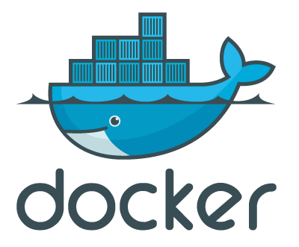
Containers
Subdivide a single virtual machine
Less overhead than creating multiple VMs
Does not require hardware support or emulation
Containers are isolated at the user (as opposed to kernel) level
Docker is the best-known container technology (docker.com)
Package an application and its dependencies as a unit
Run on any Linux server: flexible and portable
Windows support expected soon
Integrated into many other cloud products
Notes:
Containers are the latest buzzword; a software container is a sort of lightweight virtualisation. The analogy is with shipping containers, which are reusable and can contain anything, but nevertheless can be loaded onto any container ship – similarly, a software container can package up an application and its dependencies into a reusable form that can be dropped onto any Linux server. This allows a single virtual (or physical) machine to run multiple applications which have incompatible requirements (e.g. different versions of the same package).
In a cloud environment, this can allow a user to make optimal use of a single virtual machine, by subdividing it still further. Containerised applications are much more lightweight than a VM, and can reach a running state much more quickly – this makes them very elastic.
Containers have been around in Linux for years (e.g. chroot, FreeBSD jails), but have become very popular with the arrival of Docker. Docker support for Windows will be available in Windows Server 2016, and has been integrated into many cloud products – especially PaaS services such as AWS Elastic Beanstalk, Azure, OpenStack and CloudFoundry.

Slide 25
Services

Slide 26
Services
Service-Oriented Architectures
Microservices
Service-Oriented Cloud Computing Infrastructure
X-as-a-Service (IaaS, PaaS & SaaS)

Slide 27
Service-Oriented Architecture
Service: Self-contained, loosely-coupled unit of functionality
Each service should do one single thing
Public contract (interface) but private implementation details
Abstract, stateless, discoverable, composable
Get all the usual benefits of reusable modular components

Slide 28
Service-Oriented Architecture
Idea is to create applications by combining services
Easier to develop, debug and maintain
Can reuse existing components
Easier to be resilient to service failures
If one service fails, the rest of the app can carry on
Easier to swap out one service for another
e.g. switching payment processor or mapping provider

Slide 29
SOA and the Cloud
A classic problem with SOA is ‘what's in it for me?’
Creating robust reusable services is more difficult than creating something for one-time use
Requires work to define the public interface
Must be made available to other users somehow
Suspicion of over-engineering – YAGNI (‘you ain't gonna need it’)
In the context of a cloud strategy, SOA can make more sense
Other applications will be in the same environment
More likely to be able to reuse a service
Possibility of monetisation
Particularly linked to SaaS (Software as a Service) environments

Slide 30
Microservices
Service-orientation taken to an extreme
Many small, highly-decoupled services, each with a single task
Very different from to a tiered/layered architecture
May be running multiple versions of the same service
May require service discovery (e.g. Zookeeper, Eureka)
Slightly different from a service-oriented architecture
Services might not be reusable across applications
Not really about integration and reuse
More focused on modularity, replaceability
Optimised for continuous delivery/DevOps
Good fit for containerisation via (e.g.) Docker

Slide 31
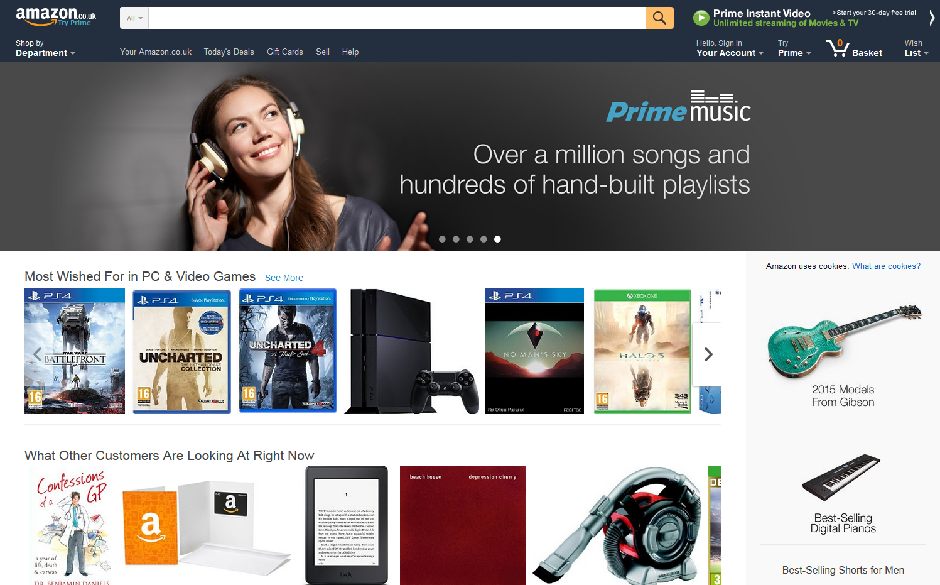
Microservices example: Amazon homepage
Not monolithic – actually built from hundreds of reusable services.
Amazon have a policy of ‘two-pizza teams’: the team that creates a service should contain very few people – no more than can be fed with two pizzas.
Notes:
Amazon use a DevOps process, and deploy over 50 million times a year (about once every 1.5 seconds). This sort of DevOps approach can probably only work in a cloud environment.

Slide 32
SOCCI: Service-Oriented Cloud Computing Infrastructure
Now we have access to virtualisation and resource pooling
So service-orientation can now be applied to infrastructure
"SOCCI can be defined as service-oriented, utility-based, manageable, scalable on-demand infrastructure that supports essential cloud characteristics, service, and deployment models“
This gives us what we need in order to implement and manage an Infrastructure-as-a-Service environment
SOCCI is the underlying infrastructure for IaaS
More about SOCCI:
http://www.opengroup.org/soa/source-book/socci/index.htm

Slide 33
IaaS, PaaS and SaaS
IaaS: Infrastructure as a Service
Consumer can provision computing, storage and network capacity
Deploy and run arbitrary applications, including operating systems
PaaS: Platform as a Service
Typically built on top of IaaS
Consumer deploys custom applications, but has limited or no access to the hosting environment, operating system, etc.
SaaS: Software as a Service
Typically built on top of PaaS
Consumer uses existing applications hosted in the cloud
Consumer may have access to user-specific configuration settings, but not to any other configuration or deployment capabilities

Slide 34
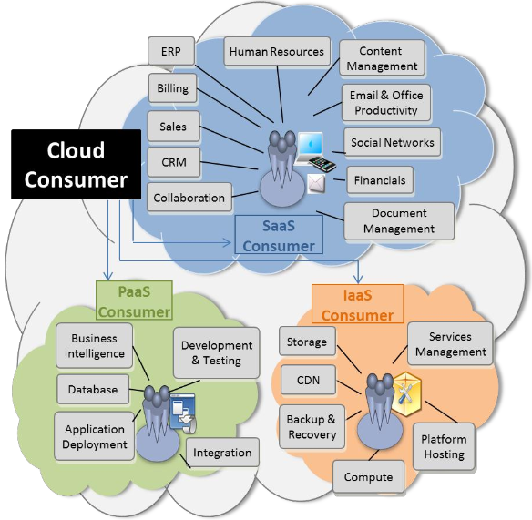
Examples
The graphic above shows some of the sorts of functionality that can be provided by IaaS, PaaS and SaaS services.

Slide 35
Management responsibilities of AS-A-Service
On-Premises
IaaS (infrastructure)
PaaS (platform)
SaaS (software)
Application
Application
Application
Application
One of the key distinctions between the three service models is in the shared management responsibilities for the infrastructure stack.
Data
Data
Data
Data
Runtime
Runtime
Runtime
Runtime
Middleware
Middleware
Middleware
Middleware
Operating System
Operating System
Operating System
Operating System
Virtualisation
Virtualisation
Virtualisation
Virtualisation
Physical server
Physical server
Physical server
Physical server
Physical storage
Physical storage
Physical storage
Physical storage
Physical network
Physical network
Physical network
Physical network
Managed by customer
Managed by vendor
Notes:
IaaS usually divides at the hypervisor, with the provider responsible for everything from the hypervisor downwards, and the consumer responsible for the OS and upwards.
With PaaS, the ‘platform’ that is provided would include middleware and runtime (e.g. web server, Java, .NET), all managed by the provider. The consumer need only deploy their own custom application and its data.
With SaaS, the entire stack belongs to the provider, and the customer simply uses it.

Slide 36
The three service models sit in layers, each on top of the next.
Notice in the diagram the ‘resource abstraction and control layer’; this is the layer that was referred to in the slide about SOCCI, earlier, which allows the provider to easily manage the underlying hardware.

Slide 37
Infrastructure as a Service
Targeted at IT Operations
Provision infrastructure in the cloud
Compute, storage, networking, database
Access via specialised dashboard/scripts
Have root/administrator level of control of virtual machines
Install OS, mount disks, create filesystems, install software, etc.
No access to physical resources/hypervisor

Slide 38
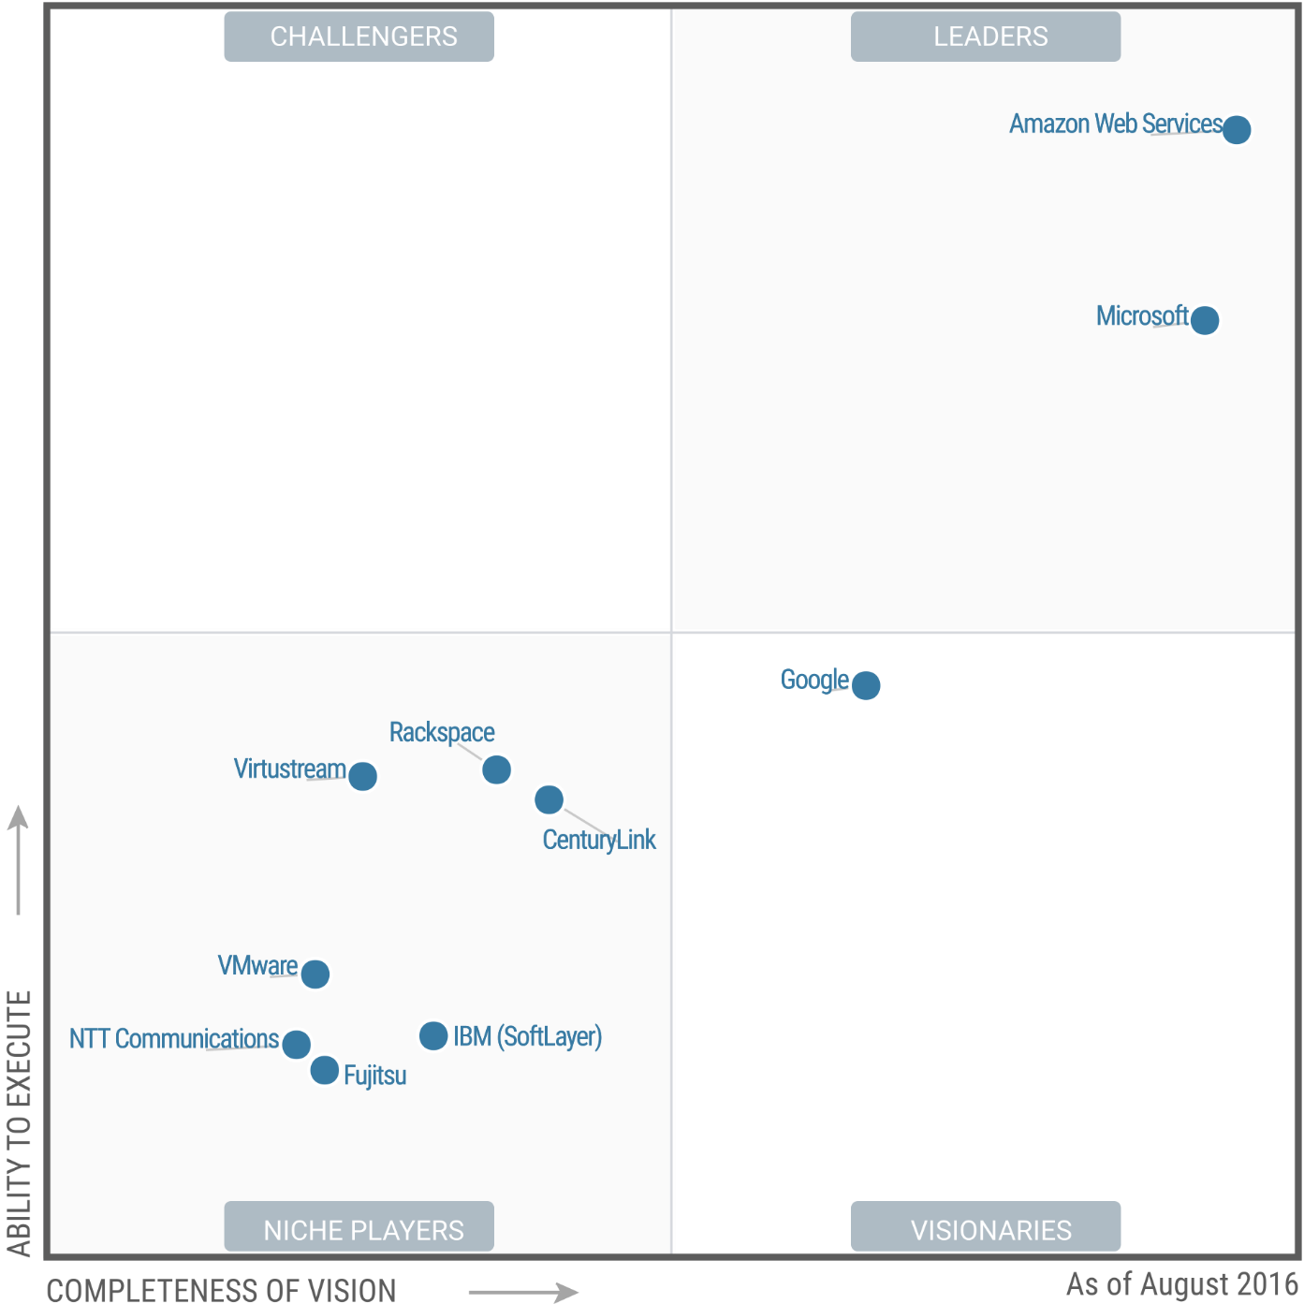
Gartner Magic Quadrant 2015 for cloud IaaS
On the graph, the x-axis is ‘completeness of vision’ and the Y-axis is ‘ability to execute’; being further to the top right is better. The graph clearly shows how dominant Amazon Web Services currently is over all other public cloud providers.

Slide 39
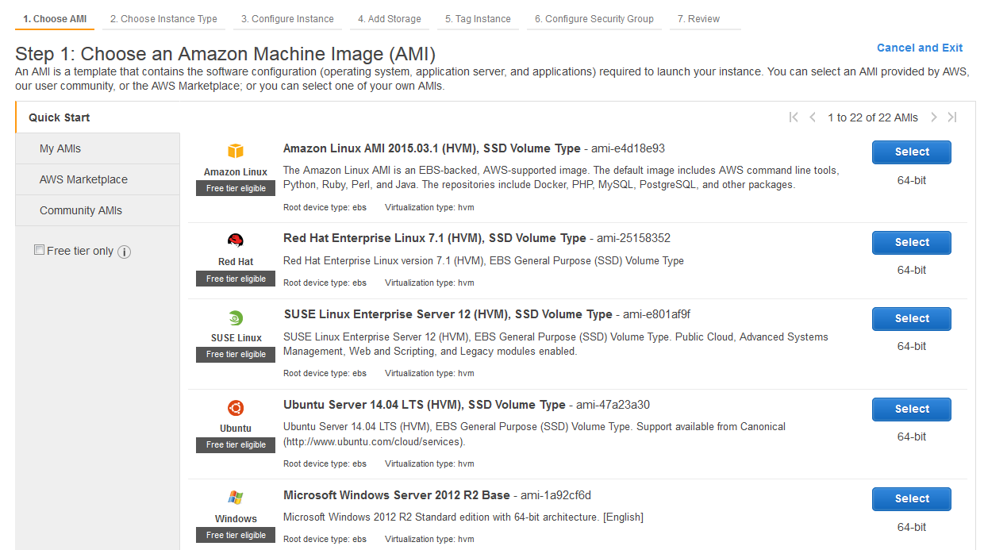
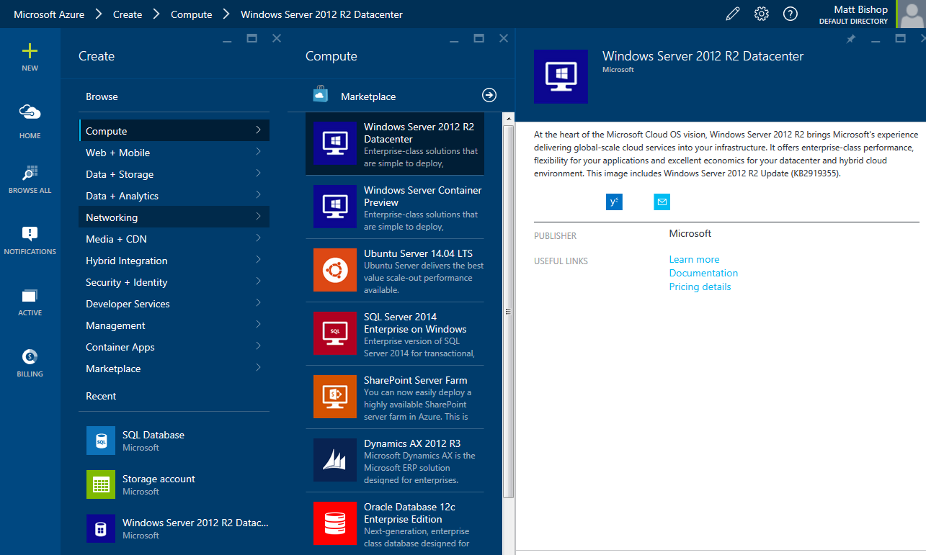
Public IaaS (AWS / Azure)

Slide 40
Platform as a Service
Targeted at Developers
Generally the least mature of the three aaS options
Deploy applications to a preconfigured environment
Easier but less flexible than IaaS
Closed environment, so consider possible lock-in:
...of code (because coding to a provider-specific API)
...of data (can always dump data to a CSV for export)
Different languages supported on each platform
Environment often running on another provider's IaaS
e.g. Heroku and OpenShift run on AWS
Comparisons:
http://www.paasify.it/

Slide 41
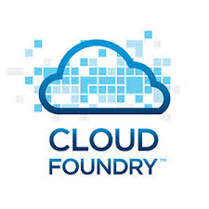

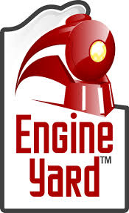

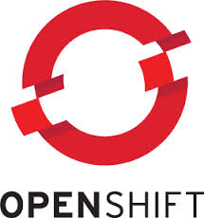
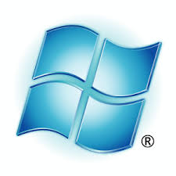
PaaS: Cloud Examples
Cloud Foundry
Heroku
Google App Engine
Engine Yard
OpenShift Online
Microsoft Azure
Amazon Elastic Beanstalk
Also customisations of existing SaaS applications:
force.com (Salesforce)
SAP Hana Cloud Platform (SAP Hana)
Office 365 (e.g. SharePoint customisations)
Notes:
There are many names in the PaaS arena; here are a few you may have come across.
Apart from developing custom standalone applications, PaaS can also be used by developers to customise SaaS services.
Heroku is owned by Salesforce, and is integrated with force.com via Heroku Connect.

Slide 42
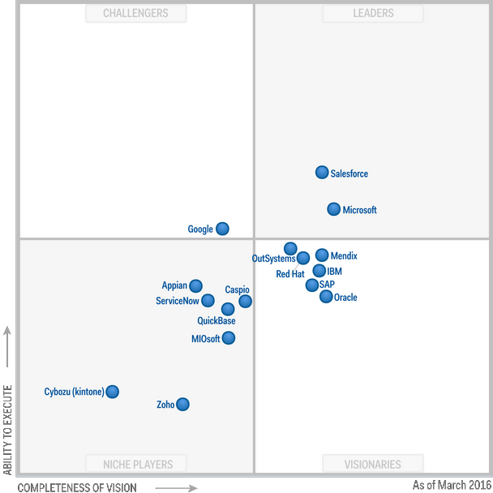
Gartner Magic Quadrant 2015 for cloud IaaS
On the graph, the x-axis is ‘completeness of vision’ and the Y-axis is ‘ability to execute’; being further to the top right is better. The graph clearly shows the wide range of competing providers.

Slide 43
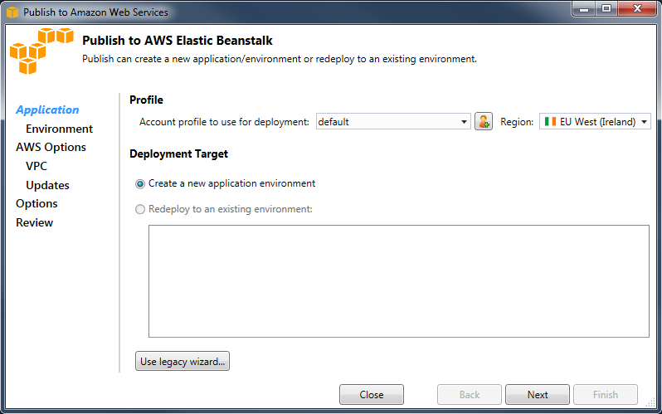
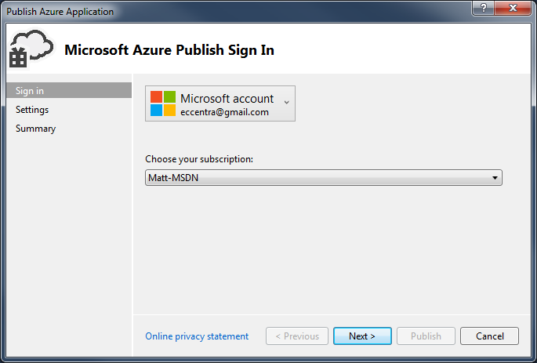
Public Paas
Notes:
PaaS can be integrated with a development environment. On the slide above are the AWS Toolkit for Visual Studio (top left) and the Windows Azure SDK for Visual Studio (bottom right), both in the process of deploying an application to their respective clouds.
AWS Elastic Beanstalk is technically IaaS, since it is possible to connect to your new virtual machine as an administrator to install and configure more software. But it behaves like PaaS from a developer's perspective.

Slide 44
Software as a Service
Targeted at Users or Business Operations
Accessed via web browser (or mobile/desktop app)
Third-party applications running on cloud infrastructure
Managed and configured by the service provider
Usually either free or with a per-user subscription model
Usually built on IaaS or PaaS services
e.g., Dropbox is built on Amazon S3
Notes:
Finally, SaaS. This is the service model that users are most likely to have encountered before; any heavy internet user can probably come up with a list of a dozen SaaS providers without pausing to draw breath.
As seen before, SaaS often sits on a layer of PaaS or IaaS, often from a different provider.
For instance, Dropbox (a cloud storage tool that synchronizes a folder across multiple machines of all major operating systems, including desktops, tablets and phones) is built on Amazon Web Services' IaaS object storage (Simple Storage Service, better known as S3).

Slide 45

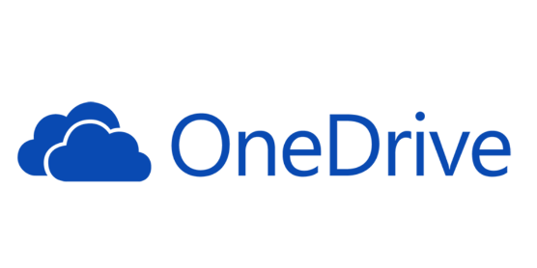

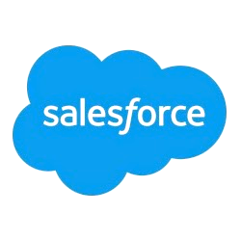


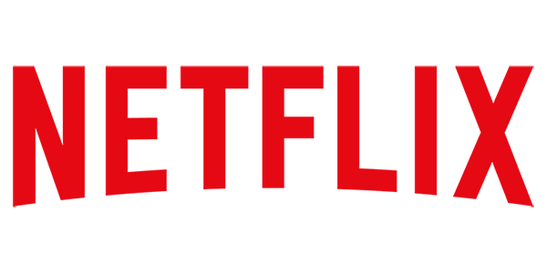


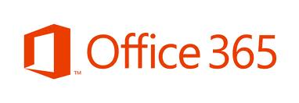
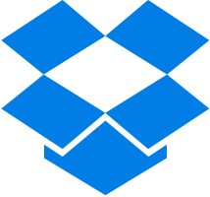
SaaS Examples
Notes:
These are literally the first few that came to mind; you could easily find hundreds more.

Slide 46
AS-A-SERVICE
It is possible to extend and subdivide the IaaS/PaaS/SaaS model
The other most common acronyms are:
SaaS (Storage)
MaaS (Monitoring)
NaaS (Network)
CaaS (Communications)
DaaS (either Data or Desktop)
BPaaS (Business Process)
XaaS (anything/everything)

Slide 47
Cloud deployment models

Slide 48
Cloud Deployment Models
Public cloud: Infrastructure for open use by the general public, on the premises of a cloud provider
Private cloud: Infrastructure for the exclusive use of a single organisation with multiple consumers (business units). May be on- or off-premises
Community cloud: Infrastructure for the use of a specific community of consumers from various organisations with shared concerns (e.g. financial traders, airlines)
Hybrid cloud: Two or more of the above infrastructures, with some mechanism – standardised or proprietary – for data and application portability between them
Note that the ownership and operation of the infrastructure is unspecified. A private cloud need not be owned by its user

Slide 49
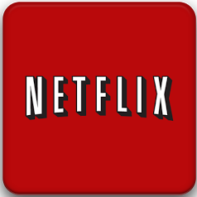
Public: Netflix
Video streaming at huge scale
Up to 1/3 of North American internet traffic
Started out with Amazon Web Services (IaaS)
‘We want to use clouds, not build them’
Built their own PaaS services on top of AWS
Attempt to isolate developers from the AWS API
Portability as a long-term goal
Trailblazer/reference architecture
Many OSS projects: Simian Army, Asgard, ICE
Notes:
http://www.youtube.com/watch?v=oH3PAGZJewA
http://www.sfisaca.org/images/FC12Presentations/D1_2.pdf
http://techblog.netflix.com/

Slide 50



Private: Government Departments
Maintenance of own private servers and infrastructure
Necessary to host government files on private servers
Maximises security for the departments

Slide 51
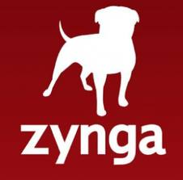
Hybrid: Zynga
Social gaming, with >250m monthly active users
Traditional infrastructure until 2009, then...
"We couldn’t get power fast enough. We couldn’t get servers fast enough. We just couldn’t scale our infrastructure to match the needs of FarmVille“
Moved to Amazon Web Services to accommodate rapid growth
Now 80% private cloud (zCloud), 20% Amazon Web Services
zCloud is built on AWS principles, using CloudStack
Customised to specific requirements of Zynga's workload
Both clouds managed together, using RightScale
Notes:
http://www.youtube.com/watch?v=GTFYlylzLtM
http://www.rightscale.com/customers/zynga-grows-to-1-social-gaming-site-with-rightscale.php

Slide 52

Community: NYSE Euronext
Global operator of financial markets and provider of trading technologies
Industry needs to share data and make trades
Very expensive to build private servers
Regulatory and security issues with public cloud
Extreme sensitivity to latency
Not internet-connected at all
Capital Markets Community Platform
VMWare-based community cloud, offering IaaS to the industry
Notes:
http://www.intersectshow.com/Video2.aspx
http://www.vmware.com/uk/company/customers/nyse-case-study.html

Slide 53
Security in the Cloud

Slide 54
Security: Datacentre and hardware
Cloud provider should be able to document:
Datacentre access
Hardware access (logical and physical)
Destruction of failed hardware
Audits and certifications (ISO 27001, SOC, ITAR, FIPS, PCI, etc.)
Compliance usually requires audits of both provider and customer

Slide 55
Security: Physical Network and Virtualisation
Attacks from outside the cloud:
DDOS attacks
Attacks on API endpoints
These can be prevented or mitigated by the cloud provider:
Standard and proprietary networking techniques
Enforcement in the hypervisor
Terms of Service
Attacks from inside the cloud:
IP spoofing
Packet sniffing
Port scanning
Zeroing data in newly-assigned RAM or disk
Other malicious behaviour

Slide 56
Security: Virtual Network
For IaaS, may be able to configure:
Firewalls (allowed and denied ports and protocols)
Virtual (software-defined) networking
Subnets (public/private)
IP addresses (public/private/persistent across reboots)
Routing tables
Access control lists
Gateways to internet and/or VPN
NAT
Software defences:
Bastion hosts
Intrusion detection/prevention systems
Anti-malware, anti-virus, etc.

Slide 57
Security: OS, Applications, Middleware
These need to be protected and patched
Exactly as for a traditional on-premises deployment
Whose responsibility is that?
It depends on the service model
In IaaS, these are the customer's responsibility
In PaaS and SaaS they're the provider's responsibility.

Slide 58
Security: Authentication and Authorisation
Who can authenticate to the cloud service provider?
e.g. in IaaS, to provision new servers and logical infrastructure
Also managing the account, billing, etc.
Not just the dashboard – must secure the API as well!
Who can authenticate to the provisioned functionality?
e.g. in IaaS, log in to a server (usually over SSH)
e.g. in PaaS, deploy and configure applications
Notes:
There are various layers that typically all have their own authentication mechanisms: the provider's own APIs, the operating system, the installed applications.
These might be three entirely different groups of users. For instance, in AWS:
The first is me, logging in with my email address and password, plus any users I choose to create in the AWS console (who log in at a special URL I give them)
The second is up to me; I have the SSH keypair, and can give it to anyone I want. AWS does not control, or know about, those users. If I want to, I can create new users in my OS, or (for Windows) install Active Directory and create users there; it's all up to me
The third depends on my application. It might be my Active Directory users, or I might let any internet user create an account
For the first, then, my cloud provider (in this case AWS) should help me manage the users and assign them permissions. For the second and third, my cloud provider has nothing to do with it, and it's up to me.

Slide 59
Security: Authentication and Authorisation
Who can use the services?
e.g. create an account in a SaaS solution
Potentially three entirely different groups of users
e.g. the third might be ‘anybody on the internet who signs up’
We also need to assign permissions to these users
There is no standardisation across providers
Notes:
There are various layers that typically all have their own authentication mechanisms: the provider's own APIs, the operating system, the installed applications.
These might be three entirely different groups of users. For instance, in AWS:
The first is me, logging in with my email address and password, plus any users I choose to create in the AWS console (who log in at a special URL I give them)
The second is up to me; I have the SSH keypair, and can give it to anyone I want. AWS does not control, or know about, those users. If I want to, I can create new users in my OS, or (for Windows) install Active Directory and create users there; it's all up to me
The third depends on my application. It might be my Active Directory users, or I might let any internet user create an account
For the first, then, my cloud provider (in this case AWS) should help me manage the users and assign them permissions. For the second and third, my cloud provider has nothing to do with it, and it's up to me.

Slide 60
Security: Data
Where is data stored and/or transmitted?
Regulatory issues may require e.g. only within EU
e.g. Amazon EU-West-1 region is physically in Dublin
Multiple physical Dublin datacentres enable HA
But there are a few US-only API endpoints (e.g. Simple Email Service)
For IaaS, customer can control this to some extent
For SaaS, is generally imposed by provider
Requires careful reading of ToS, privacy policy, applicable laws
End user may not even realise their data is in the cloud
Where, physically, is my Instagram/Vine/Dropbox data?
All of them are in Amazon's US datacentres
Notes:
Data is a major concern: where is my cloud data, and is it secure?
Remember that data exists both at rest and in motion; the question is not only where it's stored, but where it's sent.
It's necessary to analyse your data and work out what can and can't go to the cloud.

Slide 61
Security: Data Encryption
Is data encrypted at rest? How about in motion?
SSL/TLS support
Support for encryption:
Transparently as part of a service (e.g. S3)
In applications (e.g. on writing to database in a PaaS solution)
In filesystems (e.g. when using a volume in an IaaS solution)
May present key management issues
Perhaps solvable using tools like CloudHSM
Notes:
Some data security issues may be mitigated by encryption. Generally, it will be up to the consumer to either (a) verify that the provider is using appropriate encryption or (b) do it themselves.
Again, data at rest may be treated differently to data in motion; check both.
Managing keys may be an issue.
For instance, suppose your cloud server uses an encrypting filesystem. If servers are like cattle, and everything fails all the time, you don't want the server to store the encryption key, because you could lose it at any time. It needs to be kept somewhere secure, but also accessible when required (so we can bootstrap a new server).

Slide 62
Next Steps
Now you have had an introduction to Cloud, it is time to explore some of the cloud technology available.
Focus points include;
Amazon Web Services - AWS
Microsoft Azure
Google Cloud

