Slide 1
Introduction to Amazon Web Services
QACDEVPUP

Slide 2
Introduction
This course aim is to provide;
An overview of the different features available within AWS
Taking a practical approach to learning with AWS
The course begins with looking at an overview of;
EC2 Console
VPC
S3

Slide 3
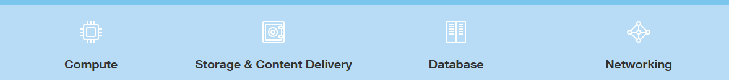
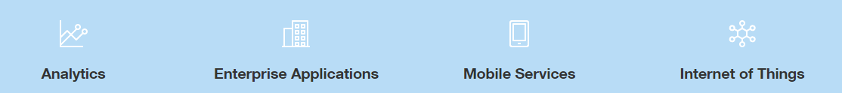
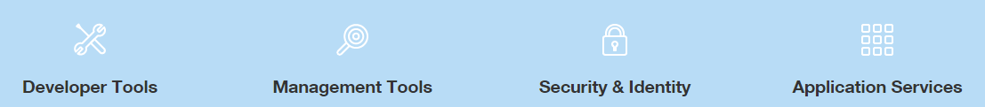
What exactly is Amazon Web Services?
Amazon Web Services is a secure cloud services platform with over 50 different services that include solutions for:

Slide 4

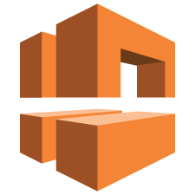




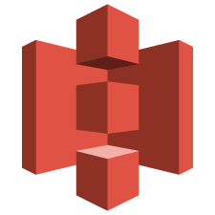







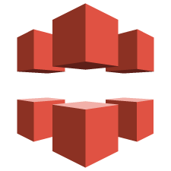






AWS By Category: Core Services
Compute
Networking
Storage
Database
Amazon EC2
AWS Elastic Beanstalk
Amazon VPC
Amazon Route 53
Amazon S3
Amazon EBS
Amazon RDS
Amazon DynamoDB
Auto Scaling
AWS Lambda
AWS Direct Connect
Elastic Load Balancing
Amazon CloudFront
Amazon Glacier
Amazon Redshift
AWS Database Migration Service
Amazon EC2 Container Registry
Amazon EC2 Container Service
Amazon Elastic File System
AWS Import/ Export
Amazon ElastiCache

Slide 5
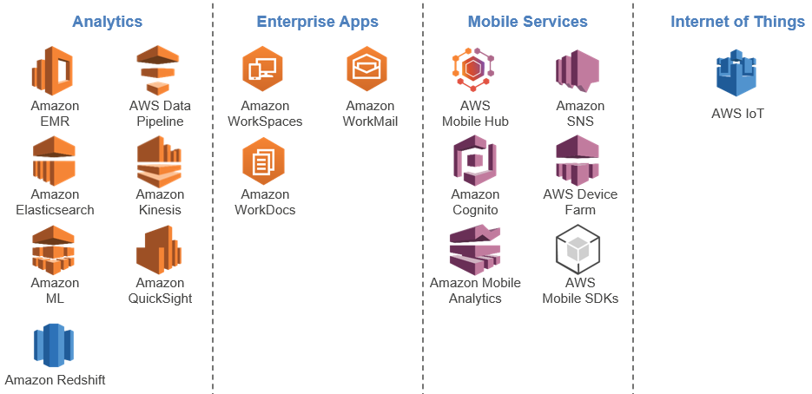
AWS By Category: Platform Services

Slide 6
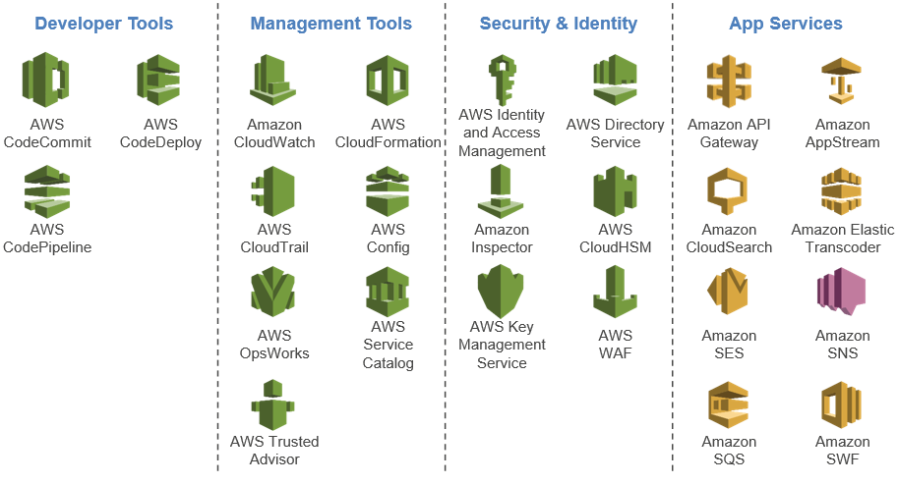
AWS By Category: Developer and Operations Services

Slide 7
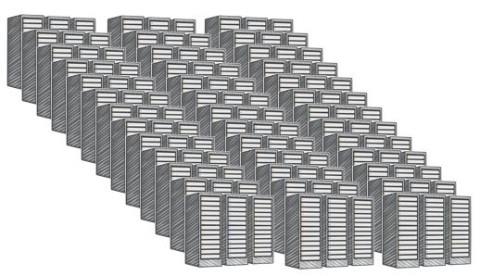
AWS Data Centres
A single data centre typically houses several thousands of servers.
All data centres are online.
No data centre is “cold.”
AWS custom network equipment:
Multi-ODM sourced
Amazon custom network protocol stack
Data center
Notes:
"ODM" refers to "original design manufacturer", which designs and manufactures products based on specifications from a second company.
The second company then rebrands the products for sale.

Slide 8
AWS Data Centres
AWS data centres are built in clusters in various global regions.
Larger data centres are undesirable
All data centres are online and serving customers;
In case of failure, automated processes move customer data traffic away from the affected area.
Core applications are deployed in an N+1 configuration, so that in the event of a data centre failure, there is sufficient capacity to enable traffic to be load-balanced to the remaining sites.

Slide 9
Availability Zones
Availability Zone
Each Availability Zone is:
Made up of one or more data centres.
Designed for fault isolation.
Interconnected with other Availability Zones using high-speed private links.
You choose your Availability Zones.
AWS recommends replicating across AZs for resiliency.
Data Center
Data Center
Data Center
Data Center

Slide 10
Availability Zones
Each Availability Zone is designed as an independent failure zone.
Meaning that Availability Zones are physically separated within a typical metropolitan region and are located in lower-risk flood plains (specific flood-zone categorization varies by region).
They are each fed via different grids from independent utilities to further reduce single points of failure.
Availability Zones are all redundantly connected to multiple tier-1 transit providers.
You are responsible for selecting the Availability Zones where your systems will reside.
Systems can span multiple Availability Zones.
You should design your systems to survive temporary or prolonged failure of an Availability Zone if a disaster occurs.
Distributing applications across multiple Availability Zones allows them to remain resilient in most failure situations, including natural disasters or system failures.

Slide 11

Regions
AWS Region
Each region is made up of two or more Availability Zones.
AWS has 14 regions worldwide.
You enable and control data replication across regions.
Communication between regions uses public Internet infrastructure.
Data center
Data center
Data center
Data center
Data center
Data center
Data center
Data center
Availability Zone
Availability Zone
Data center
Data center
Data center
Data center
Availability Zone

Slide 12
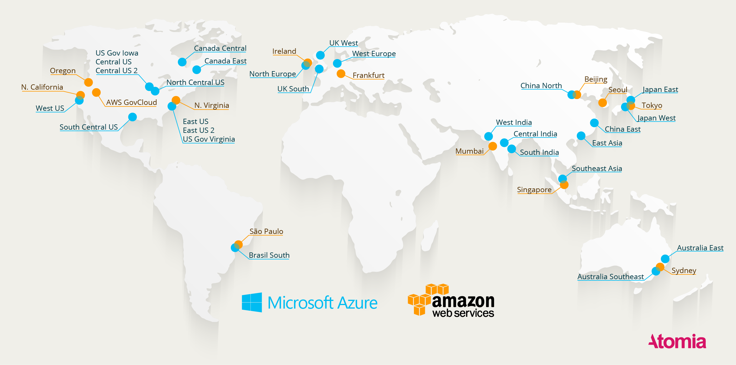
AWS & Azure Regions

Slide 13
Unmanaged vs. Managed Services

Slide 14

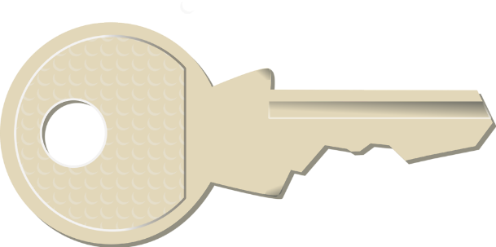
Unmanaged vs. Managed Services
Scaling, fault tolerance, and availability are managed by you.
Scaling, fault tolerance, and availability are typically built in to the service.
Unmanaged
Managed

Slide 15
Unmanaged
Unmanaged services are typically provisioned in discrete portions as specified by you.
They require the user to manage how the service responds to changes in load, errors, and situations where resources become unavailable.
For instance, if you launch a web server on an Amazon EC2 instance, that web server will not scale to handle increased traffic load or replace unhealthy instances with healthy ones unless you specify it to use a scaling solution such as Auto Scaling, because Amazon EC2 is an "unmanaged" solution.

Slide 16
Managed
If you have a static website that you're hosting
cloud-based storage solution such as Amazon S3 without a web server,
those features (scaling, fault-tolerance, and availability) would be automatically handled internally by Amazon S3,
it is a managed solution.
Managed services still require the user to configure them (for example, creating an Amazon S3 bucket and setting permissions for it); however, managed services typically require far less configuration.
The benefit to using an unmanaged service, however, is that you have more fine-tuned control over how your solution handles changes in load, errors, and situations where resources become unavailable.

Slide 17
Shared Responsibility Model
AWS account
Your responsibility
User access
Role-based access
AWS services used by customer
AWS global infrastructure
Hardware
Software
Network
AWS
responsibility
AWS data centers
Notes:
Amazon Web Services provides the same familiar approaches to security that companies have been using for decades.
Importantly, it does this while also allowing the flexibility and low cost of cloud computing.
There is nothing inherently at odds about providing on-demand infrastructure while also providing the security isolation companies have become accustomed to in their existing, privately owned environments.

Slide 18
AWS Security Responsibilities
Physical security of data centres
Controlled, need-based access
Hardware and software infrastructure
Storage decommissioning, host OS access logged and audited
Network infrastructure
Intrusion detection
Virtualization infrastructure
Instance isolation
AWS global infrastructure
Hardware
Software
Network
Amazon provided
AWS data centers

Slide 19
Your Security Responsibilities
Instance operating system
Including patching, maintenance
Application
Passwords, role-based access, etc.
Security groups
OS/host-based firewalls
Including intrusion detection/prevention systems
Network configuration
Account management
Separation of access
AWS account
User access
Role-based access
Customer-configurable
AWS services used by customer

Slide 20
The AWS Cloud Adoption Framework

Slide 21
Cloud Adoption Framework
Perspectives in planning, creating, managing, and supporting a modern IT service.
Guidelines for establishing, developing and running AWS environments.
Structure for business and IT teams to work together.
Business
Platform
Maturity
People
Process
Operating
Security
Notes:
The AWS Cloud Adoption Framework (CAF) separates complex IT environments into manageable areas of focus: business strategy and process, organizational structure and people skills, and delivery and operation of technical solutions. The CAF provides best practices for successful implementation and operation of an IT environment with AWS components. The framework helps an organization develop a plan to move from where it is to where it wants to be. The plan provides guidance to teams on changes they will make for successful adoption of AWS solutions.
For business strategy and process, the framework provides guidance to set and measure goals and define how processes need to change. Additionally, it addresses organizational structure and the skills needed to deliver and operate cloud-based solutions. Finally, it provides guidance for securing and managing daily IT operations.

Slide 22
Seven Core Perspectives
People Perspective
What skills are needed in order to adopt the AWS cloud platform? Examples include guiding processes of role descriptions, training, certification, and mentoring.
Business Perspective
How will your architectural approaches align technical delivery to business imperatives?
Process Perspective
How do you manage portfolios, programs and projects in order to deliver expected business outcomes on time and within budget, while keeping risks at acceptable levels?
Platform Perspective
What patterns, guidance, and tools are necessary to optimize your use of technology services on AWS?
Security Perspective
How will you define and implement the required levels of security, governance, and risk management to achieve compliance?
Maturity Perspective
What is the target state of your architecture and how do you get there?
Operating Perspective
How will you provide process, guidance, and tools for optimum operational service management of the AWS environment?

Slide 23
Core AWS Services

Slide 24





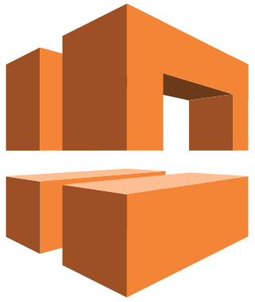

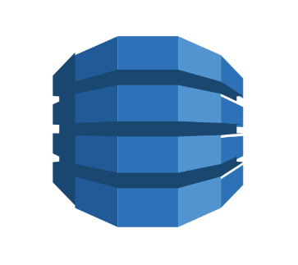
Core AWS Services
Amazon S3
Amazon Glacier
Amazon EBS
Amazon RDS
Amazon DynamoDB
Amazon VPC
Amazon EC2
AWS IAM
Storage

Slide 25
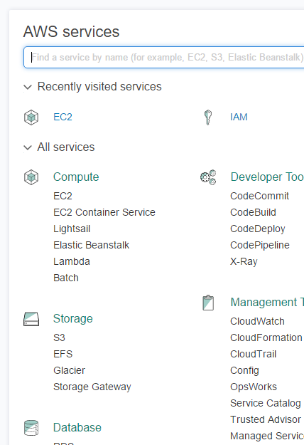
Trainer demo
Your trainer will now take you through a demo of the Amazon Web Console.
Take note of this demonstration, as you will need to figure this information out yourself later.

Slide 26
Amazon VPC
A Virtual Private Cloud allows you to provision virtual networks hosted on the AWS cloud and dedicates to your AWS account.
VPCs are logically isolated from other virtual networks.
Many AWS resources, such as Amazon EC2 instances, are launched into VPCs.
Your VPC's key features are configurable:
IP ranges
Routing
Network gateways
Security settings

Slide 27

Amazon VPC
Each VPC is contained within a region.
Resources within that VPC cannot exist outside of that region.
There are ways to connect VPCs in different regions to each other without going through the public Internet
However, resources in different Availability Zones within that region can exist in the same VPC.
AWS Region

Slide 28
Amazon VPC
Each VPC lives in a region.
VPCs can include resources in more than one Availability Zone.
You can have multiple VPCs in the same account and region and in multiple regions or accounts.
AWS Region
Availability Zone A
Availability Zone B
Development
Integration
Pre-production
Production

Slide 29
What is Amazon EC2?
Amazon Elastic Compute Cloud (EC2) offers virtual computing environments (instances) which you can launch and manage with a few clicks of a mouse or a few lines of code.
Most server operating systems are supported.
Create, save, and reuse your own server images (Amazon Machine Images).
Launch one instance at a time, or launch a whole fleet.
Add more instances when you need them; terminate when you don't.
CPU, memory, storage, networking, graphics, and general purpose types are available.
Use security groups to control traffic to and from instances.

Slide 30
Choosing the right EC2 Instance
EC2 Instance types are optimized for different use cases and come in multiple sizes. This allows you to optimally scale resources to your workload requirements.
AWS uses Intel® Xeon® processors for EC2 Instances providing customers with high performance and value.
Consider the following when choosing your instances: Core count, Memory size, Storage size and type, Network performance, and CPU technologies.
Hurry Up and Go Idle - A larger compute instance can save you time and money, therefore paying more per hour for a shorter amount of time can be less expensive.

Slide 31
EC2 Pricing Options
 | On-Demand Instances
Term | Pay as you go
Benefit | Low cost and flexibility
Cost | Pay for what you use
Use case | Short-term, spiky, or unpredictable workloads Application development or testing
Reserved Instances (RIs)
One year or three years
Predictability ensures compute capacity is available when needed
Pay low or no upfront fee; overall cost is lower
Steady state or predictable usage workloads Applications that require reserved capacity, including disaster recovery Users able to make upfront payments to reduce total computing costs even further
Spot Instances
Bid on unused capacity; instances can be lost if you are outbid
Large scale, dynamic workload
Spot price based on supply and demand
Applications with flexible start and end times Applications only feasible at very low compute prices Users with urgent computing needs for large amounts of additional capacity

Slide 32
TASK: Launching Virtual machines

Slide 33
Amazon CLI
The AWS Command Line Interface (CLI) is a unified tool to manage your AWS services.
With just one tool to download and configure, you can control multiple AWS services from the command line and automate them through scripts.
The AWS CLI introduces a new set of simple file commands for efficient file transfers to and from Amazon S3.
You can install the Amazon CLI on Windows and Mac/Linux operating systems.

Slide 34
Amazon CLI - Configuring access
Once you have installed the CLI tool, you can run the command aws configure in the CMD window to begin setting up your credentials.
You will be prompted for;
AWS Access Key ID and AWS Secret Access Key
Your trainer can provide you with these. You will each have an individual one associated with your account.
Default Region Name
Default Output Format
This can be JSON, Text or Table. If you don’t specify one, JSON will be used.

Slide 35
Amazon CLI
Once you’ve configured access through the CLI and you’re fully verified you will be able to launch EC2 instances, create new security groups among many other tasks.
For the most part, what you can do on the AWS Management Console, you can do on the AWS CLI.
You can find a list of commands on the following link.
http://docs.aws.amazon.com/cli/latest/

Slide 36
TASK: Using the CLI

Slide 37

AWS Storage Options: Block vs. Object Storage
One of the critical concepts to understanding the differences between some storage types is whether they offer "block-level" storage or "object-level" storage.
This difference has a major impact on the throughput, latency, and cost of your storage solution:
block storage solutions are typically faster and use less bandwidth but cost more than object-level storage.

Slide 38
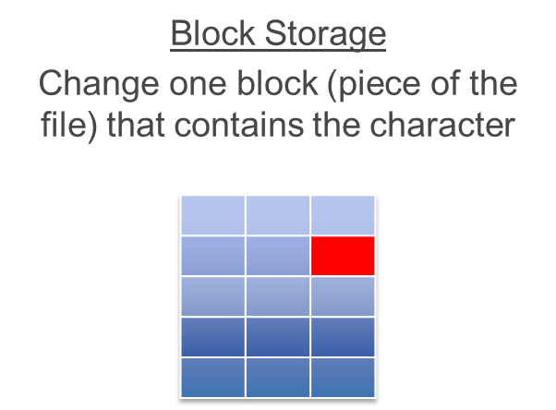
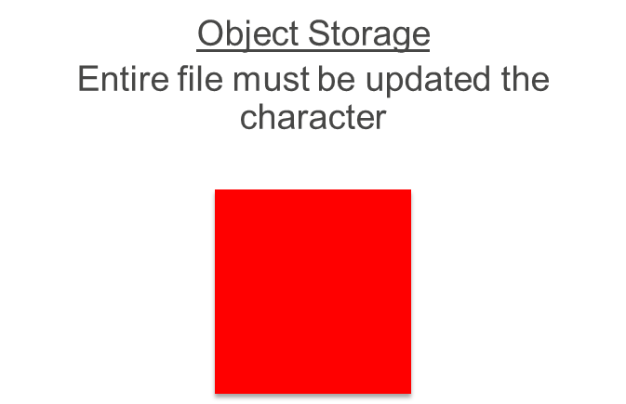
AWS Storage Options: Block vs. Object Storage

Slide 39
Amazon Simple Storage Service (S3)
Amazon S3 is a managed cloud storage solution designed to scale seamlessly and provide 99.999999999% durability.
Amazon S3 provides object-level storage.
if you want to change a part of a file, you have to make the change and then re-upload the entire modified file.
Store as many objects as you want.
Individual objects cannot be larger than 5 TB; however, you can store as much total data as you need.

Slide 40
Amazon Simple Storage Service (S3)
Data is stored redundantly
Access Amazon S3 with the AWS Management Console, one of the AWS SDKs, or a third-party solution.
Object uploads or deletes can trigger notifications, workflows, or even scripts.
Data in transit and at rest can be encrypted automatically.

Slide 41

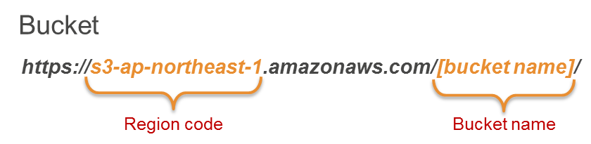

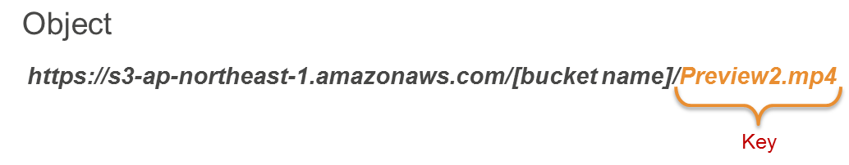
Amazon Simple Storage Service (S3)
Amazon S3
To upload your data (photos, videos, documents, etc.):
Create a bucket in one of the AWS Regions.
Upload any number of objects to the bucket.
[bucket name]
Preview2.mp4
Tokyo Region (ap-northeast-1)

Slide 42
Amazon Simple Storage Service (S3)
Pay only for what you use, including:
GBs per month
Transfer OUT to other regions
PUT, COPY, POST, LIST, and GET requests
You do NOT have to pay for:
Transfer IN to Amazon S3
Transfer OUT from Amazon S3 to Amazon CloudFront or Amazon EC2 in the same region

Slide 43
Amazon Simple Storage Service (S3)
General purpose: Amazon S3 Standard
Higher availability requirements: Use cross-region replication
Infrequently accessed data: Amazon S3 Standard - Infrequent Access
Lower cost per GB stored
Higher cost per PUT, COPY, POST, or GET request
30-day storage minimum

Slide 44
TASK: Using Amazon S3

Slide 45
Amazon Glacier
Amazon Glacier is a data archiving service designed for security, durability, and an extremely low cost.
Amazon Glacier is designed for durability of 99.999999999% of objects.
Amazon Glacier supports SSL/TLS encryption of data in transit and at rest.
The Vault Lock feature enforces compliance via a lockable policy.
Extremely low-cost design is ideal for long-term archiving;
Data retrieval will take 3-5 hours to begin.

Slide 46
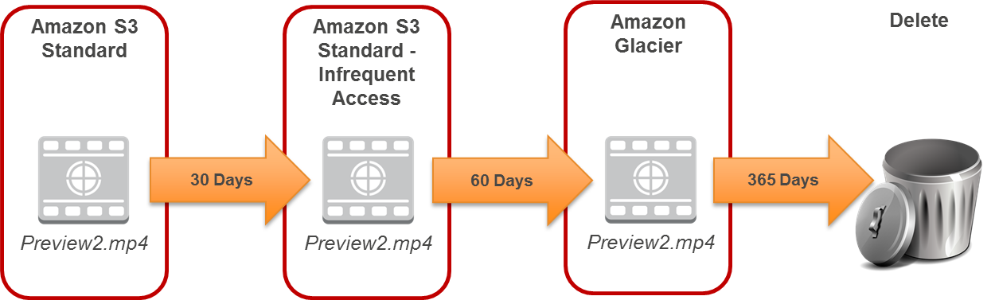
Lifecycle policies
Amazon S3 lifecycle policies allow you to delete or move objects based on age.

Slide 47
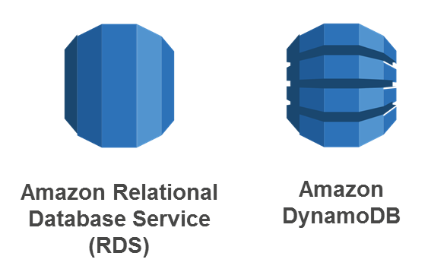
Amazon Database Options

Slide 48

Amazon Relational Database Service (RDS)
Amazon RDS lets you set up, operate, and scale relational databases in the cloud. Features include:
Managed service
Accessible via the AWS Management Console, AWS RDS Command-Line Interface, or simple API calls
Scalable (compute and storage)
Automated redundancy and backup available
Supported database engines:
Amazon Aurora
PostgreSQL
MySQL
MariaDB
ORACLE
Microsoft SQL Server

Slide 49
When to use RDS
Use Amazon RDS when your app requires:
Complex transactions or complex queries
A medium-to-high query/write rate – up to 30K IOPS (15K reads + 15K writes)
No more than a single worker node/shard
High durability
Do not use Amazon RDS when your app requires:
Massive read/write rates (e.g., 150K write/second)
Sharding due to high data size or throughput demands
Simple GET/PUT requests and queries that a NoSQL database can handle
RDBMS customization

Slide 50

Amazon DynamoDB
Amazon DynamoDB is a fully managed NoSQL database service.
Consistent, single-digit millisecond latency at any scale
No table size or throughput limits
Runs exclusively on SSDs
Document and key-value store models supported
Ideal for mobile, web, gaming, ad tech, and IoT applications
Accessible via the AWS Management Console, the AWS Command-Line Interface, or simple API calls

Slide 51
Amazon DynamoDB - Provisioned Throughput
When you create or update a table, you specify your throughput capacity requirements (read/write), and DynamoDB allocates the resources you need.
Read capacity unit:
One strongly consistent read per second for items as large as 4 KB.
Two eventually consistent reads per second for items as large as 4 KB.
Write capacity unit:
One write per second for items as large as 1 KB.

Slide 52

AWS Identity And Access Management (IAM)
Centrally manage access and authentication of your users to your AWS resources.
Offered as a feature of your AWS account for no charge.
Create users, groups, and roles, and apply policies to them to control their access to AWS resources.
Manage what resources can be accessed and how they can be accessed (e.g., terminating EC2 instances).
Define required credentials based on context (e.g., who is accessing which service and what are they trying to do?).

Slide 53
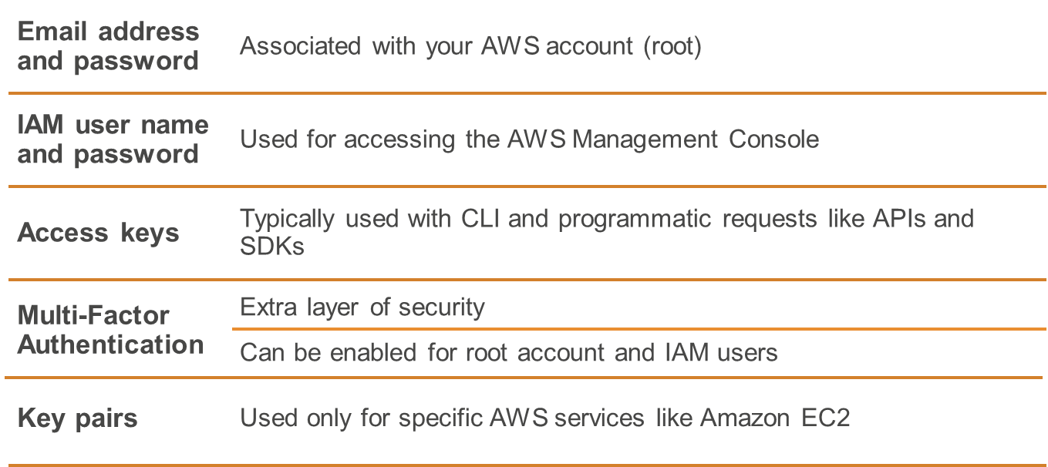
Types of security credentials

Slide 54
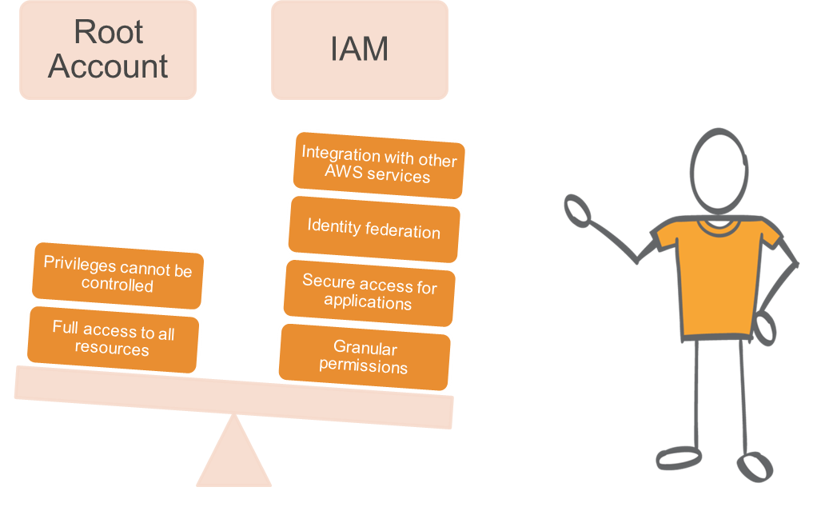
Root Account Access vs. IAM Access
IAM allows you to follow the least privilege principle.
Notes:
Use IAM to create additional users and assign permissions to these users, following the least privilege principle.

Slide 55
IAM Permissions
Permissions determine which resources and which operations are allowed to be used.
All permissions are implicitly denied by default.
If something is explicitly denied, it can never be allowed.
Best Practice: Follow the least privilege principle.

Slide 56
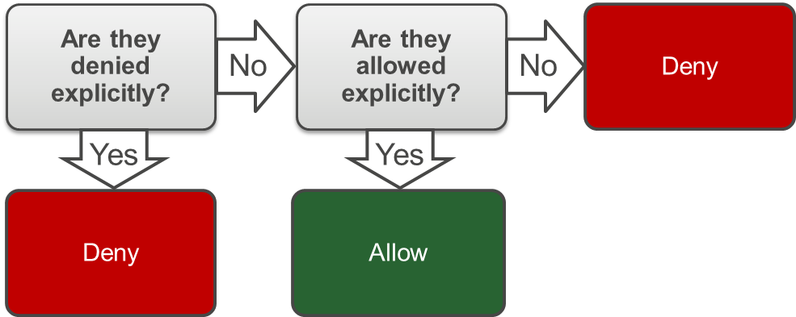
IAM Permissions
Policies give you the opportunity to fine-tune privileges granted to IAM users, groups, and roles.
As policies are stored in JSON format, they can be used in conjunction with a version control system.
When determining whether permission is allowed, IAM first checks for an explicit denial policy.
If one does not exist, it then checks for an explicit allow policy.
If neither an explicit deny or explicit allow policy exists, IAM reverts to the default: implicit deny.

Slide 57
IAM Policies
An IAM policy is a formal statement of one or more permissions.
You attach a policy to any IAM entity: user, group, or role.
Policies authorize the actions that may, or may not, be performed by the entity.
Enables fine-grained access control.
A single policy can be attached to multiple entities.
A single entity can have multiple policies attached to it.
Best practice: When attaching the same policy to multiple IAM users, put the users in a group and attach the policy to the group instead.

Slide 58
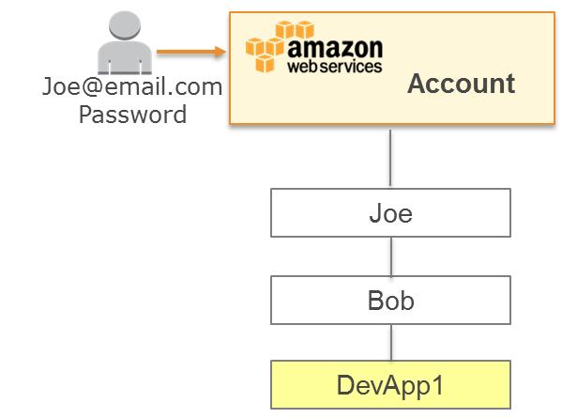
IAM Users
An entity you create in AWS.
Provides a way to interact with AWS.
No default security credentials for IAM users.
You have to assign them specifically.
IAM users are not necessarily people.
Best practice: Create a separate IAM user account with administrative privileges for the root account user.

Slide 59
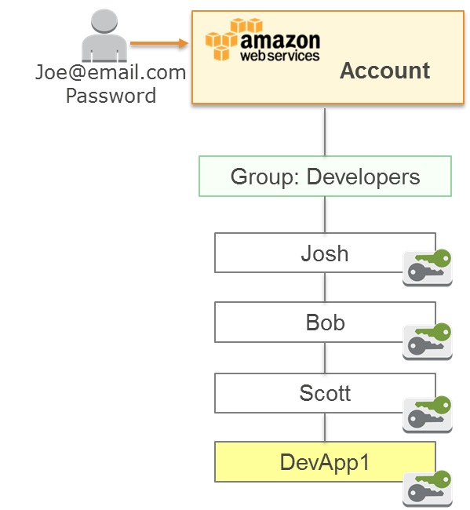
IAM Groups
Collection of IAM users.
Specify permissions for the entire group.
No default groups.
Groups cannot be nested.
A user can belong to multiple groups.
Permissions are defined using IAM policies.

Slide 60
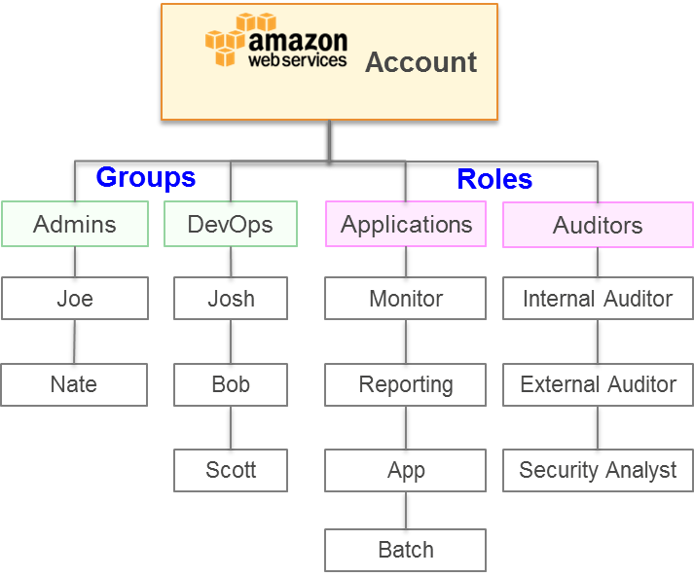
IAM Roles
Used to delegate access to AWS resources.
Provides temporary access
Eliminates the need for static AWS credentials
Permissions are:
Defined using IAM policies
Attached to the role, not to an IAM user or group

