Slide 1
DevOps
QACDEVPUP

Slide 2
Introduction
This course aim is to provide;
An overview of the main tools and components involved in DevOps and CI
The ability to support software development and deployment.
The course begins with looking at an overview of;
Continuous Integration and Continuous Deployment
The Linux Operating System
Automating key parts of a CI Pipeline

Slide 3
Continuous Integration and Continuous Deployment
Module one

Slide 4
Continuous Integration (CI)
What is CI?
It is a software development practice, which states members of a team will integrate their work frequently.
What do we mean by ‘integrate’?
When a team integrate their work, they are joining individual members code base into one centrally located repository.

Slide 5
Continuous Integration (CI)
When should we integrate?
We can schedule integrations for specific times in a working day or whenever a SCM repository is updated.
We can build, test and deploy our integrations, using a variety of tools.
This processes has teams integrating their work much more frequently.
It exposes integration issues and conflicts much quicker, reducing time and money spent on fixing thiese problems.

Slide 6
Continuous Integration (CI) Principles
We should maintain a single source code repository for our entire project.
This ensures teams are completely aware of what is happening on a project. It also ensures all our code can be polled by the integration tool.
Utilise Artifact repository tools to deploy our produced artifacts, to a variety of environments.
These will be covered in more depth in a later module.
Automate whenever possible
The key to DevOps is automation - we should be reducing the workload on tasks that can be automated to free up the developer or DevOps engineer to work on other tasks.

Slide 7
Continuous Delivery (CD)
What is CD?
Continuous Delivery is all about teams continuously delivering new versions of a product to the customer by reducing cycle time between an idea and a usable piece of software.
We accomplish through the use of automation from build, deployment, testing, and release.
Designed to be repeatable and reliable
One we have completed a delivery, the release process is likely to be the same.
Customers can enjoy new or enhanced features at a much quicker pace.

Slide 8
Continuous Delivery (CD) - Examples
The following are some examples of CD in action;
Facebook
Twitter
Windows
Can you think of any examples of when CD is not followed?
Notes:
Trainer discusses how each bullet point follows best CD practice.

Slide 9
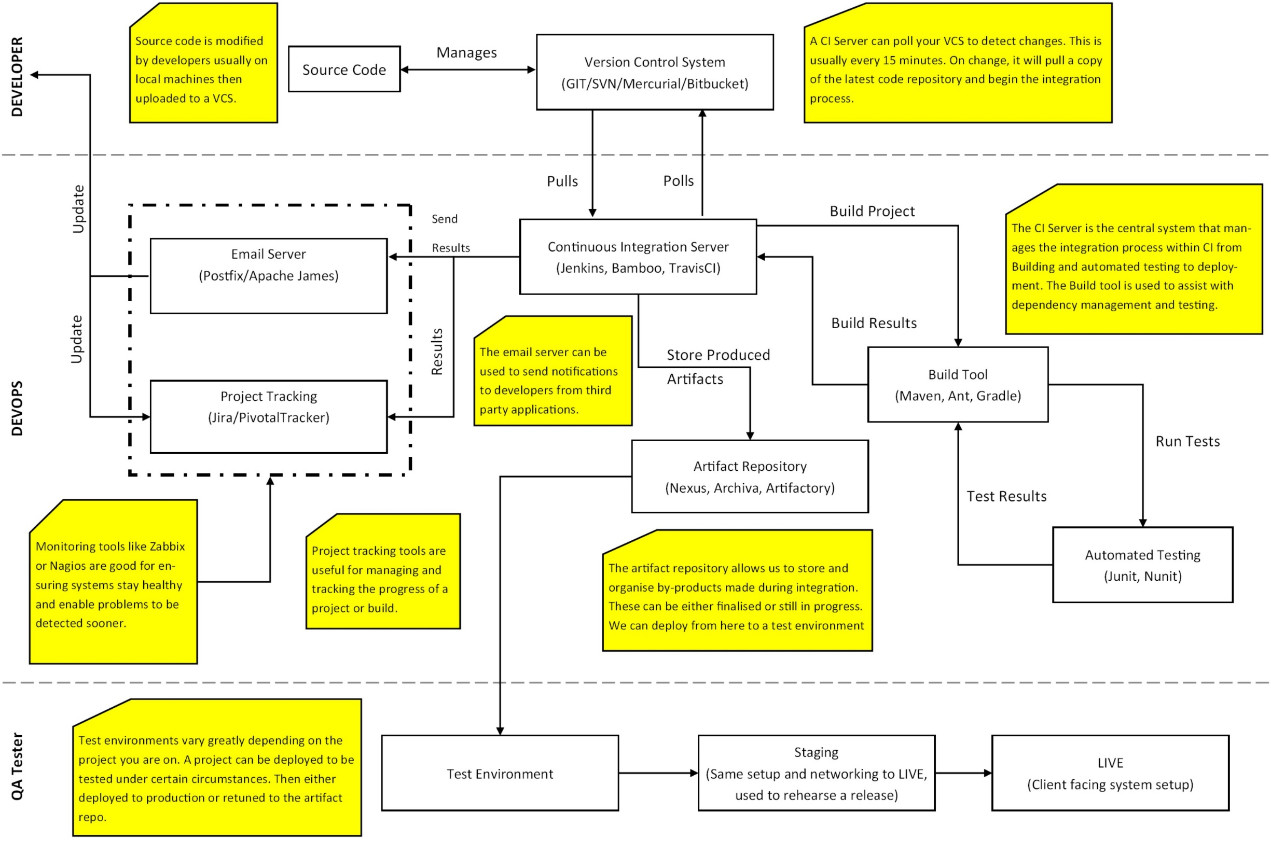
CI pipeline
Notes:
Take the consultants through each section, pointing out each section and have an open discussion with the room about it.

Slide 10
TASK: Creating Example Systems

Slide 11
Linux System Administration Part 1
Module Two

Slide 12
Linux OS
What is Linux?
Linux is an open source operating system, which has been developed collaboratively. There is not a single person responsible for the development of the systems or the ongoing support.
Linux differs from Windows and Mac as it allows much greater flexibility and control over specific tasks.
Linux initially begin as a server-based OS but has since become a widely used desktop OS and is built into a number of devices.
Sat Navs
TVs
Laptops / Desktops / Mobile Devices

Slide 13
Linux OS - Distributions
Linux has a number of distributions that offer different functionality when using the OS.
Each distribution manages software (or packages) through the use of a Package manager. These differ depending on the distribution being utilised.
There a many types of distribution in the world, however the following four are more used than most;
Ubuntu
CentOS
Fedora
Mint

Slide 14
Distributions - Ubuntu
Ubuntu is arguably one of the most popular Linux distributions available with its biggest USP being the ease of use the system has.
You can easily install and customise this OS to your own needs. The tool was designed to be simplistic enough for beginners, but not limit the potential for a more advanced user.
Ubuntu updates every six months with new features and improvements to make the continued experience to be positive.
Ubuntu is primarily targeted at; home users, developers and businesses.
Ubuntu utilises APT as it’s package manager.

Slide 15
Distributions - CentOS
CentOS is a stable distribution of Linux which was initially apart of Red Hat Enterprise Linux (RHEL).
CentOS is a community supported distribution, supported by a number of people in the development community.
The OS aims to be functionally compatible with RHEL, and was designed for cloud or served-based operation and development.
CentOS is one of the most popular versions of Linux Enterprise.
CentOS utilises YUM as a package manager.

Slide 16
Distributions - Fedora
Fedora used to be apart of the RHEL distribution. It opted to become its own distribution after RHEL moved to a subscription-based enterprise system.
This OS updates every six months and is usually at the forefront of technology upgrades, driver and software updates. It is a fast and stable release.
Targeted users include; Home, Development, Cloud and Server
Fedora utilises YUM as a package manager.

Slide 17
Distributions - Mint
Linux Mint was designed to be a modern and elegant operating system which is both powerful and easy to use.
Arguably one of the most popular desktop Linux distributions, and ranked 3rd most widely used home operating system just behind Windows and Mac OS.
Mint is a free, open-source, out-of-the-box operating system.
Mint utilises APT as it’s package manager.

Slide 18
SSH - Secure Shell
Once we’ve set up our system it’s time to simulate a real-world working environment.
We use a tool called puTTY to Secure SHell (SSH) into the virtual machine from your windows training machine. There are many other tools out there, but for this course we will be using this one.
One some setups of Linux you may need to run the following command to ensure you are able to SSH successfully.
sudo apt-get install –y openssh-server openssh-client
This should display a few bits of information and either download and install both or it will tell you it is already installed on your system.

Slide 19
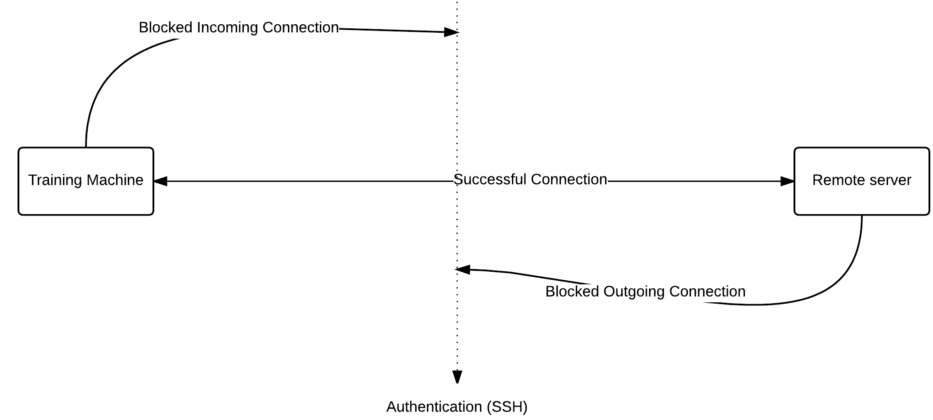
SSH - Secure Shell

Slide 20
SSH - Secure Shell
You can find putty in the LocalInstall C Drive folder. Take a copy of this and place it on your desktop.
When you open the application enter your Linux-box username along with the IP address in the following format:
USERNAME@COMPUTERIP
Ensure the port is set to 22 and that you’re connecting with SSH from the radio buttons.
When you press connect, it should ask you to save the Fingerprint, press yes and enter your password to login to the VM terminal.
If this does not work – check your firewall is disabled, and you’ve installed the SSH services.

Slide 21
Linux Virtual Machine
When launching virtual machines there are a number of different ways and we will cover all of them during this course.
Using an ISO file with Virtual Box
Using a provisioning tool
We will be giving the first one a go now. To do this you will need the following;
Oracle VM Virtual Box
Linux Ubuntu ISO file
Your files can be found in C:/LocalInstall

Slide 22
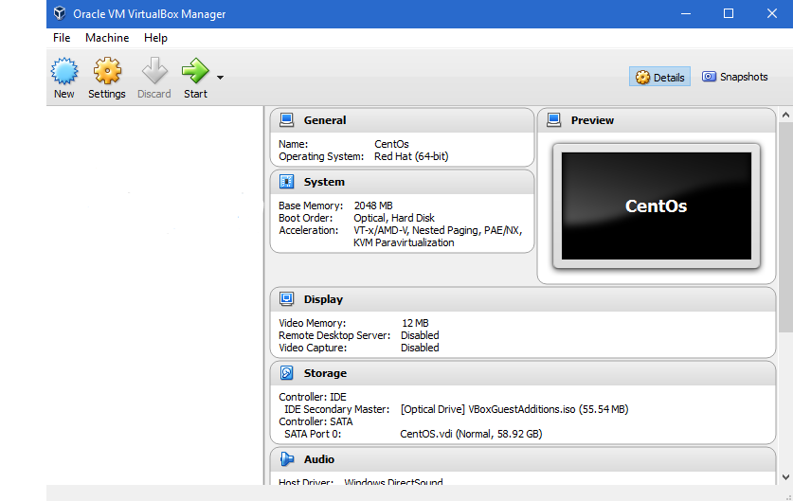
Linux Virtual Machine

Slide 23
TASK: Your first Virtual Machine

Slide 24
TASK: Terminal Exploration

Slide 25
Linux System Administration Part 2
Module four

Slide 26
The Terminal
The terminal is an important aspect of Linux for any development work, as you will be constantly switching directories, copying files and installing packages as well as creating, executing and deploying automated scripts.
There are two initial commands you should be aware of, as you are likely to use them a lot more than the rest.
sudo
apt-get / yum

Slide 27
The Terminal - Commands
There are a number of commands that will be used whenever you’re conducting some sort of administrative task on Linux.
Knowing these commands and understanding the differences is quite key.
What commands should you use regularly?
What types of commands do you know?
What types of command should you avoid?
http://beginlinux.com/twitter/1094-the-beginners-guide-to-the-ubuntu-terminal
https://help.ubuntu.com/community/UsingTheTerminal
Notes:
This is a good place to have an open discussion about a variety of different commands.
Tar / Man / ssh / rm -rf / cd / mkdir / touch.
As the group for their experiences.

Slide 28
Bash Scripting
#!/usr/bin/env bash
#echo the hello world phrase
echo “Hello World”
Most scripts come in .sh format which is a Bourne Shell Script file. Most various of UNIX-like operating systems can recognise and understand this file type.
It’s important to note that these files, have no set language, the contents is interpreted by the shell, unless you specify a particular interpreter on the first line.
There are different ways of declaring your bash file but using the top line as shown, is universal across all distributions of Linux.

Slide 29
Bash Scripting
#!/usr/bin/env bash
#update the package manager sources
sudo apt-get update
#display network information of system
ifconfig
#Install Java
sudo apt-get install -y openjdk-7-jdk
sudo apt-get install -y openjdk-7-jre
echo "Java Installed"
The example on the right shows a .sh file with a specified interpreter using BASH (Bourne Again Shell) and is currently detailing a hello world script.
You can see that the ‘Hashtag’ (#) symbolises a comment within the script file.
Other commands are being executed as normal in the file, however bare in mind these will run in an order starting from the top of the file.
The following link shows more examples;
http://tldp.org/HOWTO/Bash-Prog-Intro-HOWTO.html

Slide 30
Task: Creating a Script file

Slide 31
OS Configuration
There are many tasks you will need to perform as a System Administrator.
You will often find something does not work, the reason for this ranges, but usually its due to an out of date package or kernel.
This is easily rectified using the following commands;
sudo apt-get update – this command will download the package lists from the repositories and “update” them to get information on the newest versions of packages and their dependencies.
sudo apt-get update <package-name> - this command will do the above for the named package.

Slide 32
OS Configuration - Installing new packages
Packages are how Linux handles software. We can install new tools using either our package management tool (apt-get, yum etc) or using tarball files.
When installing packages manually, always try to follow a set structure;
Create the directory
Obtain the file(s)
Extract the file(s)
Update the links*
Set the environment variables*
Test the version*
* Depending on what you’re installing, depends on which of these you do.

Slide 33
Packages - Installing Java
Navigate to the “/opt” directory. This is used for programs that are going to be invoked by users. So for things like Java and maven.
cd /opt
You should have copies of the java.tar.gz file inside the “DevOps Short” folder you have all been given. Transfer this to your virtual machine (using either SCP or your shared folder)
Now we need to extract this folder.

Slide 34
Packages - Installing Java
You need to establish with extraction tool you should use first.
Tarball files = tar package
Zip files = zip package
Executing the following command should extract the contents of the tarball file, and present you with the folder jdk1.8.0_45
sudo tar zxvf java.tar.gz
What do the flags zxvf does? - Be aware of the casing of the letter too.

Slide 35
Packages - Installing Java
This next command allows us to set up symbolic links between the application we are installing and the application. We associate this with a word.
update-alternatives --install /usr/bin/java java /opt/jdk1.8.0_45/bin/java 100
update-alternatives --install /usr/bin/javac javac /opt/jdk1.8.0_45/bin/javac 100
update-alternatives --config java
At this point Java should be set up and ready to go on your system. We can easily test it with the version checking command listed below;
java -version

Slide 36
Task: Installing Java & Maven

Slide 37
Linux Security
Security within DevOps is a complex area, but it is necessary for the safety of our software and systems.
IP Tables is a flexible firewall utility built for Linux operating systems.
It is a command-line tool that uses policy chains to allow or block traffic.
When a connection tries to establish itself on your system, IPTables looks for a rule in its list to match it too.
If one cannot be found, it would resort to the default action.

Slide 38
Linux Security
You need to be very careful when configuring iptables rules, especially if you’ve used an SSH connection into a server. (e.g. puTTY)
One wrong command could permanently lock you out of the remote system, until someone manually turns up and fixes the problem on the machine.
IP Tables usually always comes installed on every Linux distribution, but if you do need to install or update it, use the following command.
sudo apt-get install iptables

Slide 39
Linux Security
Input
Forward
Output
This chain is used to control the behavior for incoming connections.
For example, if a user attempts to SSH into your PC/server, iptables will attempt to match the IP address and port to a rule in the input chain.
This chain is used for incoming connections that are not actually being delivered locally.
Think of a router – data is always being sent to it but rarely actually destined for the router itself; the data is just forward to its target.
Unless you are doing some kind of routing, NATing, or something else on your system that requires forwarding, you are unlikely to use this chain
This chain is used for outgoing connections.
For example, if you try to ping google.co.uk, iptables will check its output chain to see what the rules are regarding ping and google.co.uk before making a decision to allow or deny the connection attempt.

Slide 40
Task: Understanding IP Tables

Slide 41
SIEM & LOGGING

Slide 42
Security Information and Event Management
A SIEM collates and analyses all of the security alerts and log files from all of your different systems
All of the logs are collated into a central server. This is referred to as a log aggregation system
Some SIEMs provide logging and reporting for auditing and compliance purposes.
The SIEM can provide alerts when there is abnormalities in logs.
A SIEM will often perform a base line analysis of the network and hosts to get an understanding of standard traffic so reduce the chance of false positives.

Slide 43

What is a log?
Notes:
Where anything that happens to do with the server. Turned on/off, Logins, etc.
WARN, SEVERE, INFO

Slide 44
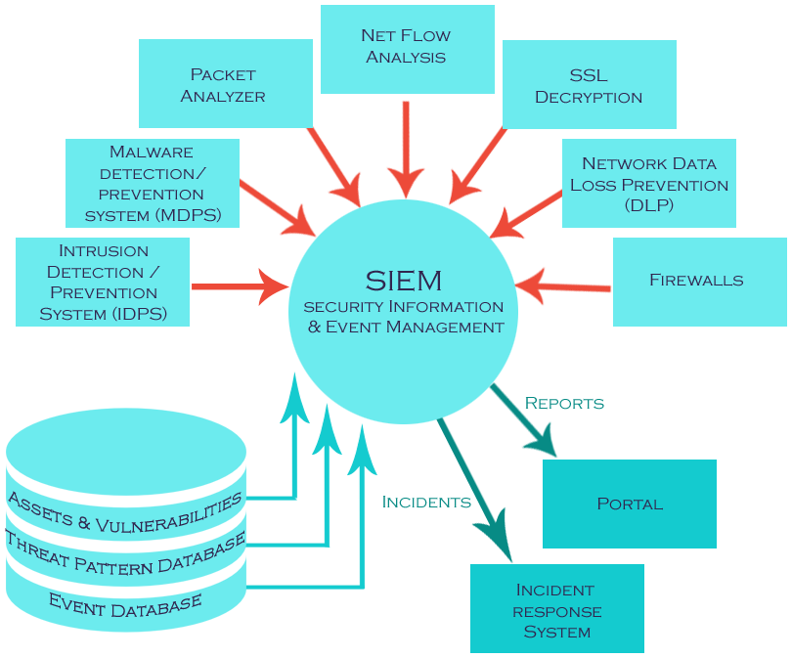
Forwarders
On your servers, IDS, IPS, Firewall etc we setup forwarders.
Small programs that send logs to SIEM
Central location for log collection
Adds security as logs cannot be changed if the server is compromised

Slide 45
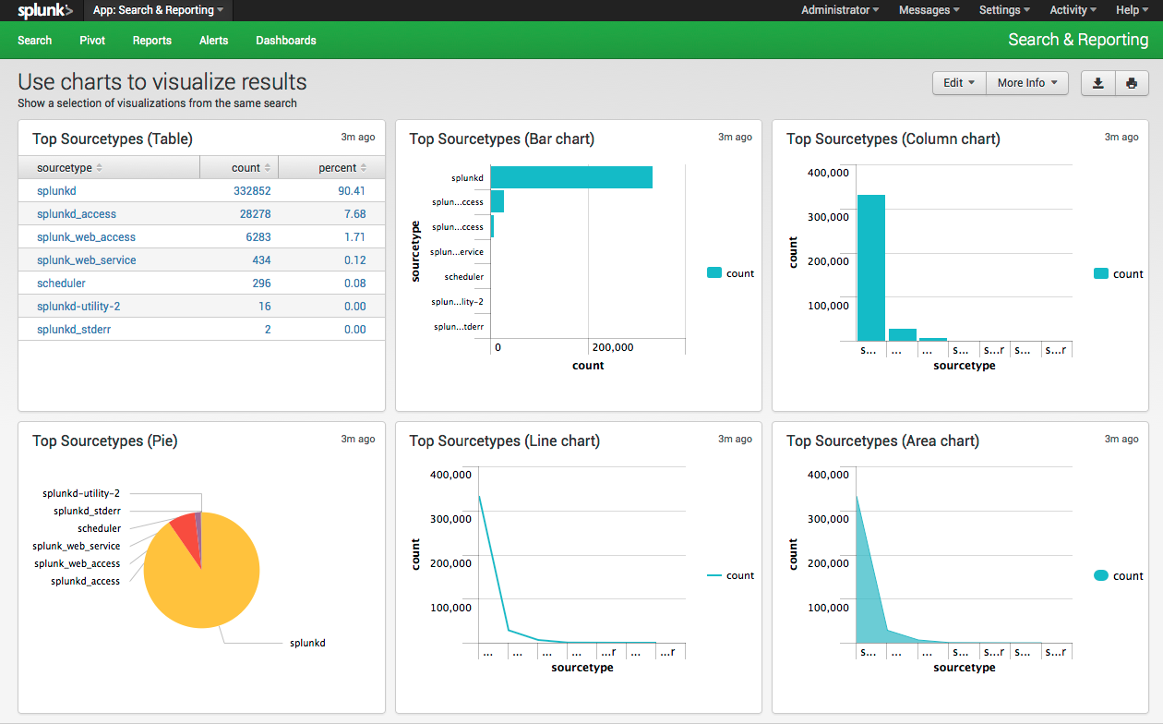
Splunk

Slide 46
Vagrant Provisioning
Module Three

Slide 47
Vagrant Provisioning
Provisioning is a popular way to setup and configure environments and systems to ensure full automation. Freeing up developers and dev teams to work on more crucial components of a project.
There are different types of provisioning available, one of which will be covered during this course is called environment provisioning, the primary tool for this is Vagrant.
The other, which we won’t be discussing this week, is Configuration Management, which focuses more on setting up the tools on the system. There are a variety of tools that can handle these, including;
Puppet (Open-Source & Enterprise)
Ansible
SaltStack
Chef

Slide 48
Vagrant Provisioning
Vagrant is an open-source tool for building and managing virtualised development environments.
Vagrant manages virtual machines hosted in Oracle’s VirtualBox, but can be used with a variety of other tools.
Vagrant provides easy to configure, reproducible, and portable work environments.
Alongside Vagrant we can utilise Shell scripts, or provisioning tools like chef or puppet to automatically install and configure software on a machine.

Slide 49
Vagrant Provisioning
Vagrant makes use of an item called a “Vagrant Box”. These boxes are pre-created virtual machines and could be described as being in a “saved-state”.
For example, say you needed an Ubuntu Server with tools already set up on it and ready to go.
You could simply download one of these readily available virtual boxes, and make use of it within your Vagrantfile.
A whole list of these boxes can be found here; https://atlas.hashicorp.com/boxes/search
If you’ve got a physical box directory ready to go, simply navigate to “C:/Users/$username/.vagrant.d/boxes” and store the box you want to use, in this directory.

Slide 50
Vagrant Provisioning
Vagrant operates through a BASH-like terminal, so ensure you have Git Bash running on your windows machine before you try to use it.
This tool may be usable through CMD, but you may be limited with the types of commands issued through it.
The next series of slides will walk you through the different features of Vagrant and how you can use it.

Slide 51
Vagrant Provisioning
This file is what Vagrant uses to configure the virtual machine, based on your configuration and setup instructions.
The Vagrant directory can only ever have one Vagrantfile. If there are multiple present, it will not function correctly.
Also note that case is key, and as such Vagrantfile must be spelt with a capital V.
Ruby Based
# -*- mode: ruby -*-
# vi: set ft=ruby :
Vagrant.configure(2) do |config|
#setting hostname of new vm and box image (Ubuntu 14.04 with GUI)
config.vm.hostname = “AARON.qac.local"
config.vm.box = “chad-thompson/ubuntu-trusty64-gui"
config.vm.network :public_network, ip: "192.168.1.10"
#Provisioning Script to install and configure system tools
config.vm.provision :shell, path: "bootstrap.sh"
#Setting up virtual box information, ram allocation, etc.
config.vm.provider :virtualbox do |master|
master.gui = true
master.name = “Aaron Server"
master.memory = 4096
master.cpus = 2
end
end

Slide 52
Vagrant Provisioning
We worked with SSH earlier in the module, and looked at how we can use a tool like PuTTY to SSH into a remote server (or in our case, virtual machine).
Vagrant offers a similar service through the use of the command vagrant ssh. This command can be executed directly from the terminal, and is only usable once you’ve deployed your first Vagrantfile.
Note if you have a number of machines deploying from one Vagrantfile, you should specify the name of the machine you want to SSH into using vagrant.
From this point, you are able to make configuration changes to the system easily.

Slide 53
Vagrant Provisioning
Shared folders are also big with Vagrant, meaning you can easily obtain certain files and folders stored in windows, and transfer them into your virtual machine.
You can specify specific directories in your Vagrantfile if you want multiple shared folders and you also have the default shared folder.
The default shared folder is automatically setup in the same directory as your Vagrantfile is stored. On the Virtual Machine this is usually in the /vagrant directory.

Slide 54
Vagrant Provisioning
#!/usr/bin/env bash
#Install Java, maven and git
sudo add-apt-repository ppa:webupd8team/java
sudo apt-get update
sudo apt-get install -y oracle-java8-installer
sudo apt-get install -y oracle-java8-set-default
echo "Java Installed"
#Create dedicated bamboo user
sudo /usr/sbin/useradd --create-home --home-dir /usr/local/bamboo --shell /bin/bash bamboo
#Download Bamboo Server
mkdir /opt/bamboo
cd /opt/bamboo
wget http://aaronmulholland.co.uk/atlassian-bamboo-5.10.1.1.tar.gz
tar zxvf atlassian-bamboo-5.10.1.1.tar.gz
#Create home directory
mkdir /home/vagrant/bamboo/bamboo-home
echo "All complete"
This is a shell script, which allows us to configure the system after the environment has been created.
This cuts environment build time down by a considerable amount and also reduces the strain on developers and DevOps team members, as everything becomes much more efficient.
config.vm.provision :shell, path: “bootstrap.sh”

Slide 55
Vagrant Provisioning
We worked with SSH earlier in the module, and looked at how we can use a tool like PuTTY to SSH into a remote server (or in our case, virtual machine).
Vagrant offers a similar service through the use of the command vagrant ssh. This command can be executed directly from the terminal, and is only usable once you’ve deployed your first Vagrantfile.
Note if you have a number of machines deploying from one Vagrantfile, you should specify the name of the machine you want to SSH into using vagrant.
From this point, you are able to make configuration changes to the system easily.

Slide 56
Vagrant Provisioning
To begin you will need the following installed;
Notepad++ (Or other text editor)
Oracle VM Virtual Box (install file located on your C:\LocalInstall folder.)
Vagrant (Install file located in C:\DevOps Short)
Git Bash (Install file located on your C:\LocalInstall Folder)

Slide 57
Task: Vagrant Scripting

Slide 58
Version Control System
Module Four

Slide 59
Version Control Systems
Version control is a system that records changes to a file or set of files over time.
It allows you to revert files back to a previous state, revert the entire project, compare changes over time and monitor who is contributed what to the project.
One huge benefit of using a VCS means, if someone in the group breaks the project or code, you can utilise the back-up features and easily restore your project, saving potentially huge amounts of money and time.
There are two main types of VCS which we’re going to cover, they are;
Centralised Version Control Systems (CVCS)
Distributed Version Control Systems (DVCS)

Slide 60
Centralised Version Control System
One major issue that developers tent to encounter is the need to collaborate with other developers working on the system.
Variety of tools that run on a single server with all the versioned files and a number of clients that check out files for that central place.
For many years this was the standard for version control.
This setup offers lots of advantages, for example;
Everyone knows to a certain degree what everyone else on the project is working on
Administrators have some level of control over who can do what
Easier to administer than to work with local databases on every client.

Slide 61
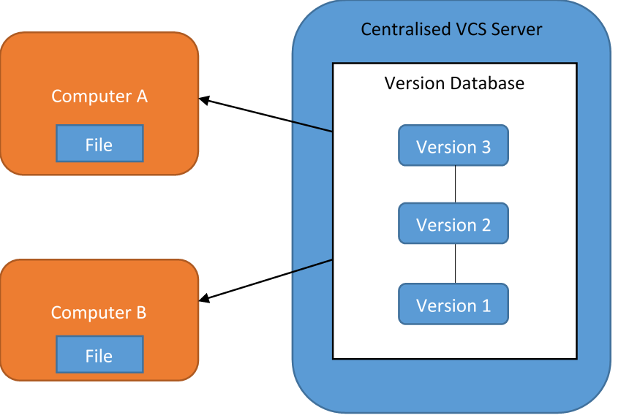
Centralised Version Control System
Major downsides to using a CVCS over other tools out there.
The main one is Single Point Failure.
You risk loosing everything, by storing it all on the same hard disk.

Slide 62
CVCS - Subversion
One major issue that developers tent to encounter is the need to collaborate with other developers working on the system.
Variety of tools that run on a single server with all the versioned files and a number of clients that check out files for that central place.
For many years this was the standard for version control.
This setup offers lots of advantages, for example;
Everyone knows to a certain degree what everyone else on the project is working on
Administrators have some level of control over who can do what
Easier to administer than to work with local databases on every client.

Slide 63
Distributed Version Control System
In a DVCS, clients don’t just check out the latest snapshot of the files; they fully mirror the repository.
So if any server ends up down, or hard disks corrupted, it shouldn’t matter, as anyone collaborating will have the latest repository.
Every time someone clones into the project, a further backup is created locally on that persons machine.
List of potential tools you can use as DVCS include;
Git
Mercurial
Bacaar
Darcs
BitBucket

Slide 64
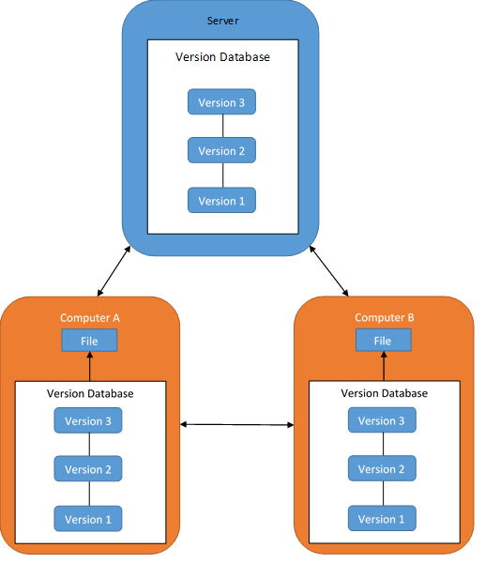
Distributed Version Control System
Avoid the single point failure issue, as the code is distributed across multiple systems.
Each time a new user joins the project, a new backup is created on their system.

Slide 65
DVCS - Git
Git is arguably the most popular distributed version control system and was initially designed and developed by Linus Torvalds (the same person who created Linux).
Some of the goals of this system where;
Speed
Simplistic, Easy to use design
Strong support for non-linear development (so thousands of parallel branches)#
Fully distributed system
Capable of handling large Linux kernel projects.
When a new developer clones a git repository, they clone the entirety of that project, so in effect they are creating a backup of the system, sometimes without even realising it.

Slide 66
Task: Repository Management

Slide 67
DevOps Tooling
Module Four

Slide 68
Tooling in DevOps
There are many tools that can be utilised within a DevOps space and understanding how these tools work can be a lengthy process.
https://xebialabs.com/periodic-table-of-devops-tools/
https://xebialabs.com/the-ultimate-devops-tool-chest/
We are going to look at a variety of tools within the next few slides, to show the differences between some tools and also explain what they do.

Slide 69
Build Servers - Also known as CI Server
Centralised reliable environment for building distributed development projects.
Usually start with a clean state - meaning no unapproved configuration has been set up on the system.
Server is configured to poll a version control system, monitoring it for changes and producing an integration when necessary.

Slide 70
Build Servers - Jenkins
Jenkins is an open source and freely available Build Server.
Jenkins was designed to be easy to use and boasts a relatively simple user interface. It has a low learning curve.
You can combine a multitude of tools (as seen in the CI Diagram) to manage and maintain projects.
Compatible with Build tools such as Maven, Ant and Gradle.

Slide 71
Build Servers - Jenkins
Jenkins can generate a variety of test reports for you based on each project.
Integrates well with a variety of Version Control Systems.
Enables deployment to a variety of artifact repository tools, or even production and testing environments.
Notifies members of a development team of problems and failed builds.

Slide 72
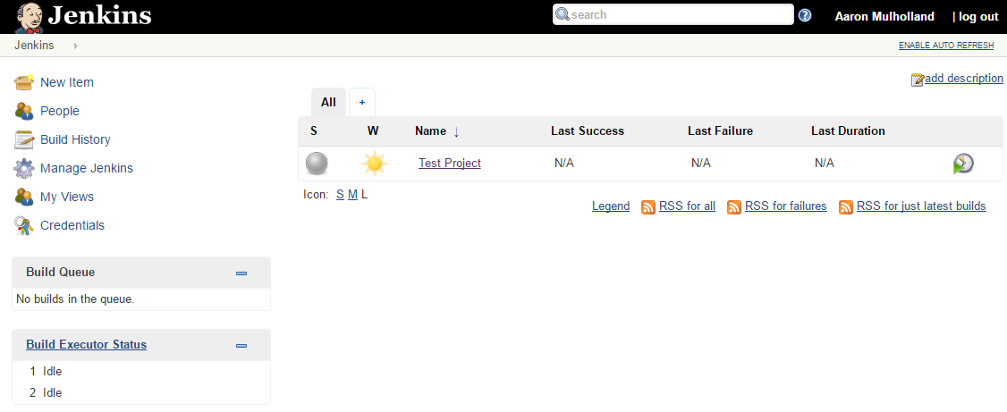
Build Servers - Jenkins

Slide 73
Build Servers - Bamboo
Atlassian Bamboo CI Server can perform builds, tests and releases together all in a single workflow.
Arguably the biggest benefit of using Bamboo, is compatibility with others in the Atlassian Stack.
The draw back of Bamboo is its cost as it is not a cheap tool and when tools such as Jenkins exist for anyone freely available.
However the added benefit of Bamboo to other CI tools such as Jenkins, is the speed in which it completes tasks.

Slide 74
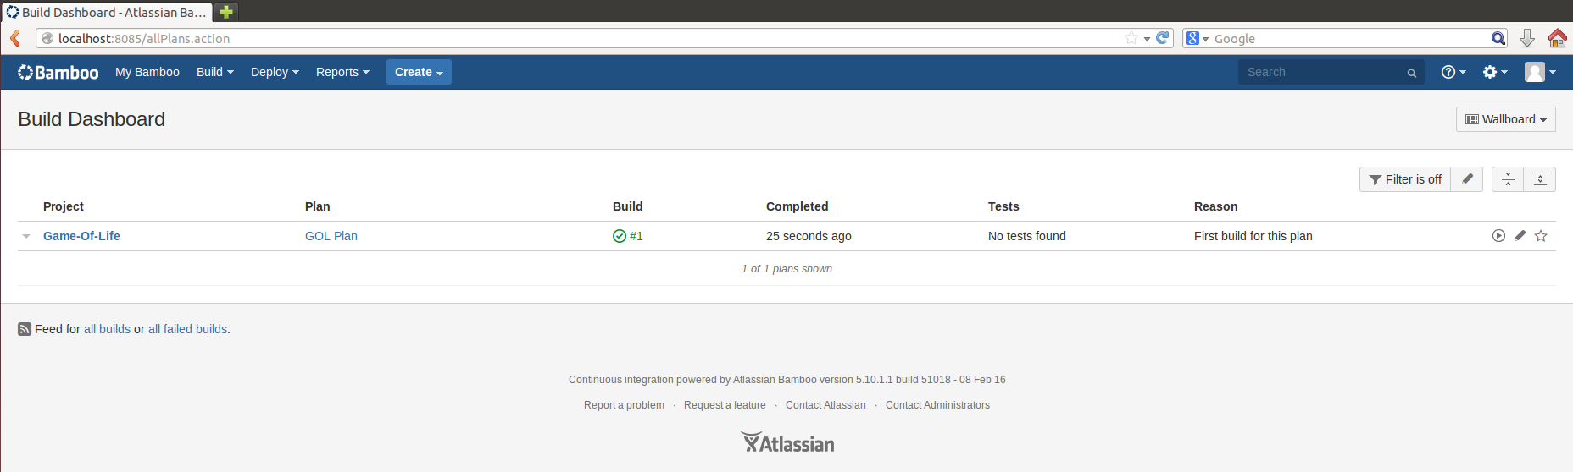
Build Servers - Bamboo

Slide 75
Task: Install and Configure Build Server
Notes:
TRAINER: Group to install either Jenkins or Bamboo. Jenkins by default, unless requirements suggest otherwise.

Slide 76
Project Tracking
It is essential to keep a track of the teams progress as you go through any type of project, development or other.
There are a multitude of tools, ranging from enterprise to open source levels all with different complexities and tools.
Constant communication and collaboration is key in DevOps and ensuring everyone in the team is fully aware of what needs doing, when to do it and how much time to spend on that task can all be handled using a project tracking tool.
The tool you’ve probably heard of is Atlassian Jira, we will take the next couple of slides to explain a couple.

Slide 77
Project Tracking - Jira
An important tool in the Atlassian Stack and arguably the most used.
Jira is an issue and project tracker, often used by agile teams for open communication and collaboration.
Issues can be assigned to members of a project and members of the project can submit changes to this issue until it is marked as complete.
Jira also allows for a several plugins, for example with Jenkins and Git, to ensure the Continuous Integration pipeline is maintained throughout.

Slide 78
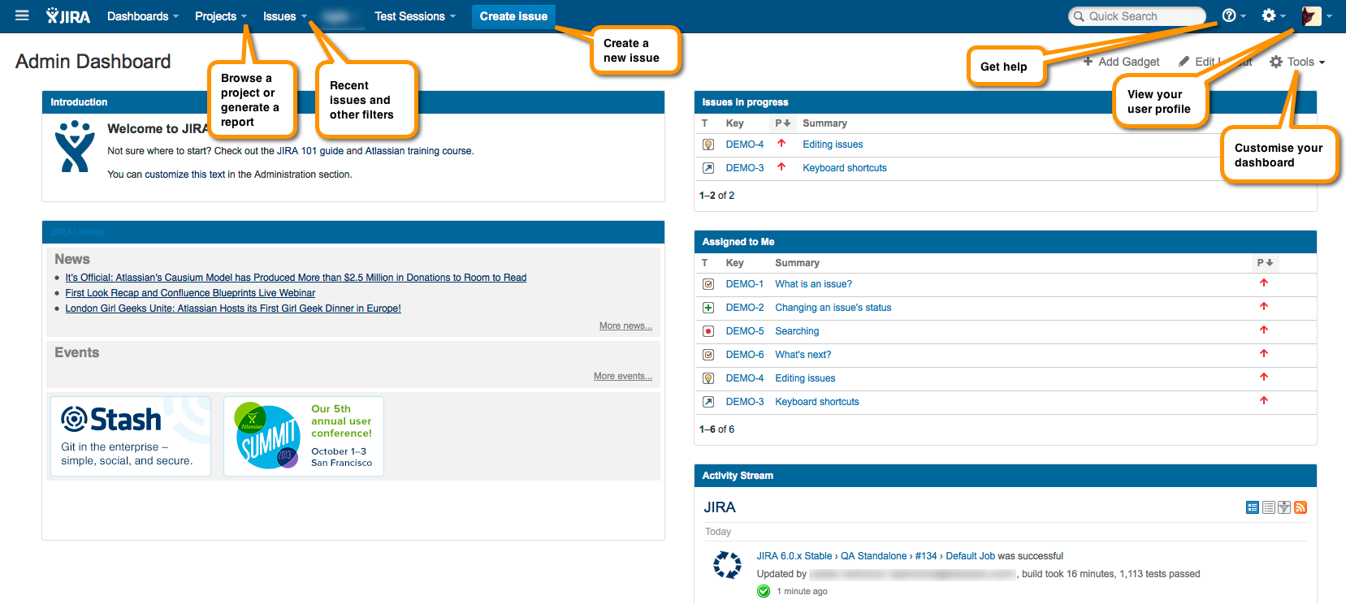
Project Tracking - Jira

Slide 79
Project Tracking - Pivotal Tracker
Pivotal Tracker is another collaboration and tracking project tool, focusing heavily on Scrum agile.
The interface is designed to be simplistic and easy to use.
This tool uses stories, which are small, actionable components of work, or the building blocks of every project.
They are easy to create, share, discuss and react to.
This is a purely cloud-based solution, meaning you don’t need to configure the system - just the content.

Slide 80
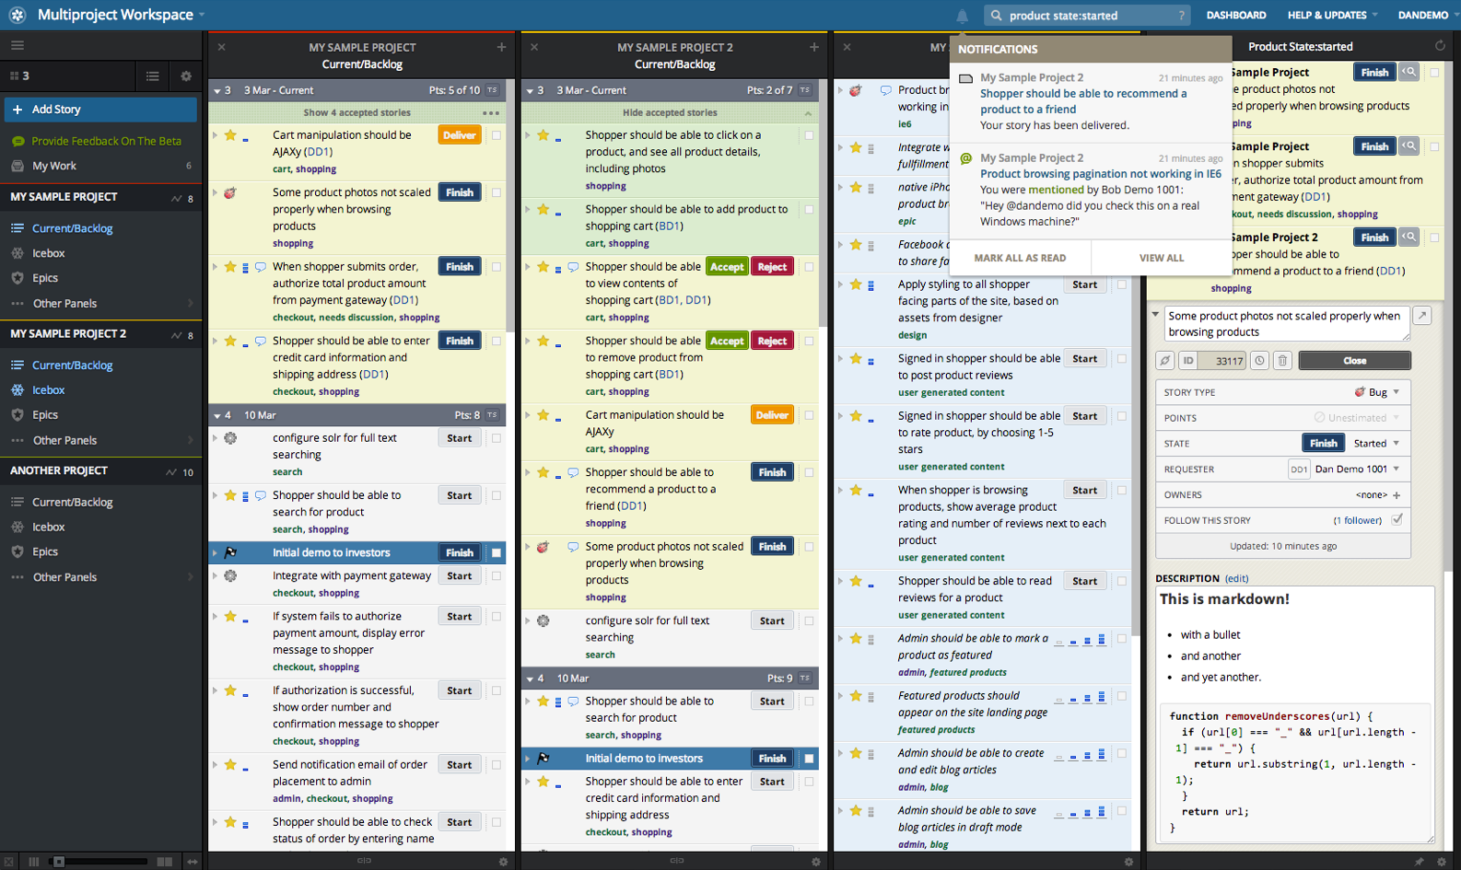
Project Tracking - Pivotal Tracker

Slide 81
Task: Installing Jira

Slide 82
Task: Configuring JIRA and Git

Slide 83
Artifact Repositories
An artifact repository is similar to what a VCS is to source code.
It’s a way of versioning code binary artifacts.
In development these artifacts can be anything from; jars, wars and ears to fully fledged applications, libraries or collections of libraries packaged up.
Artifact repositories help with dependency management too.

Slide 84
Artifact Repositories
Applications aren’t static binaries, but a collection of objects that have an interdependency on each other, e.g. a war file, will have dependencies on any kinds of common functions.
Ultimately using a repository to store built artifacts means that we have a versioned system showing us the progression of each artifact.
We also have the ability to share components with other developers and end users.

Slide 85
Artifact Repositories - Archiva
Archiva is an extensible repository management system that helps taking care of personal and enterprise-wide build artifact repositories.
It works well with Maven, Continuum and ANT.
This tool offers multiple capabilities, including remote repository proxying, security access management, build artifact storage, delivery, browsing, indexing and usage reporting just to name a few.

Slide 86
Artifact Repositories - Nexus
Nexus manages software components which are required by development teams for deployment and provisioning.
It assists with sharing components with other developers.
It can simplify the maintenance of your own internal repositories and access to external repositories.
You can control access to every component in an organisation from one single location.

Slide 87
Task: Installing Nexus

Slide 88
Monitoring Tools
A network monitoring tool is designed to monitor the network for problems cause by overloaded and/or crashed servers, network connections or other devices.
For example, to determine the status of a webserver, monitoring software may periodically send a HTTP request to fetch a page.
For email servers, a test message might be sent through SMPT, and retrieved by IMAP or POP3.
In CI, you may be managing a variety of servers, so you’ll need to be able to use a monitoring tool, to ensure the system is fully operational at all times.

Slide 89
Monitoring Tools - Nagios
Nagios is an open-source monitoring application – focusing on networks and infrastructure. It offers monitoring and alerting services for servers, switches, applications and services. Alerting users when things go wrong and alerts them a second time when the problem has been resolved.
With Nagios you can;
Monitor an entire IT infrastructure
Spot problems, before they occur
Know immediately when problems arise
Share availability data with stakeholders
Detect security breaches
Plan and budget for IT upgrades
Reduce downtime and business losses

Slide 90
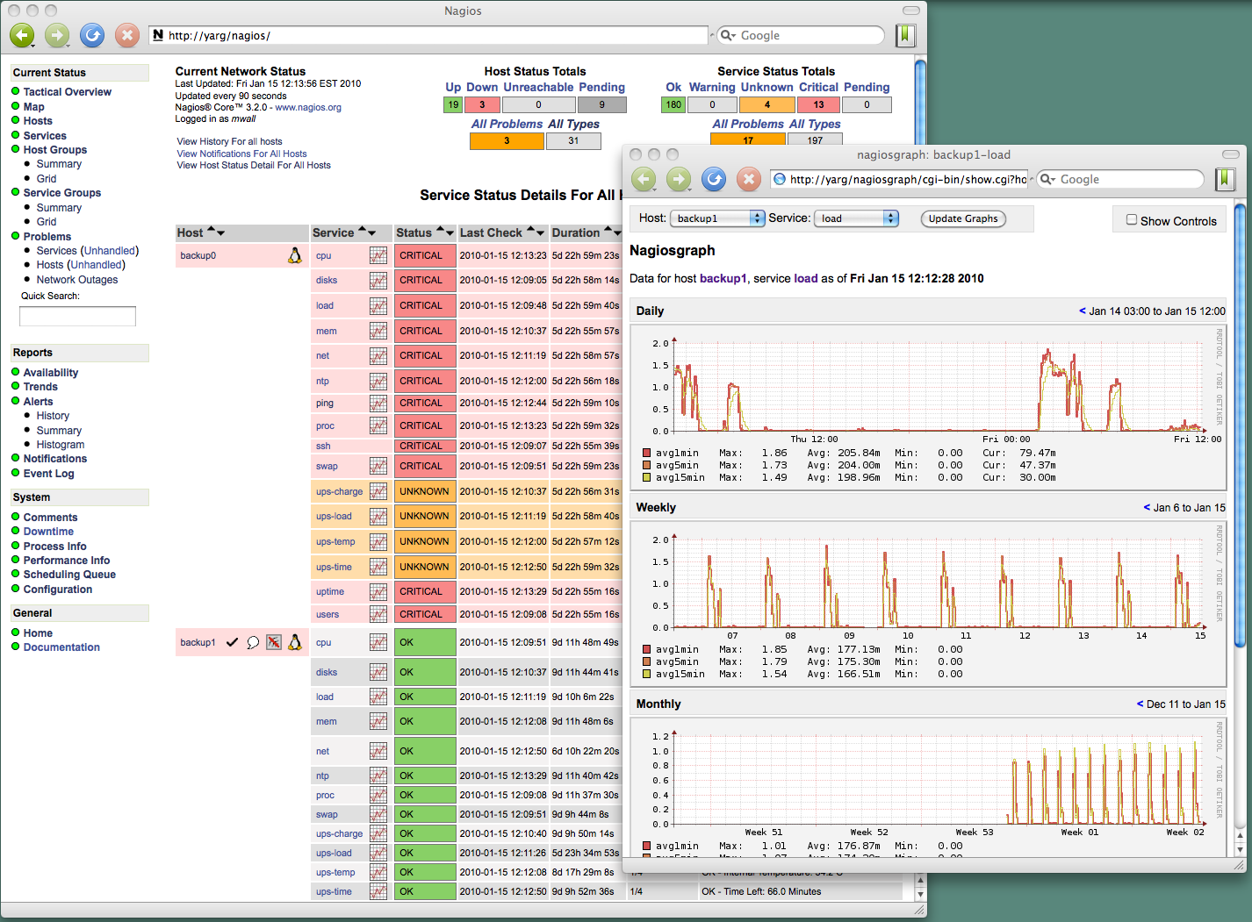
Monitoring Tools - Nagios

Slide 91
Monitoring Tools - Zabbix
Zabbix is an enterprise open-source monitoring tool for networks and applications.
It is designed to monitor and track the status of various network services, servers and other network hardware.
Zabbix uses a variety of databases to store it’s data including;
MySQL, PostgreSQL, SQLite, Oracle or IBM DB2.
With a backend written in C and the front end in PHP, Zabbix offers a variety of monitoring options;

Slide 92
Monitoring Tools - Zabbix
Simple checks can verify the availability and responsiveness of standard services such as SMTP or HTTP without installing any software on the monitored host.
A Zabbix agent can also be installed on UNIX and Windows hosts to monitor statistics such as CPU load, network utilisation, disk space, etc.

Slide 93
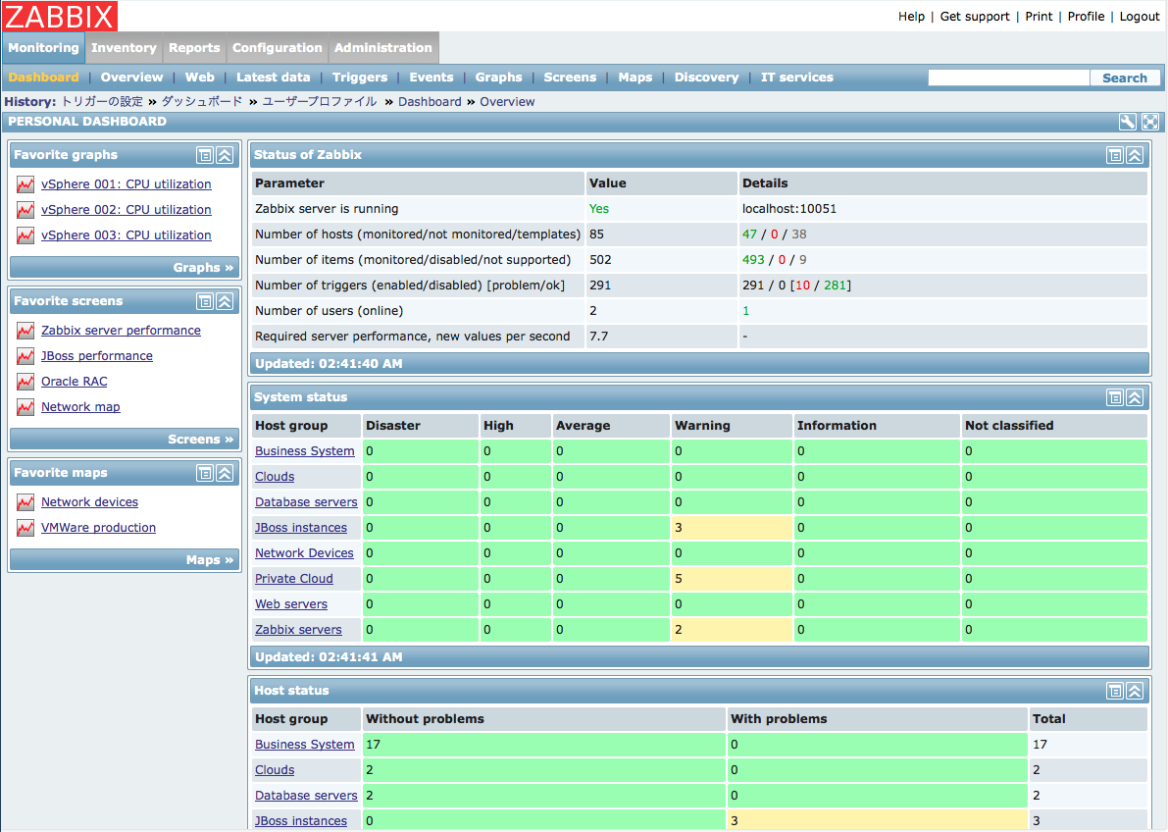
Monitoring Tools - Zabbix

Slide 94
Task: Installing Zabbix

