Slide 1
SCRUM Artifacts
04

Slide 2
Scrum has only three Artifacts
Product Backlog
Sprint Backlog
Product Increment

Slide 3
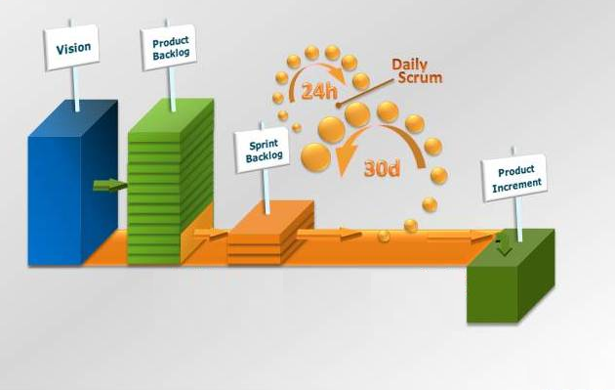

Slide 4
1. Product Backlog

Slide 5
The Product Backlog in Scrum is a prioritized features list, containing short descriptions of all functionality desired in the product.
When applying Scrum, it's not necessary to start a project with a lengthy, upfront effort to document all requirements.
Typically, a Scrum team and its Product Owner begin by writing down everything they can think of for Backlog prioritization.
This Product Backlog is almost always more than enough for a First Sprint.
The Scrum Product Backlog is then allowed to grow and change as more is learned about the product and its customers.

Slide 6
A typical Product backlog comprises the following different types of items:
Features
Bugs
Technical work
Knowledge acquisition

Slide 7
By far, the predominant way for a Scrum team to express features on the Product Backlog is in the form of user stories, which are short, simple descriptions of the desired functionality told from perspective of the user.
An example would be, "As a shopper, I can review the items in my shopping cart before checking out so that I can see what I've already selected“.
Because there's really no difference between a bug and a new feature -- each describes something different that a user wants -- bugs are also put on the Product Backlog
Technical work and knowledge acquisition activities also belong on the Product Backlog.
An example of technical work would be, "upgrade all developers' workstations to windows 7“.
An example of knowledge acquisition could be a Scrum Backlog Item about researching various javascript libraries and making a selection.

Slide 8
The Product Owner shows up at the Sprint Planning Meeting with the prioritized Product Backlog and describes the top items to the team.
The team then determines which items they can complete during the coming sprint.
The Team then moves items from the Product Backlog to the Sprint Backlog.
In doing so, they expand each Product Backlog item into one or more Sprint Backlog tasks so they can more effectively share work during the Sprint.
Conceptually, The Team starts at the top of the prioritized Backlog and draws a line after the lowest of the high-priority items they feel they can complete.
In practice, it's not unusual to see a team select, for example, the top five items and then two items from lower on the list that are associated with the initial five.

Slide 9
Example 1.
A real easy way to put user stories in a spreadsheet-based product backlog.
An example being: “as a frequent flyer, i really want to be able to connect to the internet while flying so that i can update my blog while traveling rather than having to save this as a text file and updating my blog later.”

Slide 10
a user story in this format very easy to work with in SCRUM
Excel spreadsheet is to take the boilerplate parts and put them into column headings.
So we'll have column headings like “As a” and “I” and “so that”.
The meat of each story is then clearly visible in each row.
Additional columns can be added for things like a unique identifier, notes, status and such.
In this example, I've also included a column for the theme or grouping of which the story is a part.

Slide 11
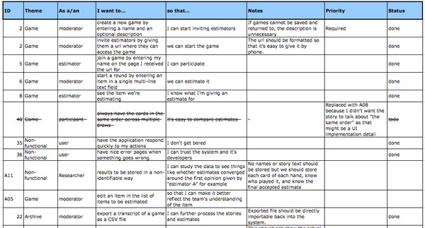

Slide 12
So as long as there a product there will a product backlog, that corresponds to it.

Slide 13
2. Sprint Backlog

Slide 14
The Sprint Backlog consists of the tasks the team performs to turn Product Backlog Items(PBI) into a “done” increment.
Its developed during the Sprint Planning Meeting.
It is all of the work that the team identifies as necessary to meet the Sprint goal.
Sprint Backlog items must be decomposed.
The decomposition is enough so changes in progress can be understood in the Daily Scrum.
One day or less is a usual size for a Sprint Backlog item that is being worked on.

Slide 15
Sprint Backlog is a plan with enough detail that the development team uses it throughout the Sprint to guide their decisions and assesses their progress towards to create the perfect Increment for that Sprint.
So “ the set of Product Backlog Items selected from the Product Backlog to be delivered in the current sprint + a plan for turning them into a product increment”

Slide 16
The Sprint Backlog is a highly visible, real time picture of the work that the Team plans to accomplish during the Sprint, and it belongs solely to the Team.

Slide 17
Sprint Backlog can change constantly through out the Sprint because the Team learns more about what its working on as soon as they begin work on the first day of the sprint.
And when ever the things are achieved mentioned in the Sprint Backlog ,only the Team can change its Sprint Backlog during a Sprint.
As tasks are worked on or completed, the estimated remaining work for each task is updated.

Slide 18
3. Product Increment

Slide 19
Product Increment or simply the Increment are the result of any successful sprint i.e. the software or product version delivered at the end of a Sprint.
The Product includes the sum of all the Product Backlog Items delivered from a Sprint plus that of all previous Sprints, mean that the product will include the features from the current Sprint and the features produced from all other Sprints.

Slide 20
The Product Owner has a role here as well
He has to decide that whether the product is ready to ship or not

Slide 21
Each item in the Product Backlog has at least these three information
Description
Order
Estimate ( estimate of the effort by the development team)

Slide 22
Thank you
QA hopes you enjoyed your course,
as much as we enjoyed teaching you.

