Slide 1
Tracking
09

Slide 2
Release Burndown Chart
On a Scrum project, the team tracks its progress against a Release Plan on a release Burndown Chart.
A Burn Down Chart is a graphical representation of work left to do versus time.
The Release Burndown Chart is updated at the end of each sprint by the ScrumMaster.

Slide 3
The outstanding work (or backlog) is often on the vertical axis, with time along the horizontal.

Slide 4
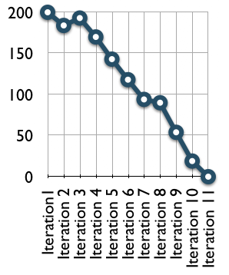

Slide 5
The horizontal axis of the Sprint Burndown Chart shows the Sprints;
The vertical axis shows the amount of work remaining at the start of each sprint.
Work remaining can be shown in whatever unit the team prefers -- story points, ideal days, team days and so on.

Slide 6
On the Burndown Chart pictured above, the team started a project that was planned to be 11 two-week sprints.
They began with 200 story points of work.
The first sprint went well, and from the chart, we can infer that they had around 180 story points of work remaining after the first sprint.

Slide 7
During the second sprint, however, the estimated work remaining actually burned up.
This could have been because work was added to the project or because the team changed some estimates of the remaining work.
From there, the project continued well.
Progress slowed during Sprint 7, but then quickly resumed.
All this information is clearly visible on the Burndown Chart, and the team can easily keep track of everything that is going on.

Slide 8
Alternative Release Burndown Chart
the typical Scrum release burndown chart shows a single value -- the net change in the amount of work remaining.
In some cases, the simplicity of this is wonderful. However, it can also mask what may be going on in a project.

Slide 9
For example, suppose a team had expected to make progress of 40 hours, points (or whatever) last sprint, but the Burndown Chart only shows net progress of 10.
Was the team slower than expected, or was more work added to the release?

Slide 10
It's important to know the answer to this question, because we cannot really predict when the release will be done without it.
With this in mind, Alternative Release Burndown Chart was introduced

Slide 11
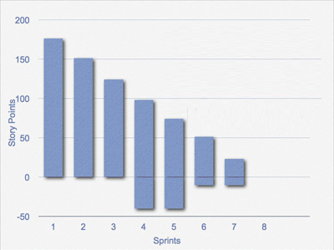

Slide 12
Progress is shown above the base line
Changes are shown below the base line

Slide 13
On this burndown chart, the height of each bar represents the amount of work remaining in the release.
We prefer to estimate product backlog items in "story points," so this figure shows a release with 175 story points planned in it as of Sprint 1.
The team finished 25 points in Sprint 1, leaving 150 to go as of the start of Sprint 2. There were 120 as of the start of Sprint 3. So, the top of the bar is reduced by the amount of work the team finishes in a given sprint.

Slide 14
Before the start of Sprint 4, the product owner added work to the project.
This additional work is shown at the bottom of the bar for the fourth sprint.
You can see that the vertical height of sprint 4 goes from about -40 to about 95, or 135 points of work remaining. Forty of those 135 points are from new work.

Slide 15
Prior to the start of Sprint 6, work was removed by the product owner.
As with an increase in scope, a decrease in scope comes off the bottom. This is true whether the work removed is work that was initially planned, or work that was added during the project.

Slide 16
One way to predict how many sprints a project will take is to draw a trend line through the bars and extend the baseline. For example:

Slide 17
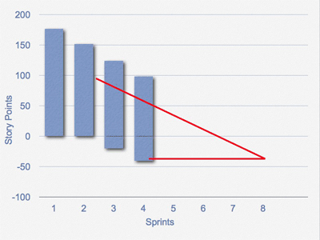

Slide 18
A problem with this is that predicting the end date as above does not include the rate of change to the scope of the project.
You can anticipate the number of sprints needed by also drawing a trend line through the changes occurring at the bottom of the bars as shown below:

Slide 19
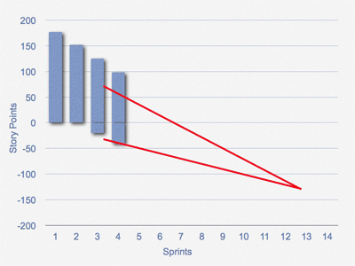

Slide 20
Burnup Chart
A Burnup Chart, tracks progress towards a projects completion.
In the simplest form of burn up chart there are two lines on the chart:
A total work line (the project scope line)
A work completed line

Slide 21
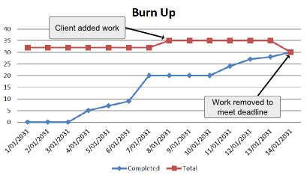

Slide 22
The vertical axis is amount of work, and is measured in units customized to your own project. Some common units are number of tasks, estimated hours or story points.
The horizontal axis is time, usually measured in days.

Slide 23
At each day you can see the amount of work completed and the total amount of work.
The distance between the two lines is thus the amount of work remaining.
When the two lines meet, the project will be complete.
This is a powerful measure of how close you are to completion of the project.

Slide 24
Why BurnUp Charts.
The problem is that Burndown Charts lack two essential pieces of information.
First, how much work was actually accomplished during a given iteration (as opposed to how much work remains to be completed) and
Second how much total work the project contains.
A burnup chart for the exact project above might look like this:

Slide 25
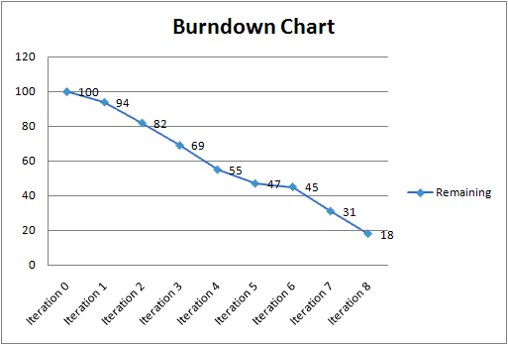

Slide 26
It shows the project started with 100 points of work in the backlog;
it's completed eight iterations;
the team accomplishes about ten points an iteration; and
if everything continues at the current velocity the project will complete all work within another two iterations.

Slide 27
But what happened in iteration six? Very little appears to have been accomplished.
Maybe the team all took a vacation.
Maybe there was a major problem or the team incorrectly estimated complexity.
Or perhaps a large set of new requirements were added to the backlog because the customer decided what they thought they wanted wasn't what they really needed: (the exact scenario agile was designed for).

Slide 28
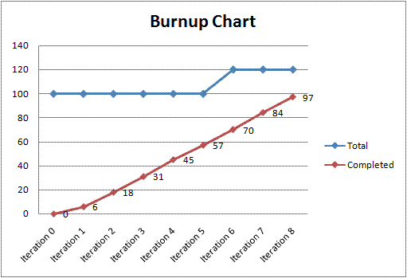

Slide 29
We can now clearly see that the team did not take a breather in iteration six. They continued to complete about ten points per iteration, but during the sixth iteration the scope increased by about twenty points.

Slide 30
One could imagine the opposite happening as well.
Later in the project the team might delete old user stories that were envisioned during project inception and thus decrease the total scope.
The burndown chart would incorrectly show such a scenario as a sudden increase in velocity.

Slide 31
Thank you
QA hopes you enjoyed your course,
as much as we enjoyed teaching you.

