Slide 1
User story

Slide 2
User stories are short, simple description of a feature told from the perspective of the person who desires the new capability, usually a user or customer of the system. They typically follow a simple template:
As a <type of user>, I want <some goal> so that <some reason>.
In software development , a user story is one or more sentences in the everyday or business language of the end user or user of a system that captures what a user does or needs to do as part of his or her job function.

Slide 3
User stories are used with agile software development methodologies as the basis for defining the functions a business system must provide, and to facilitate requirements management.

Slide 4
It captures the 'who', 'what' and 'why' of a requirement in a simple, concise way, often limited in detail by what can be hand-written on a small paper notecard.
User stories are often written on index cards or sticky notes, stored in a shoe box, and arranged on walls or tables to facilitate planning and discussion.
As such, they strongly shift the focus from writing about features to discussing them. In fact, these discussions are more important than whatever text is written.

Slide 5
One of the benefits of agile user stories is that they can be written at varying levels of detail.
We can write a user story to cover large amounts of functionality.
These large user stories are generally known as epics. Here is an epic agile user story example from a desktop backup product:
As a user, I can backup my entire hard drive.

Slide 6
Details can be added to user stories in two ways:
By splitting a user story into multiple, smaller user stories.
By adding “conditions of satisfaction.”

Slide 7
When a relatively large story is split into multiple, smaller user stories, it is natural to assume that detail has been added. After all, more has been written.
The conditions of satisfaction is simply a high-level acceptance test that will be true after the agile user story is complete.

Slide 8
Creating user stories
User stories are written by or for business users or customers as a primary way to influence the functionality of the system being developed.
User stories may also be written by developers to express non-functional requirements (security, performance, quality, etc.),though primarily it is the task of a Product Owner to ensure user stories are captured.

Slide 9
When the time comes for creating user stories, one of The Developers gets together with a customer representative, e.g. a Product Owner, which has the responsibility for formulating the user stories.
The developer may use a series of questions to get the customer representative going, such as asking about the desirability of some particular functionality.

Slide 10
As the customer representative think of a user story, it is written down on a note card (e.g. 3x5 inches or 8x13 cm) with a name and a brief description.
If the developer and the customer representative find a user story deficient in some way (too large, complicated, or imprecise), it is rewritten until satisfactory - often using the INVEST guidelines.
Commonly, user stories are not to be definite once they have been written down, since requirements tend to change throughout the development lifecycle.

Slide 11
Format of a user Story
A traditional user-story template
"As a <role>, I want <goal/desire> so that <benefit>"
Mike Cohn, a well-known author on user stories, regards the "so that" clause as optional:
"As a <role>, I want <goal/desire>"
Chris Matts suggested that "hunting the value" was the first step in successfully delivering software, and proposed this alternative as part of Feature Injection:
"In order to <receive benefit> as a <role>, I want <goal/desire>"
Another template based on the Five Ws specifies:
"As <who> <when> <where>, I <what> because <why>"

Slide 12
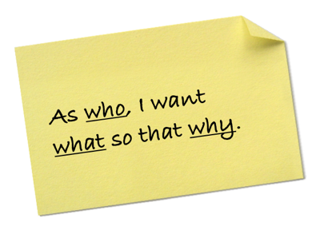

Slide 13
Examples
Search for customers
As a user, I want to search for my customers by their first and last names.
Modify schedules
As a non-administrative user, I want to modify my own schedules but not the schedules of other users.

Slide 14
Run tests
As a mobile application tester, I want to test my test cases and report results to my management.
Start application with last edit
The application begins by bringing up the last document the user was working with.
Or
As a user, I want to start an application with the last edit.

Slide 15
Close application
As a user closing the application, I want to be prompted to save if I have made any change in my data since the last save.
Or
Upon closing the application, the user is prompted to save (when ANYTHING has changed in data since the last save!).
Or
As a user closing the application, I want to be prompted to save anything that has changed since the last save so that I can preserve useful work and discard erroneous work.

Slide 16
Who Writes User Stories?
Anyone can write user stories. It's the Product Owner's responsibility to make sure a Product Backlog of agile user stories exists, but that doesn’t mean that the product owner is the one who writes them.
Also, note that who writes a user story is far less important than who is involved in the discussions of it.

Slide 17
When Are User Stories Written?
User stories are written throughout the agile project. Usually a story-writing workshop is held near the start of the agile project. Everyone on the team participates with the goal of creating a Product Backlog that fully describes the functionality to be added over the course of the project.
Some of these agile user stories will undoubtedly be epics. Epics will later be decomposed into smaller stories that fit more readily into a single iteration. Additionally, new stories can be written and added to the Product Backlog at any time and by anyone.

Slide 18
Do User Stories Replace a Requirements Document?
Agile projects, use a Product Backlog, which is a prioritized list of the functionality to be developed in a product or service. Although Product Backlog items can be whatever the team desires, user stories have emerged as the best and most popular form of Product Backlog Items.
While a product backlog can be thought of as a replacement for the requirements document of a traditional project, it is important to remember that the written part of an agile user story (“As a user, I want …”) is incomplete until the discussions about that story occur.

Slide 19
It’s often best to think of the written part as a pointer to the real requirement.
User stories could point to a diagram depicting a workflow, a spreadsheet showing how to perform a calculation, or any other artifact the Product Owner or team desires.

Slide 20
There are three components of the user story are the three Cs
Card
Conversation
Confirmation

Slide 21
1. Card
Card is meant to indicate that story is typically written by hand on an index card of 4” x 6” inches in dimension

Slide 22
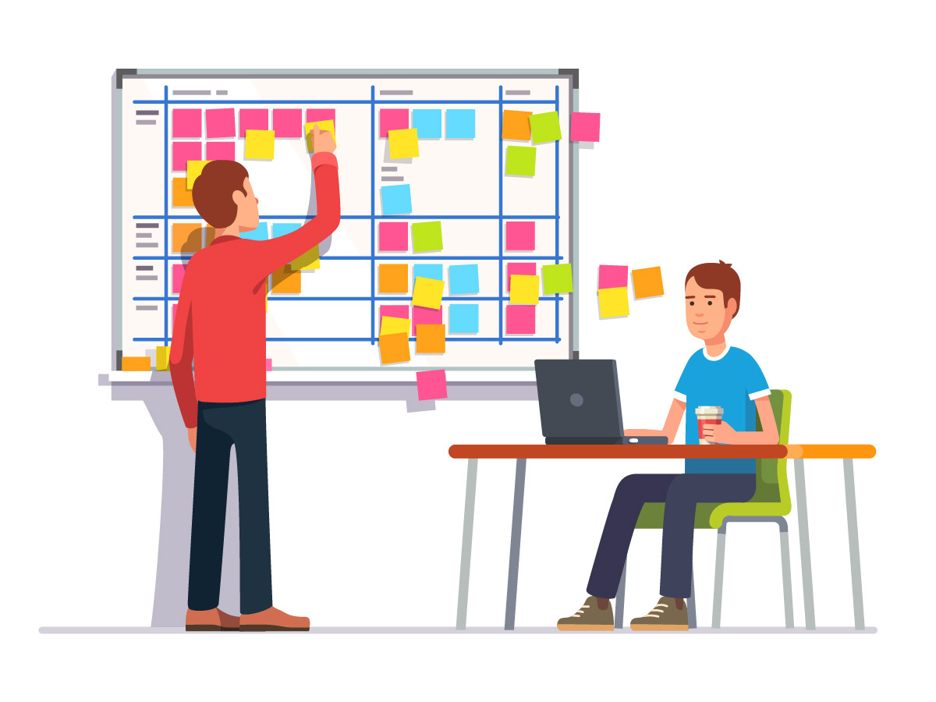

Slide 23
The idea behind writing the story on the card is to try and limit the size of each story. So writing the story on the card the writer will write as brief and short as possible and clearer to the team.

Slide 24
2. Conversation
It means that the story should be the starting point of the conversation between the team and the product owner, who typically would right the story. The story should leave the implementation details to the team and have potential to innovate and trying to implement it.

Slide 25
3. Confirmation
Confirmation means that typically you also need to provide the acceptance criteria for the story. The acceptance are usually written on the back of the card which helps the team to understand that how they would know that the work done satisfies the requirement.

Slide 26
INVEST
I - Independent
N - Negotiable
V - Valuable
E - Estimable
S - Small
T - Testable

Slide 27
User Story is basically a medium to facilitate the communication about the requirements.
Story is the starting point for communication about the details of the requirements and once they are understood and agreed it represents the agreement between the development and the customer about what the customer can accept from the implementation

Slide 28
A template for a user story is
“AS a <role> I want <goal/desire> So that <benefit>”

Slide 29
e.g. as an Employee, I want to purchase a parking pass so that I can park my car safely in the basement as save money.
Role should specify who wants it?
Goal/desire specify exactly what the user wants
Benefit should specify that why the user wants it.

Slide 30
A user story will typically be assigned priority by the Product Owner and the size estimate by the team.

Slide 31
The Story card should typically contain the following information.
Story identifier and name
Story description: A short description not more than few sentences. that describes the features from the customer point of view
Story Type:
C=Customer Domain
T=Technology Domain.

Slide 32
Customer Domain means that the story is requested by the customer.
Technology Domain means the story is technical which was generated by the team.
E.g. a feature request typically comes from the customer but a story to refactor the code or support a new version of a hardware software platform may come from the team.

Slide 33
Estimated work effort: this will be filled by the team with the amount of effort required to deliver the story. This includes time requirements gathering, coding, testing and documentation
Estimated value points: this indicates how much value it delivers to the customer.
Requirement uncertainty: how much variability is expected in requirements, sometimes called the “Exploration factor” of the specific story?

Slide 34
Story dependencies: if the story implementation depends upon the other stories.
Acceptance Tests: Criteria the customer team will use to accept or reject the story, the Acceptance test are written on the back of the user story.

Slide 35
Relationship between a Feature and Story
A feature is what the customer would typically request and understand. The Team along with the Product Owner needs to further break this down into user stories that are independent and deliverable as a unit.
A feature may contain one or more stories.

Slide 36
e.g.
“As a Credit Analyst I need the ability to check a customer’s credit rating”.
In order to achieve this feature several requirement need to be meet.
e.g.
the ability to check the prior payment history
the ability to check the credit bureau status
the ability to calculate an internal credit score

Slide 37
All these stories contribute to the completion of the feature
A story point is a unit of measure expressing a size of the user story, future or other piece of work.

Slide 38
Story point

Slide 39
Theme
A Theme is a set of related user stories that may be combined together and treated as a single entity for either estimating or release planning.
The reason of combining the related stories in the form of a theme is for the ease of estimation and planning

Slide 40
e.g. Support of Database may be a theme which may contain stories such as define a schema, migrate existing data, modify code to login into the database, create reports based on data etc
by knowing that all the stories are going towards the same theme , the team can better plan how to deliver the particular theme.

Slide 41
Epic
Epic is a larger user story, because of their size they cannot be accommodated in single iteration. So they have to break down into smaller user stories, which are worked upon in sequence.
The Epic story has given a lower priority and the lower level child stories are assigned the priorities to facilitate the planning.

Slide 42
Thank you
QA hopes you enjoyed your course,
as much as we enjoyed teaching you.

