Slide 1
Cross Browser Testing
Introduction

Slide 2

PURPOSE
To learn how to run scripts in multiple browsers

Slide 3
What is Cross browser testing?
Functional Test
Used to check if X feature works on multiple browsers.
Common issues include
Font size mismatch
JS Implementation
CSS/HTML Validation
Browsers not supporting X
Page alignment/div size
Image orientation
Incompatibility with OS

Slide 4
TestNG
TestNG is a testing framework inspired by Junit.
Covers a wider range of test categories such as:
Unit
Functional
End to end
Integration
Overall has a lot more functionality than JUnit.
Notes:
Annotation support.
Support for parameterized and data-driven testing (with @DataProvider and/or XML configuration).
Support for multiple instances of the same test class (with @Factory)
Flexible execution model. TestNG can be run either by Ant via build.xml (with or without a test suite defined), or by an IDE plugin with visual results. There isn't a TestSuite class, while test suites, groups and tests selected to run are defined and configured by XML files.
Concurrent testing: run tests in arbitrarily big thread pools with various policies available (all methods in their own thread, one thread per test class, etc.), and test whether the code is multithread safe.
Embeds BeanShell for further flexibility.
Default JDK functions for runtime and logging (no dependencies).
Dependent methods for application server testing.^{[clarification needed]}
Distributed testing: allows distribution of tests on slave machines.

Slide 5
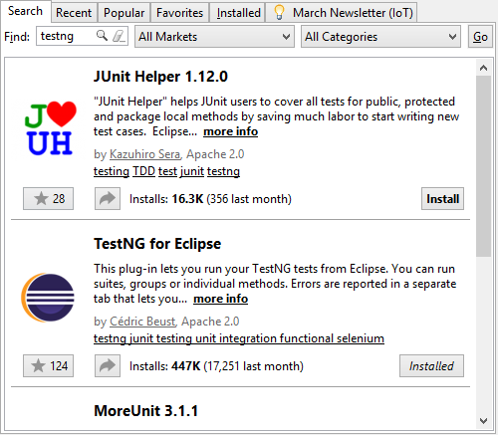
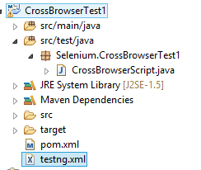
Installing TestNG
Eclipse MarketPlace (Help->Marketplace)
BuildPath -> testng.jar
Notes:
Testng jar should be provided by your trainer.
If not you can use maven to install it, or find the jar online (look for latest version)
Aswell as selenium if it’s not installed already.
*note* this will only work for browsers you have installed, it can’t run chrome without chrome installed etc.

Slide 6
TestNG – testng.xml
<?xml version="1.0" encoding="UTF-8"?>
<suite name="TestSuite" thread-count="2" parallel="tests">
<test name="ChromeTest">
<parameter name="browser" value="chrome" />
<classes>
<class name="Selenium.CrossBrowserTest1.CrossBrowserScript"></class>
</classes>
</test>
</suite>
Notes:
Testng.xml is the file that you invoke TestNG with.
It contains instructions on what tests to run and with what options.
This is the layout we’ll be using for cross browser.
Suite is the container for all the tests we’re going to run.
Thread count is how many of the tests we can run simultaneously.
Parallel is what we’re actually going to run in parallel, could be suites or classes or methods, we’ll be using tests.
Parameter is going to matchup to something later on.
Classname is the class that has the tests we’re going to run.

Slide 7
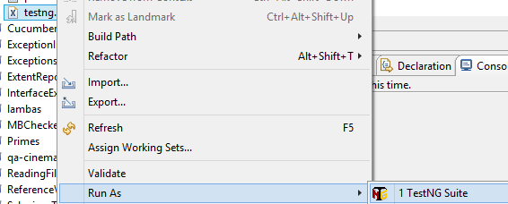

TestNG – Setup Method
@BeforeTest
@Parameters("browser")
public void setup(String browser) throws Exception {
if (browser.equalsIgnoreCase("firefox")) {
System.setProperty("webdriver.gecko.driver",
"C:\\Users\\ewomack\\Desktop\\java\\selenium\\geckodriver.exe");
driver = new FirefoxDriver();
}
}
Notes:
@BeforeTest tells TestNG to run this method before every test
@Parameters(“browser”) tells TestNG to use the parameter we give it from the xml file for this method
So this method will get called for each of the tests in our test suite, with the parameters we give it, creating a driver that matches that parameter, then our test will be run.
Our actual test must be annotated with @Test to be recognised by TestNG (@Test must be imported from TestNG, not JUnit)

Slide 8

Output
Notes:
Once run, testNG will run through all the tests in your suite with the options you have given.
Skips are generally caused because the test was setup incorrectly, which generally implies that something is wrong with your setup method.

Slide 9
Exercise
Install TestNG
Implement cross browser functional testing into a previous exercise.

