Slide 1

DealFlow AI
A Partnership Proposal for IT-Park Ventures
AI-Powered Startup Screening — Transparent, Fast, Built for Your Deal Flow
Partnership Proposal 2025
Notes:
Good morning, IT-Park team. My name is [your name], and I'm here today to propose a technology partnership — one that I believe can fundamentally change how your fund processes deal flow. I've spent time studying IT-Park's mission, your accelerator program, and the specific challenges your analysts face every cycle. What I'm about to show you isn't a generic product pitch. I built something specifically with IT-Park Ventures in mind — a tool that addresses the exact bottleneck your team experiences when hundreds of startup applications come in every cycle.

Slide 2

The Deal Flow Bottleneck
Your analysts are spending most of their time on the wrong task.
80%
94%
45 min
of analyst time spent on initial screening and basic research, not deep evaluation
of startups that apply to accelerators are ultimately rejected, but analysts still review each one manually
average time to research a single startup application — multiplied by hundreds of applicants per cycle
Industry average across early-stage VCs
Source: AEA Research on VC Selection (8,000+ deals analyzed); Affinity VC Survey 2024 — 85% of VCs now use AI tools for daily tasks
Notes:
Let's walk through each of these numbers. First, 80% — that's the industry average for how much of an early-stage VC analyst's time goes to initial screening and basic research, not the deep evaluation work that actually drives investment decisions. Second, 94% of accelerator applicants are rejected, yet every single one still gets manually reviewed. Now apply this to IT-Park's reality: if you receive 300 applications per accelerator cycle and each takes 45 minutes to research, that's 225 hours of analyst time — almost six full weeks of one person's work — spent just on initial screening, every single cycle. The math is brutal, and it's exactly this bottleneck that DealFlow AI is designed to eliminate.

Slide 3
DealFlow AI — Automated Initial Screening
A transparent AI/ML engine that filters, evaluates, and ranks startups in seconds — so your analysts only spend time on the ones that matter.
↑
◯
⚠
Batch Upload
Transparent AI Analysis
Risk Detection
Upload 1,000+ startup applications as a CSV. The system evaluates every single one in under 30 seconds.
Every startup gets a confidence score with full explainability. No black box — you see exactly why each decision was made.
Automatically identifies red flags: single-founder risk, low funding velocity, market model concerns, and more — with written explanations.
The AI does the initial filtration and research. Your analysts make the final investment decisions.
Notes:
I want to be very clear: DealFlow AI is not trying to replace your analysts. It handles the 80% of work that is repetitive and time-consuming — the initial filter, the basic research, the red flag check. The final 20% — the deep evaluation, the founder interviews, the gut instinct that comes from years of experience — that still belongs entirely to the IT-Park team. The key word here is "transparent." Every single recommendation the system makes comes with a visible decision path. You're never left wondering why the AI scored something a certain way. You can audit every decision, challenge it, and override it. This is AI that augments your team's judgment, not replaces it.

Slide 4
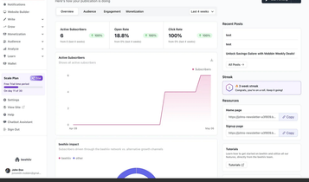
How It Works — Three Steps from Application to Decision
1
2
3
→
→
Input
AI Evaluation
Ranked Results
Startups enter via CSV upload (batch), manual form entry, or URL scraping. Works even for early-stage startups with no website — just 6-7 basic data points.
An LLM extracts structured data from applications. A trained Decision Tree ML model evaluates each startup based on: funding history, team composition, market type (B2B vs B2C), time-to-funding velocity, and founder track record.
Every startup receives: a confidence score (0-100%), a list of strengths, a list of red flags with written explanations, and the exact decision tree path showing the logic. Export results as CSV.
Conceptual UI
Notes:
Let me walk you through the three steps. Step 1 — Input — is specifically designed for IT-Park's reality. Many of your accelerator applicants are early-stage with no website, no Crunchbase profile, minimal online presence. So the system doesn't require a URL. It accepts CSV uploads and manual data entry — because that's how your applications actually arrive. You only need 6 or 7 basic data points per startup. Step 2 is where the intelligence lives. An LLM extracts structured information from each application, and then a trained Decision Tree ML model evaluates it across multiple dimensions: funding history, team size, B2B versus B2C, how quickly they raised their first round, and the founder's track record. Step 3 gives your analysts everything they need in one view — a confidence score, strengths, red flags with explanations, and the full decision logic path. All exportable as CSV for your existing workflows.

Slide 5
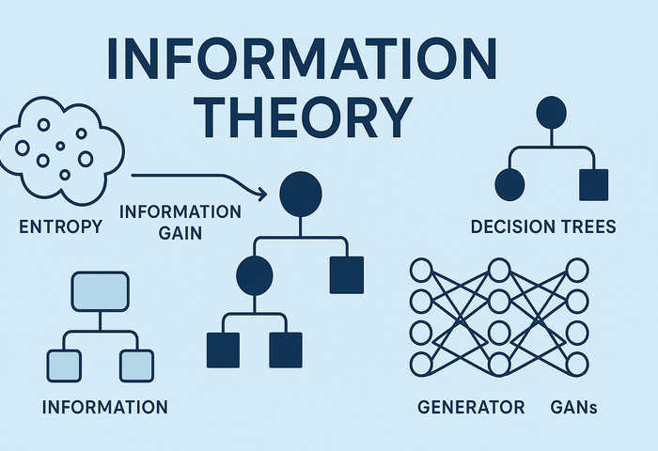
Not a Black Box — A Transparent Decision Engine
DealFlow uses a Decision Tree classifier — the most interpretable ML model available. Unlike deep learning or neural networks, a Decision Tree shows you its exact logic path for every single decision.
|--- Has previous exit? --- YES --- Team size ≤ 12? --- YES → INVEST (89%)
|--- Has previous exit? --- NO --- Funding > $4.5M? --- YES --- Time to first funding ≤ 18mo? --- YES → INVEST (76%)
|--- Has previous exit? --- NO --- Funding > $4.5M? --- NO --- B2B? --- YES --- Rounds > 1.5? --- NO → PASS (22%)
This is a simplified example. The production model is trained on 5,000+ data points and evaluates 6 core features.
Decision Tree logic — fully auditable by any analyst
Notes:
This is the slide that truly differentiates DealFlow from every other AI tool on the market. Most AI is a black box — you put data in, you get a score out, and nobody can tell you why. A Decision Tree is fundamentally different. You can literally read the logic, node by node, branch by branch. If IT-Park asks "why did you reject startup number 247?", the answer isn't "the AI said so." The answer is: "It was rejected because the founder has no prior exit, total funding is under $4.5 million, and it's a B2C company — and here is the raw data to prove each of those points." That level of transparency is what builds trust between your analysts and the tool. They don't have to take the system's word for it. They can verify every single decision themselves. This is AI you can audit, challenge, and understand.

Slide 6
Before DealFlow vs After DealFlow
Current Process
With DealFlow AI
● Analyst opens each application manually
● Spends 30-45 minutes researching basics (funding, market, team)
● Writes notes on strengths and concerns
● No standardized evaluation criteria — each analyst uses different judgment
● After 2-3 weeks, the team narrows 300 applications down to 50 for interviews
● Total time per cycle: 200+ analyst hours on screening alone
● Upload all 300 applications as a single CSV file
● AI evaluates every startup in 30 seconds with consistent criteria
● Each startup gets: confidence score, strengths, red flags, and decision logic
● Analysts immediately see the top-ranked startups and the reasons why
● First deep analysis meeting happens the next day, not next week
● Total time per cycle: under 1 hour of analyst time on screening
That is a 95%+ reduction in screening time.
Notes:
This is the moment the audience does the mental math. Walk through the left column slowly — let them feel the pain. Then switch to the right column and emphasize the speed. The key number is 200+ hours down to under 1 hour. That is not a small improvement — it is a fundamental shift in how the fund operates. Ask them: "What could your analysts do with 200 extra hours per cycle?"

Slide 7
Why Build This With IT-Park Ventures?
This is not a generic product — it is designed for your fund's specific reality.
◯
Regional Focus
▿
Accelerator Model
IT-Park operates in Uzbekistan and Central Eurasia — a unique market with limited public data on startups. Generic tools like Crunchbase have minimal coverage here. DealFlow is designed to work with the data you actually have, not the data Silicon Valley tools assume you have.
IT-Park runs an accelerator program, which means hundreds of applications per cycle, most from early-stage founders with minimal online presence. DealFlow accepts CSV uploads and manual entry because that is how your applications actually arrive.
✦
Lean Team, High Volume
⚿
Data-Driven Culture
With a $10M fund and a focused team, every analyst hour matters. A tool that saves 200+ hours per cycle is not a luxury — it is a strategic advantage.
IT-Park already partners with global players like White Hill Capital. Building an AI evaluation engine positions the fund as the most technologically advanced VC in the region.
Notes:
Personalize this for IT-Park. Mention their $10M fund size. Mention that they already collaborate with White Hill Capital and Silicon Valley players. The point is: you are not pitching a generic SaaS tool. You are saying "I studied your fund, I understand your constraints, and I built this specifically for your reality." That level of customization is what turns a cold pitch into a real partnership conversation.

Slide 8

The Partnership — A 30-Day Pilot Program
Low risk for IT-Park, high value for both sides.
What We Need From IT-Park
● Anonymized data on 50-100 past startup evaluations (features + outcome: success or fail). This is used to retrain the ML model on IT-Park's specific investment DNA.
● Access for 1-2 analysts to test the tool on incoming deal flow during the pilot period.
1
Data Integration & Model Retraining
Week 1–2
2
Analyst Testing & Feedback Loop
What IT-Park Gets
Week 2–3
● A custom-trained DealFlow instance fine-tuned on IT-Park's historical decisions.
● Full transparency: every score, every red flag, every decision path is visible and auditable.
● A dedicated development team that will iterate based on analyst feedback within 48 hours.
● At the end of 30 days: a clear report showing time saved and evaluation accuracy.
3
Results Review & Partnership Decision
Week 4
Partnership in action
Notes:
This is the ask. Be clear and specific. You are not asking for money. You are asking for data (anonymized, so there is no confidentiality concern) and a small amount of analyst time. In return, IT-Park gets a custom-built tool and a team that will iterate fast. The 30-day pilot structure reduces risk — if it does not work, they walk away. If it does, you move to a formal commercial partnership. End this slide by saying: "We are not asking you to buy software. We are asking you to test a hypothesis with us."

Slide 9
Let us build this together.
DealFlow AI is not just a tool — it is a partnership to make IT-Park Ventures the most data-driven fund in Central Asia.
1. Review the live demo (we can set up a test with your data)
2. Start the 30-day pilot this month
3. Co-develop the production version together
Ready to start? Let us talk.
Notes:
Close with confidence. You have shown them the problem (real stats), the solution (transparent AI), how it works (three clear steps), the ML engine (visible decision tree logic), the impact (95% time reduction), why it fits IT-Park specifically, and a risk-free pilot structure. Now the ball is in their court. Do not over-talk here. Say: "I built a working prototype specifically for IT-Park. I am not asking you to buy anything — I am asking for 30 days to prove it works with your data. If your analysts save even 10 hours a week, that is a win for both of us." Then stop talking and wait for their response.

