Slide 1

WEB FORMS
Week 3
Majd Darraj
Krishna Rana

Slide 2
<form>
a block-level element defines an interactive part of a webpage
https://developer.mozilla.org/en-US/docs/Web/HTML/Inline_elements

Slide 3
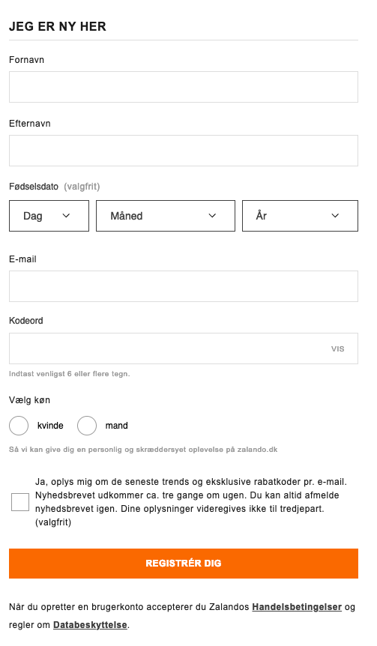
User interactions examples
Signing up and logging in to websites
Entering personal information (name, address, credit card details…)
Filtering content (by using dropdowns, checkboxes…)
Performing a search
https://www.zalando.dk/login/?view=register

Slide 4
<form>
is important
Forms can make a website usable or unusable
because they stand in the way of the user achieving their goal

Slide 5
<form> element
The <form> element wraps all the other elements inside the form. This is the form element.
<form>
Form element here
</form>
* You cannot have forms nested inside another <form>

Slide 6
<form attributes>
To submit a <form> it needs to be connected to a server (Node, Python, Ruby, PHP)
To processing the data (send to database) we need two important attributes:
action: an address defines where information will be sent
method: how the form information will be sent:
POST — Data is sent to directly to the server.
GET — Data is sent inside of the URL as parameters separated with a question mark.
* https://www.w3schools.com/tags/ref_httpmethods.asp
* action & method attributes are required
<form action = “Script URL” method = “GET | POST”
Form element here
</form>

Slide 7
Let’s build a form
<form action = ”/signup" method = "POST” class=“signup__form”>
<h1 class=“signup__form-title”>jeg er ny her</h1>
</form>
https://www.zalando.dk/login/?view=register

Slide 8
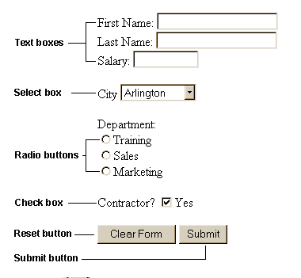
Form controls
Text Input Controls
Checkboxes Controls
Radio Box Controls
Select Box Controls
File Select boxes
Hidden Controls
Clickable Buttons
Submit and Reset Button

Slide 9
textual <input> controls
A text field where the user can type information, and their type provides specific semantics to the input
Text | <input type="text"> | Allows any type of character
Email | <input type="email"> | Might display a warning if an invalid email is entered
Password | <input type="password"> | Shows dots as characters
Number | <input type="number"> | Up/Down keyboard keys can be used
Telephone | <input type="tel"> | Can trigger an autofill
Multiple line text | <textarea></textarea> | Can be resized

Slide 10
<input> text type
Allows any type of character
<form action = ”/signup" method = "POST” class=“signup__form”>
<h1 class=“signup__form-title”>jeg er ny her</h1>
<input type="text">
</form>
https://www.zalando.dk/login/?view=register

Slide 11
<input> text attributes
type: Indicates the type of input control (email, tel, password)
id: Not mandatory, but useful when we talk about labels
name: Used to give a name to the control which is sent to the server to be recognized and get the value.
placeholder: displayed in the input field before the user enters a value (will disappear as soon as some text is entered.)
<input type="text” id=”signup—first_name” name=”first_name” placeholder=”Enter first name”>

Slide 12
Let’s try all textual control types
Text | <input type="text">
Email | <input type="email">
Password | <input type="password">
Number | <input type="number">
Telephone | <input type="tel">
Multiple line text | <textarea></textarea>
<form action = ”/signup" method = "POST” class=“signup__form”>
<h1 class=“signup__form-title”>jeg er ny her</h1>
<input type="text” id=”signup—first_name” name=”first_name” placeholder=”Enter first name here”>
<input type=”email” id=”signup—email” name=”email” placeholder=”Enter your email”>
</form>
https://www.zalando.dk/login/?view=register

Slide 13
<label> element
Descriptive text for ANY form elements (controls).
visible at all times
Paired with a specific form control by using the for attribute
Clicking on the label will focus the text input
<form action = ”/signup" method = "POST” class=“signup__form”>
<h1 class=“signup__form-title”>jeg er ny her</h1>
<label for=”signup—first_name” >Førnavn</label>
<input type="text” id=”signup—first_name” name=”first_name” placeholder=”Enter first name here”>
<label for=”signup—email” >E-mail</label>
<input type=”email” id=”signup—email” name=”email” placeholder=”Enter your email”>
</form>
https://www.zalando.dk/login/?view=register

Slide 14
<input> checkbox type
Form controls that only have 2 states: checked or unchecked
Allow the user to say “Yes” or “No” to something.
<form action = ”/signup" method = "POST” class=“signup__form”>
<input type=”checkbox"> I agree to the terms
</form>
https://www.zalando.dk/login/?view=register

Slide 15
<input> checkbox type
Because it is hard to click on a small checkbox
you wrap it in a <label>, so you can click on the label text to toggle the checkbox.
<form action = ”/signup" method = "POST” class=“signup__form”>
<label>
<input type=”checkbox"> I agree to the terms
</label>
</form>
https://www.zalando.dk/login/?view=register

Slide 16
Let’s try checkbox
By default, a checkbox status is unchecked.
You can mark it as checked by using checked attribute.
<form action = ”/signup" method = "POST” class=“signup__form”>
<label>
<input type=”checkbox” checked> I agree to the terms
</label>
</form>
https://www.zalando.dk/login/?view=register

Slide 17
<input> radio type (radio buttons)
You can present the user a list of options to choose from by using radio buttons.
You have to group a list of radio buttons together by using the same value for the name attribute
<form action = ”/signup" method = "POST” class=“signup__form”>
<label>Vælg køn</label>
<label>
<input type="radio" name="status">kvinde
</label>
<label>
<input type="radio" name="status">mand
</label>
…
</form>
https://www.zalando.dk/login/?view=register

Slide 18
checkbox vs. radio
checkbox | Radio
exists on its own | only appear as a list (at least 2 options)
clicking is optional | choosing one of the radio buttons is mandatory

Slide 19
<select> element (Dropdown menu)
Work like radio buttons with different layout.
<form action = ”/signup" method = "POST” class=“signup__form”>
<select>
<option>Januar<option>
<option>Februar<option>
<option>Mars<option>
…
</select>
</form>
https://www.zalando.dk/login/?view=register

Slide 20
<select> element (Dropdown menu)
by adding multiple attribute, user can select multiple choices.
<form action = ”/signup" method = "POST” class=“signup__form”>
<label for=”month”> Fødselsdato </label>
<select multiple id=”month”>
<option value=”Januar”>Januar<option>
<option value=”Februar”>Februar<option>
<option value=”Mars”>Mars<option>
…
</select>
</form>
https://www.zalando.dk/login/?view=register

Slide 21
value
attribute
It is whatever the user types into the field.
When creating <select> element, we use the value attribute to specify the values to predefined options.

Slide 22
<optgroup> element
organize list into logical groups
<form action = ”/signup" method = "POST” class=“signup__form”>
<label for=”month”> Fødselsdato </label>
<select multiple id=”month”>
<optgroup label=”groupname”>
<option value=”Januar”>Januar<option>
<option value=”Februar”>Februar<option>
</optgroup>
<option value=”Mars”>Mars<option>
…
</select>
</form>
https://www.zalando.dk/login/?view=register

Slide 23
<textarea> element (text box)
Allows us to type in multiple lines
Textarea element is resizable
<form action = ”/signup" method = "POST” class=“signup__form”>
<textarea></textarea>
</form>
https://www.zalando.dk/login/?view=register

Slide 24
<button> element (submit)
One of the most important form elements. Without it we cannot submit any form to the server
Attributes:
type=”reset”: Clear all the filled form data
type=”button”: Used with JavaScript for custom behavior.
type=”submit”: Submit the form and send all the data entered to the server.
<form action = ”/signup" method = "POST” class=“signup__form”>
<button type=”submit”>register dig</button>
</form>
https://www.zalando.dk/login/?view=register

Slide 25
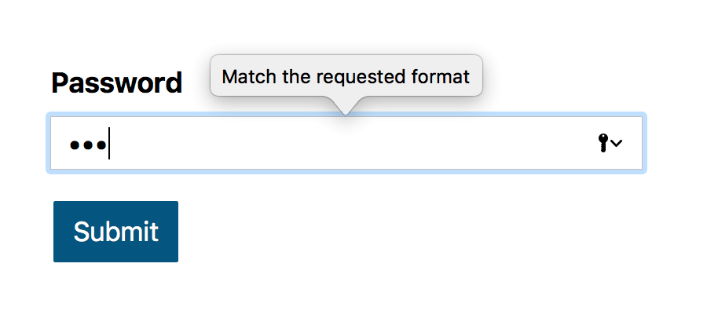
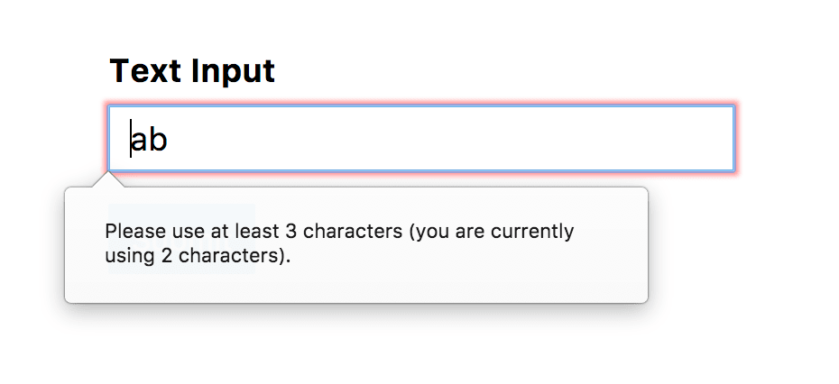
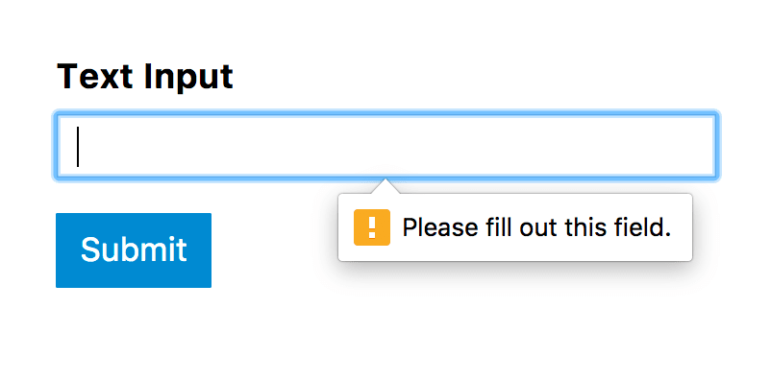
Forms Constraint Validation
<form action = ”/signup" method = "POST” >
<input type=”password” pattern=”^(?=.*\d)(?=.*[a-z])(?=.*[A-Z])(?!.*\s).*$”>
</form>
<form action = ”/signup" method = "POST” >
<input type=”text” minlength=”3” maxlenght=”12”>
</form>
<form action = ”/signup" method = "POST” >
<input type=”text” requiered>
</form>

Slide 26
Progress
<progress value="10" max="100” class=“progress-bar”></progress>
.progress–bar {
background-color: #f3f3f3;
border: 0;
height: 18px;
border-radius: 9px;
}

Slide 27
Checkbox image selector
<form action = ”/signup" method = "POST” >
<input type=”checkbox”
name=”checkbox-image1”
id=”checkbox-image1”
>
<label for=”checkbox-image1” ></label>
</form>
input[type=checkbox] {
display:none;
}
input#checkbox-image1[type=checkbox] + label {
background-image:url("http://lorempixel.com/50/50/");
height: 50px;
width: 50px;
display:inline-block;
padding: 0 0 0 0px;
}

Slide 28
references
HTML5 Forms: https://htmlreference.io/forms/
HTML link pages: https://www.youtube.com/watch?v=DiSvq5SgLMI
Tabs with Checkbox: https://codepen.io/miroot/pen/HnsmI
Show/hide toggle with Checkbox: https://codepen.io/morganfeeney/pen/KiBty
HTML forms countries: https://www.freeformatter.com/iso-country-list-html-select.html
Styling HTML forms: https://www.youtube.com/watch?v=HiHHvTcHiEk&list=PL4cUxeGkcC9g5_p_BVUGWykHfqx6bb7qK
Advanced styling forms: https://developer.mozilla.org/en-US/docs/Learn/HTML/Forms/Advanced_styling_for_HTML_forms
HTML forms styles: https://www.sanwebe.com/2014/08/css-html-forms-designs

Slide 29
Thanks!
HackYourFuture

