Slide 1


Data Translation Challenge
Andrew Zinkan

Slide 2


Movie Recommendations: Ripe-Pumpkin’s Approach to Collaborative Filtering For
This use case is designed to analyze the potential use, modeling, and feasibility of the ‘Pumpkinmeter’ for Ripe-Pumpkin

Slide 3
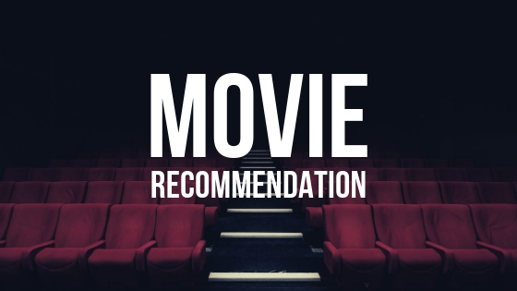
Introduction
‘Pumpkinmeter’: A measurement of collaborative recommendation for millions of fans
Indented to recommend customized movies based on individual taste and preference
Uses Machine learning (ML) via Collaborative Filtering ALS
Competitors in industry are having success with content recommendation
Data provided by GroupLens

Slide 4
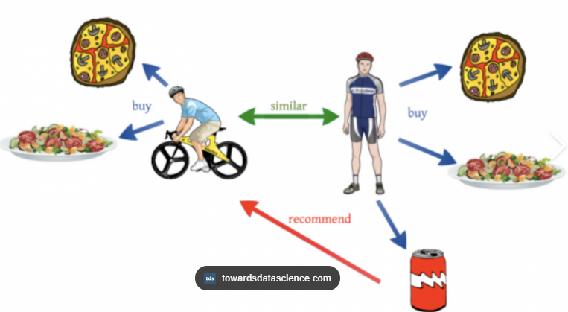
Collaborative Filtering
Machine Learning (ML)
Uses Alternating Least Squares (ALS)
Based on Similar Profile Preferences
The underlying assumption is that if a user A has the same opinion as a user B on an issue, A is more likely to have B's opinion on a different issue x than to have the opinion on x of a user chosen randomly
Allows Ripe-Pumpkin to Make Custom Movie Suggestions
Can recommend things that others similar to you like

Slide 5
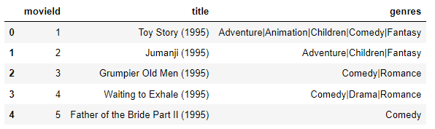
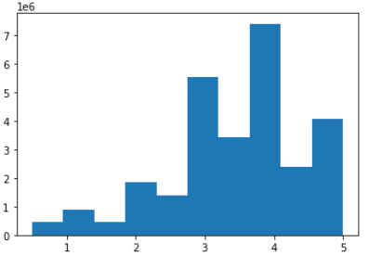
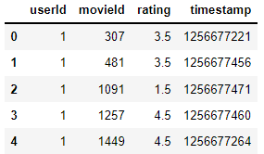
Data Availability
Movies.csv
Data comes form GroupLens
A Research Group that Collects Data
Data updated intermittently
No API available
Movies.csv
‘movieid’, ‘title’, and ‘genres’
Ratings.csv
‘userId’, ‘movieId’, ‘rating’, and ‘timestamp’
Descriptive
27,753,444 rating records
58,098 movies
283,228 user profiles
Ratings are left skewed
Rating Skew
Ratings.csv

Slide 6
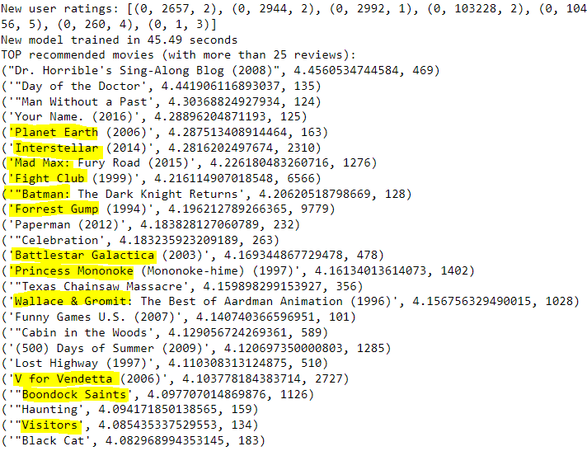
Working Example
Uses Random Sample of Available Data
10% sample size
ML Model constructed using ALS Collaborative filtering
Training 60%, Validation 20%, Testing 20%
~45 seconds to retain model (Speed a resources to be considered)
Results
root-mean-square error (RMSE) of 0.982
high degree of difference between our observed and predicted values (Model Needs Work)
Real Test Example
My Personal Recommendation Results
Another Users Results
Highlighted are ‘True Positives’ (Movies I do like)
Better performance and more reviewed films

Slide 7

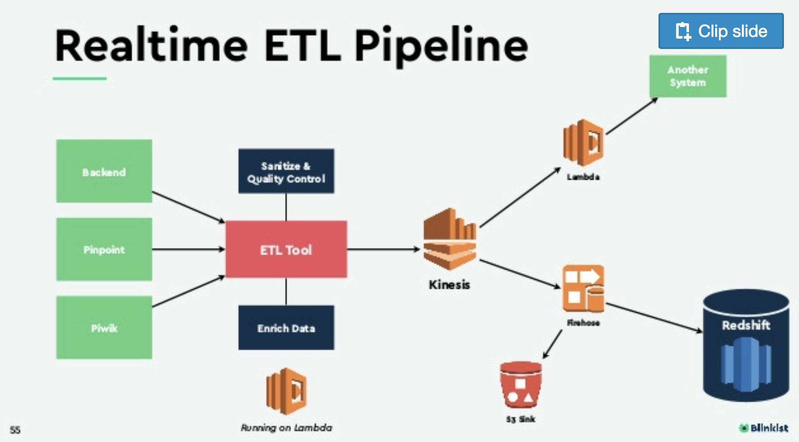
Concerns / Limitations
No Data Pipeline
Other Data providers
API calls preferred
Data Update Frequencies
Need to capture more current data
Server Resource Allocation
Larger EC2 = > Cost
Should not run locally
Model Performance Improvements
More Historical Data
Additional Features
Model Tuning
Additional models to test (matrix factorization & Content-Based Models)
Content-Based will require different movie features

Slide 8


Summary & Action
Model development to increase accuracy
More data / additional data
Feature Engineering
Test Model selection
Content-Based Approach
Research Alternate/ Additional Data Providers
Data Pipeline Construction
API or AWS Transfer Family
Plan for Platform Integration and user feedback loop for model
Complete Use Case/Users Stories & Feasibility Analysis
Determine Cost/Benefit to Business

